Slide 1


Slide 2
CHAPTER 1
The World Economy: Trends and Indicators

Slide 3
Learning objectives
Recognize the world economy’s well-being and growth indicators;
Acknowledge the growth and pivotal role of China in the world economy;
Understand recent trends in economic growth and well-being;
Acknowledge reasonable expectations for future trends.

Slide 4
Growth indicators
The most commonly used indicator of growth is gross domestic product (GDP): the total value of goods and services produced by a country in a year.
Growth of GDP is dependent on the following six factors:
Population growth;
Investment ratio (relation between investment and GDP);
Employee education level;
Foreign investment and trade;
Monetary policy;
Use of resources such as mined materials, energy and land.

Slide 5
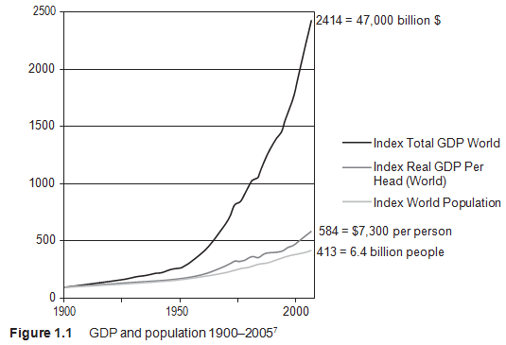
GDP and population 1900-2005
The increase of population and GDP per capita result in a growth of GDP indices for the world from 100 to 2414 over an hundred years.

Slide 6
Growth in China
 | Year | Growth | Index |  | Year | Growth | Index |  | Year | Growth | Index
 | 1979 |  | 100 |  | 1991 | 9,3% | 287 |  | 2003 | 10,0% | 921
 | 1980 | 7,8% | 108 |  | 1992 | 14,3% | 328 |  | 2004 | 10,1% | 1014
 | 1981 | 5,2% | 113 |  | 1993 | 13,9% | 374 |  | 2005 | 11,4% | 1129
 | 1982 | 9,0% | 124 |  | 1994 | 13,1% | 423 |  | 2006 | 12,7% | 1273
 | 1983 | 10,8% | 137 |  | 1995 | 11,0% | 469 |  | 2007 | 14,2% | 1453
 | 1984 | 15,2% | 158 |  | 1996 | 9,9% | 516 |  | 2008 | 9,6% | 1593
 | 1985 | 13,6% | 179 |  | 1997 | 9,2% | 563 |  | 2009 | 9,2% | 1740
 | 1986 | 8,9% | 195 |  | 1998 | 7,9% | 608 |  | 2010 | 10,6% | 1925
 | 1987 | 11,7% | 218 |  | 1999 | 7,6% | 654 |  | 2011 | 9,5% | 2108
 | 1988 | 11,3% | 243 |  | 2000 | 8,4% | 709 |  | 2012 | 7,8% | 2271
 | 1989 | 4,2% | 253 |  | 2001 | 8,3% | 768 |  | 2013 | 7,7% | 2446
 | 1990 | 3,9% | 263 |  | 2002 | 9,1% | 838 |  | 2014 | 7,3% | 2624
World Bank

Slide 7
Law of increasing and decreasing economic growth for China
In the early stages of development, low growth percentages are the norm, because the implementation of new laws and reforms needs considerable time to take effect.
After a while, when new policy begins to take effect, growth margins increase.
Finally, when desired goals are achieved the growth decreases.
From 1979 to 2013 average Chinese growth rates of GDP were 9.5% per year.
After 2010 the trend continued downwards to 7.1% in 2015.

Slide 8
Six factors influencing GDP in China
Workers’ migration to the cities from the country;
High level of foreign investment;
Educational skills (since 1999, the number of students completing Masters Degrees has increased yearly by 30%);
China’s membership of the WTO led to relaxed restrictions on imports and exports
China’s monetary policy increased the competitiveness of Chinese exports. (By 2015 the yuan was the world’s second most overvalued currency after the US dollar.)
Production of Chinese raw materials (use of resources).

Slide 9
Future growth in China
Despite positive ﬁgures, many economists feel that China is headed for a decrease in growth in the coming years which correlates with the law of diminishing returns.
Expectations for the future are a 5%–7% yearly rise, which is still more than the 1%–2% growth ﬁgures predicted for the West.

Slide 10
Distribution of welfare
The GDP on its own is not a solid indicator of economic progress for welfare
For the distribution of GDP (equality <-> inequality) there can be made use of the Gini coefficient and the Palma coefficient.

Slide 11
Gini coefficient (1)
A measure of income inequality, which ranges from 0, representing perfect equality, to 1, representing perfect inequality.
Gini coefficients have been criticized because of:
  Complexity of calculations
  Gini is a weak indicator of extreme poverty
    The indicator is hardly influenced for differences between the poorest and the richest residents.
    The indicator is heavily inﬂuenced by the proportion of middle-income citizens (the higher the percentage of middle-income citizens, the lower Gini is).

Slide 12
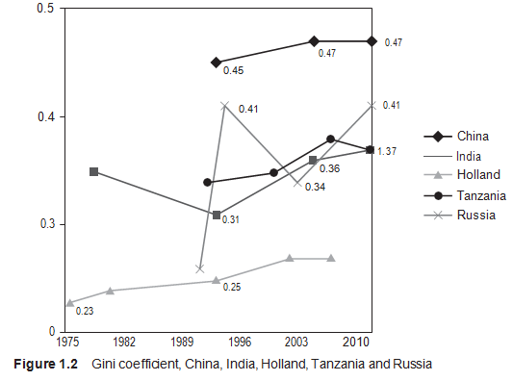
Gini coefficient (2)

Slide 13
Palma ratio
The Palma ratio is an alternative indicator of inequality, because:
- the ratios are easy to calculate;
- they are very effective for conveying extreme inequality.
Palma ratios are calculated as the aggregated income of the richest 10% divided by the aggregated income of the poorest 40%.

Slide 14
Trends in well-being
Inequality within countries has been increasing in the last decades.
Inequality between countries decreased overall, but the gap between the poorest and richest countries widened.
Statistical evidence suggests that inequality hinders long-term growth, fuels violent conﬂict and triggers migrations.
Piketty’s work predicts future exponential growth of inequality if preventive measures are not implemented globally.

Slide 15
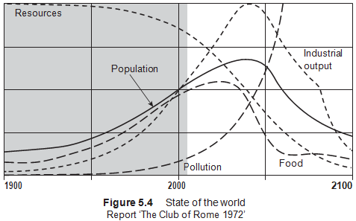
Milestones Recognition Sustainability
Publication of Our Common Future (Brundtland Report) by the United Nations in 1987. The Brundtland Report coined sustainable development as ‘development that meets the needs of the present without compromising the ability of future generations to meet their own needs’.

Slide 16
Sustainable development (SD)
SD acknowledges that control of our natural resources should be an essential part of policy making. A one-sided focus on short-term welfare growth can lead to irrevocable pollution and serious depletion of raw materials.
SD views welfare as the coexistence of economic prosperity, equity, well-being and environmental protection.

Slide 17
Videos for students/lectures (informative)
Suggestion for a video on YouTube, see search quote between []:
[Exponential growth and decay word problems | Algebra II | Khan Academy] (Khan Academy / 7:22 minutes)
[Explained: The true meaning of 'productivity‘] (ABC News (Australia) / 4:57 minutes)
[Basic Facts of Growth and Development] (Marginal revolution University / 13:17 minutes)
[MOOC | Jeffrey Sachs - The Age of Sustainable Development | Lecture 1, Chapter 1] (ColumbiaLearn / 11:23 minutes)
[The Policymaking Process Part One] (Prof. Moser’s You Tube Channel / 9:39 minutes)
[Global growth: Can we predict productivity?] (McKinsey & Company / 2:10 minutes)

Slide 18
Videos for students/lectures (politically engaged)
Suggestion for a video on YouTube, see search quote between []:
[Sustainable development: what, where and by whom?: Kitty van der Heijden at TEDxHaarlem] (TEDx Talks / 19:14 minutes)
[Sustainable Development - video1 - An Introduction] (Linda Vanasupa / 4:47 minutes)
[Dambisa Moyo on Dead Aid, Corruption and Resolving African Poverty (Norwegian TV)] (BetterGlobeTrees.com / 8:39 minutes)

Slide 19
Educational images
TargetMap. (n.d.). World map of Gini Index. Retrieved on 11 March 2016 from
http://www.targetmap.com/ThumbnailsReports/2755_THUMB_IPAD.jpg
United States Department of Agriculture. Foreign Agricultural Service. (2012). Figure 2: GDP Per Capita, 2012. Retrieved on 11 March 2016 from
http://www.fas.usda.gov/sites/default/files/2014-04/china_iatr_5.png
TargetMap. (n.d.). World Map Happiness (Thriving). Retrieved on 11 March 2016 from
http://www.targetmap.com/ThumbnailsReports/2903_THUMB_IPAD.jpg
The Visible Hand in Economics. (n.d.). GDP per capita (inflation adjusted). Retrieved on 11 March 2016 from
http://www.tvhe.co.nz/wp-content/uploads/1700_ad_through_2008_ad_per_capita_gdp_of_china_germany_india_japan_uk_usa_per_angus_maddison.png
Food and Agriculture Organization of the United States. (n.d.). World map Sustainable Development. Retrieved on 11 March 2016 from
http://www.fao.org/docrep/u8480e/U8480E62.jpg

Slide 20
Information Educational Resources
Information about cases, research assignments, videos etc.: m.oyevaar@sustainable-globalization.com

