Slide 1


Slide 2
CHAPTER 4
Life in Modern Society

Slide 3
Learning objectives
The ethical starting points which makes a ‘modern society’ possible;
Human nature characteristics which are an starting point for the ‘rules of play’ of a modern society;
The way human nature characteristics are related to ethical starting points;
Some necessary preconditions of society so individuals take their own initiative to participate in society.

Slide 4
The modern society
The modern society is directed towards values such as production, division of labour, usefulness and rationality.
This type of society owes much to:
The principles of the Enlightenment
Creating social capital
  The individual trusts the system which, in turn, stimulates initiative taking
  Trust happens when individuals feel they have been given a fair reply from the people and organizations that they are dealing with

Slide 5
Nature versus nurture debate
Nature refers to behaviour determined by our DNA, which is independent of environmental conditions.
Nurture refers to behaviour determined by ethic values, culture, upbringing and experience.

Slide 6
Social innovations
Modern society uses social innovations to deal with human characteristics that result in negative output, and to stimulate them when they benefit society.
How does the modern society deal with characteristics such as aggression, status, empathy, authority mindedness and kin selection?

Slide 7
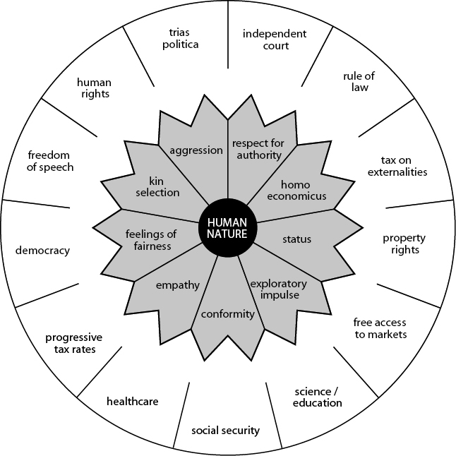
The institutionalized elements of a modern society in response to 9 human nature characteristics

Slide 8
1 Homo economicus
Homo economicus: rational calculated self-interest
Aspects of the society related to ‘homo economicus’ are:
  The market economy and property rights give human beings a financial incentive to contribute to society;
  Governments use financial incentives to control human behavior (e.g.: fines);
  Financial incentives function moderately in achieving ‘long-term policy’.
  The Marshmallow Experiment is related to ‘homo economicus’:
    Marshmallows were served to children in order to see how they dealt with reward. They were told if they did not eat the single marshmallow, they would get two when the researcher came back.
    The children were also monitored into adolescence and results showed that those who were patient to wait achieved greater success with intelligence and self-control playing an important part. The degree to which an individual is capable of controlling thinking and desires influences decision-making ability and interaction with people.
Suggestion for a video on YouTube, see search quote between []: [Marshmallow Experiment ProvenPrinciples] (ProvenPrinciples / 5:01 minutes)

Slide 9
2 Respect for authority (1)
Respect for authority: the extent to which people are authority-sensitive
Aspects of society related to ‘respect for authority’ are:
  Role division and decision-making at governments, companies and institutions in order to create a rational, effective and efficient society;
  The way in which countervailing power is organized in society, so that authorities cannot abuse their power (e.g.: human rights, democracy, trias politica).

Slide 10
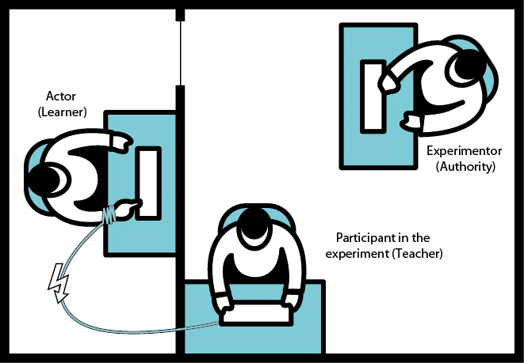
2 Respect for authority (2)
The Milgram Experiment: Milgram wanted to determine if people would discard accepted standards and values if told to do so by the authorities.
Suggestion for a video on YouTube, see search quote between []: [Milgram Experiment (Derren Brown)] (philosophyblackbelt / 10:48 minutes)

Slide 11
3 Empathy
Empathy: being aware and sensitive to the feelings of others without having to communicate in an explicit manner.
Aspects of society related to ‘empathy’ are:
  Social security and public health service;
  Industrialised countries with a feminine culture have less tension (e.g. Sweden).
Experiment about great tits, a common bird species. The birds could be divided into two groups: aggressive and sociable:
  The degree of aggressiveness was determined by genetic structure;
  Natural selection has not caused the more sociable birds to die out.
  The more aggressive and dominant birds did better in difficult situations such as harsh winters.
  Favourable conditions allowed the sociable and cautious birds to thrive by being less hectic, with normal conditions increasing survival chances.
  The percentage of sociable and aggressive birds is stable and fluctuates annually, depending on the situation.

Slide 12
4 Feelings of fairness (justice)
Feelings of fairness (justice): judicial sentiment and the anger that ensues due to unfair (unequal) treatment.
Aspects of society related to ‘feelings of fairness’ are:
  Law in which everyone is treated equally, regardless of origin, race and religion;
  Universal suffrage means that every citizen has the right to vote.
Experiment Monkeys Reject Unequal Pay:
  The experiment observed monkeys’ behaviour when they were unequally treated.
Suggestion for a video on YouTube, see search quote between []: [Capuchin monkeys reject unequal pay Vish Azadia] (Vish Azadian / 2:39 minutes)

Slide 13
5 Kin selection
Kin selection: helping to ensure the success of the next generation (e.g. ethnical and cultural related help).
Aspects of society related to ‘kin selection’ are:
  Friends and family can expect loyalty in a more intense way;
  Human rights & anti-discrimination have to be institutionalized.
Suggestion for a video on YouTube, see search quote between []: [How Racist Are You? | part 1 | Jane Elliott's Brown Eye-Blue Eye Experiment] (Xicana Corner / 11:13 minutes)

Slide 14
6 Status and 7 aggression
Status: the state of being admired.
Aspects of society related to ‘status’ are:
  All kind of awards for literature, film, science and art;
  Status is dependent of values (e.g. Nowadays, smoking a cigarette has less status than compared to fifty years ago).
Aggression: the feelings of anger or antipathy resulting in hostile or violent behaviour.
Aspects of society related to ‘aggression’ are:
  Governments could play a substantial role in neutralizing aggression, because the conditions are decisive if aggression occurs.

Slide 15
8 Exploratory impulse and 9 conformism
Exploratory impulse: the pleasure derived from research, ambition, discovery and expanding horizons.
Society aspects related to ‘exploratory impulse’ are:
  Education for children, pupils and students;
  Free entrance to participate in the market economy.
Conformism: the degree to which people adjust to norms, values and behaviour.
Society aspects related to ‘conformism’ are:
  Different cultures around the world;
  Change of values over time.

Slide 16
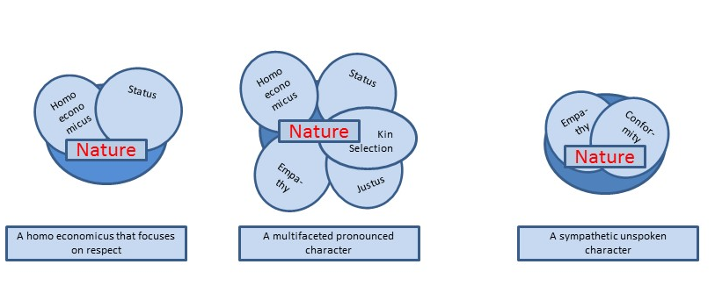
Different types of persons
Is the society designed to deal with different types of persons?

Slide 17
Ethics
Ethics deal with the question of good versus evil, right versus wrong: Is what I do acceptable?
Ethics are the reﬂection of our morals, of the standards and values that we expect to be reasonably accepted by others in an attempt to maintain balance in everyday life.

Slide 18
Ethics for other ways of life
Characteristically for tribes:
  The primary focus of a close-knit community is working together.
  Values and standards are based more on mutual loyalty and less on anonymous justice.
Characteristically for a group with a specific religion:
  Societies possess an ethical system that is not called into question, because people believe in its principles.

Slide 19
Ethics for a modern society (1)
Universalism: in a modern society when group interaction intensiﬁes, it is important that an ethical system is developed which applies the same rules to everyone.
Universalism is an answer to particularism.
Particularism: : the ethical system for a speciﬁc group in society: some rules, rights and privileges are particular for certain groups.
For example:
  Women have other (less) rights and privileges;
  Unbelievers of a certain religion are threatened in another way;
  More privileges for the elite.

Slide 20
Ethics for a modern society (2)
Characteristics are:
  Written laws with ﬁxed ethical standards (principles) for everyone;
  People should be prepared to adjust their behaviour and inclinations if they prove unacceptable behaviour to others and have no rational arguments;
  Freedom of speech and religion;
  The government keeps appropriate distance in the realm of acceptable and non-acceptable religious convictions (separation of church and state);
  Personal convictions of a few religions or of a certain religion no longer play a role in state ethics, but the state does guarantee that everyone is entitled to personal or religious beliefs.

Slide 21
Ethical starting points related to the Enlightenment (1)
The ethical principles of the Enlightenment are rational in nature.
Principle ethics: dealings are morally accepted as long as they adhere to principles with general validity, because everyone, regardless of origin, religion, sexual orientation or situation, thinks it is a logic rule.
Advantages:
  Clearness (especially suitable if many people live together);
  Consistent with feelings of fairness.
Disadvantage:
  Context aspects and ‘utility’ are no parts of the decision.

Slide 22
Ethical starting points related to Enlightenment (2)
Consequence ethics (utilitarianism)
  To determine if a decision is ethically acceptable, it is necessary to ascertain who will be affected in a positive and negative way.
  The sum of plus and minus factors will determine if the ethics serve the general interest.
Advantage:
  The premise is ‘public utility’. Scarcity (economy) is taken into account.
Disadvantages:
  Principles and duties are not an issue;
  Difficulties to what extent utility of all stakeholders are included (e.g.: exclusion of future generations, residents of other cities, countries).

Slide 23
Place of virtue ethics in a modern society
Virtue ethics: concerned with virtue, its focus is placed on the ideal character of a human being.
Virtue ethics take their inspiration from Aristotle.
Aspects related to virtue ethics:
  It is concerned with feelings;
  It is consistent with the images that people have about good and evil;
  It is less clear, and it cannot easily be defined in regulations;
  It is less easy to apply in a modern society.

Slide 24
Two viewpoints of virtue ethics
Narrative perspectives (can be applied to define loyalty and solidarity):
  Context plays an important role
  Judgement on ethical questions can be linked to precedents (what happened before) or be related to the community of the person in question;
  Moral considerations are dependent on time and situation;
  Behaviour is dependent on the relation with the person concerned.
Intention perspectives (intentionalism):
  It is concerned with the role that motivation plays in human interaction;
  Loyal and generous people are ‘good’
  It is based on fallible human beings (People are not always aware of the consequences of their dealings and if this is questioned, consideration must be taken whether a person has acted in good faith).

Slide 25
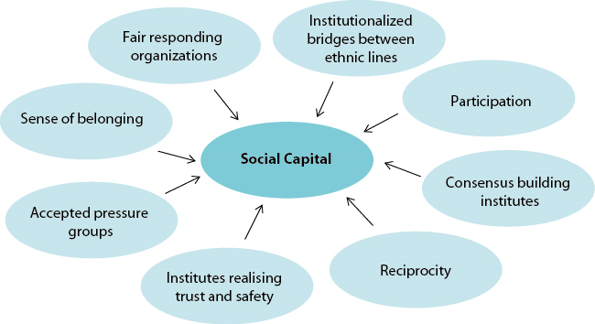
Modern society & social capital
Social capital is the result when, in society, institutionalized standards and values respond fairly.
Social capital encourages everyone to participate, regardless of ethnicity or religion.

Slide 26
Experiment on universalism and trust in society (1)
      Trompenaars and Hampden-Turner questioned whether people were loyal to institutionalized principles or to the people they live with.
      What will the test person say to the judge, if he is going to court as a witness?
      Will he testify for or against his friend who hit a pedestrian while he was driving 20 miles per hour too fast?
      The test person can choose from the following three options:
Your friend can always count on you to testify for his innocence.
Your friend has a right to legal defence, because you have attested to his innocence.
Your friend has no right to assume that you will provide testimony confirming his guilt.

Slide 27
Experiment on universalism and trust in society (2)
Country | Percentage | Country | Percentage
Venezuela | 32 | Czech Republic | 83
Korea | 37 | Germany | 87
Russia | 44 | The Netherlands | 90
China | 47 | Australia | 91
India | 54 | United Kingdom | 91
Japan | 68 | United States | 93
Singapore | 69 | Canada | 93
France | 72 | Switzerland | 97
Percentage of people with a preference for answer options 2 and 3
      Conclusion:
      Universalism in society is institutionalized when a witness declares to the court that a friend has committed an offence.
      Trust is related to faith in the government and societal organizations.

Slide 28
Videos for students/lectures (informative)
Suggestion for a video on YouTube, see search quote between []:
About Deontology: [Basics of Deontology Eric Morales] (Eric Morales / 4:06 minutes)
About different starting point for ethics: [Normative ethics: Virtue Ethics, Consequentialism, Deontological Ethics UPSC General Studies] (UPSC General Studies / 10:31 minutes)
About the need of rules for aggression: [The Stanford Prison Experiment Official Trailer #1 (2015) Ezra Miller Thriller Movie HD] (Zero Media / 5:01 minutes)
About the need of rules for aggression: [Zimbardo shows how most evil comes from hierarchy] (mr1001nights / 6:48 minutes)
About the conformity behaviour of people: [Asch Conformity Experiment eqivideos] (eqivideos / 4:11 minutes)
About mirror neurons which scientifically clarify that conformity behaviour exists: [mirror neurons part 1 Florin Arjocu] (Florin Arjocu okyanusum / 6:32 minutes)
See also the videos which can found in the following slides:
1 Homo economicus (slide 7)
2 Respect for authority (slide 8 and 9)
4 Feelings of fairness (justice) (slide 11)
5 Kin selection (slide 12)

Slide 29
Videos for students/lectures (politically engaged)
Suggestion for a video on YouTube, see search quote between []:
[Non-Zero Sum Solution Rickey Bowers] (Rickey Bowers
/ 7:30 minutes)
[Justice: What's The Right Thing To Do? Episode 01 "THE MORAL SIDE OF MURDER“] (Harvard University / 54:57 minutes)

Slide 30
Information Educational Resources
Information about cases, research assignments, videos etc.: m.oyevaar@sustainable-globalization.com

