Slide 1
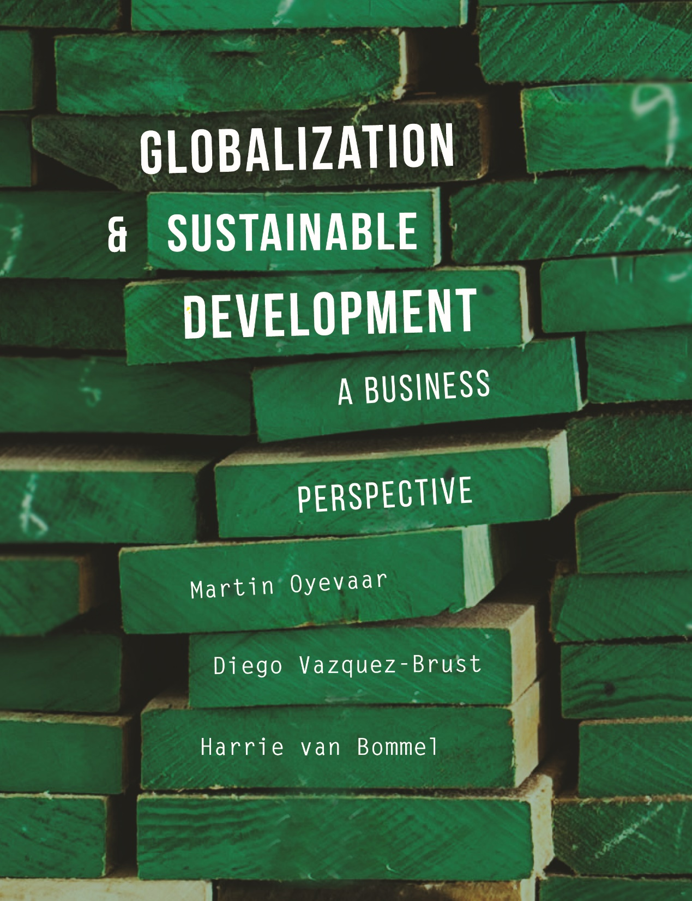

Slide 2
CHAPTER 5
Sustainable Development: Environmental and Social Aspects

Slide 3
Learning objectives
Know and understand the historical development of sustainable development;
Understand conceptual and political landmarks shaping sustainability practices: triple bottom line (three Ps); green growth; planetary boundaries, sustainable development goals;
Have insight into the environmental themes energy, water, ecosystems, biodiversity and natural resources;
Understand the importance of the social dimension of sustainable development and its relation with the environmental and economic dimensions.

Slide 4
Presentation
Sustainable development in historical perspective
Aspects environmental sustainability
Social sustainability
Economic sustainability

Slide 5
Sustainable development in historical perspective

Slide 6
Prosperity, well-being and the environment
The environment has a strong link to welfare and prosperity.
Industrial Revolution (19th century): the starting point for two centuries of increased productivity. Europe and other parts of the world beneﬁted from a dramatic improvement in welfare and well-being.
In the 1960s, gross national product (GNP) rose to more than 5% annually → consumer society. At the same time environmental concerns began to assume more prominence.
Consumption-orientated society: a social-economic plan dedicated to stimulating needs so that people continuously feel the desire to purchase more.

Slide 7
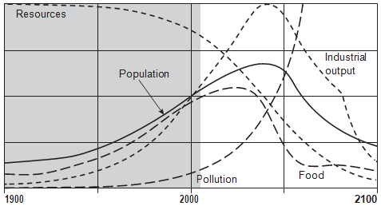
Well-known “wake up calls”
The 1968 bestseller “The Population Bomb” written by scientist Paul R. Ehrlich.
The 1972 report “The Limits to Growth” published by Massachusetts Institute of Technology (MIT).

Slide 8
Sustainable development
Mid 80s the UN World Commission on Environment and Development (WCED) was requested by the UN to develop a future-orientated long-term view on the relation between economic development and the environment.
This resulted in the report ‘Our Common Future’ (1987). The world is aware that ‘sustainable development’ is a joint responsibility.
Definition sustainable development:
  ‘Development that meets the needs of the present without compromising the ability of future generations to meet their own needs.’

Slide 9
UN goals
After the Cold War and years of ideological trench warfare between capitalism and communism, they reached consensus in the UN to accept the market economy, but it must be friendlier and more sociable.
185 countries signed up to the UN Millennium Development Goals (MDGs) in 2001.

Slide 10
Millennium Development Goals of 2001
Reduce poverty and hunger
Achieve universal primary education
Gender equality and empower women
Reduce child mortality
Improve maternal health
Combat HIV/AIDS, malaria
Ensure environmental sustainability
Develop global partnership for development

Slide 11
MDGs 2001–2012
Yearly report kept track of how the involved countries were getting on and;
Improvements have been noted in almost every goal.
Retrogression goal 7 (Environment):
  Pollution ↑
  Emissions ↑
  Extinction of species ↑

Slide 12
From MDGs to SDGs
In 2015, the UN formulated 17 sustainable development goals in het field of:
More speciﬁc goals related to:
  Equality;
  Environmental issues;
  SDGs are designed for both developed and developing countries (MDGs were aimed at developing countries only).
1) Poverty | 2) Hunger | 3) Health | 4) Education | 5) Gender equality | 6) Water and sanitation
7) Affordable and clean energy | 8) Decent work and economic growth | 9) Industry, innovation and infrastructure | 10) Reduced inequality | 11) Sustainable cities and communities | 12) Responsible consumption and production
13) Climate action | 14) Life below water | 15) Life on land | 16) Peace and justice (strong institutions) | 17) Partnership for the goals

Slide 13
Aspects environmental sustainability

Slide 14
Natural resources (1)
Renewable resources are resources which can restore their capacity in a short time (years/decades).
Examples are:
  Water, agricultural crops, wood, fish
  Bio fuel
  Solar energy (unlimited resource which is not part of the earth itself)

Slide 15
Natural resources (2)
Non-renewable resources
can be found in sinks in
deep layers of the earth.
Examples are:
  Fossil fuels
  Phosphate (mined
  nutrient used for fertilizer)
  Metals
  Phosphorus recycling is important, because there is no biochemical replacement.
  Suggestion for a video on YouTube, see search quote between [ ]:
[The Phosphorus Paradox] (wpsu / 6:40 minutes)
[The Phosphorus Challenge] (Phosphorus Platform / 2:29 minutes)

Slide 16
Planetary boundaries
There are nine distinctive natural ‘ceilings’ for growth, or planetary boundaries:
Climate change
Change in biosphere integrity (biodiversity loss and species extinction)
Stratospheric ozone depletion
Ocean acidiﬁcation
Biogeochemical ﬂows (phosphorus and nitrogen cycles)
Land-system change (e.g. deforestation)
Freshwater use
Atmospheric aerosol loading (microscopic particles in the atmosphere that affect climate and living organisms). Not yet quantiﬁed
Novel entities (e.g. organic pollutants, radioactive materials, nano- materials and micro-plastics). Not yet quantiﬁed
The ceilings are danger warnings. Trespassing the ﬁrst ‘danger signal’ means we are moving out of our safety zone and there is a high risk of irreversible change.

Slide 17
Sub 1: Climate change
The discussion about global warming often focuses on CO2 emission, a gas that contributes to the greenhouse effect, whereby the heat remittance to the universe decreases.
In the last two centuries, a lot of CO2 is released by burning fossil fuels.
Reserves of fossil fuels (CO2) in the Earth are the result of necrotizing trees and plants over the previous millions of years.
Millions of years ago, there were also higher concentrations of green gases in the atmosphere.

Slide 18
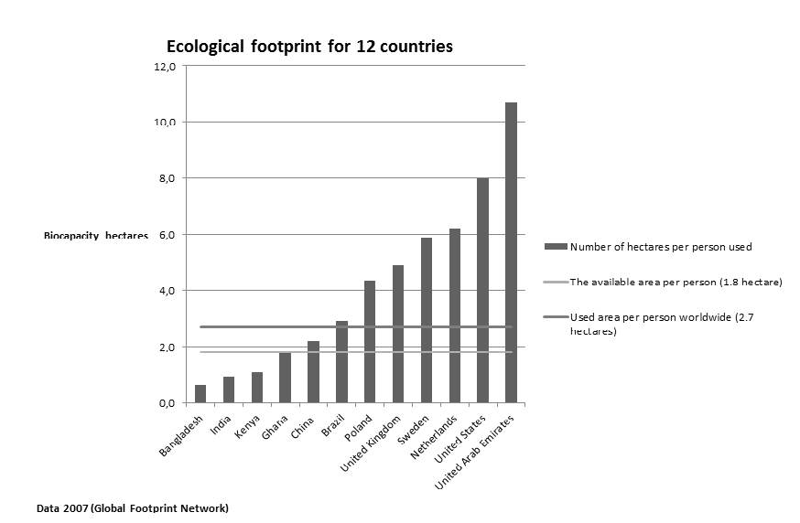
Sub 1: Ecological footprint CO2
Definition: hectares that the average person needs in order to live

Slide 19
Sub 2: Change in biosphere integrity
Ecosystems: an ecosystem is an integrated community of moulds, bacteria, plants and insects that live collectively with each other while retaining a certain form of independence. They feed and thrive with non-living entities such as water, air and temperature.
Ecosystems are important for the renewable sources we use daily in our economic system.
The causes of the enormous loss of biodiversity are:
  the relatively rapid temperature increases of 0.2 degrees per decade;
  the availability of less space and the mixed functions spaces;
  the availability of water;
  and pollution.
The number of species of mammals, birds, reptiles, amphibians and ﬁsh across the globe is, on average, about half the size it was 40 years ago.
  Suggestion for a video on YouTube, see search quote between [ ]:
[LS2C - Ecosystem Dynamics, Functioning and Resilience] (Bozeman Science / 6:53 minutes)

Slide 20
Sub 7: Freshwater use
Some facts:
World’s supply of groundwater is steadily decreasing.
Waste water disturbs the balance between nutrients and oxygen in natural aquatic ecosystems and fish might be killed.
Treated sewage water forms sludge, which may be dumped in sea or landﬁlls or spread out on agricultural land and often contains high concentrations of pollutants like heavy metals.
A person needs 2000–3000 litres daily of water to produce enough food.
In 2025, water shortages will be more prevalent among poorer countries where resources are limited and population growth is rapid.

Slide 21
Social sustainability

Slide 22
Four approaches (1)
Social sustainability is a part of the triad. The other parts are Environmental sustainability and Economic sustainability.
Social sustainability encompasses all human activities, namely 1) Economics 2) Ecology, 3) Politics and 4) Culture.
Sustainability is divided in:
  material sustainability (environment, air, water, food, fuel, housing);
  social sustainability (issues that affect the individual/family, namely 1) society, 2) politics/government and 3) economics/ﬁnance).

Slide 23
Four approaches (2)
4. Social sustainability is a domain with the next dimensions:
  The individual accepts the responsibility of consistent growth and improvement through broader social attributes
  The community accepts responsibilities with regard to:
  Equitability for all members
  Promoting diversity
  Processes, systems and structures that promote connectedness between community and non-community members
  Basic needs and quality of life
  Democratic processes

Slide 24
Economic sustainability

Slide 25
Green growth
A strategy for achieving sustainable development.
  Building a green economy in which investments in resource savings as well as sustainable management of natural capital are drivers of growth and in which governments collaborate in the phasing out of unsustainable technologies and modes of production.
  An economy which is in balance with sustainable development objectives will provide opportunities for using ﬁnancial resources and be better able to meet development needs and reduce the vulnerability of socio-economic systems to environmental change and resource constraints.

Slide 26
Business & Triple bottom line
Sustainable development is about the balance between social, environmental (or ecological) and economic/ﬁnancial aspects.
In the business environment, the triple P is being used; the three pillars of sustainability (People, Planet and Prosperity)
The framework states that a company’s responsibility lies with stakeholders rather than shareholders.
Stakeholders: anyone who is inﬂuenced, either directly or indirectly, by the actions of the ﬁrm.

Slide 27
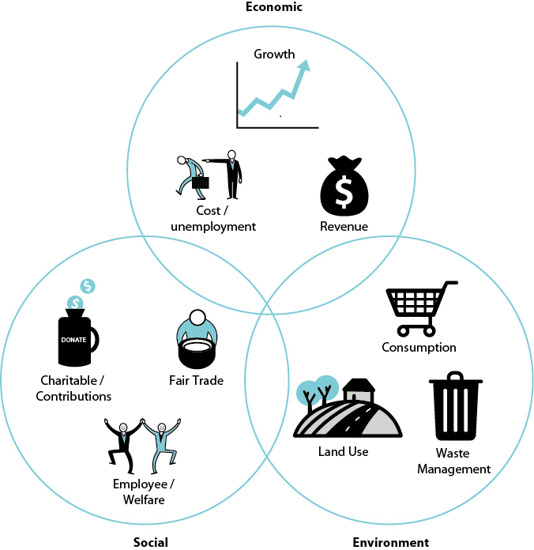
Triple bottom line (triple P)

Slide 28
Videos for students/lectures (informative)
Suggestions for videos on YouTube, see search quote between [ ]:
[The Limits to Growth- is the prediction of 1972 going to happen? studioXforum] (studioXforum / 7:30 minutes)
[The Greenhouse Effect explained in 1988] (ABCScienceOnline / 4:48 minutes)
[Ecological footprint: Do we fit on our planet?] (Sustainability Illustrated / 6:14 minutes)

Slide 29
Videos for students/lectures (politically engaged)
Suggestion for a video on YouTube, see search quote between [ ]:
Interview Brundtland (Chairman of Brundtland commission releasing the report “Our common future” (1987)
[Gro Harlem Brundtland: I'm A Lucky Person] (Skoll.org / 4:49 minutes)

Slide 30
Information Educational Resources
Information about cases, research assignments, videos etc.: m.oyevaar@sustainable-globalization.com

