Slide 1


Slide 2
CHAPTER 6
Governance of Sustainability

Slide 3
Learning objectives
Gain insight in the factors of population, welfare and technology stressing the environment;
Understand the gaps in the market economy and why this system is not always the best option for long-term welfare;
Know and understand the instruments of the market economy to increase performance so that scarce resources remain available for the long-term;
Understand the beneﬁts of countervailing powers to get long-term welfare solutions.

Slide 4
Factors influencing environmental impacts
l = P x W x T (Ehrlich’s formula) indicates if worldwide environmental damage is increasing or decreasing.
The environmental burden (l) is dependent on the factors of population (P), welfare per individual (W) and technique for environmental burden per welfare unit (T)

Slide 5
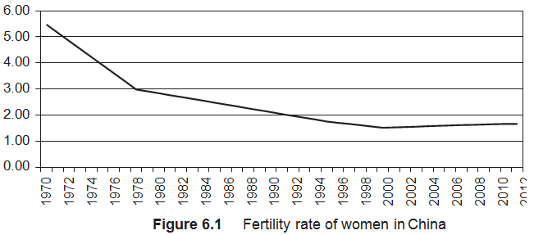
Population
Over time world annually growth percentage of population decrease (1965: 2.04% versus 2014: 1.16%)
Main reasons:
More people migrate to cities and city dwellers opt for smaller families
Increased welfare
Ambitious government family planning policy
  E.g.: Family planning policy in China
  1970 – 1979: Late, Long, Few
  1980 – 2015: One-child policy
  2015 - Two-child policy

Slide 6
Prosperity / Economy (1)
Welfare measured by GDP per capita is calculated by adding up salaries, proﬁts, leases and interest.
The calculation gives a false picture of prosperity.
Examples:
GDP does not always contribute to welfare (e.g. restoration work due vandalism)
Non calculated “economic” activities
  e.g. 1) Incorrect estimated informal sector 2) Parenthood at home versus kindergarten
Future orientated investments are calculated as GDP while consumption (= prosperity) takes place in the future (e.g. glass ﬁbre, solar panels etc.)
No insight in spending patterns (environmentally friendly versus non-environmentally friendly consumption)

Slide 7
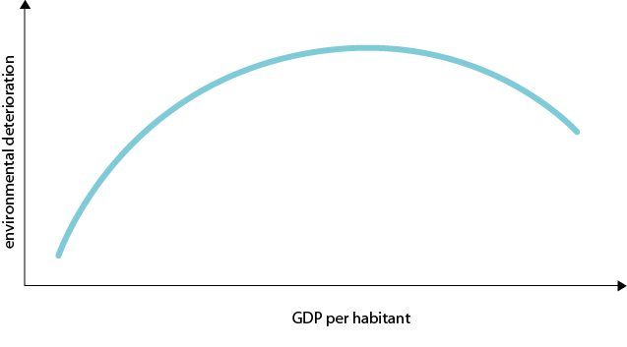
Prosperity / Economy (2)
Starting point environmental protesters in 1970s:
Unlimited economic growth is the main cause of environmental deterioration
Growth ↑ = Pollution ↑ + Natural resources ↓ + Number fragile ecosystems ↑
Starting point ‘Environmental Problem Solving’ (EPS) by John Dryzek:
Occurrence of ‘feedback mechanisms’
  E.g.: Scarcity resources ↑ => Price ↑ => Use of resources ↓ + Clean technology ↑ + Stocks ↓
Kuznets Curve of environmental deterioration

Slide 8
Prosperity / Economy (3)
An empirical study on Kuznets Curve (Stern, 2004) concluded flimsy econometrics:
None of the empirical studies was econometrically robust
Several studies about:
  Developed countries: economical growth => most pollutants ↑ (critically CO2)
  Developing countries: economical growth without sharp environmental deterioration
Critical green growth:
Investment in the green sector is not enough
Governments should actively help the market phase out polluting industries

Slide 9
Prosperity & well-being (1)
Opinion of some environmental groups:
The market economy is a failing system because of its inﬂuence on:
  culture and identity
  no tangible contribution to meaning and happiness.
GDP is not an appropriate measurement of prosperity and well-being
Alternatives for GDP:
  Happiness Index
  Happy Planet Index.

Slide 10
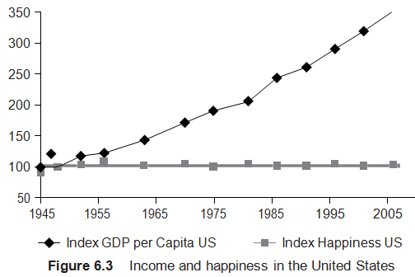
Prosperity & well-being (2)
Happiness studies by economist Richard Layard
Income paradox: income ↑ => happiness ±
Income raise is like a shot of whiskey

Slide 11
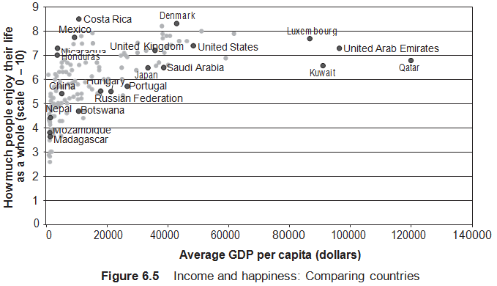
Prosperity & well-being (3)
The basic premise is that all government policy should have public contentment as its starting point.

Slide 12
Prosperity & well-being (4)
Research on variables which have an impact on happiness (Layard):
Contentment factors | Fall in happiness
Family income decreases one-third | 2
Divorced (rather than married) | 5
Unemployed (rather than employed) | 6
Subjective health down 1 point (on a 5-point scale) | 6
Quality of government (Belarus rather than Hungary in 1995) | 5
‘God is important in my life’ You say no to this rather than yes (Also followers of a more rational philosophy as Buddhism are happier.) | 3.5

Slide 13
Prosperity & well-being (5)
The happiness index as an indicator for welfare indicator does not provide any information on environmental damage.
The New Economics Foundation developed the ‘Happy Planet Index’.
The Happy Planet Index (HPI) uses the following variables:
Human happiness
Average life expectancy
Ecological footprint.
The aim of the index is to assign a single number to a country’s attempts at providing a good life for its citizens without damaging the environment.

Slide 14
Technology
Compulsion for application: the spread of technology is unstoppable, even the technology which has problematic consequences.
  Example: The combustion engine because of the CO2 emissions (there are more than 1 billion cars worldwide)
Chlorofluorocarbons (CFCs) are a counterexample for compulsion for application.
For four decades, chlorofluorocarbons were used as coolant for refrigerators and as propellant gas for sprays.
The CFCs caused the depletion of the ozone layer resulting in more ultraviolet rays, which increased the number of people with skin cancer, particularly in Australia.
Thanks to the Montreal Protocol (1987), the spread of the chlorofluorocarbons (CFCs) has been reasonably successful halted.
Nowadays, alternatives are used for coolant and propellant gas (note: alternatives are hardly more expensive).

Slide 15
Market imperfections regarding sustainability
Imperfection of price setting in respect of:
  Common goods;
  Future shortages of goods;
  Goods with undesirable (damaging) effects.

Slide 16
Market imperfections:
Common goods
Tragedy of the commons:
A classic tale based on the applied game theory about farmers who have their own cattle grazing on a common pasture.
Rational behaviour of the individual farmer leads to overexploitation and lower prosperity for all on the long-term.
The excess is caused by the individual’s quest for maximum proﬁt while the costs involved to achieve this are shared by all others (individual proﬁt maximization).
The Tragedy of commons makes clear the need for global action in order to limit the use of common resources.

Slide 17
Market imperfections: 2 and 3
Future shortages of goods
Current market prices provide no information on the scarcity of goods in the future (20 – 50 years);
Incorrect prices indicate a misallocation of resources.
Goods with undesirable effects
Costs or beneﬁts of stakeholders, other than direct market participants (mostly buyer and seller) are usually not reﬂected in the prices.
Externalities refer to under-priced goods or services with undesirable (damaging) effects.

Slide 18
Tools to overcome market imperfections
      Morality: culture and values for society are not easily to form. Examples:
        1) Public debate about values;
        2) The support of organizations that contribute to the ‘we feeling’ of new values.
      2. Ownership (property rights): preservation of common goods, such as nature reserves, by assigning ownership rights to a foundation.

Slide 19
    Tools to overcome market imperfections
      Financial incentives: in an attempt to inﬂuence supply and demand, the government can, for example, decide to count external costs by:
        taxes and duties (greening of the tax system);
        artificial markets.
      Market transparency: providing positive and negative information of goods and services.
      Commandments and prohibitions
        national (e.g. regulations of emission standards);
        international (e.g. binding of international measurements).

Slide 20
Governance & long-term well-being (1)
How should society be organized so that it creates opportunities for rational and responsible decision-making aimed at long- term well-being?
Discussion/statements:
  The democratic market economy provides dynamics and furthermore, corrections are institutionalized. If the division of property, income and power is out of balance, then the corrections are carried out quite easily.
  The democratic market economy has insufficient potential for long-term well-being, because democracy undermines rational decision-making and the market economy undermines long-term prosperity.
Concepts of long-term well-being are based on rationality. The following three concepts are partially institutionalized in modern societies.
Meritocracy:
  This concept implies that people are appointed to positions on the basis of their track record;
  Those involved with policy making are experienced professionals, politicians, officials, lecturers, physicians, engineers, etc.

Slide 21
Governance & long-term well-being (2)
Technocracy:
  Government policy is largely dependent on scientiﬁc and technical knowledge;
  Scientists, engineers, sociologists, economists replace the politicians;
  Decision-making is spearheaded by rational, effective planning and implementation;
  Democratic decision making is seen as a hindrance.
Buttresses of society:
Society is not organized as a total system and in order to realize healthy development, the government must be able to deal with institutionalized countervailing institutions (buttresses of society), such as:
  NGOs, free media, independent organisations;
  public bodies that have a more formalized influence;
  international buttresses (national policy is developed within the framework of international agreements).

Slide 22
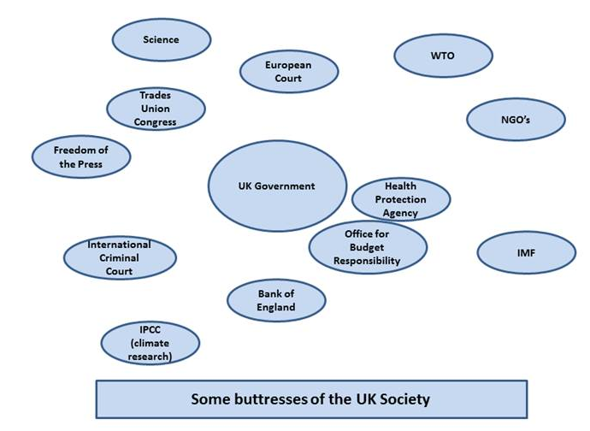
Governance & long-term well-being (3)

Slide 23
Circular versus linear industrial economy
Linear industrial economy:
Natural resources are acquired with little regard for reuse and is material and energy hungry
Makes use of complex and international supply chains and don’t take external costs into consideration.
Circular economy
Products are designed to be reused, recycled or taken apart for regeneration
Reusability is the basis for economic growth
Roles are reversed: unlimited labour assumes a central role while materials and naturally supplied sources assume a subordinate position.

Slide 24
Educational videos for students and lecturers (informative) (1)
Suggestions for videos on YouTube, see search quote between [ ]:
Growth of world population: [World Population Population Education] (Population Education / 5:47 minutes)
Growth of world population: [World population: Hans Rosling: Global population growth, box by box]
(Ted / 10:16 minutes)
Informal sector: [Lessons from the informal economy | Diana Enriquez | TEDxMünchen] (TEDx Talks / 9:36 minutes)
GDP and Prosperity: [Is GDP the wrong yardstick for measuring prosperity?] (PBS NewsHour / 9:21 minutes)
Alternative GDP: [Douglas Beal: An alternative to GDP that focuses on wellbeing, not just wealth] (TED Institute / 11:34 minutes)
Alternative GDP: [What alternative is there to GDP?] (EurActiv / 3:19 minutes)
Alternative GDP: [Nic Marks: The Happy Planet Index] (TED / 17:21 minutes)

Slide 25
Educational videos for students and lecturers (informative) (2)
Market failure: [6 Types of Market Failure Pajholden] (Pajholden / 16:33 minutes)
Tragedy of the Commons: [Tragedy of the Commons or The Problem with Open Access] (This place / 3:27)
Three remedies for the tragedy of the commons: [The Tragedy of the Commons Marginal Revolution University] (Marginal Revolution University / 10:36 minutes)
Artificial market explanation by means Carbon market: [How Carbon Trading Works | RMIT University] (RMIT University / 2:44 minutes)
Elinor Ostrom, Nobel prize winner about Tragedy of Commons: [Sustainable development and the tragedy of commons] (Stockholm Resilience Centre TV / 8:27 minutes)
Theory on Meritiocarcy [Upward and downward mobility, meritocracy] (khanacademymedicine / 6:36 minutes)
Theory on technocracy [What Is A Technocracy?] (Seeker Daily / 2:55 minutes)

Slide 26
Educational videos for students and lecturers (politically engaged)
Suggestion for a video on YouTube, see search quote between [ ]:
Critical opinion on GDP and Prosperity: [Dirk Philipsen on GDP] (The RSA / 19:48 minutes)
Government policy on happiness: [Our basic purpose | Richard Layard | TEDxOxford] (TEDx Talks / 22:22 minutes)
An opinion on political systems which gives input for debate: [Eric X. Li: A tale of two political systems] (TED / 20:38 minutes)
Opinion on Meritocracy which gives input for debate: [Meritocracy The School of Life] (The School of Life / 5:53)

Slide 27
Information Educational Resources
Information about cases, research assignments, videos etc.: m.oyevaar@sustainable-globalization.com

