Slide 1
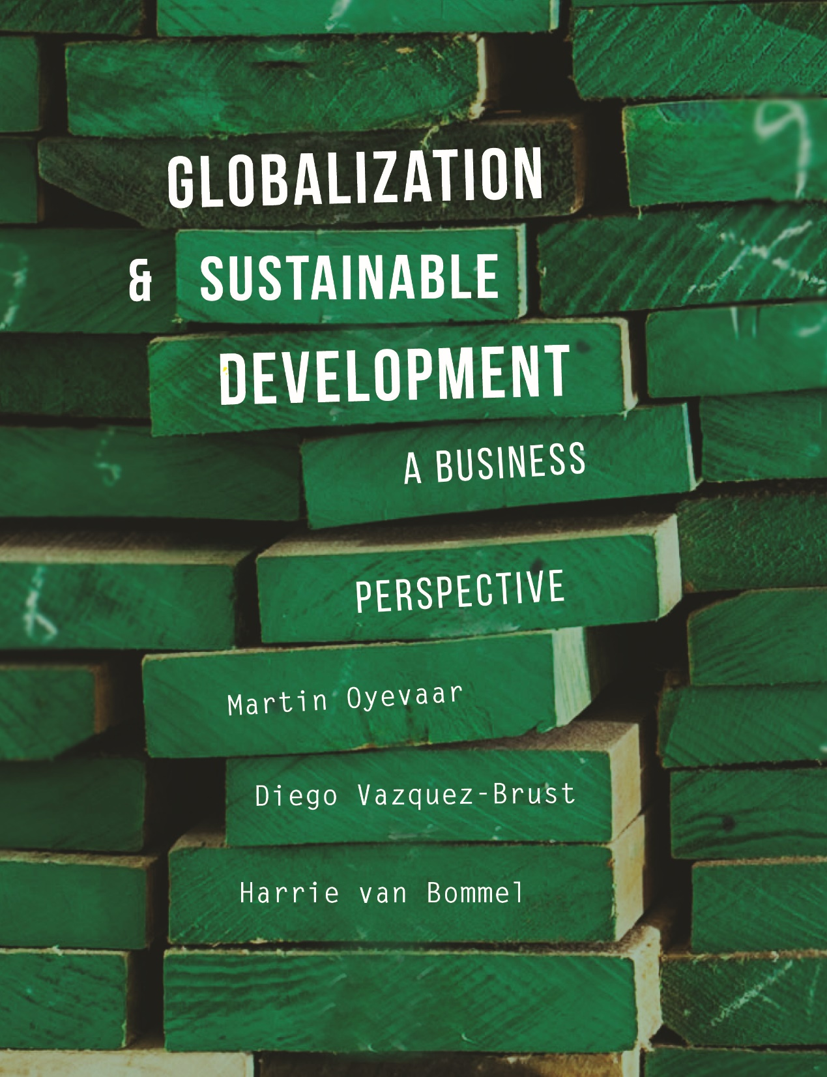

Slide 2
CHAPTER 8
The Impact of Globalization on Sustainable Development

Slide 3
Learning objectives
Develop an understanding / awareness of :
Positive and negative impacts of supranational institutions (IMF, World Bank, and WTO)
Impacts of multinational companies in host countries
Trends in terms of economic growth, well-being, and inequality
Inequality and global ﬁnancial crisis
Globalization, internationalization, and neoliberalism

Slide 4
Challenge of supranational organizations
The goal of the Bretton Woods institutions (the ﬁrst globalization institutions) is to provide governance of capital ﬂows (IMF), trade (WTO), and avoiding inequalities in the distribution of welfare (World Bank).
Findings concerning globalism:
Shallow integration of economies through international trade has resulted in competitive devaluations
World needs more globalization and less internationalization
Conclusion:
A deeper form of global economic relationships is required in order to prevent global political instability. This type of economic relationship should integrate economic systems and create interdependencies between national systems through institutions that provide global governance.

Slide 5
    IMF policy on exchange rates
Historical facts after WWII:
Till 1973, IMF policed a global system of ﬁxed exchange rates to get global commitment not to use devaluation as a competitive weapon
In the Bretton Woods System (BWS), all countries ﬁxed the values of their currency in terms of gold.
The system collapsed due to speculative pressure on the dollar, after an increase in US inﬂation and balance-of-payments deﬁcit.
After 1973, IMF switched to a system of ﬂexible or ﬂoating exchange rates

Slide 6
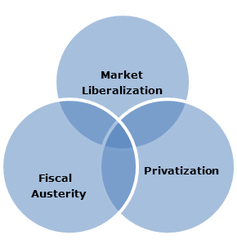
    The Washington Consensus & IMF
An informal agreement (1989) between the World Bank, the IMF, and the US Treasury to promote neoliberal policy globally:
Structural reforms in developing countries, such as liberalization of capital ﬂows, interest rates, and trade and inﬂation control.
Policies to correct the problems of inﬂation and debt created by governments that were spending beyond their means and protecting inefficient local industries through state ownership or restriction of imports
The 3 pillars of the Washington Consensus

Slide 7
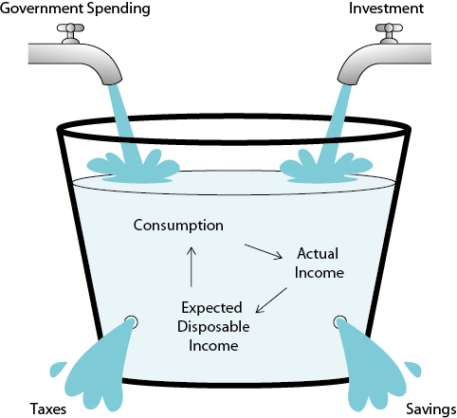
    Why did IMF distance itself from Keynes?
Keynes:
A poor economy can be stimulated by demand stimulation through
Government spending
Much money for businesses from politics, so that they invest
Opponents Keynes:
Demand stimulation is often accompanied by an irresponsible government
Demand stimulation may lead to short-term growth, but long-term instability

Slide 8
    IMF in 1980s and 1990s
The IMF abandoned foundational Keynesian objectives and created policy based on neoliberalism (“promoting free markets”)
Neoliberals in the IMF believed in the Solow hypothesis and countries with poor economies were to tighten their belts (austerity)
Solow hypothesis: Austerity is needed to encourage savings, and savings are a pre-condition for growth.
Recent statistical analysis in developing countries suggests that Keynes was right and the IMF was wrong: savings are a consequence of growth

Slide 9
How Washington Consensus works out
Success of the Washington Consensus policies
Tame spiraling debt and inﬂation in Latin America
The reasons behind Washington Consensus failures
Policy is applied as a ‘one-size-ﬁts-all’ policy and it disregards differences between countries
Ideological blindness to potential market failures specially for developing countries:
  Absent government led to environmental damage.
  Privatizations failed to provide more efficient services and failed to fight unemployment
  Liberalization led to destruction of local control over ﬁnancial systems and restricted the access of small entrepreneurs to capital
  Trade liberalization destroyed local industry and led to unemployment
  Fiscal austerity was the only option left to the government, which still needed to pay its debt to the IMF and other creditors.

Slide 10
    The augmented and benevolent Washington Consensus
The ‘augmented Washington Consensus’ (1996 – 2001)
Less of a ‘one-size-ﬁts-all’ approach:
  Maintaining previous neoliberal policies in combination with acknowledging that capital-account opening needs to be “prudent.”
Promoting
  Environmental awareness
  Corporate governance
  Anti-corruption
  Social-safety nets to protect those unemployed if unemployment is caused by privatization and the disappearance of local industry.
The ‘benevolent consensus’ (used by Peet to describe the post-2002 neoliberal agenda)
More focus on poverty elimination, debt relief, and external aid to achieve the Millennium Development Goals.
External capital injection (aid, FDI) is needed to move the economy to a level of capital where ﬁnancial markets work and it does pay to invest.

Slide 11
World Bank Policy
1949 - 1968:
WB supports reconstruction of Europe, which is devastated by WWII
1968 - 1981:
WB is focused on elimination of poverty in developing countries
WB provides development loans, and aims for improvement of markets and compensation for market failures
WB policy gives more possibilities for Keynesian government strategies; life expectancy and Human Development Index improved
1981 -
WB requires application of Washington Consensus policies as a condition for loans
WB loans help implementation of structural adjustment programs aimed at liberalizing developing countries’ economies.
WB increases its portfolio of works and gives out more risky loans to give positive appraisal of (inadequate) projects.

Slide 12
    World Bank Debate
Critical issues:
WB does not charge interest to the least-developed countries, but still charges a fee of 0.75% per year
Loans are often used to buy goods and services from developed countries, and more than 70% of the capital lent (Rich, 1994) flows directly into developed countries
Many projects designed and supported by the World Bank were inappropriate for the context and failed to achieve results (A World Bank internal report of 1992)
Loans had to be repaid in dollars, even if devaluation of the currency was the result of the implementation of structural reforms demanded by IMF and WB
Answer to critical issues:
The last two decades, the World Bank has shifted its economic mantra to the promotion of good governance, environmental sustainability, and entrepreneurship as pre-requisites for well-being and poverty elimination.

Slide 13
    World Trade Organization (Debate)
WTO is accused of unfair bias toward multinationals and developed countries:
WTO tolerates protectionist agricultural policies of wealthy countries
Membership of WTO is not a choice anymore when a country wishes to trade internationally with developing countries, but membership implies full acceptance of all WTO rules, even if they are detrimental to the weak economy
The Intellectual Property Rights (TRIPS) that are part of the agreement puts the interest of multinationals over users and affects the welfare of developing countries by raising the prices of medicine, agricultural products, and technology.

Slide 14
The Doha round (Still in progress)
In response to criticisms, the WTO opened a new round of trade negotiations in Doha in 2004 in consonance with developing countries’ concerns. However, there is still no new agreement.
Aspects discussion:
Enforcement of intellectual property rights (TRIPS) is important for the encouragement of innovation
Industrialized countries have to stop subsidies and import restrictions on agricultural goods
The “one-size-fits-all” TRIPS regime needs exceptions for national emergencies (e.g.: expensive medicines for developing countries)
Failure to acknowledge inequalities in income and wealth between countries
TRIPS damps competitiveness and enforces unfair monopolistic advantages
TRIPS hinders development with restrictions on the diffusion of knowledge
WTO is about freeing trade rather than being the organization in charge of enforcing property rights (‘fair trade’)
Aspects not included in discussion:
WTO scope of negotiations is limited. It needs to be extended to matters such as worldwide environmental and labor standards.

Slide 15
The gap in supranational governance: Direct Foreign Investment Regulation
There is no supranational organization regulating foreign direct investment, because developing and developed countries cannot reach an agreement.
Pragmatists acknowledge:
FDI can foster or distort economic development, create jobs or destroy them, etc. Therefore, countries should encourage FDI, but actively intervene to minimize any negative aspects.
Dicken (2011):
National states and multinational companies (MNCs) need each other, but the fundamental goals of the states and MNCs differ considerably: MNCs aim to maximize proﬁt and shareholders’ value, while the states aim to maximize growth of the gross domestic product (GDP) and people’s well-being.

Slide 16
Discussion FDI regulation
Arguments FDI regulation:
Developing countries should have the ability to restrict or forbid FDI, constraining the excesses of proﬁt-driven multinationals
Foreign companies threaten to leave the country (blackmail)
Foreign companies use developing countries as “pollution havens,” producing in a dirty way due to the lack of environmental regulations
Foreign companies outcompete local industry and unemployment increases.
Arguments free FDI:
New capital for poor countries
Local companies learn best practices and new technologies from foreign companies
Previously imported goods are now made domestically
Foreign companies bring advanced environmental standards and ‘cascade’ them in their supply chains.

Slide 17
Consequences of globalization (1)
Dicken (2011):
Moving low-skilled labor to low-income countries leads to unemployment in the poorest sectors in developed countries and growing inequality in rich countries.
Stiglitz (2012):
The current level of inequalities within most countries will lead to social polarization and the fracture of social cohesion
A market economy with internationalization, and without corrective mechanisms and state regulation (i.e. neoliberalism) will increase differences between countries
Globalization (FDI, global supply chains) will increase differences within countries.
The problem is not globalization (transplanetary integration) but internationalization (free trade) paired with neoliberalism (weak state)
A capitalist system without excessive inequality is a Keynesian system.
Piketty (2014):
Neither internationalization nor globalization are the root of inequality; capitalism is
The degree of “perfection” of the market is equal to the degree of its inequality
The degree of concentration of capital is equal to the degree of inequality of the distribution of personal income.

Slide 18
Consequences of globalization (2)
Increased dependency between countries may lead to less war and more welfare
Know-how in areas of food production, mass production, hygiene, and health care continues to evolve
Increase of environmental damage
Dissatisfaction about new society demands high ﬂexibility and individualism
Information asymmetries or ambiguities lead to cultural misunderstandings and problems in reconciling conﬂicting value patterns

Slide 19
Globalization and financial crises
Reasons for increased vulnerability to financial crisis:
Institutions are overcapitalized due to bubbles
Increased capital mobility due to investors operating 24 hours a day, 7 days a week in stock markets
Integrated procedures and transplanetary connectivity gives real-time transactions across the world
The Washington Consensus pushed capital account liberalization policies worldwide
International supply chain, ﬁnancial and trade linkages and interdependencies
Contagion effects in investment behavior
Conclusion:
Globalization increases the vulnerability to ﬁnancial crisis in those countries more dependent on highly mobile foreign capital – those with high levels of debt in foreign currency and poorly developed local ﬁnancial markets – and in countries that make themselves targets for speculators with ﬁxed exchange rates combined with capital-account liberalization.

Slide 20
Videos for students/lectures (informative)
Suggestion for a video on YouTube, see search quote between []:
Information about the World Bank: [What is the World Bank?] (Big Think / 4:02 minutes)
Information about World Bank today: [World Bank President Jim Yong Kim: The VICE News Interview] (VICE News / 8:07 minutes)
Information about Washington Consensus [4.3 The Washington Consensus] (Noah Zerbe / 12:23 minutes)
Introduction on Transnational corporations: [Multinational Corporations allensens] (allensens / 8:05 minutes)
Introduction on Globalization: [Globalization edeos- digital education] (edeos- digital education / 8:11 minutes)
Globalization and interstate conflicts: [Ukraine-Russia conflict: has globalisation helped or hindered responses? (NATO Review)] (NATO / 4:22 minutes)
Globalization and interstate conflicts [International Relations 101 (#25): Militarized Interstate Disputes] (William Spaniel / 7:19 minutes)
Income inequality within countries [Income inequality within countries - Lecture 2 - Chapter 3] (Jasson Cordones / 13:43 minutes)

Slide 21
Videos for students/lectures (politically engaged)
Suggestion for a video on YouTube, see search quote between []:
Debate about Keynesian vs. Austrian Economics: [Keynesian Economics vs. Austrian Economics] (NicosMind / 10:04 minutes)
About regulation of financial markets: {Global financial markets and regulatory change | Christoph Ohler | TEDxFSUJena] (TEDx Talks / 15:45 minutes)
Will "Beijing consensus" replace “Washington consensus”? [Beijing vs. Washington] (Big Think / 4:07 minutes)

Slide 22
Information Educational Resources
Information about cases, research assignments, videos etc.: m.oyevaar@sustainable-globalization.com

