Slide 1
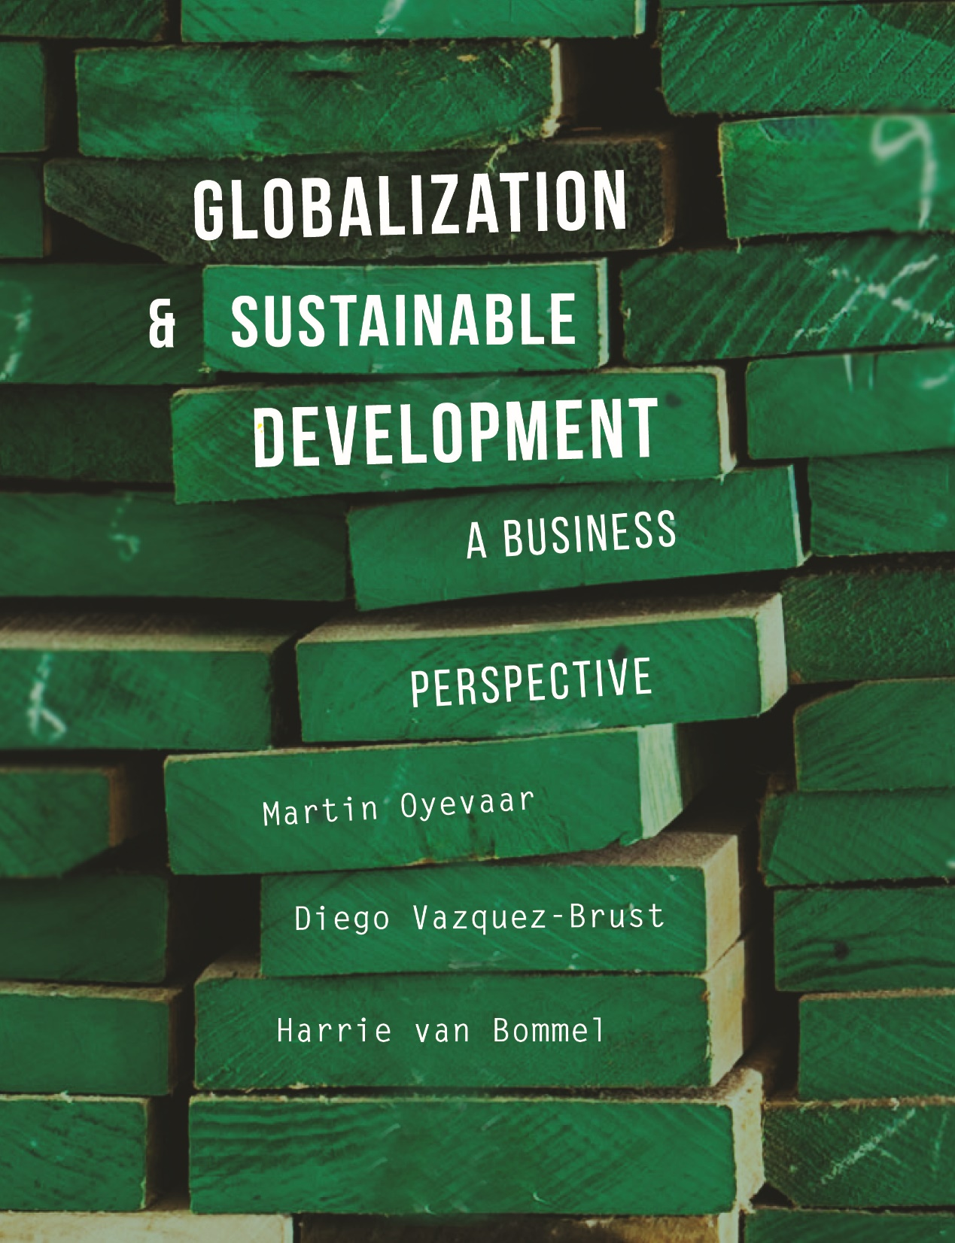

Slide 2
CHAPTER 9
Innovations in Global Supply Networks

Slide 3
Learning objectives
Understand the impact of globalization on international cooperation between businesses;
Understand the dynamics in the international supply chain and industrial network management;
Know that companies are increasingly being held responsible for the social and environmental impacts in the whole supply chain;
Know how resources and materials are managed and why and how recycling is increasing;
Understand the environmental impacts of products during their life cycle.

Slide 4
International supply chains
and
industrial network management

Slide 5
Increasing number of international supply chains
There is an increasing number of stretching international supply chains due to less trade restrictions and better transport and communications:
Optimization of source-linked business activities:
  Materials are required from the most optimal place (e.g.: coal from South Africa, bananas from Caribbean)
Optimization of footloose business activities:
  Manufacturers and services are required from the lowest cost location (e.g.: mass production in China, services such as call centres in India)
In particular, market-linked business activities (manufacturing and services which are directly related to the customer) do not easy form part of international supply chains (e.g.: health care, restaurants, sales, construction of buildings).

Slide 6
    Supply network dynamics
Supply chains are networks with many linkages between the different actors and due to globalization they become extremely complex and diverse.
Three different approaches for analysing the industrial supply networks:
1. Technological/economical approach:
  A rational approach which focuses on using materials, information and money to manage the supply chain processes in an effective way.
2. Inter-organizational approach:
  The supply network is seen as a social system and it focuses on the relation between actors (organizations and individuals) in the supply network and the way they cooperate with, stimulate and inﬂuence each other.
3. Complex systems approach:
  Supply networks emerge rather than being a result of purposeful design and in order to become successful the emergent patterns should be managed by freedom and stimulation.

Slide 7
    Supply network responsibility
Companies are increasingly being held responsible for the social and environmental impacts of their supply network, upstream and downstream.
‘Up-stream’ responsibility:
  The responsibility that an organization has for the links in early stages of the supply network.
‘Down-stream’ responsibility:
  The responsibility that an organization has for those links occurring later on.

Slide 8
Factors for supply network responsibility
Factors which inﬂuence supply network responsibility:
1. Dominance:
  Corporations with a dominant market position are increasingly held accountable for responsible behaviour;
2. Higher production complexity and diversity:
  Companies with a product that requires a large array of raw materials and parts supplied by many different manufacturers cannot provide a smooth uniformity and they must set limits on its supply network responsibility;
3. Lower production complexity and diversity:
  Companies that rely on a single or limited amount of raw materials have an easier time inﬂuencing links in the production network;
4. Mainstream:
  Enterprises operating in a mainstream market must keep in mind that by applying CSR principles, behavioural changes must be realized for large groups of suppliers, clients and consumers;
5. Niche market:
  Enterprises operating in a niche market can use CSR to get distinctive power.

Slide 9
Multinationals and supply network responsibility
For multinationals, supply network responsibility is:
An important element in developing reputation management;
Often based on a defensive strategy;
Often about developing a CSR strategy based on procurement (e.g.: improving working and environmental conditions in the preliminary production stages).

Slide 10
Balance of forces in dynamic supply networks
In the network, a focal company is inﬂuencing the whole supply network because of its position and related power.
In the network, ‘multiple’ focal companies and their individual strategies can strengthen a speciﬁc development but they can also conﬂict with and frustrate each other’s strategies.

Slide 11
Drivers for improving supply networks

Slide 12
    Applying principles of the circular economy
A circular economy is an industrial economy that is, by design or intention, restorative.
For a transition to a circular economy, it is important that the parties in the supply chain have an interest in the products that are designed:
to re-enter the biosphere safely;
for disassembly and reuse – in their entirety, or on a material/component level.
Aspects of the design of the circular economy:
Companies have an interest in hiring products rather than selling them which requires a shift towards licensing 'performance' over selling 'products‘;
Logistics is focused on forward and backward streams of products between suppliers and customers.

Slide 13
Cradle to Cradle (C2C)
Michael Braungart and William McDonough wrote a book and started a movement called ‘Cradle to Cradle’.
Principles to work on:
Closing material circles, using renewable energy and creating diversity;
Waste does not exist and waste equals food;
Create different loops for all the biodegradable and technical materials;
Design and manufacturing is focused on 100% reuse of the parts or materials can go back into one of the circles;
Avoid ‘downcycling’, because in that case materials lose value;
Strengthen position of natural sources instead of the damage control approach (= ‘eco-effectiveness’).

Slide 14
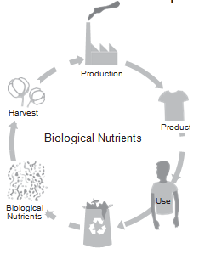
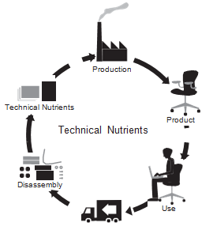
Cradle to Cradle (C2C)

Slide 15
Criticism on Cradle to Cradle as a total solution movement
Cradle to Cradle is based on disputable premises:
Unlimited growth of consumption;
Endless material recycling, which is impossible because materials disperse;
Environmental friendly transport for material ﬂows all over the world;
A paradigm shift at consumer side, because they have a relevant role in closing the loops for the different materials;
The industry is able to connect industrial material ﬂows with each other (industrial ecology).
Limited scope of Cradle to Cradle:
No focus on social sustainability in developing countries;
No focus on a solution to our energy problem.

Slide 16
Material management
Definition:
Material management is an approach to provide an unbroken flow of material in a supply chain.
Developments:
Up until now, material management was described as a method to move materials forward in the supply network (forward logistics);
The waste phase of the life cycle of products is becoming part of material management strategies;
Reverse logistics and redesign of the supply chain is recognized as one of the important ‘drivers’ for change towards the implementation of Cradle to Cradle in business.

Slide 17
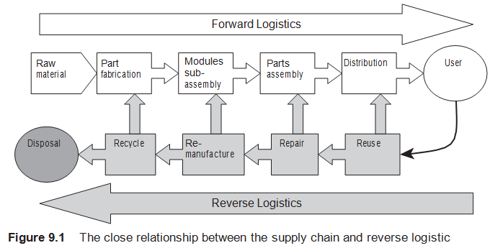
Reverse logistics
Reverse logistics concerns:
Closing the loop;
All operations related to the reuse of products and materials for the purpose of capturing value or proper disposal;
Any logistic process or management after the sale;
New business models for the circular economy to unburden the customer.

Slide 18
    New business models for sustainability
Supply networks innovations, which make use of new concepts of material management and Cradle to Cradle, often make use of new business models .
Characteristics of new business models for sustainability:
Cooperative teamwork;
Entrepreneurship is the driver for new ways of collaboration;
Time, energy, and care are deployed are exchangeable assets besides the use of money;
Economy is focused on needs and utilization;
Having access to products is preferred over owning;
Expressing long-term commitment;
Contributing to a circular and sharing economy.

Slide 19
    Some barriers and drivers for new sustainable business models
Barriers:
Societal systems (infrastructure, tax systems, labour market legal systems) are not set up for a circular economy, but for a linear economy;
The necessary paradigm shift;
Vested interests.
Drivers:
Grassroots innovation movements (community-led solutions for sustainability);
Technology.

Slide 20
Assessing sustainability of products

Slide 21
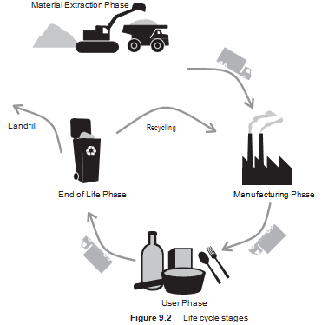
Assessment of product life cycles
The environmental performance of products should evaluate all environmental aspects during all the phases.
Analysis of trade-offs.
E.g.: A product uses less energy during the user phase, but the environmental impact during the manufacturing phase is worse.

Slide 22
    Life cycle assessment (LCA)
The analysis looks at items during the entire life cycle:
  scarcity of raw materials and their extraction plus the accompanying environmental impacts;
  transport;
  production methods;
  harmful emissions;
  waste disposal;
  environmental consequences during the product’s
  active life and disposal phase.
LCA is a useful tool for government and certifying organizations who create policy to determine which products are most suitable.

Slide 23
    Social assessment of a product life cycle
Assesses which social impact a product has on workers, consumers and local community during the life cycle stages: sourcing, manufacturing, use phase and end-of-life.
Objectives of a social impact assessment :
Measurable and visible positive and negative impacts;
Support decision-making and communication at product level;
Contribute to overall sustainability assessment.

Slide 24
Videos for students and lecturers (informative)
Suggestion for a video on YouTube, see search quote between []:
Socially Responsible Supply Chain Management: [Module 8: Socially Responsible Supply Chain Management] (W. P. Carey School of Business / 4:33 minutes)
Information in Supply chain: [Sustainability of supply chains in the age of information | Tom Pathuis | TEDxYouth@Maastricht] (TEDx Talks / 15:36 minutes)
Company information of Unilever about sustainability: [Sustainability at Unilever - The Value Chain] (Unilever / 2:26 minutes)
Information about Cradle to Cradle and upcycling: [William McDonough author of Cradle to Cradle] (chrisaotearoa / 7:18 minutes)
CEO Paul Polman of Unilever about their strategy: [A Sustainable Business Model - Business for Peace speech, Paul Polman] (Unilever / 6:11 minutes)
A statement about Five Circular Economy Business Models: [WEF 2016: Five Circular Economy Business Models – Product as a Service (Accenture / 1:24 minutes)

Slide 25
Videos for students and lecturers (informative)
Suggestion for a video on YouTube, see search quote between []:
The concept leasing to realise a circular economy: [The circular economy: from consumer to user] (Ellen MacArthur Foundation / 3:12 minutes)
Information about a sustainable alternative for Business Model Canvas: [3 Minute Introduction to Strongly Sustainable Business Model Canvas] (ssbusinessmodeltv / 4:51 minutes)
Philips Lighting about a new business concept for the product lighting: [Lighting towards a circular economy (Nick Kelso)] (PhilipsLighting / 8:58 minutes)
A more extensive introduction on circular economy: [Clarissa Morawski: The Circular Economy] (The Agenda with Steve Paikin / 15:25 minutes)
Information about Life cycle assessment: [Life Cycle Assessment as part of Strategic Sustainability for Product Design] (Autodesk / 3:04 minutes)

Slide 26
Videos for students and lecturers (informative)
Suggestion for a video on YouTube, see search quote between []:
Information about the LCA of Gore Tex Hiking boots: [Life Cycle Assessment: GORE-TEX® Footwear] (GORE-TEX® Products / 5:20 minutes)
Technical instructions making a LCA: [Life cycle assessment (LCA) example of hand dryer options, PRé Consultants by Marisa Vieira] (PRé Sustainability / 5:12 minutes)
Statements about Social Impact Assessment: [An overview of IAIA's Social Impact Assessment "What is Social Impact Assessment?"] (iaiachannel / 2:26 minutes)
A brief introduction about a Social Impact Measurement: [Social Impact Measurement (SIM) Assessment Overview]
An extensive introduction about a Social Impact Measurement: [Barbara Scheck: Social Impact Assessment] (SCE - Strascheg Center for Entrepreneurship / 15:34 minutes)

Slide 27
Videos for students and lecturers
(politically engaged)
Suggestion for a video on YouTube, see search quote between []:
Wake up call for a circular economy: [The Circular Economy | World Economic Forum] (World Economic Forum / 1:52 minutes)
The role of grassroots initiatives within the economy: [Grassroots Economy KnowledgeWorks] (KnowledgeWorks / 3:15 minutes)

Slide 28
Information Educational Resources
For more information about cases, research assignments or videos, please contact: m.oyevaar@sustainable-globalization.com

