Slide 1


Slide 2
CHAPTER 10
Corporate Social Responsibility

Slide 3
Learning objectives
Know and understand:
The historical developments of CSR;
The motives for the development of CSR;
The different labels, guidelines, standards and schemes used for CSR;
The Global Reporting Initiative;
The relevant factors for the implementation of CSR;
The criticism concerning principles of CSR.

Slide 4
Background of CSR

Slide 5
  CSR in the twentieth century
Focus on employees /direct stakeholders (< ± 1980):
For example, in the beginning of the twentieth century Philip developed a vision of an employee policy which was geared towards social issues and based on the concept of ‘enlightened self-interest’.
  E.g. A visionary housing programme in the 1920s for employees made it possible to search for motivated and disciplined workers in other parts of the country.
Focus on all stakeholders/stakeholder management (> ± 1980)
In the end of the 1980s, business increasingly realized the importance of the involvement of indirect stakeholders, such as action groups.

Slide 6
  Three licenses for business
License to sell (market orientated):
  Customers give authorization for a company to manufacture an item so long as it conforms to certain standards, such as price, technical quality and product safety.
License to produce (contract orientated)
  Authorization to produce is obtained via legislation, voting rights of ﬁnancial backers and contracts. The enterprise is directly allied to stakeholders such as employees, government and owners.
License to operate (society orientated):
  Indirect stakeholders grant the enterprise the space and recognition when social expectations are met to a satisfactory degree.

Slide 7
License to operate Shell
Reasons for Shell to develop the policy of ‘License to operate’ in the end of the 1990’s
Brent spar is the direct cause:
  Public opinion turned against oil giant Shell’s decision to purposely sink a storage tank (Brent spar) in the ocean. The decision of Shell was based on rational, methodical research and she acted ‘responsibly’ but the confrontation with society forced Shell to change direction.
Long term vision
  Shell has direct relationships with indirect stakeholders and the public debate and Shell realizes that good relations with society are an essential element of business strategy.
For videos about Shell, please see slide 28.

Slide 8
Stakeholder management
Strategy is not only determined by analysis of consumer habits, new technology, new materials and competition, but also includes consideration of the media, local residents and protest groups.
Stakeholder management implies an established relationship with direct and indirect stakeholders based on an open dialogue focused on the integration of stakeholders’ concerns within corporate practices and strategies.

Slide 9
    Corporate social responsibility orientation (CSRO) (1)
CSRO is the extent to which companies privilege particular types of responsibilities over others when making social investments.
4 types of corporate responsibilities (Archibald Carrol):
Economic (responsibility to be proﬁtable);
Legal (responsibility to obey the law);
Ethical (responsibility to act in accordance with social norms, values and moral principles);
Philanthropic (responsibility to be a good citizen).
Remarks:
The four responsibilities must be embedded in corporate behaviour and must be fulﬁlled at all times.
Criticisms on CSR are the result of failing to identify the best allocation of resources across components 1 – 4 when budgets are limited and trade-offs between components cannot be avoided.
For videos about Carroll, please see slide 28-29.

Slide 10
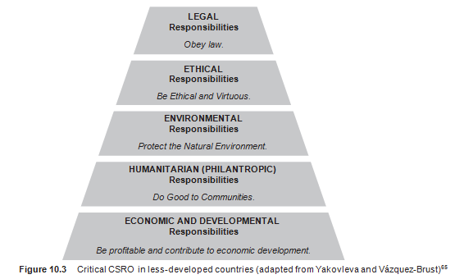
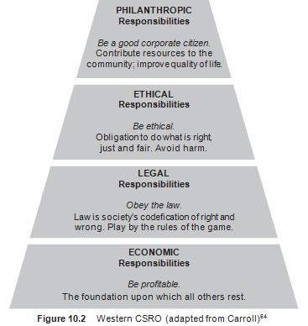
Corporate social responsibility orientation (CSRO) (2)
Pyramid for Western countries of which economic responsibilities are the foundation, followed by legal, ethical, and philanthropic at the top.
The proposed order for the pyramid components for poor countries is different, because , among others, taxes are not used efficiently due to government failure and a weak rule of law.

Slide 11
6 characteristics of CSR
Crane, Matten and Spence (2013)
  Voluntary (not forced by legislation)
  Internalizing or managing externalities
  Multiple stakeholder orientation
  Alignment of social and economic responsibilities
  Practices and values
  Beyond philanthropy

Slide 12
Society view on CSR

Slide 13
    The government tools: values and legislation
Government must play an active role in spreading the principles of society that enjoy widespread consensus, such as honesty, solidarity, thrift and involvement.
Regulation of acceptable corporate behaviour via the law does not always work positively.
It is important to involve business with values in order to implement legislation, rules and standards.
Values have an emotional connotation and they stimulate people/business to involve them in a search for solutions.

Slide 14
Corporate Social Responsibility: a tool for self regulation
The European Commission encourages enterprises to integrate CSR into their business operations and core strategy.
CSR implies that companies work voluntarily on the integration of the concern for environmental and social aspects into their daily operations in interaction with their stakeholders.

Slide 15
Discussion on self regulation of business (1)
Pro-arguments:
Companies can be expected to take sufficient responsibility for their actions.
  ‘Noblesse oblige’ or ‘mandatory nobility’
  It basically serves to make the use of power (e.g. multinationals) legitimate with the condition that the rulers are required to demonstrate moral fortitude.
Companies, specifically large companies, are dependent of the ‘license to operate’ and of their reputation.

Slide 16
Discussion on self regulation of business (2)
Counterarguments:
Only through (international) legislation, the government can exert influence on companies when it comes to issues like:
  Sale of unwanted products (e.g. fat food, expensive personal credit);
  Manipulation of consumer behaviour (e.g. sugary drinks);
  Tax avoidance via tax heavens;
  Extreme low wages via outsourcing to low income countries.

Slide 17
Labels, standards and guidelines of CSR

Slide 18
    CSR labels, standards, guidelines and initiatives (1)
Labels, standards, guidelines and initiatives could be categorized into:
  Certified versus non-certified;
  Environmental versus social;
  Product-related versus organizational;
  General versus sector speciﬁc.
For videos about labels, standards and guidelines, please see slide 29-30.

Slide 19
    CSR labels, standards, guidelines and initiatives (2)
Labels
Certified, sector specific, product-related
  E.g.: Energy labels for washing machines.
Standards
Certified, more general, organizational
  E.g.: Social Accountability SA8000 is a standard used for controlling working conditions in companies at organizational level.

Slide 20
    CSR labels, standards, guidelines and initiatives (3)
Initiatives
Non-certified, organizational
  E.g.: Fair Wear Foundation has developed programmes in the fashion industry in order to create better working conditions in the supply chain.
Guidelines
Non-certified, authorized document, more general, organizational
  E.g.: ISO 26000 is an international Guideline for CSR, published by the International Standard Organization.

Slide 21
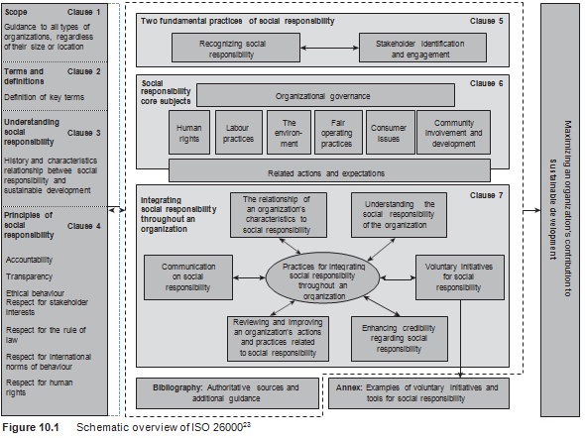
Schematic overview of ISO 26000

Slide 22
Guidelines CSR reporting (1)
The Global Reporting Initiative (GRI) provides an integral Sustainability Reporting Framework that is widely used around the world.
Criteria to enforce relevant content:
Materiality
  Information is about a relevant economic activity and its impact on environment and social territory.
Stakeholder inclusiveness
  Stakeholder inclusiveness is determined on the basis of their inﬂuence on themes and indicators for which information has been provided.

Slide 23
Guidelines CSR reporting (2)
In addition to content, information is also evaluated for quality. GRI guidelines are that they should be:
Trustworthy
  Information includes veriﬁed facts
Clarity
  Understandable for all stakeholders
Balance
  Well-balanced information with positive and negative elements
Comparability
  Easy to compare with information from previous years and similar enterprises
Accuracy
  Up to date and detailed
Timely
  Available in a reasonable period of time

Slide 24
CSR strategy

Slide 25
  Success factors of the CSR strategy (1)
Mission: Missions encourage people participation;
Community: The management model makes use of social and societal values to create a community that encourages employees;
Cooperation: Cooperate with stakeholders such as customers (e.g. product testing), suppliers (innovation) or even with volunteers (e.g. ideas, product design).

Slide 26
Success factors of the CSR strategy (2)
Transparant: Work on a trust relation with stakeholders. Trust occurs when stakeholders are informed about aspects of a company’s progress and when they are able to take stock of the development at various intervals.
Authentic: A company is stated to be authentic if its image correspond to reality.

Slide 27
CSR & Public Relations
Publicity about CSR can make a company vulnerable.
Greenwashing and window dressing can cause reputation loss of the company.
For large companies it is particularly important to have a balanced CSR publicity policy, so that there is less risk of being accused of ‘greenwashing’ or ‘window dressing’.

Slide 28
CSR and Reputation Management
Six factors are important for reputation management:
  Corporate Social Responsibility;
  Emotional attractiveness;
  Products and services;
  Finances;
  Work climate;
  Vision and leadership.
CSR policy supports reputation, but there are other inﬂuencing factors as well.

Slide 29
Limitations of corporate social responsibility
CSR concentrates on communities surrounding a multinational: it remains focused on the direct environment.
  E.g.: Only the working conditions of the employees or suppliers of a multinational improve.
Most CSR solutions cannot be scaled up to address societal challenges.
Many CSR strategies can be characterized be their reactive approach.
Many companies practice a fragmented strategy (decoupling).
  On the one hand the firm publicly endorses CSR and environmentally friendly practices.
  On the other hand, it is business as usual in its operational practices.
For many CSR strategies, the range of stakeholders engaged is limited.

Slide 30
Videos for students and lecturers (informative)
Suggestion for a video on YouTube, see search quote between []:
The impact of society (protest groups) on Shell: [Brent Spar Greenpeace vs. Shell] (Planet Film International / 4:39 minutes)
Information Shell about decommissioning a platform: [Brent decommissioning comparative assessment] (Shell / 7:20 minutes)
CSR strategy for the whole company: [What is Your CSR Strategy?] (Harvard Business School Executive Education / 2:59 minutes)
A short introduction on CSR: [Corporate Social Responsibility Strategy berkeleyexeced] (berkeleyexeced / 1:18 minutes)
Historical background CSR: [Corporate Responsibility: The American Experience -- Archie Carroll Interview] (University of St. Thomas | Minnesota / 4:51 minutes)

Slide 31
Videos for students and lecturers (informative)
Suggestion for a video on YouTube, see search quote between []:
Information about pyramid of Caroll: [Carroll and CSR] (LearnLoads / 4:44 minutes)
Critical view on CSR: [Impact of Corporate Social Responsibility] (LeBow College of Business / 4:37 minutes)
Debate CSR and Values: [Is CSR Dead? Barclays Debates 3BL Media] (3BL Media / 3:53 minutes)
Information about a label: [What does the USDA Organic label really mean?] (Michael Tapp / 2:54 minutes)
Information about ISO, in particular ISO 26000: [Importance and benefits of ISO 26000 on Social Responsibility] (GreenIngot / 37:30 minutes)

Slide 32
Videos for students and lecturers (informative)
Suggestion for a video on YouTube, see search quote between []:
Information about ISO 26000: [Launch of ISO 26000: Interview, Rob Steele, ISO Secretary-General] (ISO / 4:00 minutes)
Information about ISO 26000: [Social Responsibility and ISO 26000 Training Overview] (CBG Inc. / 8:46 minutes)
Information about the Global Reporting Initiative: [What is the Global Reporting Initiative?] (Toby Webb / 5:53 minutes)
Information about Reputation Management: [Defining Reputation Management and Why It's Important] (LeBow College of Business / 6:21 minutes)

Slide 33
Videos for students and lecturers
(politically engaged)
Suggestion for a video on YouTube, see search quote between []:
Why change the strategy into a sustainable business strategy? [Ray Anderson: The business logic of sustainability] (TED / 16:40 minutes)

Slide 34
Information Educational Resources
For more information about cases, research assignments or videos, please contact: m.oyevaar@sustainable-globalization.com

