Slide 1


Slide 2
CHAPTER 11
Globalization and Strategy Development

Slide 3
Learning objectives
Understand how globalization is becoming the working terrain for small and medium enterprises (SMEs) and social entrepreneurs;
Understand why business has good reason to focus on low income markets;
Gain insight into the external drivers for an innovative CSR strategy;
Learn to apply models for developing innovative business strategies.

Slide 4
New actors in the international economic sphere

Slide 5
Bottom up initiatives and Small and Medium Enterprises in a globalizing world
Global integration of economic environments and ICT has created new frontiers for Grassroots Movements, Social Entrepreneurship and Micro Multinationals to operate internationally and it provides new opportunities in developed and developing countries.

Slide 6
New actors in the (international) economic sphere
Grassroots innovation movements (GIMs)
  Organizations that contribute valuable plurality and reflexivity to innovation policies and politics, looking for innovation processes that are socially inclusive towards local communities in terms of the knowledge, processes and outcomes involved.
Social entrepreneurship
  Initiatives that are born out of ideals. It is aimed at social improvement with economic yields and proﬁts assuming a secondary role.
Micro Multinationals
  Small and Medium Enterprises with a maximum of 250 employees with branches spread out over several continents.

Slide 7
Drivers for CSR strategy

Slide 8
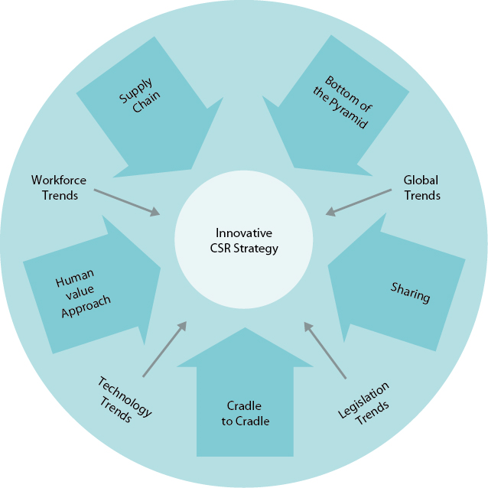
Drivers for an innovative CSR strategy
Flexible labour market, network organizations, offshoring
Individual empowerment, diffusion of power, demographic patterns, food water energy nexus
Biotechnology, nanotechnology
Legislation for environment, safety, health

Slide 9
Drivers for an innovative CSR strategy
Reverse logistics, collaboration
between chains (chapter 9)
New markets in developing countries
(slides 9)
Meaningful
work for employees
(slides 12)
Sharing goods with others, lease concept, second hand market
(slides 14)
Developing materials for technical and biological cycle (chapter 9)

Slide 10
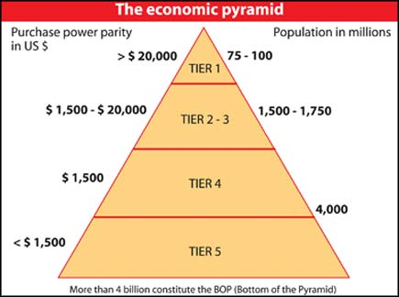
Bottom of the Pyramid
Companies searching for strategic possibilities for accessing the ‘Bottom of the Pyramid’, which is a market of four billion poor. It constitutes a huge potential market.
Offering products and services to people on the lowest rung of society asks new business concepts, so costs can reduce substantially.

Slide 11
Nine principles for Bottom of the Pyramid production
Achieving scale size and innovation directed towards structural reduction of production costs are important elements in Prahalad’s theory. This approach has led to new business initiatives worldwide.
Principles to make products available for the lowest income group:
  Create the capacity to consume (price achievement)
  Hybrid innovation
  Scale of operations
  Sustainable development
  Functionality for the BoP client
  Supply chain innovation
  Making better use of uneducated employees
  Schooling and client empowerment
  Integral approach.

Slide 12
Discussions on the Bottom of the Pyramid
Cheap products which have inferior quality and/or are not useful do not contribute to poverty reduction.
Overestimates of the indulgences and potential purchasing power of the poor can lead to the creation of artiﬁcial needs.
The private sector cannot compensate for the failure of the state and government’s role should be considered to provide essential goods for the poor.

Slide 13
Human Value Management
Human Value Management
Employees want to exploit their own abilities and manage their talents.
The value synchronization between human beings and the organization is an important starting point. The concept of ‘work for money’ assumes a secondary position. The ‘boss–employee hierarchy’ is exchanged for a ‘network relation’ with the company offering satisfaction and fulﬁlment in the workplace.
Predecessor Concept: Human Resource Management
Companies invest in employees and spend attention on education, motivation and career development.

Slide 14
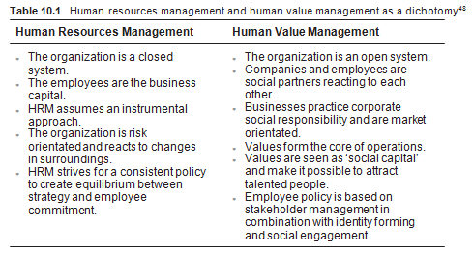
Differences between HRM and HVM

Slide 15
Sharing
The concept of ‘sharing’ is used for the development of systems aimed at redefinition of the roles of user and owner, so that the product is used more intensively.
Search directions for the concept of ‘sharing’:
ICT provides opportunities to connect users and owners, so that real-time tuning occurs and administration can be automated.

Slide 16
Sharing
Aspects of Sharing
It provides opportunities for new societal values, based on worldwide community, with responsibilities for all actors of the supply chain, including users.
Discussion:
  Can the concept of 'sharing' serve as a catalyst for elimination of consumerism, in which the economy is based on acquiring and owning goods to dump them afterwards?
Philosophy of linear liberalised market economy:
  ‘You are what you own’
Philosophy of circular economy: Philosophy:
  ‘You are what you access’

Slide 17
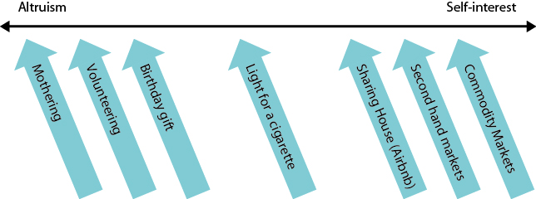
Sharing
Continuum of Sharing

Slide 18
CSR Strategy Development for innovative product concepts and new business models

Slide 19
Development of an innovative CSR strategy
Outdated technologies have to be replaced by new, sustainable ones.
Developing a new enterprise with ‘disruptive’ (positive) connotations is a complex creative process. In addition to new technology it includes redeﬁnition of markets, change in the organization and the creation of new innovations in the supply chains.

Slide 20
Greening versus Beyond Greening
Strategies for Greening | Strategies for Beyond Greening
Focus on the Existing Products Processes Suppliers Customers Shareholders | Focus on New Developments Technologies Markets Partners Needs Stakeholders
Features Stepwise Continuous improvement Rationalistic | Features Intermittent Creative Destruction Restructuring
Example Responsible Environmental care | Example Revolutionary Bio technology

Slide 21
Developing innovative business strategies
Three methods for developing a new strategy for ‘beyond greening’:
Distinctive value proposition
Expansion of scope (Stuart Hart)
Business Model Canvas (Osterwalder).

Slide 22
Innovative value proposition (1)
The innovative value proposition is directed towards client values and focuses on new markets in order to stand out from the competition (Kim and Maubrogne)
Key questions to redeﬁning the value proposition:
Which values must be weakened or diluted to a lower level than branch standards?
Which obvious branch values have to be eliminated?
Which values need to be strengthened to levels higher than branch standards?
Which values (that the branch has never offered) must be created?

Slide 23
Value proposition of Zipcar and standard rental agencies
Value Proposition | Loca-tion | Ser-vice | Pri-ce | Diffe-rent cars | Environ-ment | Proces-sing | Self manage-ment
Standard Rental agencies | 2 | 4 | 4 | 4 | 3 | 2 | 0
Zipcar | 5 | 3 | 2 | 2 | 5 | 4 | 5

Slide 24
Stuart Hart’s expansion of scope (2)
A stepwise plan to give form to future-orientated business strategy which helps managers expand their horizons and control the risks involved.
The stepwise plan depends on three stages:
Transactive links: Innovations that can only be implemented through cooperation between different sections inside and outside the supply chain;
Renewed research ﬁelds: Imagination is an important part of any breakthrough innovation;
Incubation. The incubation period is necessary for consolidation. It is irresponsible to promote radical new concepts without a planned incubation time.

Slide 25
Transactive links (A)
Search for relations to create breakthrough innovations:
Redefining relations with stakeholders;
New functions for existing and new relations in the supply chain;
New alliances with ‘fringe stakeholders’: organizations that have marginal contact with the target group, but belong to a completely different circuit.

Slide 26
Renewed research fields (B)
Search for business concepts diametrically opposed to current practices and develop new combinations of different techniques for new products/markets in relation to new transactive links.
The procedure contains the following activities:
Deﬁning research ﬁelds making use of societal and renewed technical domains such as climate change, social inequality and human rights, and engage new stakeholders;
Gathering the information from informative websites and creating a learning community to establish new knowledge and determine which target groups will beneﬁt;
Making sure managers visit places that are deemed to be the most interesting so they can understand how new products can relate to customer needs.

Slide 27
Incubation (C)
An incubation period is necessary, because different ideas are embraced, often based on conﬂicting information.
Questions for incubation period:
What are the critical success factors?
What barriers must be overcome in the target group before their needs can be converted into a purchasing pattern?
Activities for the incubation period:
Organise dialogue between (fringe) stakeholders and the line managers, product developers and technicians of the enterprise;
Appointing the task groups to perform additional research;
Conducting the tests and redeﬁne the product concepts and the new business models;
Organise horizontal and vertical information channels to keep everyone informed.

Slide 28
Business Model Canvas of Osterwalder (3)
The Business Model Canvas is a strategic business start-up template and it helps determine how the business is to be set up.
In the Business Model Canvas, the following aspects are indicated:
Delivered value proposition for the customer segments and the associated logistic and communication channels
The necessary resources, activities and key partners providing goods and services
Cost structure and revenue streams
Discussion on Business Model Canvas
  In the Business Model Canvas, CSR themes are not mentioned and the contribution to society and stakeholders is not explicitly addressed.

Slide 29
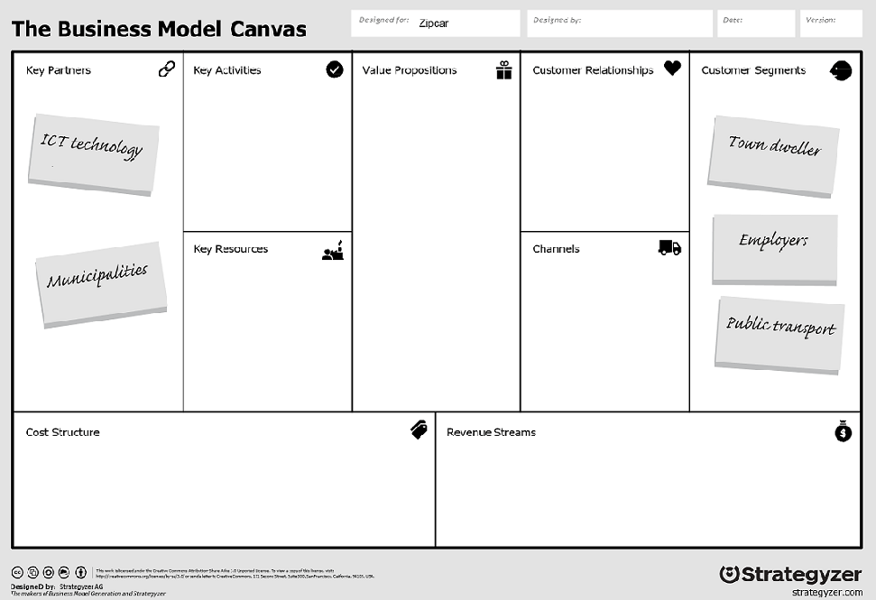
Some aspects of Zipcar in the template of Business Model Canvas

Slide 30
Videos for students and lecturers (informative)
Suggestion for a video on YouTube, see search quote between []:
Economic participation at the Bottom of the Pyramid: [Prahalad @ MSM Opportunities at Bottom of the Pyramid 1/6] (MaasSchoManage / 10:01 minutes)
Unilever’s Bottom of the Pyramid Strategy: [Chapter 7 (International Marketing and Unilever’s BOP Strategy – Marketing for Global Success)] (Darwin Dhas / 6:40 minutes)
Bottom of the Pyramid Case Jaipur Foot: [India Jaipur Foot] (VOA South Asia / 3:22 minutes)
Bottom of the Pyramid Case Microcredit: [How Microcredit Works Whole Planet Foundation] (Whole Planet Foundation / 2:51 minutes)
Bottom of the Pyramid Case Eye disease: [Aravind Eye Hospital byronetics] (byronetics / 6:08 minutes)

Slide 31
Videos for students and lecturers (informative)
Suggestion for a video on YouTube, see search quote between []:
Opinion about The Share Economy: [Who Really Wins In The Share Economy?] (AJ+ / 3:08 minutes)
Theory about Reverse Logistic: [Reverse Logistics in Circular Economy] (Surus Inversa / 2:20 minutes)
Information about Business Model Canvas Osterwalder: [Business Model Canvas Explained Strategyzer] (Strategyzer / 2:20 minutes)
Aspects of a Sustainable Strategy: [Build a Strategy for Sustainability Harvard Business Review] (Harvard Business Review / 10:27 minutes)
A short introduction on ‘Blue Ocean Strategy: [What is Blue Ocean Strategy? Blue Ocean Strategy] (Blue Ocean Strategy / 2:16 minutes)

Slide 32
Videos for students and lecturers (informative)
Suggestion for a video on YouTube, see search quote between []:
Introduction Blue Ocean Strategy: [VideoBrief: 'Blue Ocean Strategy' Business Management Book Synopsis] (bryaneye / 2:48 minutes)
How to find Blue Ocean segments: [Implementing Blue Ocean Strategy | Andi Simon] (simonassociates / 3:27 minutes)

Slide 33
Videos for students and lecturers
(politically engaged)
Suggestion for a video on YouTube, see search quote between []:
Socialism versus Market Economy: [UBER is not part of a 'sharing economy' - mike Maloney] (GoldSilver (w/ Mike Maloney) / 4:29 minutes)
The Sharing Economy and Race to the Bottom: [The sharing economy - monopolies and race to the bottom for workers] (The Aspen Institute / 2:21 minutes)

Slide 34
Information Educational Resources
For more information about cases, research assignments, videos, please contact: m.oyevaar@sustainable-globalization.com

