Slide 1


Slide 2
CHAPTER 12
The Challenge of Progress Towards Sustainable Development

Slide 3
Learning objectives
Understand that the effectiveness of managerial and administrative innovations depends on consideration of the characteristics of human nature;
Understand that institutionalizing of managerial and administrative innovations is a dynamic transition process;
Understand the factors that can speed up the transition process towards a sustainable economy.

Slide 4
Managerial and administrative innovations

Slide 5
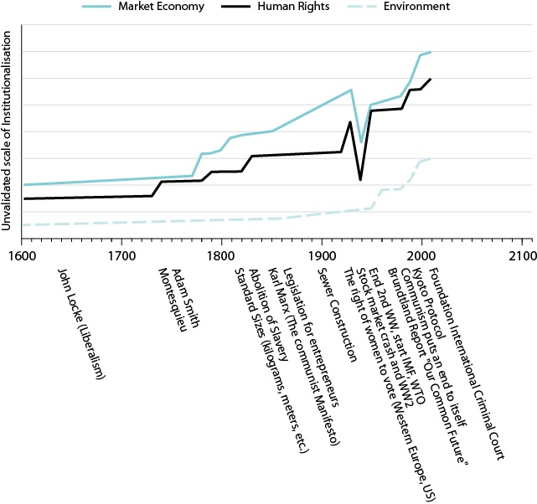
Spread of managerial innovations in the past (1)
The institutionalizing of social capital is dependent on rules that deal directly with human nature characteristics, such as:
Homo economicus
Feelings of fairness
Empathy
Exploratory impulse
Respect for authority
Status
Conformism
Aggression
Kin selection.

Slide 6
Spread of managerial innovations in the past (2)
Examples of institutionalized human nature aspects:
Market economy/property rights is based on Homo economicus
The independent court recognizes feelings of fairness
An unhealthy desire for status is limited by trias politica
Social services are based on feelings of fairness and empathy
The concept of human rights was far less prevalent in political thinking before WWII. This concept has inﬂuenced cultural traditions and changed mass values in the last 70 years (Falk, 2002).
Democracy is the institutionalized form of self-expression and freedom of choice (Inglehart and Welzel’s, 2005).

Slide 7
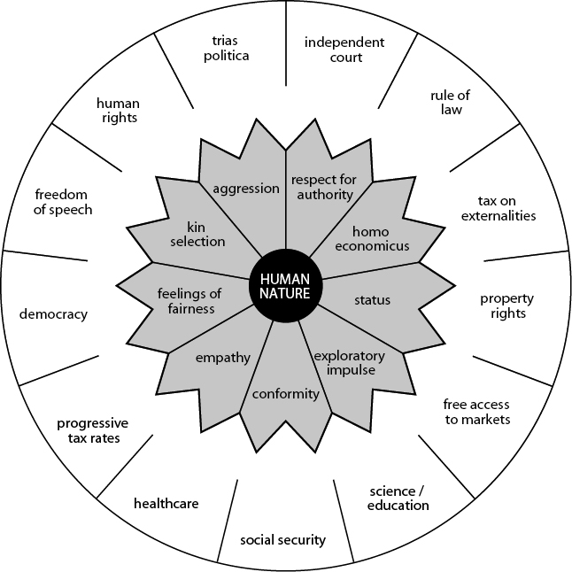
The institutionalized elements of a modern society in response to nine human nature characteristics

Slide 8
Managerial innovations nowadays
Worldwide development of the last 400 years can be partially seen as a result of the institutionalization of human rights and the market economy.
Sustainability is quite a new theme to institutionalize:
How to transform the linear market economy in a circular economy?
In what way are vested interests and managerial and administrative policies a hindrance?

Slide 9
The dynamics and multi-dimensionality of the transition to sustainable development

Slide 10
  Multi-dimensionality as prerequisite for a transition
Transition only occurs when diverse players in society become involved. Government, citizens and business are dependent on each other and need to be engaged in transitions at local, regional, national and global levels.
Societal transition is a dynamic process through which the society structurally reforms in multiple areas such as technology, production facilities, infrastructure, regulations and values.
The success of societal transition is dependent on the international context, government, civil society and business.

Slide 11
Did the Arab spring fail due to unidimensionality?
E.g. Egypt:
In Egypt, the transition from dictatorship to democracy was believed to be happening naturally with the replacement of an alleged tyrant (Hosni Mubarak) with a democratically elected leader (Mohamed Morsi), without an actual change in the power structure and countervailing institutions.
How can democracy and human rights become institutionalized in a country where its leaders have only known a system based on power struggles, mutual distrust and suppression?

Slide 12
Transition to sustainable development
The transition to sustainability searches for an answer to the tragedy of the commons.
The switch to sustainability differs from other societal transitions through the implementation of technique, with a prime example being the invention of the combustion engine which provides power for more than one billion cars worldwide.
Societies in transition are searching for new value systems while previously held values are gradually abandoned.
Transition has more to do with evolution than revolution. It creates a fundamental shift in society which will take a generation or more.

Slide 13
Multi-dimensionality of the transition to sustainable development
Statements of Tim Jackson, a member of the UK’s Sustainable Development Commission:
It is becoming evident that society will have to make some hard choices that will be more fundamental than renewing socio-technical systems.
Many governments’ attempts to achieve clean production costs with no regard for consumer lifestyle is starting to look like an untenable proposition.
The ‘myth of decoupling’ is a farce. Growth and clean production are not simultaneously possible, because the current increase in GDP is linked to a greater dependence on resources.

Slide 14
Transition to sustainability: a multi-level perspective (Geels)
Sustainability transitions is a dynamic process and its outcome is based on the interactions of three domains:
Radical technologies
  The necessary actors involved in order to adopt radical technologies, such as legislation, infrastructure, tech institutions and level of training.
Socio-technical regimes
  The existing regulations, infrastructure, businesses and organizations that provide services in areas of food supply, transport, energy, communications and consumer durables are decisive for the success of transitions.
Landscapes
  The effectiveness of the government, political system and values to deal with business and pressure groups to bring about new legislation and measurements to realise socio-technical regimes.

Slide 15
Interactions between the three domains
Radical technologies
Solar PV system
Legislation, infrastructure, tech institutions
China installed solar capacity per year per person = 21 watt
(based on 1st quarter 2016)
UK installed solar capacity per year per person = 58 watt
(2015)
Political system, economical system, values, pressure groups
One party state, market economy, pragmatic, future-oriented , environmental pressure groups are accepted
Multi-level perspective
Multi-level perspective China

Slide 16
The role of actors in the transition process

Slide 17
    Role of citizens
For a transition to occur, it is important that citizens in a society get linked to the values needed for sustainability.
Change in society is not only a question of an idea becoming widespread, but is also dependent on different groups in society approaching the problem with the same attitude.
Protest groups are important to help shatter the status quo but remains sterile if it is not connected to values that are widespread in society.
If ideas spread through different segments of society, there is an increased chance that government will turn them into legislation.

Slide 18
Role of government
New government legislation is the result of political conﬂicts based on cultural and ideological standpoints.
A government has the instruments at its disposal to speed up transition.
Society beneﬁts by implementing a stricter environmental policy. It forces companies to perform better on environmental issues.
Porter Hypothesis:
  Legislation directed towards environmental improvement acts as a trigger for environmental innovation and companies get a better competitive position with regard to waste issues.

Slide 19
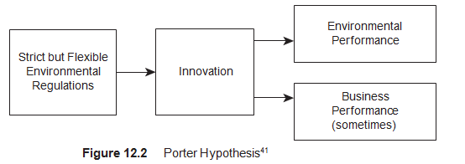
Porter Hypothesis

Slide 20
    Role of business
Business which have innovation at the heart of their core values are open to a responsibly orientated strategy (Van Bommel, 2011).
Innovative companies beneﬁt from societies that embrace transitional policy and the associated new socio-technical systems.
Innovative companies, as opposed to those reliant on vested interests, see new regulations as an opportunity.
Transition is about creative destruction and it faces resistance from ingrained vested interests.

Slide 21
Videos for students and lecturers (informative)
Suggestion for a video on YouTube, see search quote between []:
Aspects of a sustainable society: [Designing a Sustainable Society TalkingScience.org Videos] (TalkingScience.org Videos / 4:38 minutes)
A short introduction about the spreading of ideas: [IMPORTANT! Scientists Discover Tipping Point For Spread of Ideas 10 Critical Mass Change] (Debi H. / 2:59 minutes)
Lecture about the dynamics of the spreading of ideas: [Sandy Pentland: "Social Physics: How Good Ideas Spread" | Talks at Google] (Talks at Google / 54:47 minutes)
Denmark’s electric power distribution policy for the future: [Smart Grid Denmark] (energinet / 14:44 minutes)
Why does Europe need a supergrid?: [Module 2: 2050 Supergrid Mainstream Renewable Power] (Mainstream Renewable Power / 3:56 minutes)

Slide 22
Videos for students and lecturers (informative)
Suggestion for a video on YouTube, see search quote between []:
Influence of protest groups on the society: [Germany’s Grass-Roots Energy Revolution | The New York Times] (The New York Times / 6:10 minutes)
An economic transition for China: [China: An Economy in Transition] (Goldman Sachs / 5:20 minutes)
The role for business for the transition to sustainability: [Germany’s Energiewende – Good for the Environment AND Business?]
Other starting points for the design for business: [Design a Worldview for Social Impact: Terry Irwin at TEDxArtCenterCollegeOfDesign] (TEDx Talks / 18:26 minutes)
The Porter Hypothesis: [Lecture #14 by Matthew E. Kahn] (Matthew Kahn / 5:45 minutes)

Slide 23
Information Educational Resources
For more information about cases, research assignments and videos, please contact: m.oyevaar@sustainable-globalization.com

