Slide 1
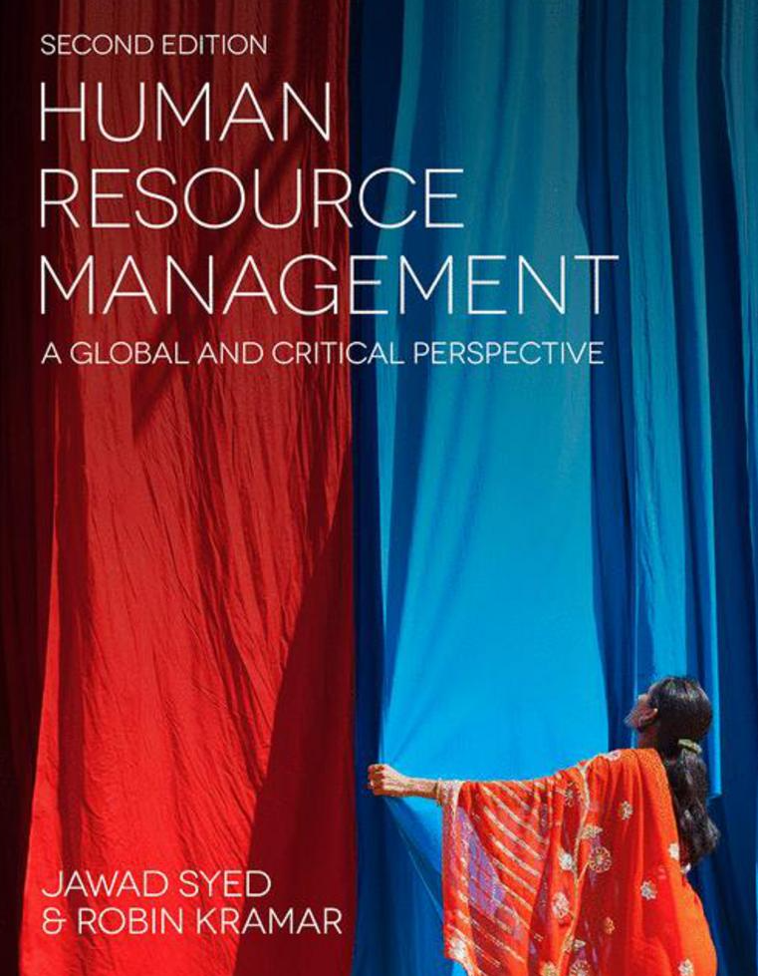

Slide 2
Chapter 1: Context-specific human resource management
HUMAN RESOURCE MANAGEMENT – a global and critical perspective (2e)
Jawad Syed

Slide 3
Learning Outcomes
After reading this chapter, you should be able to:
Understand the importance of local context and its implications for HRM.
Identify the external contexts that affect the policies and actions involved in HRM.
Learn how to design context-appropriate HRM.
Understand the pros and cons of a cross-cultural transfer of HRM practices.
Identify future directions for contextualising HRM.

Slide 4
Summary of Chapter Contents
Opening Case Study: Employees’ rights and labour disputes in China
Introduction
Contextualising HRM in a global village
Contextual influences on HRM
Critical discussion and analysis
Conclusion
For discussion and revision
Further reading
End of Chapter Case Study: HRM in Brunei’s public sector
References

Slide 5
Introduction
Background of HRM as a management concept
Lack of universal solutions for managing people
Mainstream HRM scholarship dominated by North American and Western European theorizations and empirical studies
Literature Review: Parochialism in HRM literature

Slide 6
Contextualising HRM in a global village
Context - multilayered, multidimensional, and interwoven
The concept of globalisation – merits and demerits
The concept of geographical variation in philosophy

Slide 7
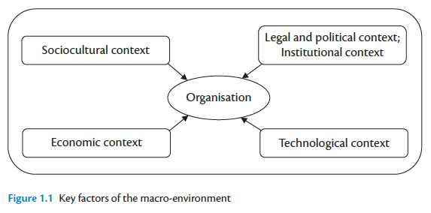
Contextual influences on HRM

Slide 8
Contextual influences on HRM
Legal and Political Factors
Economic Factors
National legislation (current and future)
International legislation
Regulatory bodies and processes
Government policies
Government term and change
Trading policies
Funding, grants and initiatives
Home market pressure groups
International pressure groups
Ecological/environmental issues
Wars and conflicts
Home economy
Trends in the economy
Overseas economies
General taxation
Taxation specific to the product/service
Seasonality issues
Market/trade cycles
Specific industry factors
Distribution trends
Customer/end-user drivers
Interest/exchange rates
International trade and monetary issues

Slide 9
Contextual influences on HRM
Sociocultural factors
Technological Factors
Lifestyle trends
Demographics (age, gender, literacy)
Language
Ethnicity/race
Religion/sect
Ethical issues
Social policy
Technology
Media views
Consumer attitudes and opinions
Company image
Fashion, brand, role models
Major events and influences
Information and communications
Development of competing technology
Associated/dependent technologies
Replacement technology/ solutions
Maturity of technology
Manufacturing maturity and capacity
Research funding
Technology legislation
Innovation potential
Intellectual property issues
Global communications

Slide 10
Critical discussion and analysis
HRM is constantly being reshaped by new economic, institutional, sociocultural, and political realities.
It is possible to link cultural traits and orientations theorised by management scholars with the observed manifestations of HRM across regions.
Importance of cultural analysis of HRM to avoid cross-cultural misunderstandings.
Industrial-organisational psychology and social work psychology, may be very useful in advancing our understanding of HRM in context.

Slide 11
Conclusion
It is imperative that contextual factors are considered when designing and operationalising HRM policies.
This chapter has demonstrated that the field of HRM will have limited value if it does not adequately take into account cultural and institutional contexts.
In this chapter, we have identified a number of elements
in the macro-level environment, that is, the sociocultural, legal, political, economic, and technological contexts, that affect HRM in different ways.

Slide 12
Further Reading
Budhwar, P. and Khatri, P. (2001) HRM in context: the applicability of HRM models in India. International Journal of Cross Cultural Management, 1(3): 333–356.
Dowling, P. J., Festing, M. and Engle, A. D. (2008) International Human Resource Management: Managing People in a Multinational Context (5th edn). London: Thomson Publishing.
Jackson, S. E. and Schuler, R. S. (1995) Understanding human resource management in the context of organizations and their environment. Annual Review of Psychology, 46: 237–264.
Kamoche, K. (2002) Introduction: Human resource management in Africa. International Journal of Human Resource Management, 13(7): 993–997.
Khatri, N. (1999) Emerging issues in strategic HRM in Singapore. International Journal of Manpower, 20(8): 516–529.
Price, A. (2007) Human Resource Management in a Business Context (3rd edn). London: Thomson Learning.
Quinn, J. B., Mintzberg, H. and James, R. M. (eds) (1988) The Strategy Process: Concepts, Context, and Cases. Englewood Cliffs, NJ: Prentice Hall International.

