Slide 2
Chapter 11: Training, development and learning
HUMAN RESOURCE MANAGEMENT – a global and critical perspective (2e)
Peter A. Murray

Slide 3
Learning Outcomes
After reading this chapter, students should be able to:
Understand the differences between training and learning.
Distinguish between the more classical approaches to training and more contemporary training and learning strategies.
Explore needs and person assessments in relation to building the human capital pool of an organisation in a global context.
Reflect on individual differences in training, development, and learning (TDL) and explore various training methods.
Apply organisational needs with performance capability matched to broader organisational and global strategies.
Analyse the relationship between knowledge and learning and ways to implement knowledge-sharing strategies.
Explore and apply different narratives in learning and their influence on performance.
Reflect on contemporary issues in learning such as digital and e-learning.
Specify how to solve training problems by analysing case study material.

Slide 4
Summary of Chapter Contents
Opening Case Study: Changying Precision Technology
Introduction
Training, development, and learning concepts
Remaking history: from training to learning
From classical to contemporary training methods
Learning for international environments
Conclusion
Further reading
End of Chapter Case Study: Ericsson

Slide 5
Introduction
Chapter discusses critical issues related to training, development, and learning
Difference between the terms
Classical vs. contemporary approaches to training
Individual vs. organisational learning

Slide 6
Training, development, and learning concepts
Training can be thought of as a kind of formal learning process
Development is tied to training since organizations want to increase the capabilities and skills
Learning is about a demonstrated change in the level of knowledge displayed by individuals

Slide 7
Remaking history: from training to learning Contrasting classical views of training
Variation in training experiences between countries
External and internal organizational factors that drive training and learning
Recent research findings that influence training outcomes
Contrast between classical and contemporary training methods

Slide 8
Remaking history: from training to learning Contrasting classical views of training
Early 1900s, emphasis on establishing apprenticeships, meeting the skills requirements for all kinds of occupational persuasion
Training and teaching for professionals was always the domain of the universities
For technical training, priority was given to supervisory and technical staff, and most teaching occurred at night.
Technical training did not extend to ordinary workers

Slide 9
Remaking history: from training to learning Needs assessment and discontinuous change
Training and learning changed fundamentally from the 1960s
Inadequate needs assessments that were poorly articulated into training strategies
Job analysis: position analysis questionnaire (PAQ)
Training needs analysis (TNA)

Slide 10
Remaking history: from training to learning Training in practice
The amount expended on training is context-specific, it varies from country to country
Training is tied to strategic business goals
Poor management practices lead to lack of practice
Shift from an employee-centred focus to a strategic focus

Slide 11
From classical to contemporary training methods
Questioning the logic of learning
The flow of learning
Cognition and behaviour
Knowledge management
Learning from narrative and reflection
Corporate social responsibility

Slide 12
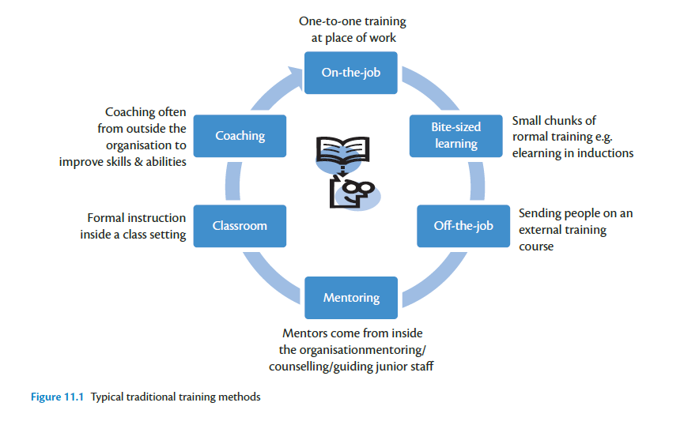

Slide 13
Social interaction in teams
Flow of learning is important
Cognition and behavior
Knowledge management
Learning from narrative and reflection
Corporate social responsibility

Slide 14
Learning for international assignments
Expatriate workers have no pressing need to be bound to their host country sources for knowledge applications
Expatriates’ experiential learning is heavily influenced by local knowledge such as local personal networks
Crosscultural adjustment does not always follow from crosscultural training
Issue of the type of training

Slide 15
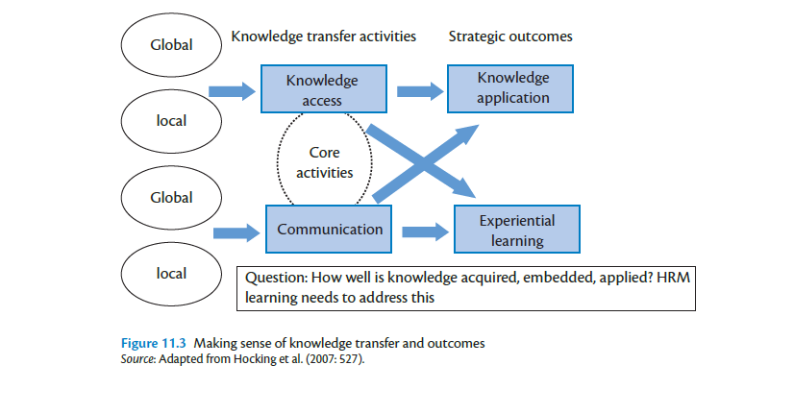

Slide 16
Conclusion
Understand the differences between training and learning
Distinguish between the more classical approaches to training and more contemporary training and learning strategies
Explore different narratives in learning and their influence on performance
Relate to various international issues of training and learning and to context-specific problems

Slide 17
Further Reading
Bingham, C. B. and Davis, J. P. (2012) Learning sequences: Their existence, effect, and evolution. Academy of Management Journal, 55(3): 611–641.
Bozkurt, O. and Mohr, A. T. (2010) Forms of cross-border mobility and social capital in multinational enterprises. Human Resource Management Journal, 21(2): 138–55.
Galagan, P. (2010) Disappearing act: the vanishing corporate classroom. Training and Development, 64(3): 29–31.
Malhotra, N. and Hinings, C. R. (2015) Unpacking continuity and change as a process of organisational transformation. Long Range Planning, 48: 1–22.
Raisch, S., Birkinshaw, J., Probst, G. and Tushman, M. L. (2009) Organisational ambidexterity: Balancing exploitation and xploration for sustained performance. Organisation Science, 20(4): 685–695.
Tarique, I. and Caligiuri, P. (2009) The role of crosscultural absorptive capacity in the effectiveness of incounty cross-cultural training. International Journal of Training and Development, 13(3): 148–164.
Tomkins, I. and Ulus, E. (2015) ‘Oh, was that “experiential learning”?!’ Spaces, synergies and surprises with Kolb’s learning cycle. Management Learning, doi: 10.1177/1350507615587451.

