Slide 2
Chapter 12: Talent management: Critical perspectives
HUMAN RESOURCE MANAGEMENT – a global and critical perspective (2e)
Stephen Swailes, Janet Handley, and Liz Rivers

Slide 3
Learning Outcomes
After reading this chapter you should be able to:
Compare and critique definitions of talent management.
Explain the differences between talent management and human resource management.
Explain the reasons for the growth of corporate interest in talent management.
Discuss rational and critical approaches to talent management.
Discuss and critique the difficulties of identifying talent fairly and reliably.

Slide 4
Summary of chapter contents
Opening Case Study: Localisation in the Gulf States
The rise of talent management
Definitions of talent and talent management
Identifying talent
Theoretical perspectives
Biasing factors
Gender and talent management
End of chapter case study: Talent identification
A case study of talent identification

Slide 5
Introduction
Talk of ‘talent’ and ‘talent management’ was uncommon before 2000, but the benefits of talented people to organisations and society had been recognised long before
Despite the heavy rhetoric about the importance of talent identification, many companies do not run talent programmes.
Factors positively influencing the adoption of talent management in multinationals:
size of the firm
whether products/services are standardised
whether the firm has a global HR approach
Whether the firm operates in relatively low technology sectors

Slide 6
Talent and talent management 1/3
What is talent?
In the context of gifted children, Howe, Davidson and Sloboda (1998) argued that talent has five properties. These include: a partly innate and genetically transmitted component, that talent is something confined to a minority, and that talents are domain-specific, for example, music or dance.
Main determinants of excellence are differences in early experiences, opportunities, training, and practice.

Slide 7
Talent and talent management 2/3
Extending this theory to organisations suggests that:
employees showing exceptional talent will make-up only a small proportion of the workforce;
employees will need ample opportunities to hone and practice their talents; and,
employees will use social capital accumulated in early life.

Slide 8
Talent and talent management 3/3
Activities and processes that involve:
the systematic identification of key positions which differentially contribute to the organisation’s sustainable competitive advantage,
the development of a talent pool of high potential and high performing incumbents to fill these roles,
and the development of a differentiated human resource architecture to facilitate filling these positions with competent incumbents and to ensure their continued commitment to the organisation.

Slide 9
Global talent management
Essentially the same philosophy and approach but applied across a much larger scale.
More complex because of the larger scale
Has to respond to an organisation’s differing strategic priorities globally and be sensitive to cross-national and regional differences

Slide 10
Inclusive talent management
In contrast to the elitist definition, inclusive talent management has been defined as, ‘the recognition and acceptance that all employees have talent together with the on-going evaluation and deployment of employees in positions that gives the best fit and opportunity (via participation) for employees to use those talents’.

Slide 11
Characteristics of Inclusive talent management
Inclusive talent management has to focus on all (or at least most) employees.
Talent in inclusive talent management in seen as an absolute characteristic of a person, not something that is relative to the talent of others.
Organisations must try to identify and deploy the unique talents of all employees. Talent deployment on a larger scale requires greater organisational willingness to rotate people through jobs as a way of helping to discover where talents are best deployed.
Where a person’s talent cannot be effectively deployed in an organisation then reasonable efforts should be made to help the individual deploy their talents elsewhere.

Slide 12
Institutionalism
Some organisations adopt talent management because others do.
Insight from institutionalism tells us that, in some sectors, talent management, which is essentially an idea about how people should be managed, is probably adopted:
to gain or maintain legitimacy;
to appear rational and normal; and
to offer something different from other organisations but also to conform with other organisations

Slide 13
Celebrity society
With constant pressure to deliver business improvements and a media hungry for stories, organisations are always looking out for success stories and individuality.
Attracting attention, making bold decisions, publicising successes, winning prizes and awards have become part of what it means to be talented.
Oversupply of information and a scarcity of attention
Talent management can be a way of helping to simplify the management of very complex situations

Slide 14
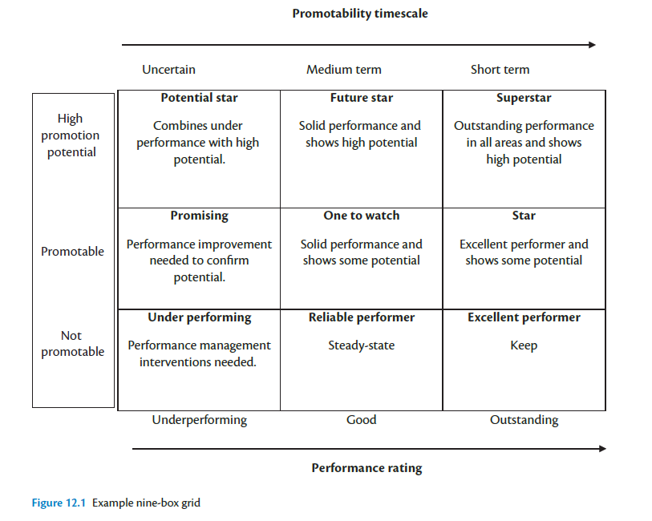
Identifying talent: Nine box grids

Slide 15
Identifying talent: Biasing factors in talent identification
Physical differences
Upward influence and liking
Gender

Slide 16
Talent identification in multinational companies
interaction of management styles emanating from the parent country and the host countries in which subsidiaries are based.
Institutional effects of host country
Factors that bias talent identification: cultural differences, similarilty with decision makers, position in network
Subsidiaries also suppress talent to keep it inside the subsidiary

Slide 17
Identifying talent: Large and fast moving economies
Particular challenge arising from the type and availability of the human capital open
Concerns centre mostly around country-level effects such as the mobility of talented people
Four basic problems:
Population growth and shifts in the working age
Specialist skills could be in short supply
The nature of work in India and China is changing, moving from labour-intensive to more capital-intensive and knowledge-based sectors
Increasing interactions will push for convergence of HR systems, including talent management

Slide 18
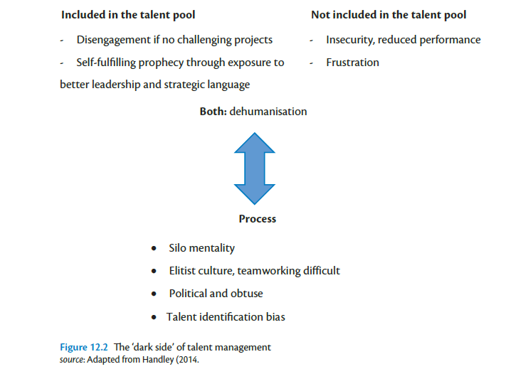
Talent Management The dark side

Slide 19
Conclusion
Talent management is an evolving and complex field, fraught with political overlays and interests.
Some organisations have explicit talent programmes; others avoid explicit programmes but maintain ‘hidden’ talent lists of staff; and others avoid the practice altogether.
The reasons why organisations adopt a particular approach are mired in assumptions about good leadership, what it looks like and how leaders should be developed
Each business sector has its own set of influencing factors
Despite the investments that many organisations make in talent programmes, their effects on business performance are not well understood.

Slide 20
Further Reading
J. (1990) Hierarchies, jobs, bodies: A theory of gendered organizations. Gender and Society, 4(2): 139–158.
Mulcahy, M. and Linehan, C. (2014) Females and precarious board positions: Further evidence of the glass cliff. British Journal of Management, 25(3): 425–438.
Farndale, E., Scullion, H. and Sparrow, P. (2010) The role of the corporate HR function in global talent management. Journal of World Business, 45: 161–168.
Tarique, I. and Schuler, R. S. (2010) Global talent management: Literature review, integrative framework and suggestions for further research. Journal of World Business, 45: 122–133.
Dries, N. (2013) The psychology of talent management: A review and research agenda. Human Resource Management Review, 23(4): 267–290.
Sparrow, P., Scullion, H. and Tarique, I. (2014) Multiple lenses on talent management: Definitions and contours of the field. In Sparrow, P., Scullion, H. and Tarique, I. (eds), Strategic Talent Management: Contemporary Issues in International Context. Cambridge: Cambridge University Press, pp. 36–69.

