Slide 2
Chapter 14: HRM, productivity, and employee involvement
HUMAN RESOURCE MANAGEMENT – a global and critical perspective (2e)
Amanda Pyman

Slide 3
Learning Outcomes
After reading this chapter, you should be able to:
Explain the link between strategic human resource management and employee involvement, and why productivity is a better measure of the impact of human resource management practices than profitability.
Define employee involvement using human resource management and employment relations lenses; identify channels used to facilitate employee involvement and their potential challenges.
Distinguish between employee involvement and employee participation.
Identify the major trends in employee involvement in Anglo-American and European countries and the major drivers of these trends.
Identify and critically discuss the objectives and effectiveness of employee involvement.
Identify good practices in employee involvement and participation for organisations, managers, employees and policy makers.

Slide 4
Summary of Chapter Contents
Opening Case Study: ‘Health and safety in the workplace’
Introduction
SHRM and employee involvement
Theories and concepts of employee involvement: Human resource management versus employment relations
Employee involvement and productivity: examples from Europe
Critical summary of employee involvement
Employee involvement in a global context: macro-environmental influences
A critical analysis of employee involvement
Benefits of studying HRM from a critical perspective for managers
Conclusion
End of Chapter Case Study: Employee involvement at Paper Co

Slide 5
Introduction
The term ‘employee voice’ has been used to cover a variety of processes and structures, including employee involvement, that enable and at times empower employeesto contribute to and/or participate in a firm’s decision-making
Within the strategic HRM (SHRM) literature, employee involvement is afforded a central role in high-commitment and high-performance work systems
High levels of involvement are linked to improved productivity
and profitability of the firm
This assumption is based on the notion that employees are a major source of competitive advantage, and thus employee involvement practices increase the stock of ideas and contributions

Slide 6
SHRM and employee involvement
Three goal domains that contribute to a firm’s viability:
productivity
flexibility
legitimacy
Superior performance equates to the attainment of
successful outcomes across all three domains.
In strategy terms, this would normally include a blend of human resource practices concerned with hiringnand developing employee skills, motivating appropriate performance and providing leadership and opportunities
Employees’ skills, commitment and satisfaction levels are performance-drivers in all firms
Labour productivity is a better measure of HRM than is profitability

Slide 7
Theories and concepts of employee involvement: HRM Vs. Employee relations 1/2
Employee involvement can be explored from a human resource management lens and/or an employment relations lens.
According to HRM theory, the rationale for employee involvement is to increase performance through individual forms such as focus groups or anopen door policy. The philosophy underpinning employee involvement is managerial or unitarist.
This lens contrasts with an organisational behaviour lens, whereby the rationale for involvement is job design through both individual and groups forms, such as teamwork and speaking up programs.The philosophy underpinning organisational behaviour is also unitarist, yet in comparison to HRM it is focused on engagement and commitment

Slide 8
Theories and concepts of employee involvement: HRM Vs. Employee relations 2/2
Given the multidisciplinary nature of employment relations, there are several different theoretical strands from which to explore employee involvement.
The first is the political science tradition whereby involvement is representative for the purpose of creating citizenship. The philosophy of involvement is therefore legalistic and rights-based
The second strand is labour process theory. Here, involvement is collective and is achieved through collective bargaining, works councils, and partnership between employers and unions. The overarching philosophy is pluralist
The final strand, transaction cost economics, entails the application of economics to employment relations. Involvement is representative, whether through union or non-union forms or a combination of the two. The philosophy is utilitarian

Slide 9
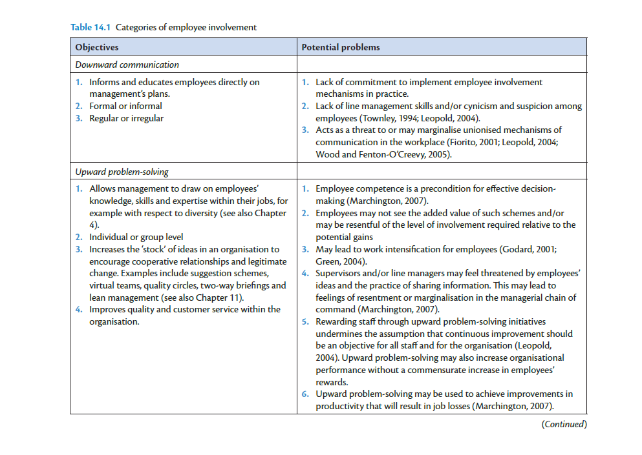

Slide 10
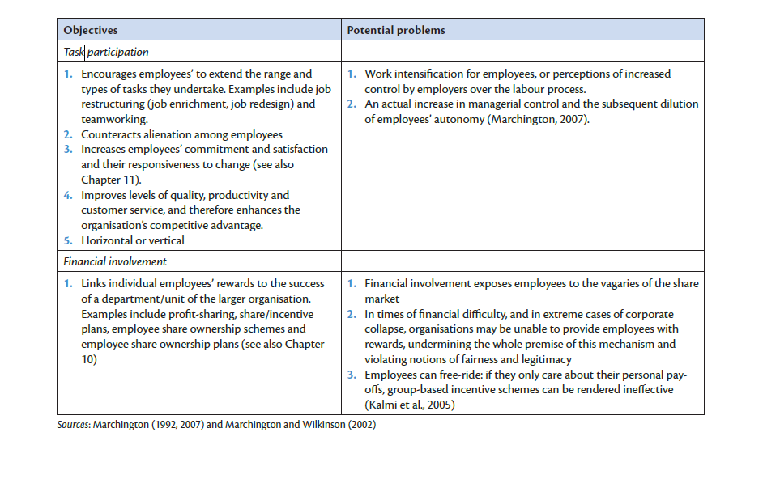

Slide 11
Employee involvement and productivity in a global context
One of the main drivers of employee involvement is increased productivity.
The notion of employee involvement leading to increased productivity is derived from the resource-based view
There has been increased interest in financial participation, profit-based pay, and employee share ownership plans in many European economies

Slide 12
Macro-environmental influences on employee involvement in the global context
The strategic goals and impact of HRM and employee involvement in a broader sense
Employee involvement relates to a range of stakeholder interests
‘Social legitimacy’ element
Macro-environmental factors that together with organisational/workplace factors shape involvement:
market influences
technology, skills and staffing levels;
structural influences
the regulatory or policy environment and financial system

Slide 13
A critical analysis of employee involvement
Potential for contradictory and competing objectives and initiatives between senior and line managers
Adverse consequences for employees’ job satisfaction, commitment and loyalty
Constantly changing and contradictory nature of employee involvement
Involvement initiatives not in themselves enough to secure favourable outcomes

Slide 14
Summary
Link between strategic human resource management and employee involvement
Employee involvement and employee participation
Trends in employee involvement
Objectives and effectiveness of employee involvement

Slide 15
Further Reading
Boxall, P. and Macky, K. (2007) High-performance work systems and organisational performance: bridging theory and practice. Asia Pacific Journal of Human Resources, 45(3): 261–70.
Boxall, P. and Macky, K. (2009) Research and theory on high-performance work systems: progressing the high involvement stream. Human Resource Management Journal, 19(1): 3–23.
Brown, M., Geddes, A. and Heywood, J. S. (2009) The determinants of employee involvement schemes: private sector Australian evidence. Economic and Industrial Democracy, 28(2): 259–91.
Budd, J., Gollan, P. and Wilkinson, A. (2010) New approaches to employee voice and participation in organizations. Human Relations, 63(3, Special Issue).
Cheng, Z. (2014) The effects of employee involvement and participation on subjective wellbeing: Evidence from urban China. Social Indicators Research, 118: 457–483.
Holland, P., Pyman, A., Cooper, B. and Teicher, J. (2011) Employee voice and job satisfaction in Australia: The centrality of direct voice. Human Resource Management, 50(1): 95–111.
Marchington, M. (2015a) The role of institutional and intermediary forces in shaping patterns of employee involvement and participation in Anglo-American countries. International Journal of Human Resource Management, 26(20): 2594–2616.
Pyman, A., Holland, P., Teicher, J. and Cooper, B. (2010) Industrial relations climate, employee voice and managerial attitudes to unions: An Australian study. British Journal of Industrial Relations, 48(2): 460–480.

