Slide 1
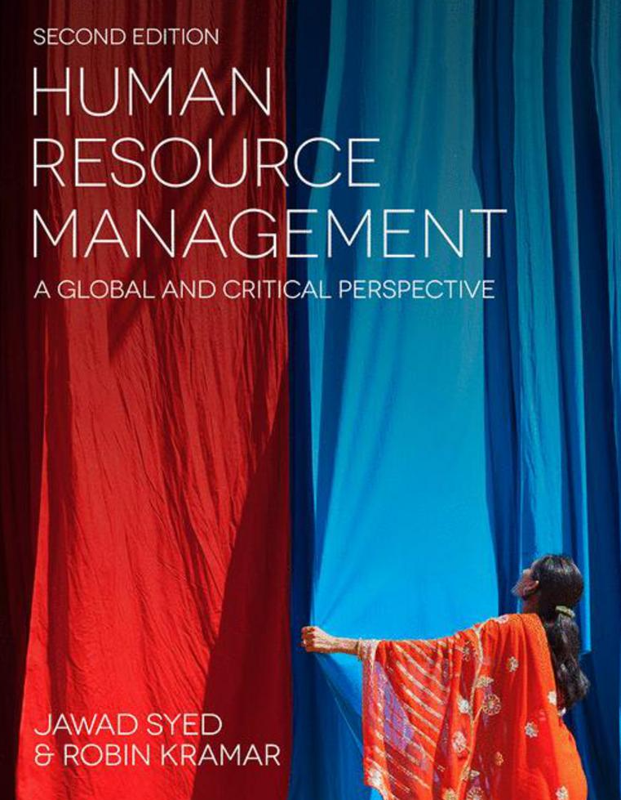

Slide 2
Chapter 15: Work-Life Balance in the Twenty-First Century
HUMAN RESOURCE MANAGEMENT – a global and critical perspective (2e)
Nicolina Kamenou-Aigbekaen and Yu Fu

Slide 3
Learning Outcomes
After reading this chapter, you should be able to
Understand the changing nature of the workplace and its effects on work–life balance in a global context.
Review the changing nature of employment in relation to issues of work–life balance for different social groups, focusing on gender, age, disability, ethnicity, religion, and sexuality.
Outline the range of work–life balance initiatives and flexible working practices.
Outline the legislative context for work and family balance, as well as key equality legislation.
Evaluate the societal and economic benefits and costs in relation to balancing work and life.
Outline key current debates on work–life balance issues in a global context
Acknowledge, and engage in debates relating to, cultural specificity and variation across countries and regions in terms of issues of work–life balance.
Critically engage with key work–life balance issues through examples, questions and an end-of-chapter case study.

Slide 4
Summary of Chapter Contents
Opening Case Study: Balancing work and life in a non-Western economy
Introduction
The changing face of employment
Work–life balance initiatives and flexible working arrangements
The legal framework
Employee wellbeing and health
International and contextual considerations in work–life balance debates
Conclusion
End of Chapter Case Study: Work and wellbeing in a Chinese multinational

Slide 5
Introduction
Global perspective, acknowledging national and cultural differences in how WLB is perceived
How flexible working arrangements are negotiated
Diverse legal frameworks and workplace practices dealing with work and employment, rights for parents, carers, etc.
Changing demographics
Aging population
Increased number of women in labor force

Slide 6
The changing face of employment: Gender
The number of women entering employment has been steadily increasing
Rise in the number of single-parent families
Women and work commitment
Statutory Gender Equality Duty in the UK
Progress in renegotiating traditional gender roles

Slide 7
The changing face of employment: Age
Increased ageing population and the issues related to the care, retirement and pensions
Increased competition for young employees
Age-related stereotypes
Legal protection against age discrimination

Slide 8
The changing face of employment: disability, sexual orientation, race
Disable people and discrimination at workplace
Disability Discrimination Act in 1995 (extended in 2005)
Challenging situation for LGBT people in employment
Employment Equality (Sexual Orientation) Regulations 2003.
Protection from race discrimination in the UK
Race Relations Act 1976 and the Race Relations (Amendment) Act 2000
WLB and factors such as race, religion and culture

Slide 9
Work-life balance initiatives and flexible working arrangements
Work outside the ‘standard’ arrangements of permanent, fixed daytime of work
Gender differences in terms of the requests for flexible working
Dangers of flexible working arrangements
There is a wide range of flexible working arrangements:
part-time work
flexible hours
job-sharing
career breaks
working from home/working remotely (teleworking)
seasonal hours
term-time work
shift-swapping
compressed working time
unpaid leave

Slide 10
The legal framework
The legal framework has been developing in the area of employment and work practices, and legislation has been a key driver for developing organisational policies on family-friendly policies
Examples of WLB related legislation in UK, EU

Slide 11
Employee health and wellbeing
Effects of long working hours on employee health and wellbeing
Increased level of stress due to long-hour work culture
Cost of inaction

Slide 12
International and contextual considerations in Work-Life balance debates
Discussion of key issues in contexts other than UK, USA and Europe, including non-Western societies such as Africa, India,and Japan
Issues facing employees, including expatriates, in multinational corporations (MNCs) around the world
Greater level of diversity

Slide 13
Conclusion
Chapter critically reviewed key WLB theories, debates, and pertinent issues.
Most WLB debates have assumed a naive view of the ‘life’
Chapter has attempted to provide a more balanced perspective on key issues.
Engaged with changing trends in the workplace, acknowledging the diversity of experiences across social groups and across regions
Examined diversity through the lens of gender, age, disability, ethnicity, religion and sexual orientation

Slide 14
Further Reading
Burke, R. J. and Cooper, C. L. (2008) The Long Hours Culture: Causes, Consequences and Choices. Bingley: Emerald Group.
CIPD (Chartered Institute of Personnel and Development) (2000) Getting the Right Work–Life Balance. London: CIPD.
Felstead, A. and Jewson, N. (1999) Global Trends in Flexible Labour. London: Macmillan Business.
Heery, E. and Salmon, J. (2000) The Insecure Workforce. London: Routledge.
Houston, D. M. (2005) Work–Life Balance in the 21st Century. Basingstoke: Palgrave Macmillan.

