Slide 1
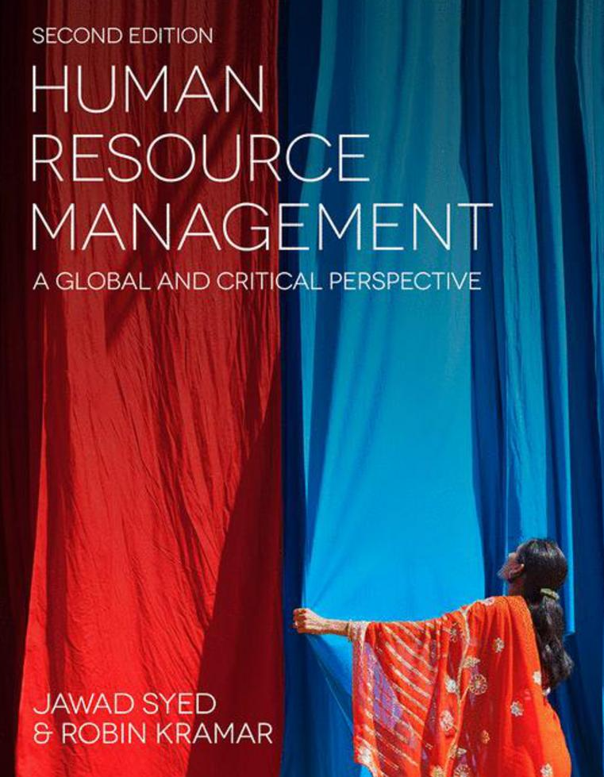

Slide 2
Chapter 16: Managing global and migrant workers
HUMAN RESOURCE MANAGEMENT – a global and critical perspective (2e)
Chris Brewster, Michael Dickmann, Liisa Mäkelä, and Vesa Suutari

Slide 3
Learning Outcomes
After reading this chapter, you will:
Understand the different forms of international work;
Be familiar with benefits and problems involved with each type of international work both from an individual and an organisational perspective;
Understand the issues involved in the management of different types of international work within international organisations.

Slide 4
Summary of Chapter Contents
Opening Case Study: Cool International
Introduction
International business travel
Short-term assignments
Assigned expatriates
Self-initiated expatriates
Global careerists
Migrant workers
Global work and the use of knowledge and networks
Work-life balance related issues facing expatriates
Conclusion
End of Chapter Case Study: Management of short-term project mobility within a Finnish company

Slide 5
Introduction
International job markets may offer increasingly interesting job options for many looking for new experiences and development opportunities
Increasing need for migrant workers, in the context of skill shortages, aging population, and decreasing fertility rates
Chapter will next discuss different forms of international work and the management of these different types of individuals within organisations

Slide 6
International business travel
International business travel has increased substantially during the past few decades due to geographically expanded markets and business networks
The objective is to provide cost control for companies and varied career opportunities for employees, since it is argued that there may be a reluctance to expatriate
There remains an un-researched, perhaps un-researchable, question about whether this is money well spent.
Business travel may not reduce costs as much as anticipated: the costs of the travel, hotels, entertaining, etc., is high in itself.
Costs are transferred from central expatriation budgets to decentralised line or project budgets, so comparisons are not easy

Slide 7
Short-term assignments
Assignments that last between a month and a year
Absence from the country for less than six months means that people stay in the taxation, social security, and pensions systems of their home base, so such assignments are much simpler to administer
Easier and cheaper travel and improvements in communications technology have made the option of short-term assignments more feasible in recent years
A frequent use of short-term assignments is by organisations that operate on a project basis
Downsides are limited and only operate in certain circumstances: for example, difficulties in building up effective relationships with local employees and customers

Slide 8
Assigned expatriates 1/2
Long-term assigned expatriates (AEs) are supported by their employers to legally work in a country outside their country-of-origin generally for a duration of more than one year
Topics explored in relation to expatriation:
demographics, personality, gender, location, remuneration, benefits, tax and social security issues, legal and labour law context, motivations to go, selection, cross-cultural adjustment, health and wellbeing, hostile environments, host teams and wider host country context, training and development, global careers, performance, repatriation and retention

Slide 9
Assigned expatriates 2/2
Reasons why expatriates are sent by their organisations to their international assignments:
controlling the MNEs’ foreign subsidiaries, coordinating softer aspects such as organisational culture, developing (and testing) the potential global leaders of the future, or simply providing expertise and staffing a position when this does not seem possible from the local labour market
Research has shown that AEs are strongly career orientated, valuing a range of developmental opportunities in relation to their job-related skills and abilities, leadership competencies, as well as the promotion prospects

Slide 10
Self-initiated expatriates (SIE) 1/2
People working in foreign countries as expatriates, who are not assigned there by their employer, and are not employed on expatriate terms and conditions, but have made their own way to the country
Since cost of moving employees with families is high, AE are usually chosen for high-level job while SIE can also be working on lower-level jobs
The SIE-population is very diverse and different groups within it have different motives for working abroad

Slide 11
Self-initiated expatriates (SIE) 2/2
The population includes early career professionals who are looking for international experience and new adventure or language skills, typically working in
lower-level jobs in local organisations.
At the other end of the career continuum, we find internationally experienced senior managers who have spent much of their career internationally and thus operate in senior management jobs

Slide 12
Global careerists
International professionals who have a succession of international jobs.
These global talents have developed an ability to apply skills and transfer knowledge quickly and efficiently and to lead foreign and cross-cultural teams and activities abroad.
Organisations need internationally experienced and mobile employees, particularly at managerial level
High mobility results in diverse skills which can be an asset for organisations but at the same time, due to high mobility such individuals are hard to retain

Slide 13
Migrant workers
In many economies, there is an increasing need for migrants, in the context of skill shortages, aging population, and decreasing fertility rates
Migrants tend to be more entrepreneurial, more active, and prepared to do unpopular jobs, which means that they are often seen as a key means to keep economies moving forward
Not necessarily a well-managed part of the global talent pool; their skills are under-utilized
May be discriminated against in selection or promotion processes or in daily management practices by supervisors, due to them being seen as different

Slide 14
Global work and the use of knowledge and networks
Individuals need to maximise their investment (and accumulation) of three forms of career capital
knowledge, skills and abilities (knowing how),
social networks (knowing whom), and
the energy and motivation that they bring into the world of work (knowing why).
Each of the three ‘knowings’ is interconnected
Transfer of knowledge upon the return of expatriates can be highly valuable

Slide 15
Work-life balance related issues facing expatriates
Movement with families
In case of moving alone, distant relationships and absence from family roles
Family reasons have been found to be among the main reasons for expatriate failure
Parental responsibilities increase the risk of work–family conflict and the risk is the most severe for mothers who travel very intensively

Slide 16
Conclusion
This chapter has explored the importance and difficulty of managing the international workforce, recognising that contextual and strategic influences will affect the strategic management of international mobility.
The different options presented here are not mutually exclusive
Clear need for more focus on and more research into all forms
Research gap in identifying the full range of international experience available within an MNE, the advantages and disadvantages for all concerned

Slide 17
Further reading
Akram, A. (ed.) (2015) Global Talent Management - Challenges, Strategies, and Opportunities. London: Springer.
Collings, D., Caligiuri, P. and Wood, G. (eds) (2015) Routledge Companion to International HRM. London: Routledge.
Dickmann, M. and Y. Baruch (2011) Global Careers. New York, Milton Park: Routledge. Global Business Travel Association. Available at: http://www.gbta.org.
Haslberger, B., Brewster, C. and Hippler, T. (2014) Managing Performance Abroad: A New Model for Understanding Expatriate Adjustment. London: Routledge.
Mäkelä, L. and Suutari, V. (eds) (2015) Work and Family Interface in the International Career Context. London: Springer.
Vaiman, V. and Haslberger, A. (eds) (2013) Managing Talent of Self-Initiated Expatriates: A Neglected Source of the Global Talent Flow. London: Palgrave Macmillan.

