Slide 1
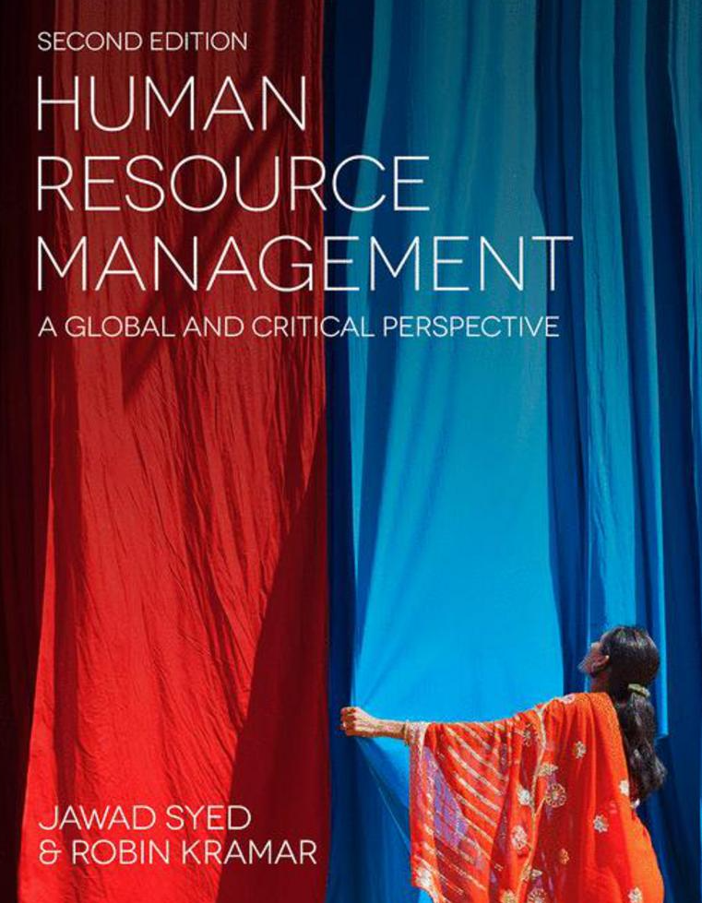

Slide 2
Chapter 2: A critical perspective on strategic human resource management
HUMAN RESOURCE MANAGEMENT – a global and critical perspective (2e)
Fida Afiouni and Dima Jamali

Slide 3
Learning outcomes
After reading this chapter, you should be able to:
Recognise recent transformations and dynamic change in the human resources management (HRM) field.
Demonstrate good knowledge of the various theoretical approaches to strategic HRM.
Discuss how human resources can be a source of sustainable competitive advantage within a global context.
Critically examine choices and contingencies in the HRM field.
Recognise the significant advances brought about by the strategic HRM paradigm, as well as lingering challenges, particularly the gap that remains between human resources policies and practices.

Slide 4
Summary of chapter contents
Opening Case Study: Boecker
Introduction
From personnel management to SHRM: An evolutionary road map
Differentiating attributes, key contributions and underlying theories
Critical analysis and discussion
Conclusion
End of Chapter Case Study: Strategic human resource management: Insights from Deloitte ME’s experience
End of chapter questions and exercise
Glossary
Further reading
References

Slide 5
Introduction
Change and evolution in the field of HRM over the past three decades
Two major transformations
From personnel management to HRM
The introduction of Strategic HRM (SHRM)
A third transformation concerning Global Talent Management (GTM)

Slide 6
From Personnel Management to SHRM: an evolutionary road map
Beginning of the twentieth century – WW-I, abundant supply of labor and Taylorism
The human relations movement
HRM – the short term focus
1990’s, globalization, competition and Strategic HRM

Slide 7
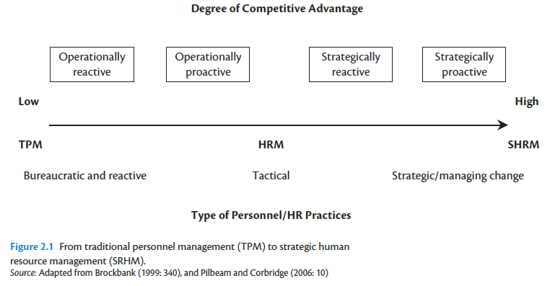

Slide 8
Differentiating attributes, key contributions and underlying theories
Human resource policies need to be integrated with each other, as well as linked to the strategies and overall direction of the organisation (Schuler and Jackson, 2007).
In essence, SHRM is more fluid, organic and strategy-driven practice and is associated with commitment-based systems of control (Guest, 1990: 152).
SHRM is therefore based on the assumption that people are not only assets but also have value-creating properties.
SHRM, Human Capital Advantage and the Resource Based View (RBV)

Slide 9
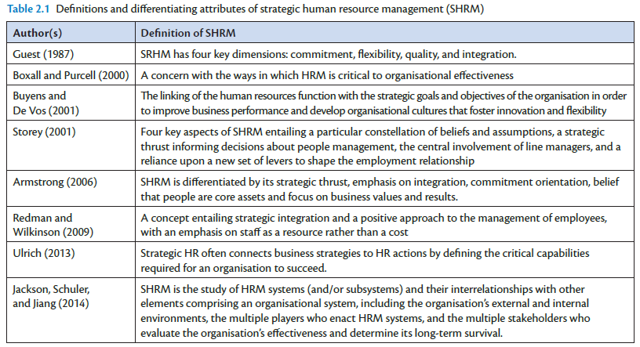

Slide 10
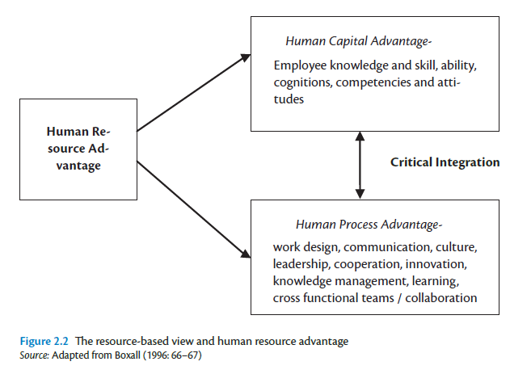

Slide 11
Differentiating attributes, key contributions and underlying theories
Human resource architecture and the strategic choice – three different modes of theorising in the field of SHRM:
the universalistic perspective;
the contingency perspective;
the configurational approach.

Slide 12
Critical analysis and discussion
Evolution of SHRM – in response to increased competition as well as a justification for the long standing debate concerning the relevance and importance of HRM function
RBV as a theoretical rationale for SHRM
Despite the appeal of the notion of universally applicable HRM practices, some problems persist:
subjectivity and a lack of agreement on a definitive prescription of the best bundle;
the implicit assumption that a particular bundle of practices is feasible for all organisations;
the way in which best practices sometimes become ends in themselves dissociated from company goals (Boxall and Purcell, 2011).

Slide 13
Conclusion
The aim of this chapter was to provide a critical assessment of SHRM, shedding light on its differentiating attributes and theoretical foundations, as well as on the lingering gaps and challenges in this field
RBV – a theoretical bridge between HRM and strategic management
RBV – the ‘how?’ question

Slide 14
Further Reading
Books
BOXALL, P. AND PURCELL, J. (2015) Strategy and Human Resource Management (4th edn). New York: Palgrave Macmillan.
SCHULER, R. AND JACKSON, S. (2007) Strategic Human Resource Management (2nd edn). Malden, MA: Blackwell Publishing.
Journals
LEGNICK-HALL, M. L., LEGNICK-HALL, C. A., ANDRADE, L. S. AND DRAKE B. (2009) Strategic human resource management: the evolution of the field. Human Resource Management Review, 19: 64–85.
PAAUWE, J. AND BOSELIE, P. (2003) Challenging ‘strategic HRM’ and the relevance of the institutional setting. Human Resource Management Journal, 13(3): 56–70.
WRIGHT, P. M., MCMAHAN, G. C. AND MCWILLIAMS, A. (1994) Human resources and sustained competitive advantage: A resource-based perspective. International Journal of Human Resource Management, 5(2): 301–326.

