Slide 1
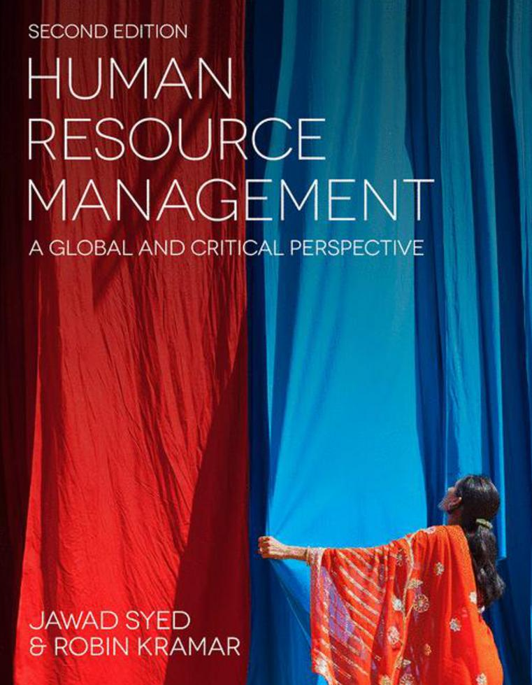

Slide 2
Chapter 3: HRM in multi-national companies – A Critical Approach
HUMAN RESOURCE MANAGEMENT – a global and critical perspective (2e)
Julie Davies

Slide 3
Learning Objectives
After reading this chapter, you should be able to:
Understand dynamic globalised contexts for MNCs, HR professionals, workers, line managers, employee representatives, and policy-makers.
Frame dilemmas and decisions using relevant theoretical concepts and models.
Discuss the behaviours and roles of transnational HRM professionals.
Reflect critically on challenges within MNCs for HR strategies and future prospects.

Slide 4
Summary of chapter contents
Opening Case Study: Banking on professional HR Integration versus differentiation, convergence v. divergence; best practice versus best fit
Are we all global now?
Critical thinking
In the news
MNCs – Benefactors or villains? Ethical issues
National culture versus dominance effect model
Influence on HR in MNCs
Developing cross-cultural skills, global HR professionals and departments
HR careers in MNCs
Behaviours of global professionals
IHRM futures
End of Chapter Case Study: Xiaoinc: An HR professional on a long-distance assignment

Slide 5
Introduction
Complexities of MNCs in comparison to domestic only firms
Challenges: multiple cultures, national systems, time zones, and different perceptions of what is ethical
Strategic HRM:
universalistic ‘best practices’ (Pfeffer, 1994), contingency
approaches (Schuler and Jackson, 1987), i.e. ‘best fit’, and
a configurational perspective,

Slide 6
HR Practices in Context

Slide 7
Integration versus differentiation, convergence, versus divergence; best practice versus best fit
Variations in staffing policies
Ethnocentric
Polycentric
Regiocentric
Geocentric

Slide 8
MNCs – Benefactors or villains? Ethical issues 1/2
Credited with:
Distribution of wealth
Creation of jobs
Create inward investment with foreign currency and economies of scale.
Increased standards and investment in R&D
Powerful in building social capital and supporting workers
Progressive HR practices in MNCs that can create family-like corporate cultures

Slide 9
MNCs – Benefactors or villains? Ethical issues 1/2
Criticised for:
Acting as monopolies, exploiting customers
Disregarding human rights
Treating employees as slaves
Harming communities and the environment
Squeezing out local businesses
Evading taxes

Slide 10
National culture versus dominance effect model
HR practices adapted or localised?
The national culture model
Dominance effect model
MNCs must balance institutional tensions between
the push of transferring and localising home HRM practices and
pull of host-country HRM.

Slide 11
Developing cross - Cultural skills and global HR professionals and departments
Convergence theory
Divergence theory
Cross-vergence

Slide 12
Final Thoughts
HRM in MNCs: multifaceted and challenging
Problems in power asymmetries and multicultural working
Differences in national institutions and sensitivities.
These demands require open systems and mind-sets and a willingness to change.

Slide 13
Further Reading
Cerdin, J. L. and Selmer, J. (2014) Who is a self-initiated expatriate? Towards conceptual clarity of a common notion. International Journal of Human Resource Management, 25: 1281–1301.
Collings, D. G., Wood, G. T. and Caligiuri, P. M. (2014) (eds) The Routledge Companion to International Human Resource Management. Abingdon: Routledge.
Cooke, F. L. (2009) A decade of transformation of HRM in China: A review of literature and suggestion for future studies. Asia Pacific Journal of Human Resources, 47(6): 6–40.
Deloitte (2011) Global Business Driven HR Transformation. London: Deloitte. http://www2.deloitte.com/content/dam/Deloitte/de/Documents/human-capital/ global-business-driven-hr-transformation.pdf.
Deloitte University Press (2015) Global Human Capital Trends 2015: Leading in the New World of Work. Deloitte University Press: Westlake, TX. http://www2.deloitte. com/content/dam/Deloitte/at/Documents/humancapital/ hc-trends-2015.pdf.
Dickmann, M. (2015) Models of international HRM. In
Wiley Encyclopedia of Management (3rd edn). Hoboken, NJ: John Wiley & Sons, 5: 1–3.

Slide 14
Further Reading
Harzing, A.-W. and Penningon, A. (2014) (eds) International Human Resource Management. London: Sage.
Hayton, J. C. (2012) Global Human Resource Management Casebook. New York and London: Routledge.
Horwitz, F. (2015) Human resources management in multinational companies in Africa: A systematic literature review. International Journal of Human Resource Management, 26: 2786–2809.
Horwitz, F. and Budhwar, P. (2015) (eds) Handbook of Human Resource Management in Emerging Markets. Cheltenham: Edward Elgar.
Kamoche, K., Yaw, D., Horwitz, F. and Muuka, G. N. (2004) (eds) Managing Human Resources in Africa. New York and London: Routledge.
Purcell, J. (1999) Best practice and best fit: Chimera or cul-de-sac? Human Resource Management Journal, 9(3): 26–41.
Tarique, I., Briscoe, D. and Schuler, R. (2015) International Human Resource Management: Policies and Practices for Multinational Enterprises (5th edn). New York and London: Routledge.
Xing, Y., Liu, Y., Tarba, S. Y. and Cooper, C. L. (2014) Intercultural influences on managing African employees of Chinese firms in Africa: Chinese managers’ HRM practices. International Business Review, 25: 28–41.

