Slide 2
Chapter 4: Diversity management in a global context
HUMAN RESOURCE MANAGEMENT – a global and critical perspective (2e)
Nicolina Kamenou-Aigbekaen and Jawad Syed

Slide 3
Learning Outcomes
After reading this chapter, you should be able to:
Understand and distinguish between diversity management and equal employment opportunity.
Understand how demographic transformation of the population and the workforce affects the future of
diversity
management in the workplace.
Understand various forms of employment stereotypes and discrimination.
Know about various laws and regulations in place in several countries to tackle workplace discrimination.
Distinguish between the business case and social equity approaches to diversity management.
Understand methodological considerations in diversity management research.

Slide 4
Summary of Chapter Contents
Opening Case Study: Oscars so white
Introduction
Key concepts of diversity management
The diversity management discourse and its limitations
A relational framework for diversity management
Advantages of diversity
From positive discrimination to positive action
Strategies to manage diversity
Methodological considerations in conducting research on diversity management:
the case of ethnic minority women
Conclusion
End of Chapter Case Study: Samina’s career experiences in different contexts: UK and the Middle East
References

Slide 5
Introduction
Managing diversity and equal opportunities in employment
Employment discrimination
Diversity of labour force and stereotyping in organisations

Slide 6
Key concepts of diversity management
Business case for diversity – the benefits of diversity management
Legal concerns
Limited academic attention

Slide 7
The diversity management discourse and its limitations
‘equal employment opportunity’ (EEO), ‘affirmative action’ and ‘diversity management’
the emphasis of EEO on eliminating discrimination in human resources policies and practices;
the emphasis of affirmative action on equality of outcomes;
the emphasis of diversity management on the inclusion of all forms of diversity and business outcomes.
Diversity management: alternate approach to affirmative action because the realities facing organisations were ‘no longer the realities affirmative action was designed to fix’

Slide 8
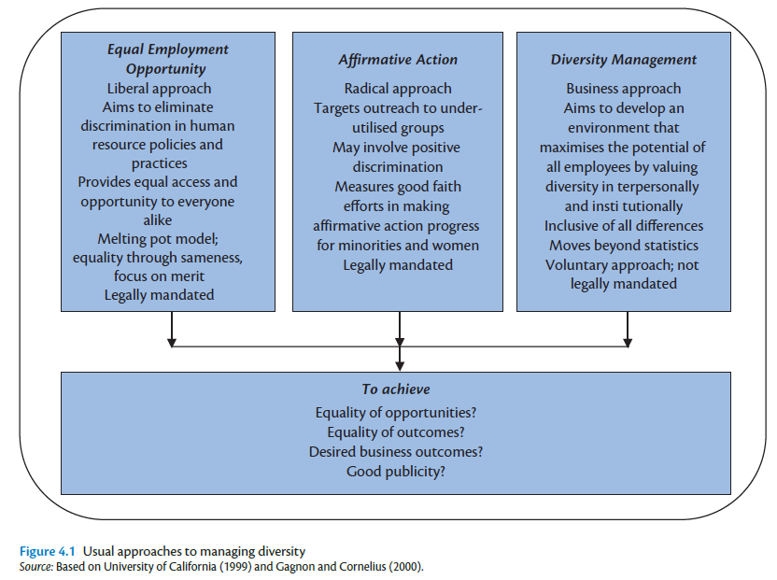

Slide 9
A relational framework for diversity management
The macro-national level
The meso-organisational level
The micro-individual level

Slide 10
Advantages of Diversity
Cost
Turnover costs
Absenteeism costs
Problem solving and system flexibility
Understanding of multiple cultures

Slide 11
From positive discrimination to positive action
Positive discrimination (affirmative action) not legal in many countries because it violates
Merit
equality
Positive action
non-discriminatory selection procedures and training programmes
Policies aimed at preventing sexual harassment.

Slide 12
Sexual harassment at work
Form of bullying or abuse (physical or psychological)
Costs:
Hostile work environment
Adverse employment decisions
Key legal concern
Cultural factors that influence policy implementation:
dentifies
sociocultural factors (e.g. female modesty),
Institutional factors (e.g. inappropriate redress procedures),
and managerial expertise/bias.

Slide 13
Strategies to manage diversity
Leadership commitment
Diversity as part of an organisation’s strategic plan
Diversity linked to performance
Measurement
Accountability
Succession planning
Recruitment
Employee involvement
Diversity training

Slide 14
Methodological considerations
The ethno-centric feminist ideology
The feminist methodology
Ethnographic research
Standpoint approach

Slide 15
Conclusion
Ongoing demographic transformation of workforce and the general population has immense implications for the future of HRM, including diversity management
Chapter criticised usual organisation-focused approaches to diversity management and instead argued for a multilevel approach to diversity

Slide 16
Further Reading
Books:
Anthias, F. And Yuval-Davis, N. (1992) Racialised Boundaries: Race, Nation, Gender, Colour and Class and the Anti-racist Struggle. London: Routledge.
Bell, M. (2007) Diversity in Organizations. Mason, OH: Thomson/South-Western.
Bhavnani, R. (1994) Black Women in the Labour Market: A Research Review. London: Organisation Development Centre, City University.
Blaine, B. E. (2007) Understanding the Psychology of Diversity. London: Sage.
Davidson, M. J. (1997) The Black and Ethnic Minority Woman Manager: Cracking the Concrete Ceiling. London: Paul Chapman.
Harvey, C. and Allard, m. J. (eds) (2005) Understanding and Managing Diversity: Readings, Cases, and Exercises (3rd edn). New York: Prentice Hall.
Konrad, A., Prasad, P. And Pringle, J. (eds) (2006) Handbook of Workplace Diversity. London: Sage.
Modood, T., Berthoud, R., Lakey, J., Nazroo, J., Smith, P., Virdee, S. and Beishon, S. (1997) Ethnic Minorities in Britain: Diversity and Disadvantage. Fourth National Survey on Ethnic Minorities. London: Policy Studies Institute.
Özbilgin, M. (2009) Equality, Diversity and Inclusion at Work: A Research Companion. Cheltenham: Edward Elgar.
Özbilgin, M. And Syed, J. (eds) (2010) Managing Cultural Diversity in Asia: A Research Companion. Cheltenham: Edward Elgar.
Özbilgin, M. And Tatli, A. (2008) Global Diversity Management: An Evidence-Based Approach. New York: Palgrave Macmillan.

Slide 17
Further Reading
Journals
Amos, V. and Parmar, P. (1984) Challenging imperial feminism. Feminist Review, 17: 3–20. fearfull, a. and kamenou, n. (2006) How do you account for it? A critical exploration of career opportunities for and experiences of ethnic minority women. Critical Perspectiveson Accounting, 17(7): 883–901.
Kamenou, N. (2008) Reconsidering work–life balance debates: challenging limited understandings of the ‘life’ component in the context of ethnic minority women’s experiences. British Journal of Management, Special Issue on Gender in Management: New Theoretical Perspectives, 19: S99–S109.
Mcguire, G. M. (2000) Gender, race, ethnicity and networks: The factors affecting the status of employees’ network members. Work and Occupations, 27: 500–523.
Mcguire, G. M. (2002) Gender, race and the shadow structure: A study of informal networks and inequality in a work organization. Gender and Society, 16(3): 303–322.

