Slide 1
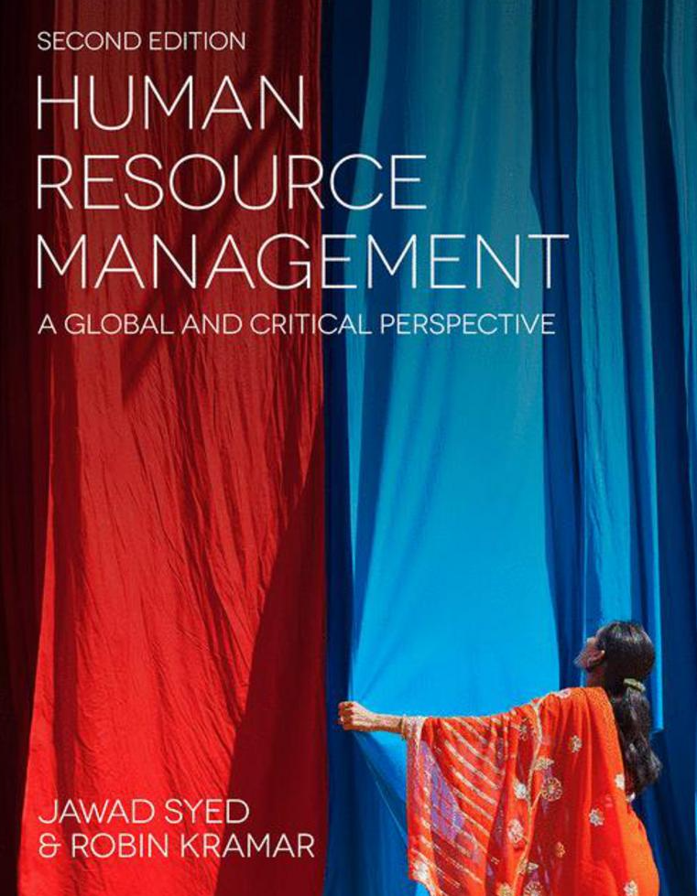

Slide 2
Chapter 5: HRM, ethics, and corporate social responsibility
HUMAN RESOURCE MANAGEMENT – a global and critical perspective (2e)
Tracy Wilcox and Diannah Lowry

Slide 3
Learning Objectives
After reading this chapter, you should be able to:
Understand why and how human resources activities have an ethical dimension and identify various ethical
issues in contemporary human resource management activities.
Recognise the connections among ethical human resources practices, corporate social responsibility, and ethical
global business operations.
Describe the key features of ethical thinking in the context of ethics, business, and human resources.
Recognise some of the various ethical frameworks that can apply to human resources in a global context.
Distinguish between ethical relativism and ethical pluralism.
Describe some of the features of critical business ethics.

Slide 4
Summary of chapter contents
Opening Case Study: ‘Ethics and HR practices’
Introduction
Ethics and human resources
Critical thinking and ethics
Ethical thinking and behaviour
Ethical theories and frameworks
Corporate social responsibility and HRM
Critical business ethics: The problem of being ‘charmed’
Where to next? Ethics in practice
Conclusion
End of Chapter Case Study: ‘Amazon’s brutal workplace is an indicator of an inhumane economy’

Slide 5
Introduction
Ethical considerations emerge in most of areas of human resource management (HRM) practice
Relationships between business and society
Implicit notions of trust, responsibility, rights, duties and authority
Global business activities and ethics

Slide 6
Ethics and Human Resources
Defining ethics
Ethics as moral philosophy
Ethical reasoning involves an evaluation of a situation and its context
Ethical issues may arise at
Individual level
Organizational level
Macro national level

Slide 7
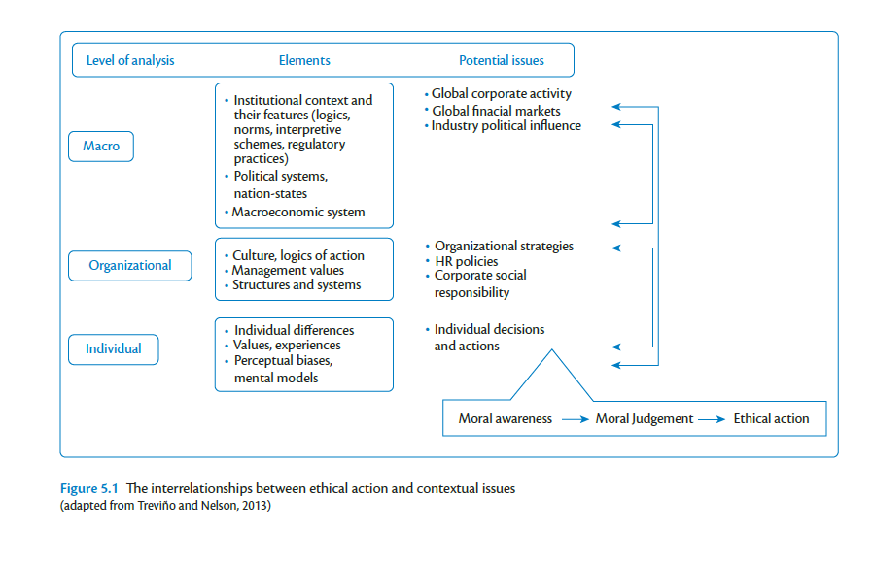

Slide 8
Ethical thinking and behavior
The three interrelated elements of ethical practice are :
moral awareness – recognising the existence of an ethical dilemma;
moral judgement – deciding what is right;
ethical behaviour – taking action to do the right thing

Slide 9
Ethical theories and frameworks Consequences of actions (consequentialism)
Considering the consequences (both intended and unintended) of decisions
Teleology – end or purpose
Decision on action considering consequences
Utilitarianism – maximum utility
This approach is appropriate when working through complex issues with multiple stakeholders

Slide 10
Ethical theories and frameworks Deontological principles
Non-consequentialism
Judge actions as right or wrong in themselves
Universal and duty-based principles for everyone
Religious ethics as an example
Kant’s framework of ethical decision-making

Slide 11
Ethical theories and frameworks: virtues
Ethics are practiced as human virtues
Who ought we become?
Association with the ideas of the ancient Greek philosopher Aristotle, and religious thinkers
There are number of various virtues to be followed such as honesty, generosity and courage etc.
Virtues can contradict each other

Slide 12
Ethical theories and frameworks: care ethics
Deals with recognition of, and responsiveness to, others’ wellbeing needs.
The practice of care specifically involves:
caring about – a recognition of another’s need, which is a form of moral awareness;
taking care of – acting when care is needed, entailing a sense of responsibility;
care-giving – ensuring that care needs are met, entailing both empathy and competence;
care-receiving – the interaction between the carer and the recipient, entailing responsiveness and receptiveness

Slide 13
Corporate social responsibility and human resource management
Definition of CSR
CSR and HRM – socially responsible HRM practices
Strategies for socially responsible HRM
CSR-HRM relation: the political aspects

Slide 14
Critical business ethics: an anti-essentialist view
Ethics can be conceived in many different ways.
The essence of business ethics is not hiding waiting to be found, nor is it found in a clear code of rules prescribing specific forms of ethical behaviour
Ethics is not something that we can approach directly or something that is easy to represent, but neither should we deny that it is important, or give up because minor royalty are confidently telling us what is in the box.

Slide 15
Where to next? Ethics in practice
What is it that is ethically (or morally) wrong about the situation? What has triggered your conscience?
When you apply your ethical reasoning to the situation, what will you think is the proper course of action?
What are the demands and expectations that other stakeholders in the situation wish to impose?
What, in practical terms, should be done about it, given all the constraints and complexities of the ‘real’ world? What are the options for action?

Slide 16
Summary
There is the need, and potential, for ethical human resources practices
Are ethical human resources practices and outcomes possible or simply quixotic musings?
Acting ethically is not easy
Organisations should ‘strive for the good’

Slide 17
Further reading
Bolton, S. C. and Houlihan, M. (2007) Searching for the Human in Human Resource Management: Theory, Practice and Workplace Contexts. Basingstoke: Palgrave Macmillan.
Crane, A., Matten, D. and Spence L. (2013) Corporate Social Responsibility: Readings and Cases in a Global Context (2nd edn.). Abingdon: Routledge
Grace, D. and Cohen, S. (2013) Business Ethics (5th edn). Oxford: Oxford University Press.
Jones, C., Parker, M. and Ten Bos, M. (2005) For Business Ethics. London: Routledge.
Pinnington, A., Macklin, R. and Campbell, T. (2007) Human Resource Management: Ethics and Employment. Oxford: Oxford University Press.
Preston, N. (2014) Understanding Ethics (3rd edn). Sydney: Federation Press.
Treviño, L. K. and Nelson, K. A. (2013) Managing Business Ethics: Straight Talk About How to Do It Right (6th edn). Hoboken, NJ: Wiley.
Winstanley, D. and Woodall, J. (2000) Ethical Issues in Contemporary Human Resource Management. Basingstoke: Macmillan.

