Slide 1
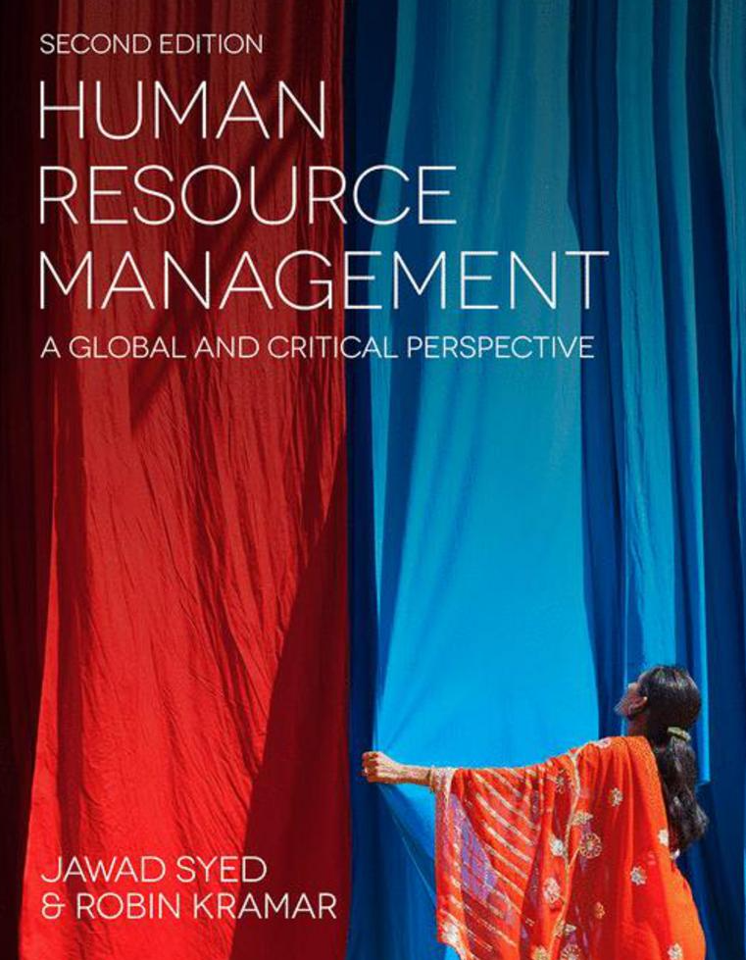

Slide 2
Chapter 5: Human resources planning
HUMAN RESOURCE MANAGEMENT – a global and critical perspective (2e)
Cathy Sheehan

Slide 3
Learning Outcomes
After reading this chapter, you should be able to:
Discuss the rise of human resource planning (HRP) as a strategic priority.
Explain the techniques associated with forecasting the supply and demand of human resources.
Outline the role of job analysis in the HRP process.
Describe and analyse the impact of restructuring on HRP responses.
Explain the role of HRP in talent management.
Discuss international HRP considerations.

Slide 4
Summary of Chapter Contents
Opening Case Study: Offshoring in the banking industry
Introduction
Approaches to HRP
The strategic role of HRP
Meeting human resource planning challenges through flexibility
Conclusion
End of Chapter Case Study: Play Smart Toys

Slide 5
Introduction
Purpose of this chapter:
To broadly review approaches to HRP
To critically analyse some of the strategic responses to issues associated with the supply and demand of labour.
Chapter starts with a discussion of the emerging recognition of the strategic importance of this area.
Techniques for HRP are explored

Slide 6
Approaches to HRP: The evolution of HRP
Changes in the international labour market pose particular challenges for the human HRM function
HRP is a dynamic process effected by predictable and unpredictable forces
Change from manufacturing sector to services sector
Changed expectations of type of worker who is in demand
From regulatory role to strategic competitive advantage

Slide 7
Approaches to HRP: Techniques of HRP
Demand forecasting in HRM determines the quantity and quality of employees required to meet goals.
Forecasts are usually associated with particular job categories and skill areas.
Quantitative demand forecasting
Qualitative demand forecasting
Supply foecasting

Slide 8
Approaches to HRP: Job analysis
Refines information regarding labour requirements
Process of getting detailed information about the job
List of knowledge, skills and abilities
Common methods include:
Observation
Interviews
Diaries
Critical incident reports
The process can be complicated due to changing nature of environment

Slide 9
The strategic role of HRP: Restructuring and downsizing
Technology and market changes
Workforce reduction, increased level of efficiency
Human reactions to downsizing
Downsizing survivors issues
Effective execution and management of reduction initiative is necessary

Slide 10
The strategic role of HRP: Ethical factors in downsizing
Not a morally neutral event
Effects on firm reputation and financial performance
Downsizing vs. downscoping
How the process is carried out

Slide 11
Meeting human resource planning challenges through flexibility
HRP and environmental factors
Core and the periphery workforce
Functional flexibility
Numerical flexibility
Financial flexibility
Procedural flexibility
Problems related to flexibility
Shift to non-standard forms of work

Slide 12
Meeting human resource planning challenges through flexibility: Talent Management
Vaiman and Vance (2008: 3–4) define talent as including ‘all of the employed people within an organization who may differ dramatically in levels of knowledge, skill and ability.’
Competence, skills and values with commitment and contribution
Value of talent and HRM approaches
Measuring employee-focused HRM

Slide 13
Meeting human resource planning challenges through flexibility: International Considerations
Complexities involved in sourcing labour from international sites:
Idiosyncratic nature of tasks
Lack of maturity in the newly developing offshoring market
Need for additional monitoring

Slide 14
Conclusion
Overview of technical approaches to HRP
Discussion of some of the strategic challenges that are now being incorporated into HRP thinking
External forces and recognition of employee resourcing
Changes in the flexibility of work organization
Flexibility of work organisations

Slide 15
Further Reading
Berger, L. A. and Berger, D. R. (2011), The Talent Management Handbook: Creating a Sustainable Competitive Advantage by Selecting, Developing, and Promoting the Best People (2nd edn). New York: McGraw-Hill.
Boxall, P. and Purcell, J. (2011) Strategy and Human Resource Management. Basingstoke: Palgrave Macmillan.
Caplan, J. (2011) The Value of Talent: Promoting Talent Management Across the Organization. London: Kogan Page.
Cascio, W. (2010) Managing Human Resources: Productivity, Quality of Work Life, Profits. Boston: McGraw-Hill/Irwin.
Delahaye, B. (2011) Human Resource Development: Managing Learning and Knowledge Capital. Prahran: Tilde University Press.
Guest, D. (2004) Flexible employment contracts, the psychological contract and employment outcomes: An analysis and review of the evidence. International Journal of Management Reviews, 5/6(1): 1–19.
Grant, R. (2003) Strategic planning in a turbulent environment: evidence from the oil majors. Strategic Management Journal, 24(6): 491–517.

Slide 16
Further Reading
Hartel, C. E. J., Fujimoto, Y., Strybosch, V. E. and Fitzpatrick, K. (2007) Human Resource Management. Transforming Theory into Innovative Practice. French’s Forest, NSW: Pearson.
Kramar, R., Bartram, T., De Cieri, H., Hoe, R., Hollenbeck, J., Gerhart, B. and Wright, P. (2010) Human Resource Management in Australia (4th edn). Sydney: McGraw-Hill.
Lepak, D. and Snell, S. (2002) Examining the human resource architecture: The relationships among human capital, employment and human resource configurations. Journal of Management, 28(4): 517–543.
Teicher, J., Holland, P. and Gough, R. (eds) (2006) Employee Relations Management: Australia in a Global Context (2nd edn). Frenchs Forest, NSW: Prentice Hall.
Tsui, A., Pearce, J., Porter, L. and Hite, J. (1995) Alternative approaches to the employee-organizational relationship: Does investment in employees pay off? Academy of Management Journal, 44: 1089–10121.
Withers, M., Williamson, M. and Reddington, M. (2010) Transforming HR: Creating Value Through People (2nd edn). Amsterdam: Butterworth-Heinemann.ENDFR

