Slide 1
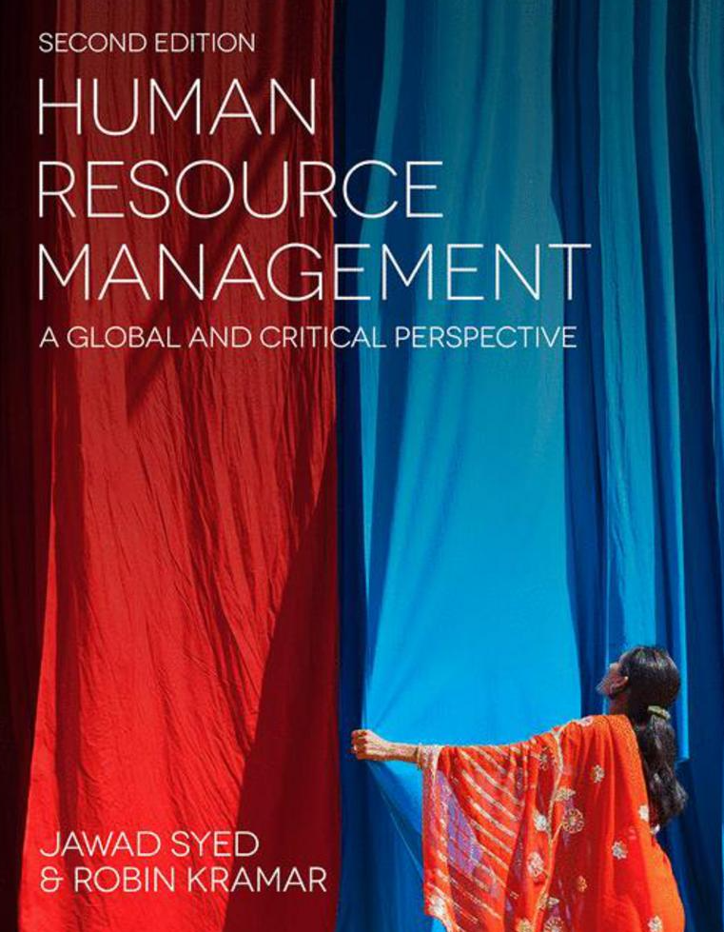

Slide 2
Chapter 8: Recruitment and selection
HUMAN RESOURCE MANAGEMENT – a global and critical perspective (2e)
Olivia Kyriakidou

Slide 3
Learning Objectives
After reading this chapter, you should be able to:
Describe the personnel selection system and its component parts.
Understand the role played by the rational and objective staffing technologies, including job analysis and recruitment and selection methods.
Critically assess the concern with the selection–performance relationship that underlines the personnel staffing agenda.
Come to terms with the fact that employees are not simple ‘human resources’ that can be selected, recruited, controlled, and processed, but are human beings characterised by agency, subjectivity, and reflexivity.
Consider the international implications of recruitment and selection, analyse the different selection methods for expatriates, and develop effective methods for selecting expatriate managers.
Understand the necessity of studying recruitment and selection from a critical perspective, exploring, in particular, the ethical dimensions.
Identify future theoretical and practical challenges in the field of research into recruitment and selection.

Slide 4
Summary of Chapter Contents
Opening Case Study: ‘Structuring interviews’
Introduction
Stages of recruitment and selection
Critical analysis and discussion
In the News
Benefits of studying HRM from a critical perspective
Critical Thinking
Conclusion
End of Chapter Case Study: The design of a new multinational personnel selection system at MobilCom

Slide 5
Introduction
Recruitment and selection are seminal topics within HRM
Recognition of the strategic potential of recruitment and selection
Selection processes should not exclude the broader moral, social and political considerations
Pluralist approach stressing the existence of divergent interests and the roles of the following:
human agency
subjectivity
reflexivity
International dimensions of personnel selection

Slide 6
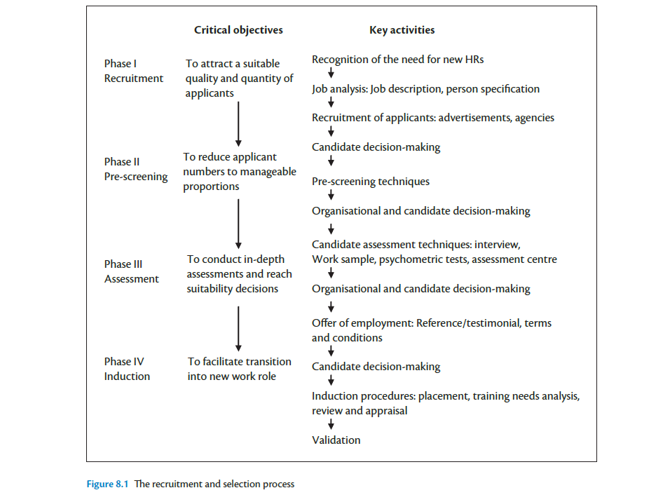

Slide 7
Stages of recruitment and selection: Job Analysis
work activities, including both individual behaviours and job outcomes
the machines, tools, equipment and work aids used
job-related tangibles and intangibles, such as materials processed and knowledge applied, respectively
standards of work performance
job context
personnel requirements, such as education, experience, aptitudes and so forth

Slide 8
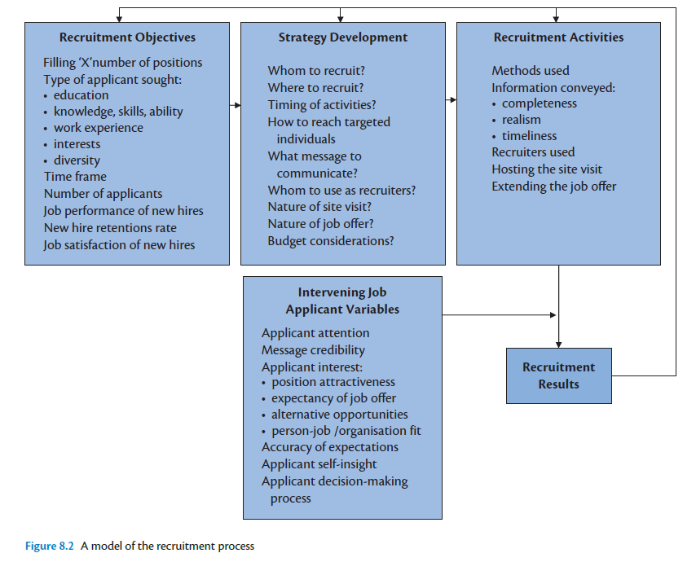
Stages of recruitment and selection: the Recruitment Process

Slide 9
Stages of recruitment and selection: Recruitment Methods
External recruitment – employee referrals; job advertisements; Internet; universities, colleges and placement offers; cooperatives, internships and job fairs; employment agencies
Internal recruitment – job posting; Intranet and intraplacement; talent management system; career development centres; replacement and succession plans

Slide 10
Stages of recruitment and selection: Realistic Job Previews
Employers provide recruits with candid information concerning the pleasant, and also the unpleasant, aspects of the job.
Three important job applicant-related variables – anchoring and adjustment, the inability to predict how one will react to events in the future, lack of self-insight
Inability to predict one’s reactions

Slide 11
Stages of recruitment and selection Personnel selection methods
Application forms, CVs and references
Selection interviews
Applicant factors and characteristics
Psychometric tests
Cognitive ability tests
Personality inventories
Faking and personality assessment
Assessment centres
Work samples
Integrity and honesty tests
Recruiting and selecting expatriate managers

Slide 12
Critical Analysis and Discussion
Generic focus on improving the efficiency, effectiveness and fairness of personnel management practice
Organizations will try to govern the souls of employees and regulate their social behaviour by attempting to persuade them to identify with managerial objectives
The unitarist approach: all members if an organization have a mutual interest

Slide 13
Further Reading
Bolton, S. C. and Houlihan, M. (2007) Searching for the Human in Human Resource Management. London: Palgrave Macmillan.
Boxall, P., Purcell, J. and Wright, P. (2007) The Oxford Handbook of Human Resource Management. Oxford: Oxford University Press.
Grey, C. and Willmott, H. (2005) Critical Management Studies: A Reader. Oxford: Oxford University Press.
Legge, K. (1995) Human Resource Management: Rhetorics and Realities. London: Palgrave Macmillan.
Leopold, J., Harris, L. and Watson, T. J. (2005) The Strategic Management of Human Resources. London: FT Prentice Hall.
Pinnington, A., Macklin, R. and Campbell, T. (2007) Human Resource Management: Ethics and Employment. Oxford: Oxford University Press.

