Slide 2
Chapter 9: Performance Management
HUMAN RESOURCE MANAGEMENT – a global and critical perspective (2e)
Olivia Kyriakidou

Slide 3
Learning Outcomes
After reading this chapter, you should be able to:
Understand the strategic importance of the performance management system in a global context.
Explain the purpose, criteria, and ethics of an effective global performance management system.
Identify the main approaches to performance appraisals.
Critically reflect on the most effective sources for performance management.
Recognise strategies to improve performance.
Manage performance in uncertainty.
Consider alternatives to performance appraisal.

Slide 4
Summary of Chapter Contents
Opening Case Study: Performance management in Brazilian bureaucracy
Introduction
The strategic importance of performance management in a global context
Characteristics of performance management
The criteria of an effective performance management system
Ethics in performance management
Multisource feedback
Strategies to improve global performance
Performance management in a global context
The cultural impact of performance management
Managing performance in uncertainty
Alternatives to performance appraisal
Conclusion
End of Chapter Case Study: Feedback in politics and government

Slide 5
Introduction
A process by which organizations set goals, determine standards, assign and evaluate work, and distribute rewards
Measuring the performance of individuals and teams has become an important tool
A complicated process
The dilemma of both geographical distance and cultural distance

Slide 6
The strategic importance of performance management in a global context
The purpose and approach of performance management changes as the Multinational Corporation expands
Key types of international employee
The employees in its subsidiaries (HCNs, TCNs) become increasingly more important
Global employee

Slide 7
Characteristics of Performance Management
Employee performance management includes:
planning work and setting expectations
continually monitoring performance
developing the capacity to perform
periodically appraising performance
rewarding good performance
Performance management cycle

Slide 8
Performance Management Cycle
Figure 9.1

Slide 9
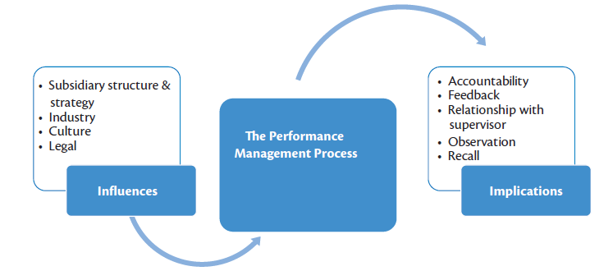
The purpose of performance management
Figure 9.2

Slide 10
The criteria of an effective performance management system
Emic (culturally specific) and etic (universal) dimensions in the perceptions of performance criteria
A recent standpoint (Kramar and Bartram, 2015) advocates five clear criteria:
strategic alignment,
Validity
Reliability
Specificity
acceptability.

Slide 11
Ethics in Performance Management
Inconsistency in the approach to ethics of performance management may cause employees to become frustrated, cynical, and withdrawn
Role of culture
Organisational climate
Ethical considerations in cross-cultural settings

Slide 12
Main approaches to performance appraisal

Slide 13
Multisource Feedback
The supervisor as a source
Subordinates as sources
Self as source
Peers as sources
Multisource feedback

Slide 14
Strategies to improve global performance
Politics
Trust
Fairness
Feedback

Slide 15
Performance management in a global context
The cultural impact of performance management
The divergence–convergence question
International legislation

Slide 16
The cultural impact of performance management
Purpose of performance management could be categorised into three broad groups:
bottom-line profit incorporating pay for performance
communication, training, and development; and
control
There is a cultural difference between the purposes in Eastern and Western countries
Divergence-convergence question
Global legislation

Slide 17
Alternatives to performance appraisal
Drawbacks of annual performance appraisal systems
Organisations abandoning their annual appraisal systems
Moving towards more regular feedback
Informal review processes

Slide 18
Summary
The contentious nature of performance management and its implications for the organization
Use and refinement of behavioural methods (BOS) will be a major step
Lack of training
The area of culture in the Multinational Corporation presents many challenges

Slide 19
Benefits of studying performance management from a critical perspective
Encourages self-directed, self-disciplined, self-monitored, and self-corrective thinking
Permits future global managers to acquire an enhanced perception of the numerous perspectives of different employees.
It involves cultural divergence and human resource structural and strategic inconsistency

Slide 20
Further Reading
Brewster, C., Carey, L., Dowling, P., Grobbler, P., Holland, P. and Warnich, S. (2007) Contemporary Issues in Human Resource Management (2nd edn). Southern Africa : Oxford University Press.
Budhwar, P. S. and Debrah, Y. A. (eds) (2013) Human Resource Management in Developing Countries. Routledge.
Briscoe, D., Randall, S. and Clauss, L. (2009) Global Human Resource Management: Policies and Practice for Multinational Enterprises (3rd ed.). London: Routledge.
Kramar, R. and Bartam, T. (2015) Human Resource Management in Australia: Strategy, People and Performance, 5th edn. McGraw Hill
Tarique, I., Briscoe, D. R. and Schuler, R. S. (2015) International Human Resource Management: Policies and Practices for Multinational Enterprises. London: Routledge

