Slide 2
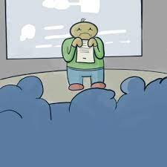
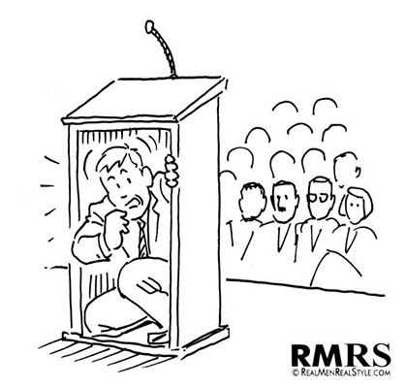
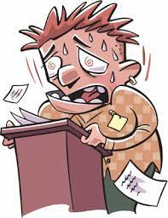
Notes:
Make a note on the slide saying ‘add pictures of anxious speakers’

Slide 3
Oral presentation
This is how I feel:
My fears/worries/thoughts:

Slide 4
Fears/worries/negative thoughts
positive thoughts/ strategies

Slide 5
Notes:
Make note on slide ‘anxious speaker (arrow) confident speaker

