Slide 1
Homework: Therapy Between Sessions
Chapter 10

Slide 2
Homework

Slide 3
Homework
Homework is a necessary specific factor for CBT
  In many ways, a good portion of therapy happens outside the office
    167 of 168 hours a week is not in therapy
  A CBT therapist who does not do homework is not doing CBT
  CBT without homework significantly reduces therapeutic effectiveness
The focus of this chapter is on the general process of integrating homework as a key component of CBT, from assigning a task to maintaining client compliance

Slide 4
Assigning Homework

Slide 5
Assigning Homework
One of the key driving forces for assigning homework is your CBT conceptualization, treatment plan, and interventions
There are a variety of client specific factors that should be considered when assigning homework
  (a) severity of psychological distress; (b) cognitive, emotional, and behavioral functioning; (c) motivation and readiness to change; (d) reading and writing skills; (e) CBT skills; (f) past therapy experience; and (g) personal constraints (e.g., living situation and available resources)

Slide 6
Assigning Homework
The expectation and necessity for homework assignments should be set by the first session
  First assignment should be as early as the first session; no later than the second session
Clients who initiate and develop their own homework assignments increase their level of self-efficacy and have a better chance continuing this behavior patter after therapy is over

Slide 7
Assigning Homework
Early phase therapy – you should take the initial lead
Middle phase therapy – clients should have an increasing collaborative role
Late phase therapy – clients should have more of a lead role with your support

Slide 8
Assigning Homework
Always provide a rationale when assigning homework
  Most often, the task being assigned is an extension of what is being done in session
Review the assignment in detail, including expectations for follow-up in the next session
Potential obstacles should be explored, including motivation and relevant negative automatic thoughts

Slide 9
Assigning Homework
Examples of common types of homework assignments that are generally unique to CBT:
  Bibliotherapy
  Activity monitoring and scheduling
  Automatic thoughts and core beliefs: monitoring, evaluating, and modifying
  Exposure to fearful situations
  Skills training and practice
  Next session preparation

Slide 10
Assigning Homeowrk
*See Video Vignettes 4.4 (PDA-5), 4.5 (PDA-8), and 4.6 (PDA-10) demonstrating assigning homework during the late session stage across all three phases of therapy with the same client

Slide 11
Fostering Homework Compliance

Slide 12
Provide a Clear Rationale and Clear Instructions
The best way to provide a rationale is to link the homework assignments with what has just been covered in the current session and address how it will be related to the next session
  The more clients understand why they are doing something, the more likely they will comply
As therapy progresses to the middle and late phases, you can begin asking clients to develop their own homework assignments

Slide 13
Provide a Clear Rationale and Clear Instructions
When providing instructions, it is important that you remind yourself to take the perspective of your client; do not make any assumptions
In most cases, you should be completing and reviewing a portion of the homework assignment before the session ends
  Use this as an opportunity to review the specific steps and highlight what will be of primary focus during the next session
*Poorly assigned homework can cause more therapeutic damage than no assigned homework

Slide 14
Initiate Homework in Session
Beginning homework in session is a “live” opportunity to make sure that your clients understand how to do the assignment and you can respond to any questions or feedback
  Provides opportunity to troubleshoot for potential obstacles and develop a coping plan
  Model how to complete particular tasks
Completing a portion of a homework assignment can increase motivation – it is much easier to continue a task that is already started than to initiate a task independently

Slide 15
Individualize Homework Assignments
Examples of client characteristics or factors to consider include:
  Level of distress, level of cognitive functioning, current motivation, attention span, life stressors, and external environmental factors
Beyond the type of homework assignment, how much is assigned can also be adjusted over time
  Breaking down certain assignments into smaller, more manageable steps
  Adjust expectations and goals to be completed between sessions

Slide 16
Individualize Homework Assignments
Allow for creativity for alternative means to accomplish the same goals
  e.g., instead of using paper and pencil for thought records, some clients may benefit from typing them out on their computer or using a smartphone application
  Use of video and audio recordings for homework assignments can provide a lot of useful information to review during a session

Slide 17
Develop and Initiate Homework Collaboratively
Like all aspects of CBT, there should be a collaborative process in developing, initiating, and reviewing homework assignments
  Early phase therapy – propose it in an inviting manner, including soliciting your clients’ feedback
  Middle phase therapy – offer some suggestions tentatively and explicitly encourage client input
  Late phase therapy – clients can develop and initiate their own assignments
As therapy evolves and clients continue to make therapeutic gains, they will have a better understanding of what would be an effective homework assignment

Slide 18
“Set Up” Your Clients for Success
Make sure your clients have both the capacity and motivation to complete the assignment
Emphasize to not focus on “success” or “failure” and/or “full completion” or “incomplete”
  Focus on the process, not only the outcome
  Making it clear to clients to not focus only on the outcome will often reduce anxiety and increase motivation
Even if clients do not fully complete their assignment, there is often sill useful information available

Slide 19
“Set Up” Your Clients for Success
Remind clients that it is okay for them to make “mistakes,” have moments of confusion, and have additional questions
Balance between challenging and easy homework assignments
Clients who have a sense of progress with their homework assignments are more likely to initiate and complete future assignments, including those that may be more challenging

Slide 20
Help Clients Remember to Do Homework
For some clients, writing down their assignments at the end of session is enough for them to remember to do their homework
For other clients, once home, it is still possible for them to misplace their therapy notes or simply forget
You may have to think outside the box for strategies to improve some clients’ chances of remembering to do their homework

Slide 21
Help Clients Remember to Do Homework
Some possible options to consider include:
  Using sticky notes on common items
  Using a smartphone app, computer, or appointment book for reminders
  Requesting reminders from a trusted friend/family member immediately after the session
  Associating another activity to cue when to review therapy notes
  Reviewing what clients do to remember other tasks
  Using automated e-mail, voice mail, or text message from your office

Slide 22
Anticipate Possible Problems
Beck (2011) recommends directly asking clients if they have any potential concerns:
  “What are the chances of you attempting (completing) this homework assignment, 0 to 100%?”
    If clients are less than 90% confident, follow up and troubleshoot
If there are concerns, first simply ask, “Why?”
  e.g., do not understand rationale or instructions, too complex, fear of failure, not sure will remember how to do it, or unmotivated

Slide 23
Anticipate Possible Problems
One commonly recommend technique is guided imagery (as discussed in Chapter 7)
  Listen for any potential obstacles that are often associated with negative automatic thoughts and/or strong emotions
Ask clients to predict possible negative automatic thoughts while they attempt the homework assignment and if it does not go as planned
If your clients still think they will not be able to initiate or complete their assignment at this point, it might be best to consider making a revision or an alternative assignment that will still meet their therapeutic goals

Slide 24
Review Homework in the Next Session
Reviewing homework in the next session not only is therapeutically appropriate to achieve each clients’ goals but also reinforces the importance of future homework assignments
Not following up on homework can communicate that it is not a worthwhile task
  Can result in clients experiencing negative emotions and potentially damage the therapeutic relationship

Slide 25
Review Homework in the Next Session
It is best to start with a simple open-ended question that focuses on the process
  e.g., “What was your experience working on last week’s homework assignment?”
    Instead of a closed-ended question that focuses on the outcome
  e.g., “Did you complete last week’s homework assignment?”
Your emphasis should be on what was learned, what worked, and what did not work
  Not “success” or “failure”

Slide 26
Review Homework in the Next Session
Initially focus on praising any attempts at completing the homework, on validating emotions, and on processing associated thoughts
  Do not blame or shame if the homework was not attempted or completed
If the homework assignment was not completed, have clients identify possible reasons, including exploring in detail their thought process before, during, and after the attempt
  e.g., Was it appropriately completed? If not, what prevented it from being appropriately completed? Did they make any modifications? Were there any unanticipated obstacles? What is their interpretation for not completing it?

Slide 27
Review Homework in the Next Session
Reinforce what was done right, provide supportive problem-solving suggestions for improvement, and make any necessary modifications
  i.e., learning opportunity
If appropriate, complete a portion of the homework in session and convey its relationship to what will be done in the current session
Consider assigning the homework again for the next session
  Conveys importance of completing homework while also demonstrating empathy and flexibility

Slide 28
Fostering Homework Compliance
*See Video Case Examples MDD-6, MDD-13, and MDD-18 demonstrating reviewing homework during the early session stage across all three phases of therapy with the same client
Discussion Questions 10.1 (p. 307)
Activity 10.1: Responding to Clients Not Completing Homework (p. 307)

Slide 29
Common Challenges for Homework

Slide 30
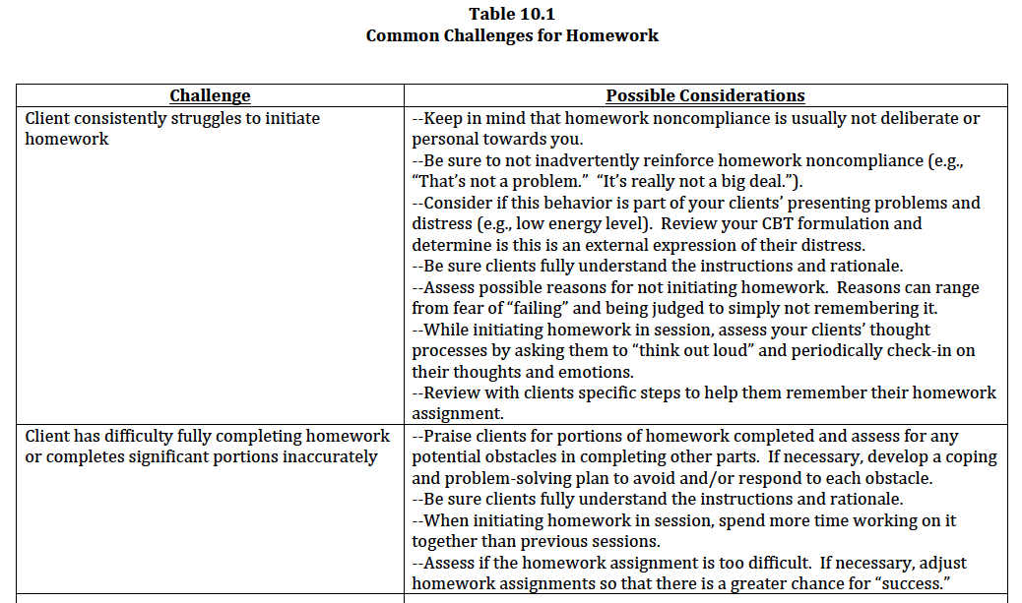

Slide 31
