Slide 1
Psychoeducation: Teaching, Supporting, and Motivating
Chapter 5

Slide 2
Psychoeducation

Slide 3
Psychoeducation
A major tenet of CBT is that clients will need to learn new skills as they collaboratively participate in their own therapy
Another major tenet of CBT is to provide clients with the knowledge and ability to effectively apply cognitive-behavioral skills autonomously
  Goal is to have clients be their own CBT therapists where they can independently solve their life problems long after therapy is over

Slide 4
Psychoeducation
Some therapists, especially those early in their career, view psychoeducation with disdain as something that is not worth the time with little value
  May be due to feeling vulnerable to be in the expert role (e.g., must know the CBT model really well)
  May be due to a strong desire to immediately begin specific steps to reduce client distress (i.e., focused more on the outcome than the process)
Psychoeducation helps establish therapeutic rapport
  Not lecturing – modeling for clients the collaborative role in their own treatment

Slide 5
Psychoeducation
Psychoeducation has a continuous role through all phases of therapy
Two main parts:
  Early phase CBT psychoeducation – a formal process where general expectations for therapy and information related to your clients’ diagnosis and problems
  CBT skill psychoeducation – As therapy progresses, there will be multiple opportunities for psychoeducation where a new skills needs to be taught and practiced

Slide 6
Early Phase Psychoeducation

Slide 7
Early Phase Psychoeducation
Most of the initial psychoeducation content is relatively nonthreatening (e.g., therapy expectations, cognitive model)
  This process allows the client to naturally acclimate to the therapeutic experience instead of being put immediately on the spot by being asked a deeply personal question or expected to engage in a new behavioral routine
Information can also be used to build optimism and motivation
  Educating clients about their specific condition (i.e., diagnosis) and how CBT has legitimate potential to reduce their distress and improve their quality of life can be just enough to consider remaining in therapy in order to “give it a chance”

Slide 8
Early Phase Psychoeducation
Prepare in advance before educating clients on specific topics
  Knowledge is important, but it is also important to know how to communicate this information in a way that clients can both understand and be engaged
*If you come off as unsure or unclear about these topics and/or have minimal client interactions due to being rigid or scripted, your therapeutic rapport could be damaged, or, worse, your client may terminate prematurely

Slide 9
Early Phase Psychoeducation
Table 5.1 – Early Phase Psychoeducation Worksheet
  Can be helpful in providing a template to ensure that certain information is addressed with your clients soon after your intake
  A brief description of relevant content is provided for each topic, and there is space available for your own client-specific notes

Slide 10
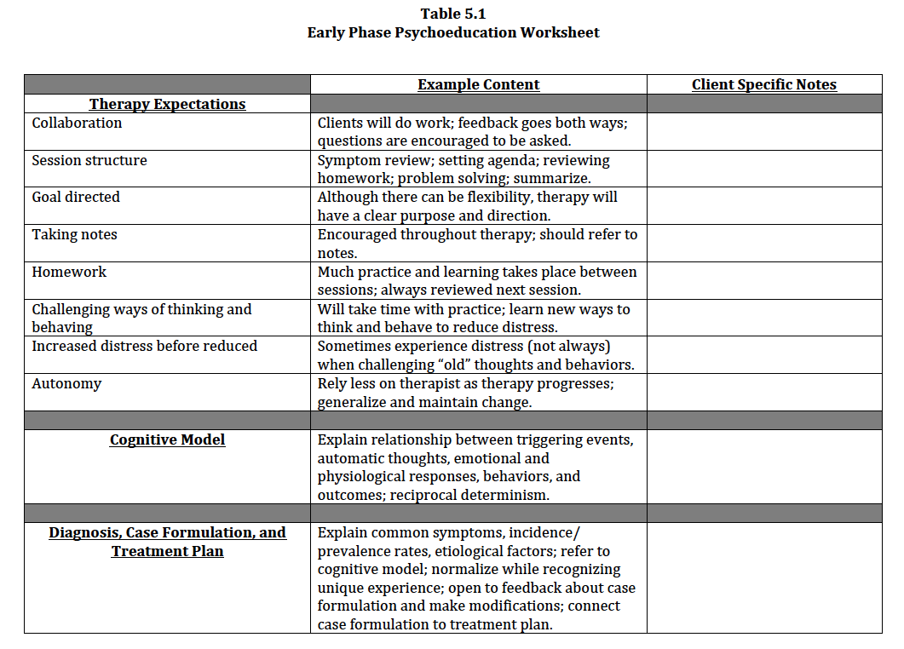

Slide 11
Therapy Expectations
Like setting a broad agenda for therapy as a whole rather than for just one session
Clients come to therapy with different expectations
  For those with no expectations, explaining CBT can provide some comfort by minimizing the mystery of therapy and setting structure
  For others, their expectations and/or previous therapeutic experiences may not be similar to how CBT actually works
    Thus, you might be in the position to adjust their expectations or even “retrain” their role as a client, especially if they have received a form of non-directive therapy in the past

Slide 12
Therapy Expectations
At this point in therapy, it is generally best to be brief and simple in your explanation of therapy expectations
  Spending too much time on this topic and/or using too much CBT jargon has the potential to intimidate and overwhelm clients
    There will be many other opportunities to provide psychoeducation about specific topics and skills

Slide 13
Therapy Expectations
Information that should be addressed while discussing therapy expectations (See Table 5.1):
  Collaboration
  Session structure
  Goal directed
  Taking notes
  Homework
  Challenge ways of thinking and behaving
  Moments of increased distress before reduced
  Autonomy

Slide 14
Cognitive Model
Must be reviewed early in therapy because it sets the foundation for how clients’ problems are conceptualized and treated
Relationship between triggering events, automatic thoughts (or images), emotional and physiological responses, behaviors, and associated outcomes
Visual models using a client specific example
  See Figure 1.1 – Reciprocal Cognitive-Behavioral Model
  Can also use handouts or whiteboard

Slide 15
Early Phase Psychoeducation
Video Vignette 5.1 (p. 110)
  MDD-4: Psychoeducation – Therapy Expectations and the Cognitive Model
    *Discussion questions and an activity will follow Video Vignette 5.2 (psychoeducation of diagnosis)

Slide 16
Diagnosis, Case Formulation, and Treatment Plan
Psychoeducation of diagnoses and associated problems
  Most clients often feel at least some relief when informed of their diagnosis because it is a step closer to understanding their distress
  Help normalize experience by discussing common symptoms, incidence/prevalence rates, and possible etiological factors
    While normalizing be cautious to not minimize their own unique experiences
  Cannot promise to fully “cure” clients but can assure them that past clients with similar diagnoses and problems have been treated with positive outcomes

Slide 17
Diagnosis, Case Formulation, and Treatment Plan
Initial case formulation
  Can use your CBT model of psychoeducation of diagnoses and problems as a backdrop to explain your conceptualization of your clients’ distress
  Be open to client feedback and do not present your case formulation as infallible; it will evolve over time
Treatment plan – goals and interventions
  Better treatment compliance when there is a collaborative understanding and mutual agreement of the precipitating and maintaining factors for client distress and an understanding why specific interventions will be used

Slide 18
Early Phase Psychoeducation
Video Vignette 5.2 (p. 114)
  PDA-4: Psychoeducation – Diagnosis
Discussion Questions 5.1 (p. 116)
Activity 5.1: Psychoeducation (p. 116)

Slide 19
CBT Skill Psychoeducation

Slide 20
CBT Skill Psychoeducation
Beyond early phase psychoeducation, there will be many moments of psychoeducation during essentially every session
There is significant variation of psychoeducation content during the middle and late phases of therapy
  Depends on clients’ type of distress and severity
Two components that receive focus here include:
  Teaching new skills
  Bibliotherapy and technology

Slide 21
Teaching New Skills: In-Session Practice to Between Session Application
Provide many “mini-lessons” for new skills – accumulate into “big” cognitive-behavioral skills
Use examples specific to your clients’ presenting problems
  Scaffold your clients through each step of the exercise
  A copy of the completed exercise or a photo of the whiteboard can be used as a template for clients to study and use outside of session
  A therapy notebook can be used to organize completed exercises
    Homework assignments, handouts, client therapy notes worksheets, and self-report measures

Slide 22
Teaching New Skills: In-Session Practice to Between Session Application
There will also be opportunities where it is most appropriate for clients to practice and apply their new skills beyond written exercises
  First practice these new skills in session because they can sometimes be distress provoking for some clients
    Also allows for you to provide direct feedback to ensure that the skills are being applied appropriately

Slide 23
Bibliotherapy and Technology
There are many self-help books and related materials available through multiple avenues of technology (e.g., professional mental health websites, computer programs/games, smartphone applications)
  However, without appropriate professional assistance, many of these resources do not provide long-term effective change; and in some cases can cause more harm
  Your role as a therapist is to be judicious in what CBT materials are assigned to your clients and continuously monitor its impact on therapy

Slide 24
Bibliotherapy and Technology
Consider the phase of therapy and your clients’ level of intelligence, cognitive and emotional sophistication, and psychological self-awareness
You should read and review any resources you assign to your clients in advance
  You must understand the content in order to determine appropriateness and monitor clients’ use
Your assigned resources will be most effective if they are purposefully integrated into your treatment plan
  What clients are reading and using outside of session should match what is being covered in session

Slide 25
Common Challenges for CBT Psychoeducation

Slide 26
