Slide 1
CBT Session Structure: Purposeful and Flexible
Chapter 4

Slide 2
CBT Session Structure

Slide 3
CBT Session Structure
CBT skills addressed in the proceeding chapters will have little to no value if the directionality and focus that are afforded in structured sessions are lacking
Most clients want and need structure
  Clients attend therapy because they are distressed and some may still be unsure if therapy is a viable option
    Many clients feel vulnerable at the onset of therapy
      Structure from the first session instills comfort and hope that therapy might provide some relief to their distress
It also demonstrates your expertness, trustworthiness, and attractiveness as a therapist – important factors for developing a therapeutic alliance

Slide 4
CBT Session Structure
Consistent session structure socializes clients to CBT
Allows you to model the collaborative nature of CBT
Provides direction for both you and the client
  Even experienced therapists require guidance in maneuvering each session
Enhances therapeutic efficiency by facilitating organized therapy that stays focused on the problems of most relevance and corresponding goals and interventions

Slide 5
CBT Session Structure
How much structure is necessary for your clients will vary, often depending on the current phase of therapy
  Early phase therapy will require significantly more structure and guidance by the therapist compared to late phase therapy
Each session is broken down into four stages: pre-session, early session, middle session, and late session
Table 4.1 – Therapy Session Stages
  Highlights each stage and its associated components

Slide 6
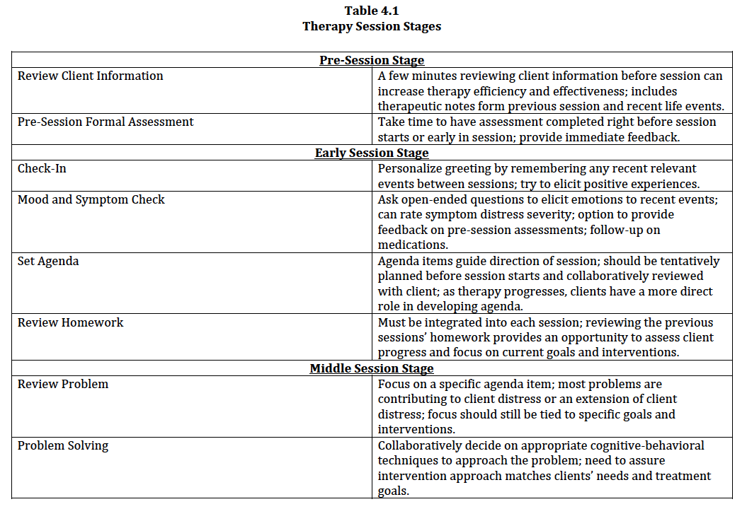

Slide 7
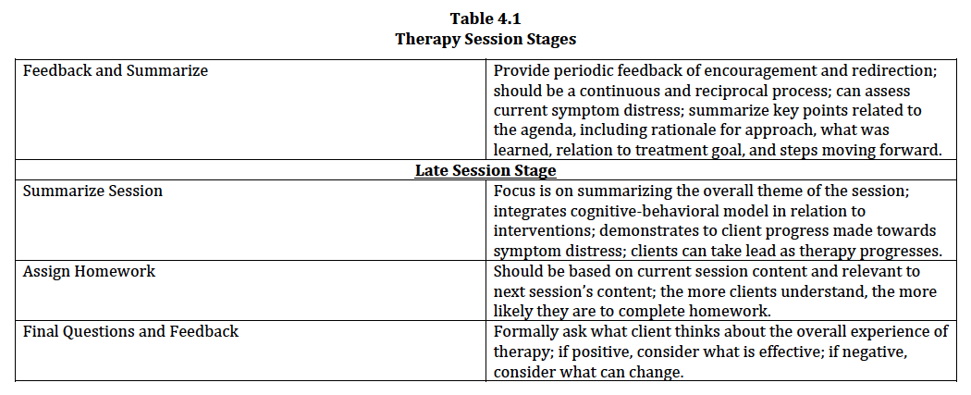

Slide 8
Pre-Session Stage

Slide 9
Pre-Session Stage
This stage is probably the most critical because how you prepare before you session will influence the effectiveness of the following three stages
Preparing for the next session typically takes only 5 to 10 minutes
  Yet, can often be overlooked by therapists
Consists of two key components:
  Review client information
  Pre-session formal assessment

Slide 10
Pre-Session Stage
Sample Form 4.1 – Therapy Session Worksheet
  Helps make sure you review and prep for both content and process during the pre-session stage
  Relevant information that is typically gathered at each session stage is addressed in its corresponding section
  Some therapists do not like or do not think it is necessary to take notes during sessions
    Research shows that therapists’ perception of what they remember from a recent session is often inaccurate
    Effective CBT often requires clients taking notes as well

Slide 11
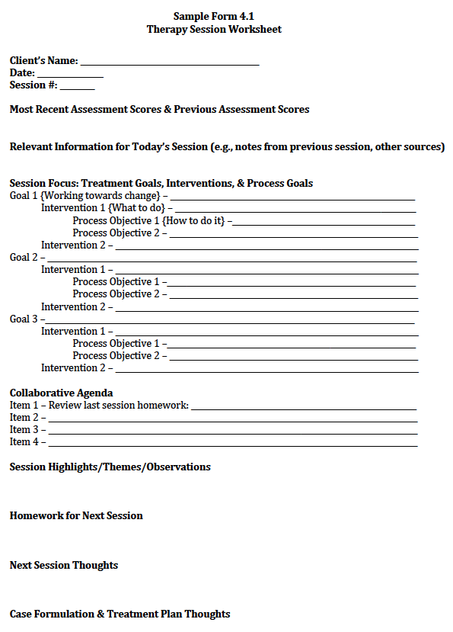

Slide 12
Review Client Information
Improves overall therapy efficiency and effectiveness by way of having a purposeful direction for each session
Recalling basic information about clients (e.g., recent weekend vacation, favorite hobby, or grade on recent exam) can help build a strong therapeutic alliance
Sources of information include recent progress notes, Therapy Session Worksheet, and Client Therapy Notes Worksheet (Sample Form 4.2 – discussed later)

Slide 13
Review Client Information
Review client’s case formulation and treatment plan, including goals and interventions
  Can supplement with “process objectives”
    An intervention is a statement of what will be done to work toward a goal (e.g., cognitive restructuring)
    A process objective states how it will actually be done (e.g., complete thought record with focus on dichotomous thinking)
Although setting the agenda involves collaboration with your client, you should still note in advance what you believe should be covered in session

Slide 14
Pre-Session Formal Assessment
Self-report assessments (5-10 minutes) right before session begins
  Can provide immediate feedback and compare to previous assessment scores
If possible, ask clients to arrive about 10 to 15 early
  If this is not possible, on occasion it is okay to have assessments completed during the first 5 minutes of the session

Slide 15
Early Session Stage

Slide 16
Early Session Stage
There are many “small” parts to cover in this stage, but they will shape and influence the direction of your agenda items by the middle stage
  Check-in
  Mood and symptom check
  Set agenda
  Review homework

Slide 17
Check-In
Personalize greeting
  Show sincere interest in your clients and possibly remember any recent relevant events between sessions
    e.g., “How was your weekend vacation?” “Did you get a chance to visit your mother over the past week?”
Try to elicit positive experience – hope/optimism
  “You stated last week you were looking forward to your daughter’s birthday party. How did it go?”
Sometimes information revealed during the check-in may be relevant enough to inform and possibly modify your agenda

Slide 18
Mood and Symptom Check
Assess current mood and emotions over the past week (or since last session)
  Builds rapport while naturally monitoring treatment progress
  Eliciting “fresh” emotions to recent events is most useful
    “Here and now” effect – incorporate any themes into your agenda
If appropriate, you can do more formal symptom checks
  e.g., ask clients to rate their depression or anxiety on a 0-10 scale
  e.g., number of binges, substance use (frequency and amount)
  Can also review any monitoring forms for homework

Slide 19
Mood and Symptom Check
Review any pre-session (or prior session) assessments
  Provides insight into therapy progress (i.e., effectiveness)
  Focus on individual items
    Consider specific areas of concern or possible contradictions
      e.g., “You said to me during our check-in that you haven’t had any thoughts of suicide over the past week, but I’ve noticed that you selected ‘sometimes’ for thoughts of suicide on the suicide scale.”
Follow-up on any medications including side effects, adherence, and any related problems or questions

Slide 20
Set Agenda
If treatment planning sets the stage for the course of therapy, then agenda setting sets the stage for the course of each session
Driving force for the direction of therapy
  Most effective when connected to treatment goals (specific and measurable)
  Make sure interventions allow for the opportunity for clients to experience some level of progress and success
By the first or second session (part of psychoeducation), explain the purpose, process, and value that comes with agenda setting

Slide 21
Set Agenda
Always collaborate with clients; increasing flexibility with each phase of therapy
  i.e., client has more of a role in developing the session agenda as therapy progresses
  Balance transition from teacher—student relationship to mentor-protégé relationship
May need to prioritize agenda items based on session time, clients’ immediate needs, and level of distress (need to “triage”)
It is okay to modify an agenda item in session if it is not addressing a key problem effectively

Slide 22
Set Agenda
Sample Form 4.2 – Client Therapy Notes Worksheet
  Helps clients monitor their thoughts/emotions, reflect on homework, focus on their identified problems and positive experiences, note progress on learning new skills, and reflect on experiences during session and outside of session
  Asking clients to share their notes can be a helpful contribution to the session agenda
  Enhances clients’ preparedness to both collaborate and take responsibility for their therapeutic progress

Slide 23
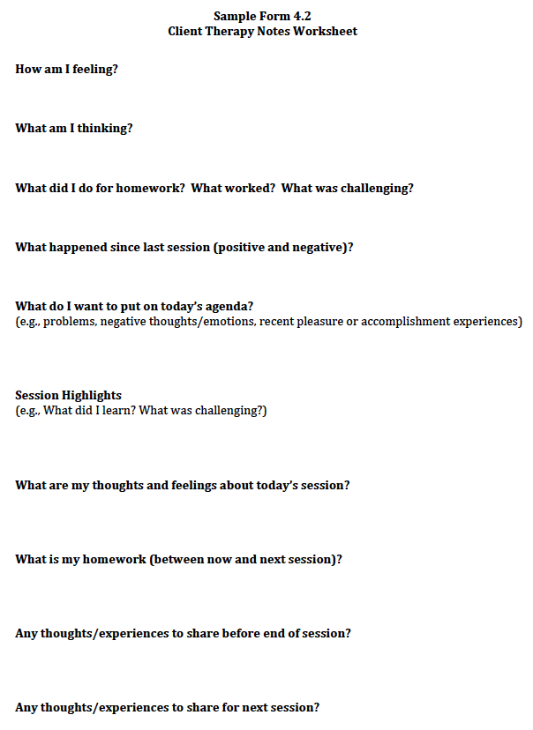

Slide 24
Review Homework
Homework must be reviewed every session
Can be part of a check-in or more detailed
Not reviewing homework will result in clients not completing it and damage the therapeutic alliance
  *CBT without homework can negatively impact client outcomes
Reviewing homework is a great way to bridge content and themes from the previous session
  Ideal to practice newly learned CBT skills between sessions

Slide 25
Early Session Stage
Video Vignette 4.1 (p. 85)
  MDD-6: Early Session Stage—Early Phase Therapy
Video Vignette 4.2 (p. 86)
  MDD-13: Early Session Stage—Middle Phase Therapy
Video Vignette 4.3 (p. 88)
  MDD-13: Early Session Stage—Late Phase Therapy
Discussion Questions 4.1 (p. 89)
Activity 4.1: Early Session Stage (p. 89)

Slide 26
Middle Session Stage

Slide 27
Middle Session Stage
Number of agenda items and how much of a lead you or your clients take in initiating and moving forward with the agenda will depend on the phase of therapy and the type of problem
The content and process can vary greatly for each client depending on presenting problems, goals, and corresponding interventions
  The following sections serve only as a general template:
    Review problem
    Problem-solving strategies
    Feedback and summarize

Slide 28
Review Problem
Best to use problem/event that is recent
  Strong emotional content and easier to recall
  Better chance for immediacy and engagement
Conceptualize how problem fits in case formulation/cognitive model
  Most problems are an extension of or a part of their distress, either as a contributing factor or as outcome
  “Micro” problem tied into specific “macro” goals and interventions

Slide 29
Problem-Solving Strategies
Collaboratively decide on how you will focus on the problem using the cognitive-behavioral model:
  Psychoeducation of specific CBT skills
  Basic problem-solving strategies
  Behavioral activation
  Emotion and thought identification
  Modification of automatic thoughts and core beliefs
  Relaxation techniques
  Exposure
The focus here is to provide a guide in determining possible intervention options to resolve the problems

Slide 30
Feedback and Summarize
Provide periodic feedback of encouragement and redirection
Encourage and elicit feedback from clients about what is and is not working for them
Clients can report their current symptom distress (e.g., 0-10)
Client feedback and self-report of distress will allow you to more accurately assess the effectiveness of your interventions and possibly make any necessary modifications

Slide 31
Feedback and Summarize
Summarize by highlighting the rationale for the approach, what skill was learned/used, how it can be applied to other problems, its relation to a particular treatment goal, what was helpful and not helpful, and the next steps in moving forward
Depending on phase of therapy, either you or your client can provide the summary
  This is a good opportunity to assess their understanding of the problem and how the interventions were helpful, including their current level of distress

Slide 32
Late Session Stage

Slide 33
Late Session Stage
Typically the last 5-10 minutes of session
Just as essential as the other stages because it provides an opportunity to integrate key conceptual themes and review what was learning during the session
Can be your bridge for next session
  Often done through assigning homework
Consists of the following components:
  Summarize session
  Assign homework for next session
  Final questions and feedback

Slide 34
Summarize Session
Focus on the overall themes that were covered in session
Explicitly integrate the cognitive-behavioral model relevant to the interventions implemented
  Demonstrates to your client that the work done during the session was purposeful toward overall symptom distress reduction and improved quality of life

Slide 35
Summarize Session
With more therapy experience, clients can summarize session
  Can be a great opportunity to integrate and modify their own conceptualization of distress
Highlight any symptom relief
  Connecting what clients have done in session to how they currently think and feel can be very powerful for developing and enhancing hope and motivation to change

Slide 36
Assign Homework for Next Session
Can assign next homework assignment either before or after summary
Should be based on current session content while also keeping in mind your focus for next session
Provide a clear rationale for the homework assignment and convey the role it will have during your next session
  The more clients understand this, the greater the chance they will complete the assignment with effort

Slide 37
Final Questions and Feedback
Ask clients to review their Client Therapy Notes Worksheet
Elicit questions or feedback about any part of the session
Remind clients to take any final notes to review before next session
Check-in on their overall experience of therapy
  What is working?
  What can be done to improve therapeutic experience?
Remember to take down any final notes on your Therapy Session Worksheet

Slide 38
Late Session Stage
Video Vignette 4.4 (p. 93)
  PDA-5: Late Session Stage—Early Phase Therapy
Video Vignette 4.5 (p. 97)
  PDA-8: Late Session Stage—Middle Phase Therapy
Video Vignette 4.6 (p. 99)
  PDA-10: Late Session Stage—Late Phase Therapy
Discussion Questions 4.2 (p. 101)
Activity 4.2: Late Session Stage (p. 101)

Slide 39
Common Challenges for CBT Session Structure

