Slide 1
Automatic Thoughts: Eliciting, Identifying, Evaluating, & Modifying Maladaptive Thought Patterns
Chapter 7

Slide 2
Automatic Thoughts

Slide 3
Automatic Thoughts
At the heart of long-term change for CBT is being able to change clients’ maladaptive thinking patterns
The challenge is to first identify these thoughts and then evaluate them to see fi they are negative automatic thoughts that warrant modification
This chapter is divided into many parts for the purpose of developing solid clinical development in specific therapeutic techniques:
(a) understanding automatic thoughts, (b) psychoeducation, (c) eliciting and identifying, (d) evaluating and modifying, (e) valid negative automatic thoughts

Slide 4
What are Automatic Thoughts?

Slide 5
What are Automatic Thoughts?
Automatic Thoughts = “pre-surface thinking”
All people experience automatic thoughts
But we often lack awareness of such thoughts
Generally not of concern until people experience negative automatic thoughts that start to contribute to distress and inhibit daily function
Table 7.1 – Key Elements of Automatic Thoughts
Provides a brief summary of the key elements of automatic thoughts that can be helpful for quick recall and to share with your clients during psychoeducation

Slide 6
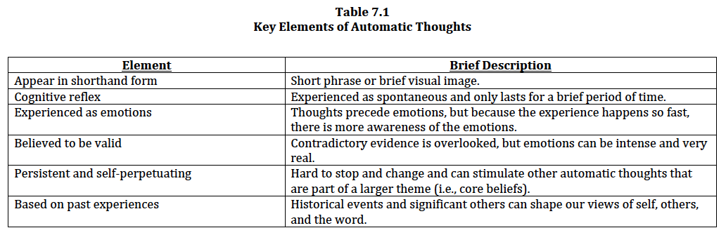
What are Automatic Thoughts?

Slide 7
What are Automatic Thoughts?
J. S. Beck (2011) states that negative automatic thoughts generally fall into three categories based on their validity and utility
(1) no validity and no utility
(2) valid with misdirected/maladaptive utility
Conclusion/meaning derived from thought is distorted
(3) valid with no utility
Conclusion/meaning derived from thought is accurate
Table 7.2 – Validity and Utility of Negative Automatic Thoughts
Provides a summary of the three different categories of negative automatic thoughts and response strategies

Slide 8
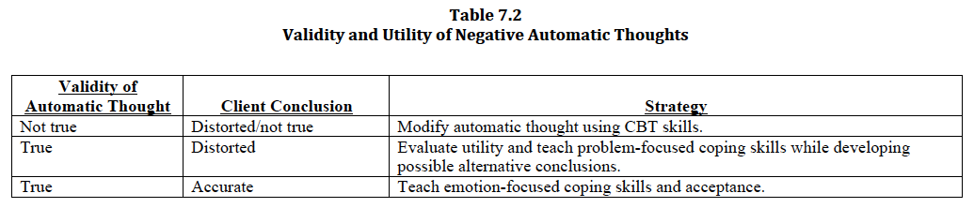
What are Automatic Thoughts?

Slide 9
Psychoeducation of Automatic Thoughts

Slide 10
Psychoeducation of Automatic Thoughts
Explain during early phase of therapy (within the first few sessions)
Sometimes best done when naturally noticing your clients verbalizing a series of negative automatic thoughts and associated strong emotions
Try to use clients’ own events as examples to explain negative automatic thoughts
Using “in-the-moment” emotions related to real-life examples can enhance attention, motivation, and learning

Slide 11
Psychoeducation of Automatic Thoughts
During psychoeducation refer to Table 7.1 and visually display the CBT model
Also integrate the following:
Normalize the experience – all people have negative automatic thoughts
Some people experience distress when they are not aware and/or are unable to change their negative automatic thoughts
Remind – perception of events affect emotions
Ask clients to imagine how their emotions might change if they learned that their automatic thought was not true
Occasionally check in to see if clients have any questions
As clients to summarize key points

Slide 12
Psychoeducation of Automatic Thoughts
Video Vignette 7.1 (p. 161)
MDD-9: Automatic Thoughts—Psychoeducation
Discussion Questions 7.1 (p. 163)

Slide 13
Eliciting and Identifying Automatic Thoughts

Slide 14
Eliciting and Identifying Automatic Thoughts
Guided Discovery
Using emotions to elicit automatic thoughts
“What was just going through your mind?”
Guided Imagery
Using images to elicit automatic thoughts
Role Play
Recreating interactions to elicit automatic thoughts
Differentiating Thoughts from Emotions
Sentence/phrase = thought; single word = emotion
Tracking Negative Automatic Thoughts
Now including thoughts with emotions and events

Slide 15
Guided Discovery (Using Emotions to Elicit Automatic Thoughts)
“Emotion is the royal road to cognition” (Aaron T. Beck)
1) Initially, primarily focus on emotions
Validate emotions (do not modify)
Shift in negative emotion and intensity is often associated with a negative automatic thought or image – “hot cognitions”
Using recent events has a greater chance to be more accurately remembered, associated with more “raw” emotion, and have more heightened relevance than events that have occurred in the past

Slide 16
Guided Discovery
2) Observe and respond to mood shifts
Observe both verbal and nonverbal cues for mood shifts
“What was just going through your mind?”
Want specificity for details of thoughts and any images for accurate evaluation

Slide 17
Guided Discovery
3) Consider point in time
Experiencing highest level of distress in relation to negative automatic thought
Before – anticipation of what could happen before the event
e.g., “She will probably be disappointed in me.”
During – in-the-moment, while the event is happening
e.g., “I’m not going to be able to complete the test on time.”
After – reflecting/ruminating after the event
e.g., “Once again, I screwed up.”

Slide 18
Guided Discovery
4) Follow-up on initial automatic thoughts
There may be a chain reaction of additional automatic thoughts that are part of a larger theme
“What else were you thinking?”
There may be additional automatic thoughts about their reaction to the situation rather than the actual situation
“What are your thoughts about how you responded to the situation?
There may be a negative reaction to their responding emotions and/or behaviors
e.g., “It shows that I’m weak to let him make me so angry.”
Many times these thoughts are interrelated to larger themes or core beliefs

Slide 19
Guided Discovery
5) Strategies when clients struggle to identify automatic thoughts
Shift from focusing on emotions to physiological arousal
Focus on the meaning on the event
Ask to “guess”
Hypothesize possible thought
Hypothesize possible thought that might be the opposite
Figure 7.1 – Guided Discovery: Using Emotions to Elicit Automatic Thoughts
Flowchart of the common techniques used during guided discovery

Slide 20
Guided Discovery

Slide 21
Guided Discovery
Video Vignette 7.2 (p. 166)
MDD-10: Automatic Thoughts—Eliciting and Identifying
Discussion Questions 7.2 (p. 168)

Slide 22
Guided Imagery (Using Images to Elicit Automatic Thoughts)
Helpful for clients who are primarily reporting images, but need help with clarity and details
The uses of images can greatly aide in stimulating emotions (and physiological arousal) and thoughts related to the target event
Be sure to explain the rationale and process of technique
Start with having clients think/imagine what was going on right before the event of interest:
“What was happening before the event?”
“What was going on in your mind leading up to the event?”
“What were you feeling before the event?”

Slide 23
Guided Imagery
Thereafter, follow-up with additional questions to help your clients recall the actual event by focusing on relevant details:
“Where are you?”
“Describe your surroundings?”
“What are you doing?”
“Do you recall any sounds or smells?”
“What are you wearing?”
“Who else is there?”
“What do these people look like?”
“What are these people saying?”
“Is there anything else you can see or hear?”

Slide 24
Role Play (Re-Creating Interactions to Elicit Automatic Thoughts)
Sometimes acting out a recent interpersonal event can assist memory recall
Initially, take the role of a person who interacted with your clients while the clients play themselves
Goal is to simulate the original interaction to stimulate recall of particular details
Can use guided discovery and guided imagery techniques
Can also reverse roles
Serve as a model for your clients to observe and respond (e.g., thought processes, social skills, behavioral responses) in these situations

Slide 25
Differentiating Thoughts from Emotions
Some clients mistake emotions (e.g. hurt) for thoughts (e.g., “I know my boss gave me an extra shift over the weekend on purpose because he does not like me.”)
Provide examples by writing out some thoughts in one column and associated emotions in the next column
Full sentence (or phrase) = thought
Single word = emotion

Slide 26
Differentiating Thoughts from Emotions
Some clients have a poor vocabulary for emotions or struggle labeling their own personal emotions
Table 7.3 – Negative Emotions and Negative Automatic Thoughts Worksheet
Provides a sample list of common negative emotions often associated with negative automatic thoughts
Some clients struggle understanding the relationship between events and emotions
Table 7.4 – Negative Emotions and Associated Events Worksheet
Example template that can be used to list separate negative emotions and associated events

Slide 27
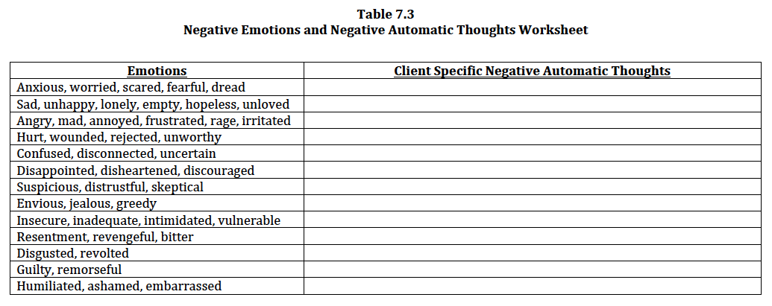
Differentiating Thoughts from Emotions

Slide 28
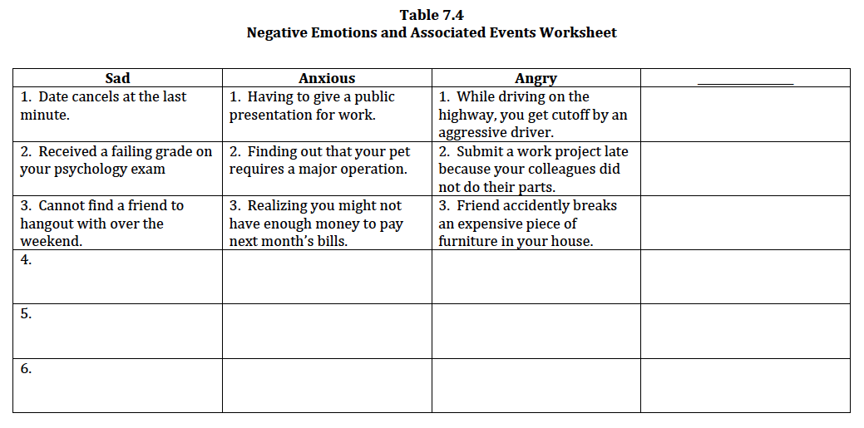
Differentiating Thoughts from Emotions

Slide 29
Tracking Negative Automatic Thoughts
In addition to writing down emotions and events, clients can record their negative automatic thoughts as soon as possible
Can heighten self-awareness of relevant thoughts
This process is essentially scaffolding clients to eventually use the Negative Automatic Thought Record (discussed later)
Table 7.5 – Negative Automatic Thoughts Tracker
Can be used as a template to track specific negative automatic thoughts throughout the day or week
Can also record body sensations

Slide 30
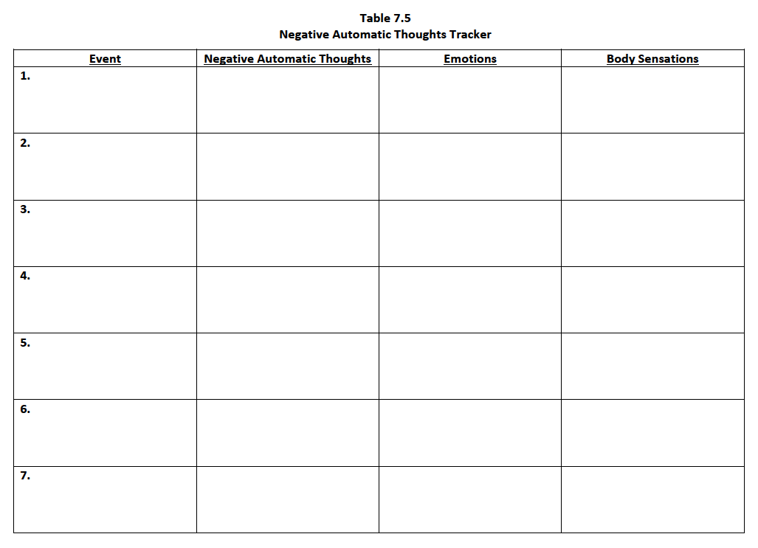

Slide 31
Remember: Use Your CBT Case Formulation
Your CBT case formulation can shape the direction of your questions to elicit emotions related to relevant automatic thoughts
e.g., precipitating and maintaining factors, presenting problems, background history
Additional information gained can help further develop your CBT case formulation, including possible core beliefs
Assessment and interventions are a continuous process

Slide 32
Evaluating and Modifying Negative Automatic Thoughts

Slide 33
Evaluating and Modifying Automatic Thoughts
Before modifying, you need to first evaluate the thoughts to see if they have practical/therapeutic relevance and are appropriate for modification
Evaluation = “emotion and thought assessment”
Modification = “emotion and thought intervention”

Slide 34
Evaluating and Modifying Automatic Thoughts
The Evaluation Process
Focusing on relevant automatic thoughts
Socratic Techniques
Evaluating to modifying automatic thoughts
Identifying Cognitive Distortions
Modifying specific thought patterns
Negative Automatic Thought Record
Cognitive Rehearsal
Imaginal cognitive exposure
Behavioral Experiments

Slide 35
The Evaluation Process (Focusing on Relevant Automatic Thoughts)
1) Rating Emotion Intensity (0-10)
Helps determine if automatic thought merits further examination
2) Rating Thought Believability (0-10)
Helps determine likelihood of client to have the particular negative automatic thought again – does the thought warrant modification?
Figure 7.2 – Emotion Intensity and Negative Automatic Thought Believability Scale
A visual scale to compare both emotion intensity and thought believability at once

Slide 36
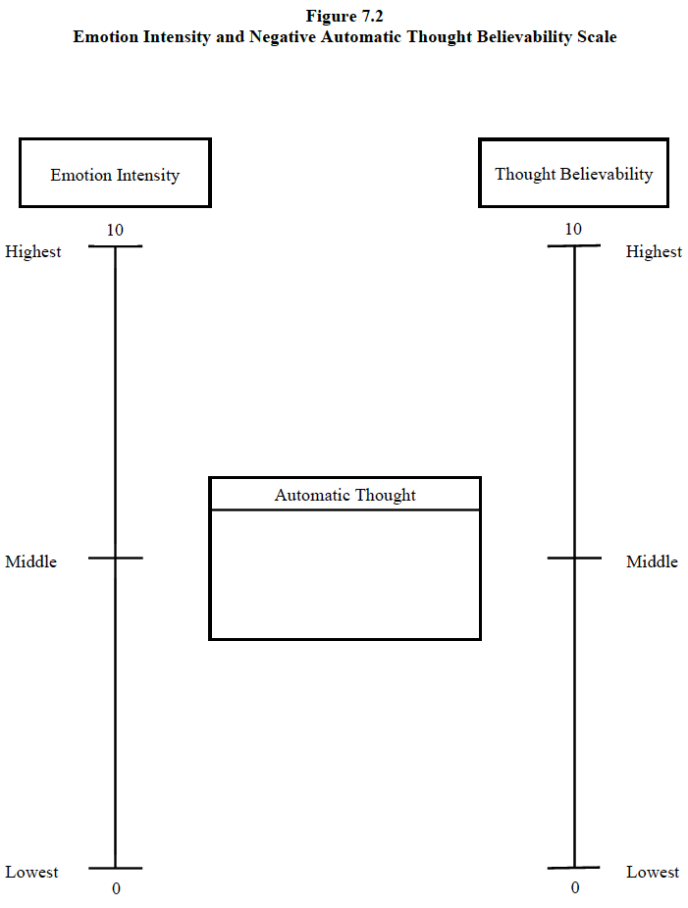

Slide 37
The Evaluation Process
3) Focus on Event
“Where?” and “When?”
Other individuals associated with event?
Other emotions, physiological arousal, thoughts/images?
Behaviors that followed – outcomes or consequences?

Slide 38
The Evaluation Process
Video Vignette 7.3 (p. 176)
MDD-10: Automatic Thoughts—Evaluating
*Includes eliciting and identifying
Discussion Questions 7.3 (p. 178)
Activity 7.1: Automatic Thoughts—Eliciting, Identifying, and Evaluating (p. 178)

Slide 39
Evaluating and Modifying Negative Automatic Thoughts
Socratic Techniques

Slide 40
Socratic Techniques (Evaluating to Modifying Automatic Thoughts)
Socratic questioning is a common term used in CBT that refers to asking clients direct questions about their negative automatic thoughts to help them “get to the truth” in their own words
In other words, you do not want to “tell” your clients what to think; rather, you want to help “show” them so they can see it for themselves
Not all of these Socratic techniques will be used for every automatic thought
It depends on the context for each thought
Table 7.6 – Socratic Techniques and Common Questions for Automatic Thoughts

Slide 41
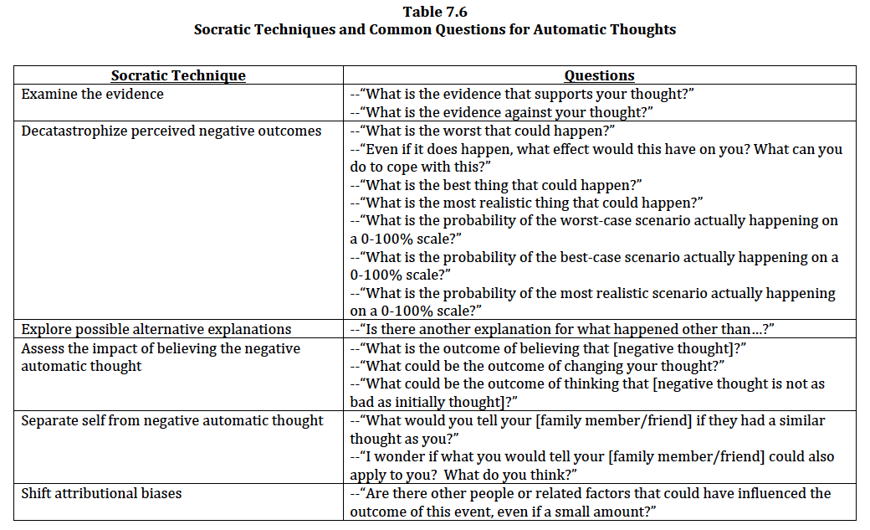
Socratic Techniques

Slide 42
Socratic Techniques
1. Examine the evidence: Determine if the negative automatic thought is invalid
2. Decatastrophize perceived negative outcomes
3. Explore possible alternative explanations
4. Assess the impact of believing the negative automatic thought
5. Separate self from negative automatic thought
6. Shift attributional biases

Slide 43
1. Examine the Evidence (Determine if the Negative Automatic Thought is Invalid)
This technique should always be used first
Once you have identified a negative automatic thought with high emotion intensity and believability you must first establish its validity
This will determine your next approach
If largely invalid, then continue with other modification techniques
If largely valid, then shift approach to focus on how to cope with such thoughts
Most automatic thoughts have some level of validity
Appropriate to acknowledge what may be true about the thought

Slide 44
1. Examine the Evidence
J. S. Beck (2011) provides three reasons for caution to not immediately attempt to modify a negative automatic thought
a) you do not know how much a negative automatic thought is truly distorted (i.e., a portion may be valid)
b) immediately modifying a thought may be invalidating to the client
c) modifying a thought without the client’s involvement does not adhere to the CBT principle of collaborative empiricism
Table 7.7 – Examining the Evidence Worksheet – Automatic Thoughts

Slide 45
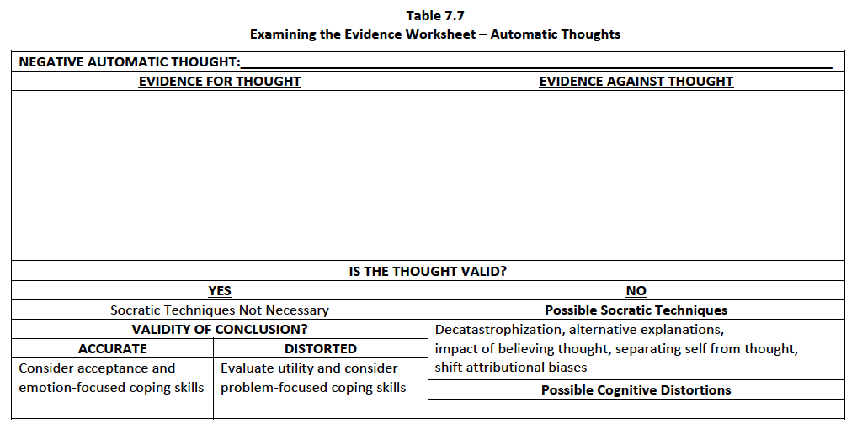
1. Examine the Evidence
1. What is the evidence that
supports your thought?
2. What is the evidence
against your thought?

Slide 46
2. Decatastrophize Perceived Negative Outcomes
Many clients associate the worst-case scenario or worst fear with their negative automatic thoughts
i.e., catastrophic predictions of the future
Catastrophic predictions are often unrealistic due to overestimation
i.e., the probability of its occurrence is minimal to none
First, focus on probability of worst-case, best-case, and most realistic scenario
If appropriate, you can follow-up with what would be the consequence if the worst thing happened and what could clients do to cope with it
If necessary, can develop a coping plan

Slide 47
2. Decatastrophize Perceived Negative Outcomes
Second, ask clients to compare the chances of the worst-case, best-case, and most realistic scenario
The final goal is to help clients recognize that worst-case scenarios rarely happen and that, if they do, it is often not that bad and that they have the skills to cope
Table 7.8 – Decatastrophizing Worksheet

Slide 48
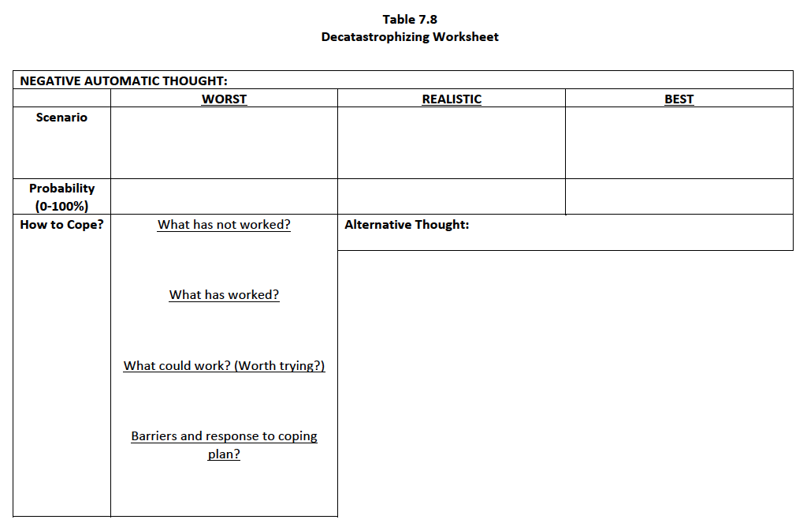
1. What is the worst thing
that could happen?*
3. What is the most realistic
thing that could happen?
2. What is the best thing
that could happen?
4. What is the probability
of the worst-case scenario?
6. What is the probability
of the most realistic scenario?
5. What is the probability
of the best-case scenario?
*Even if this does happen, what
effect would this have on you?
*What can you do
to cope with this?

Slide 49
3. Explore Possible Alternative Explanations
Many times there are different explanations for the event associated with the negative automatic thoughts and emotions
Simply ask if there is an alternative explanation for what happened
Clients might begin to recognize that their alternative explanation is actually more valid than their initial perception and negative automatic thought
Thereafter, ask them to consider possible alternative thoughts, emotions, and behaviors
Table 7.9 – Possible Alternatives Worksheet

Slide 50
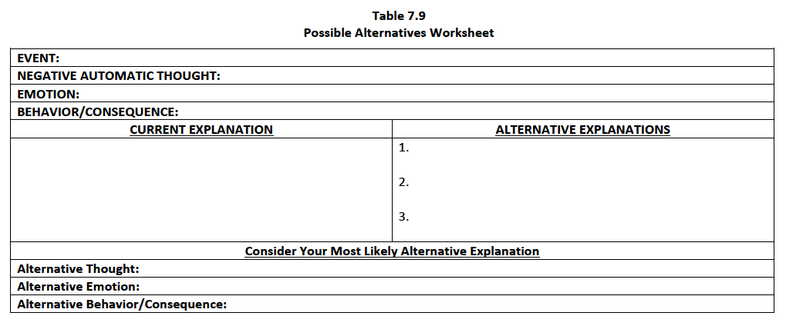
3. Explore Possible Alternative Explanations
Is there another explanation for
what happened other than…?

Slide 51
4. Assess the Impact of Believing the Negative Automatic Thought
Simply ask the outcome of believing a specific negative automatic thought
“What is the outcome of believing that you will fail your exam next week?”
Then, follow-up by asking the outcome of not believing the specific negative automatic thought and replacing it with another
“What could be the outcome of changing your thought?”
“What could be the outcome of thinking that you might not get a perfect score on your exam, but will probably get a solid passing grade?”

Slide 52
5. Separate Self From Negative Automatic Thought
Sometimes, having clients separate themselves from their thoughts helps to observe the context of a situation more objectively
A common method is to ask clients to consider what they would tell a family member or friend if they had a similar thought
“What would you tell your mother if she had a similar thought as you?”
If the alternative interpretation appears to be more adaptive and relevant to your clients’ needs, then you can ask if this can also apply to them
“I wonder if what you would tell your mother could also apply to you? What do you think?”

Slide 53
6. Shift Attributional Biases
a) Personal attribution refers to how much a person attributes events internally (themselves) or externally (the environment)
b) Permanent attribution refers to how much a person attributes events as stable (it will always be this way) or unstable (it can change)
c) Pervasive attribution refers to how much a person attributes events as global (it happens everywhere/always) or specific (it was unique/atypical)

Slide 54
6. Shift Attributional Biases
People experiencing significant distress tend to view negative events as internal/stable/global and positive events as external/unstable/specific
Of course, people do not fall into just one category of each type; they fall within a spectrum

Slide 55
6. Shift Attributional Biases
Figure 7.3 – Attributional Style Worksheet
Have clients mark where they think they fall on the dimension for each attribution
Note: it is important to differentiate their perceived attributions by negative and positive events in order to identify potential patterns
Review a recent event and negative automatic thought to “test the validity” of each attribution
Compare “right now” vs. “more adaptive”

Slide 56
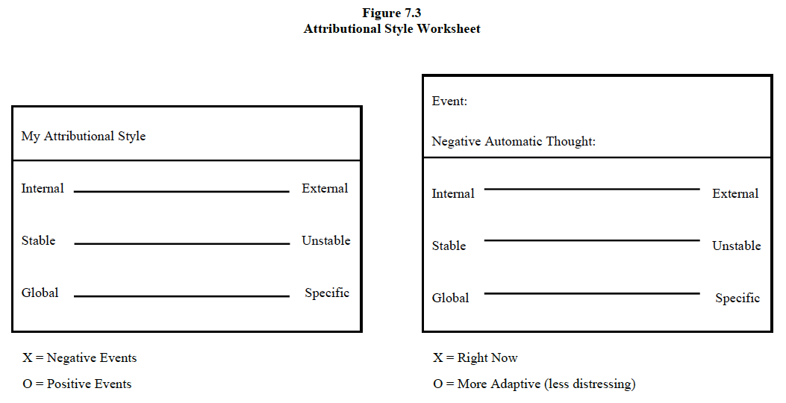
6. Shift Attributional Biases

Slide 57
6. Shift Attributional Biases
Figure 7.4 – Responsibility Attribution Pie
First, have clients identify an event with an associated negative automatic thought and emotions
Ask clients to think of anyone or something that is responsible for the negative event (try for 4 or more)
You want to ask questions that get them thinking from alternative perspectives beyond themselves
“Are there other people or related factors that could have influenced the outcome of this event, even if a small amount?”
Next, assign a percentage of responsibility to each of the identified people and factors
Then use the percentages to complete the responsibility attribution pie

Slide 58
6. Shift Attributional Biases
Figure 7.4 – Responsibility Attribution Pie (cont.)
Once the pie is complete process your clients’ reactions and assist them with shifting towards external responsibility for certain negative events
You can ask your clients to explain why the other people and/or related factors also share some of the responsibility
Thereafter, once an alternative automatic thought has been identified, have clients use the same list of who/what is responsible (there might be an addition or two) and reassign the percentages of responsibility
After creating another responsibility pie have clients reflect on the difference between the two, including alternative thoughts and emotions

Slide 59
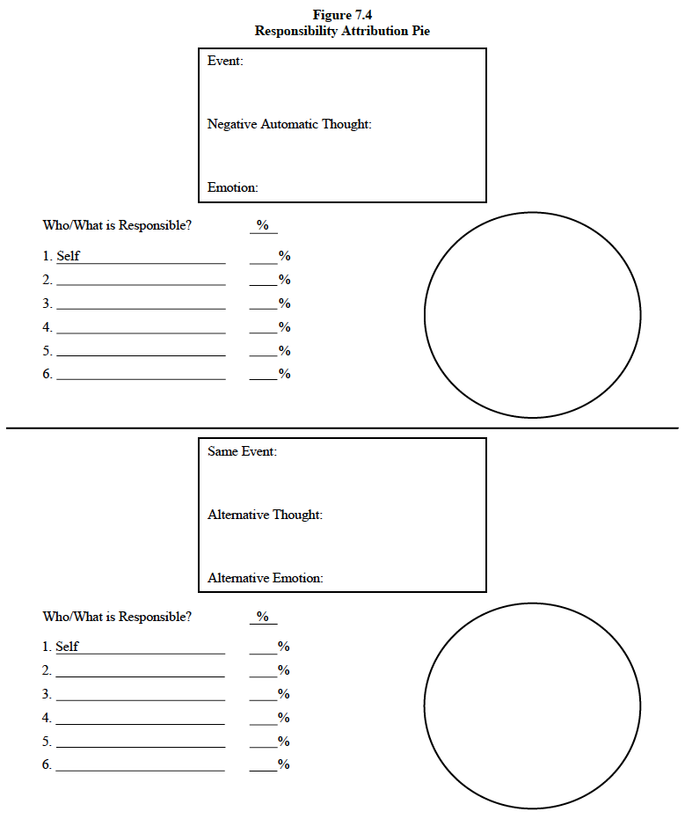

Slide 60
Socratic Techniques
Video Vignette 7.4 (p. 188)
MDD-11: Automatic Thoughts—Modifying
Discussion Questions 7.4 (p. 191)
Activity 7.2: Automatic Thoughts—Modifying (p. 192)
Activity 7.3: Automatic Thoughts—Modifying 2 (p. 192)

Slide 61
Evaluating and Modifying Negative Automatic Thoughts
*Back to remaining techniques

Slide 62
Identifying Cognitive Distortions (Modifying Specific Thought Patterns)
The primary purpose of using cognitive distortion labels is to help clients recognize their own patterns of maladaptive thinking
This can heighten clients’ self-awareness of their own automatic thoughts, which can aid in making future modifications
This cognitive awareness is sometimes referred to as “thinking about thinking,” or metacognition

Slide 63
Identifying Cognitive Distortions
Eventually some clients will be able to “prevent” and respond to such thoughts from occurring when they are able to recognize certain patterns of thinking before they spiral out of control
Table 7.10 – Cognitive Distortions and Examples
Provides a list of some of the more common types of cognitive distortions and examples

Slide 64
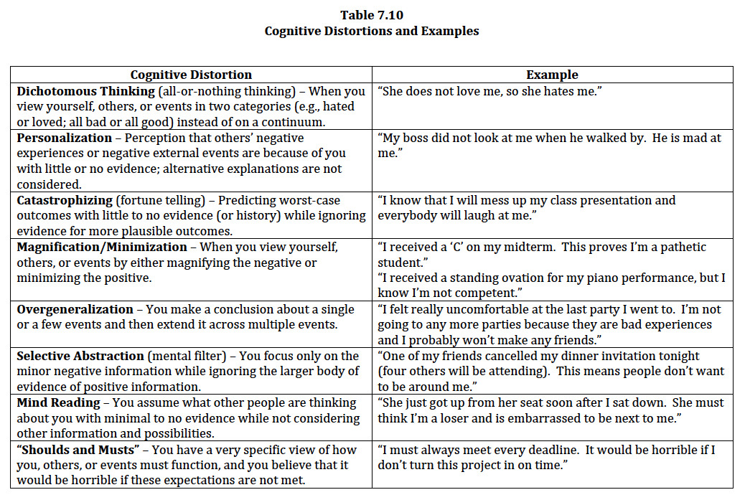

Slide 65
Negative Automatic Thought Record
A great intervention to integrate into identifying, evaluating, and modifying negative automatic thoughts
Effective use of thought records facilitates distress regulation, changes maladaptive behavioral patterns, and helps assess outcomes
Thought records also provide a great opportunity to track and log therapeutic progress over time

Slide 66
Negative Automatic Thought Record
When using the NATR the first few times, walk through each step while writing in the information provided by the client
You can also use a whiteboard and eventually have clients complete it themselves while you verbally guide them
Table 7.11 – Negative Automatic Thought Record
A version of the thought record that best matches the CBT content and skills presented in this book

Slide 68
Negative Automatic Thought Record
Start with the “Before” section
Day/time of event (or image)
Negative automatic thoughts
Rate believability
Identify cognitive distortions
Emotions/body sensations
Rate intensity
Behavioral response
Done during or after experiencing thoughts/emotions
Outcome
Result/outcome of behaviors
Thoughts/emotions in response to the outcome
Be sure to summarize and process clients’ thoughts and feelings

Slide 69
Negative Automatic Thought Record
Complete “After” section after clients have practiced Socratic techniques
Day/time of event (or image) [same as “Before”]
Alternative thoughts
Respond to any appropriate noted Socratic techniques for negative automatic thoughts
Rate believability in response to each Socratic technique
Develop alternative thought based on reviewing “Before” section and completed Socratic techniques
Rate believability of the alternative thought

Slide 70
Negative Automatic Thought Record
“After” section (continued)
Alternative emotions/body sensations
Rate intensity
Alternative behaviors
Alternative behaviors in response to alternative thoughts/emotions
Clients compare alternative emotions and behaviors to their original/actual emotions and behaviors for “Before” section
Potential for alternative thought to be less distressing than the original negative automatic thought
Alternative outcome
Alternative outcome of behavior
Believability of original negative automatic thought and believability of alternative thought

Slide 71
Negative Automatic Thought Record
When you believe clients are ready, you can have them first complete the “Before” section (or select parts) as homework
Clients can complete the “After” section as homework once it has been reviewed in session
It is okay if clients get stuck in completing their NATR homework
These moments of getting stuck can be presented as opportunities for further learning and practice

Slide 72
Negative Automatic Thought Record
Video Vignette 7.5 (p. 200)
MDD-12: Automatic Thoughts—Negative Automatic Thought Record
Completion of the “Before” section
*See Video Vignette 4.2 (MDD-13) for another example of reviewing the “Before” section
Discussion Questions 7.5 (p. 202)
Activity 7.4: Automatic Thoughts—Negative Automatic Thought Record—“Before” (p. 202)
Activity 7.5: Automatic Thoughts—Negative Automatic Thought Record—“After” (p. 203)

Slide 73
Cognitive Rehearsal (Imaginal Cognitive Exposure)
A more formal process of “thinking before acting”
Cognitive rehearsal is like “imaginal cognitive exposure” with problem solving and eventual live application
Table 7.12 – Cognitive Rehearsal Steps Worksheet
A quick reference guide to walk your clients through each of these steps while taking notes

Slide 75
Behavioral Experiments
Behavioral experiments can help clients test the validity of a specific automatic thought
Many of the modification techniques naturally lend themselves to behavioral experiments – clients will practice their new skills between sessions
Chapter 8 – Core Beliefs addresses behavioral experiments in detail

Slide 76
Working with Valid Negative Automatic Thoughts

Slide 77
Working with Valid Negative Automatic Thoughts?
Sometimes your clients will have largely valid negative automatic thoughts but are still experiencing distress
You do not want to use any Socratic or modification techniques
Your concern is more on the consequence/utility of the thought

Slide 78
Working with Valid Negative Automatic Thoughts?
Sometimes the valid negative automatic thought is associated with a distorted conclusion/meaning
Focus can be on the utility of the automatic thought by developing possible alternative conclusions and problem-focused styles of coping
Sometimes the valid negative automatic thought and conclusion/meaning are both accurate
Focus can be on accepting the reality of the situation and more emotion-focused styles of coping
Recall: Table 7.2 – Validity and Utility of Negative Automatic Thoughts

Slide 79
Working with Valid Negative Automatic Thoughts?

Slide 80
Working with Valid Negative Automatic Thoughts
Helpful strategies when working with valid negative automatic thoughts
1. Assess validity of the conclusion
2. Consider alternative conclusions
3. Problem-focused coping
4. Acceptance and emotion-focused coping

Slide 81
Working with Valid Negative Automatic Thoughts
1. Assess validity of the conclusion
Instead of challenging your clients’ thoughts, challenge their conclusions (e.g., examining the evidence)
2. Consider alternative conclusions
Develop conclusions both that are accurate and that contribute to adaptive functioning and distress reduction
Can include addressing the reality of the problem/ situation, including genuine risks and personal flaws and limitations
Includes enhancing and/or developing alternative coping strategies

Slide 82
Working with Valid Negative Automatic Thoughts
3. Problem-focused coping
Some clients may have an accurate/valid perception of the situation, but it may be possible to consider a few strategies to problem solve and alter the situation
No all problems can be solved; many times a problem can only be solved partially
Key is to find balance in using problem-focused and emotion-focused coping

Slide 83
Working with Valid Negative Automatic Thoughts
4. Acceptance and emotion-focused coping
Sometimes, there are conclusions that are accurate and do not necessarily warrant alternative conclusions
Ruminating over these conclusions can result in significant distress
Socratic technique – impact of ruminating over negative conclusions
Clients cannot change the outcome/conclusion, but they can still control how they emotionally cope
Some clients will need assistance in accepting the outcome, often through emotion-focused coping

Slide 84
Common Challenges for Automatic Thoughts

Slide 85
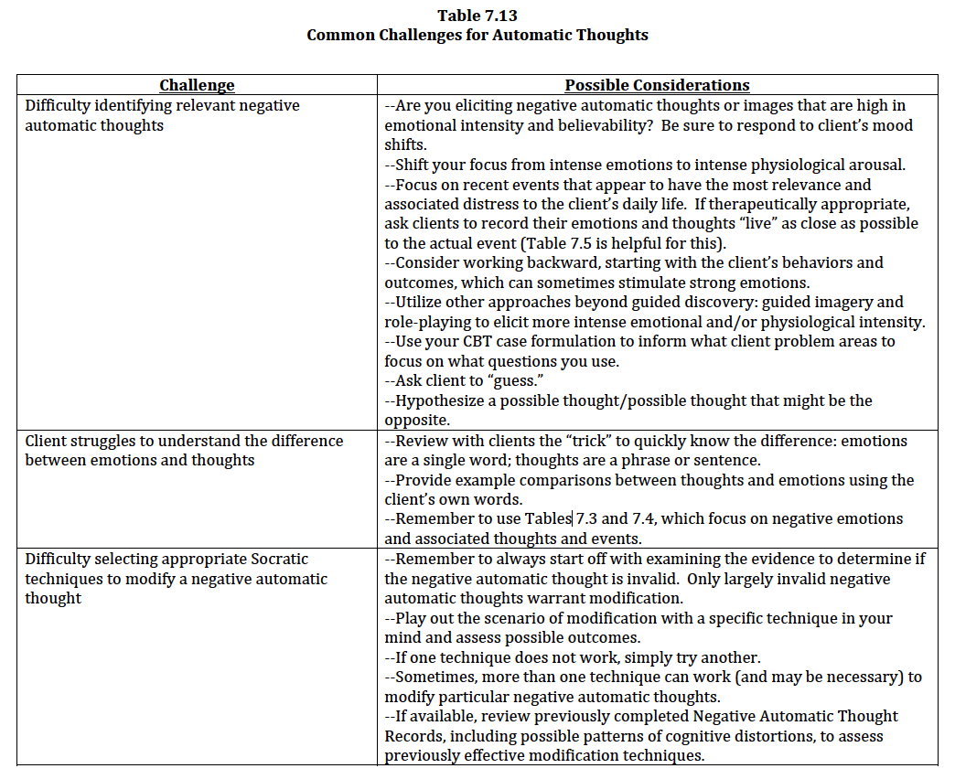

Slide 86
