Slide 1


Feminist Ethnography Thinking through Methodologies, Challenges, and Possibilities, Second Edition DÁNA-AIN DAVIS AND CHRISTA CRAVEN

Slide 2
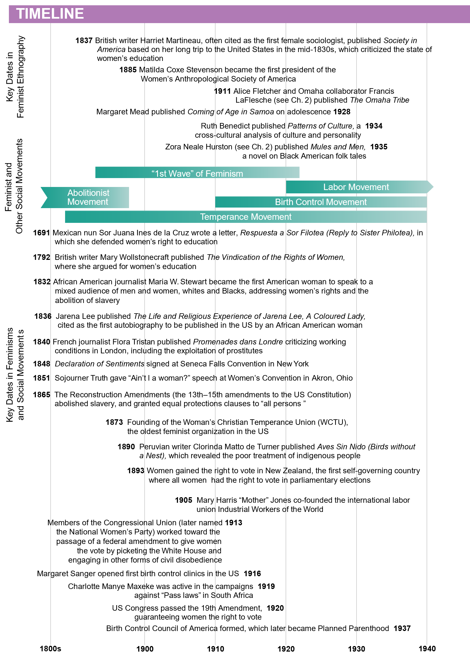
© Rowman & Littlefield

Slide 3
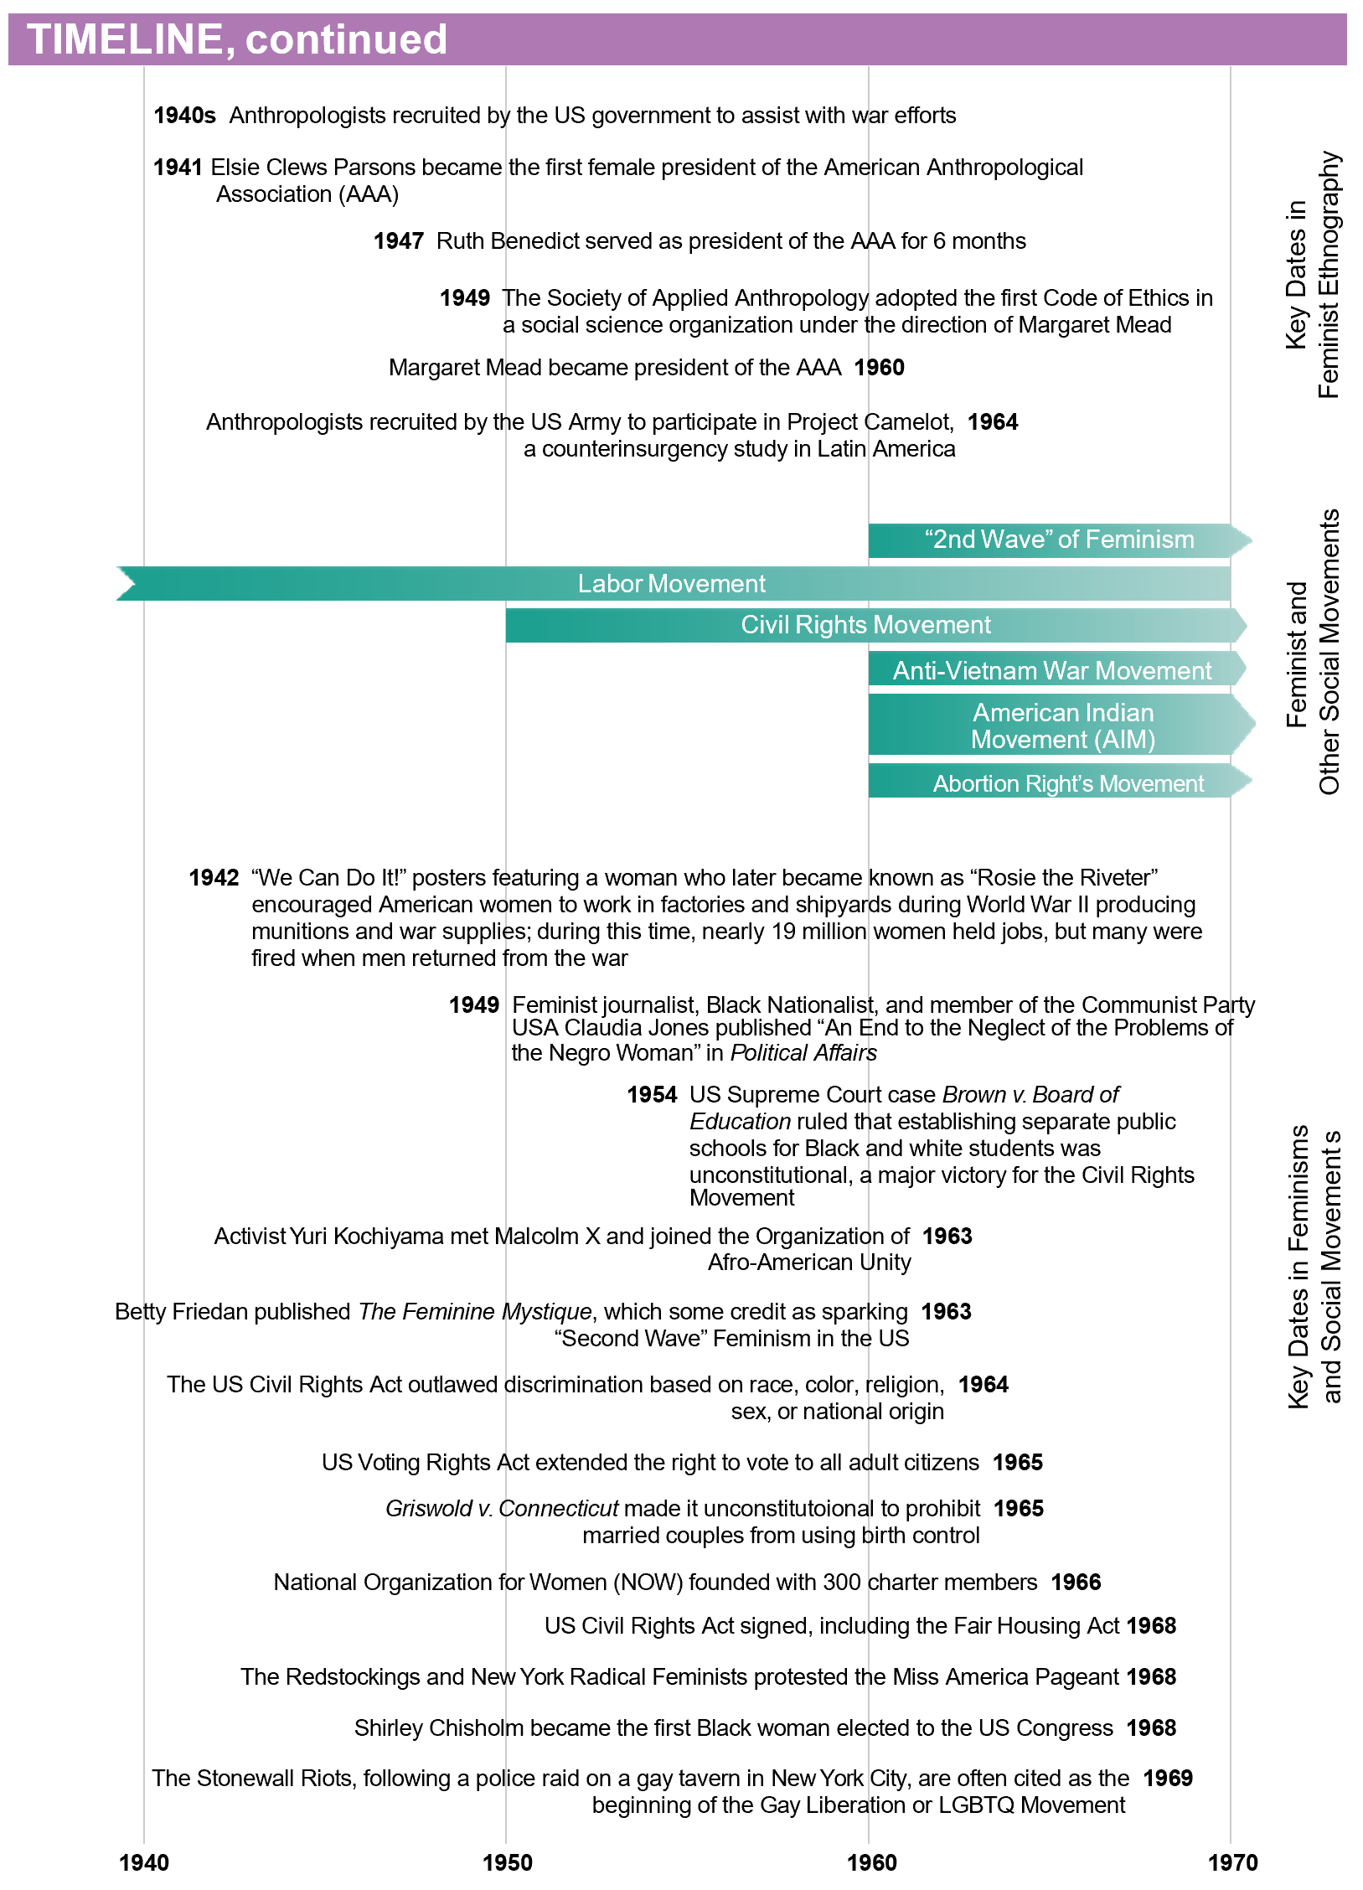
© Rowman & Littlefield

Slide 4
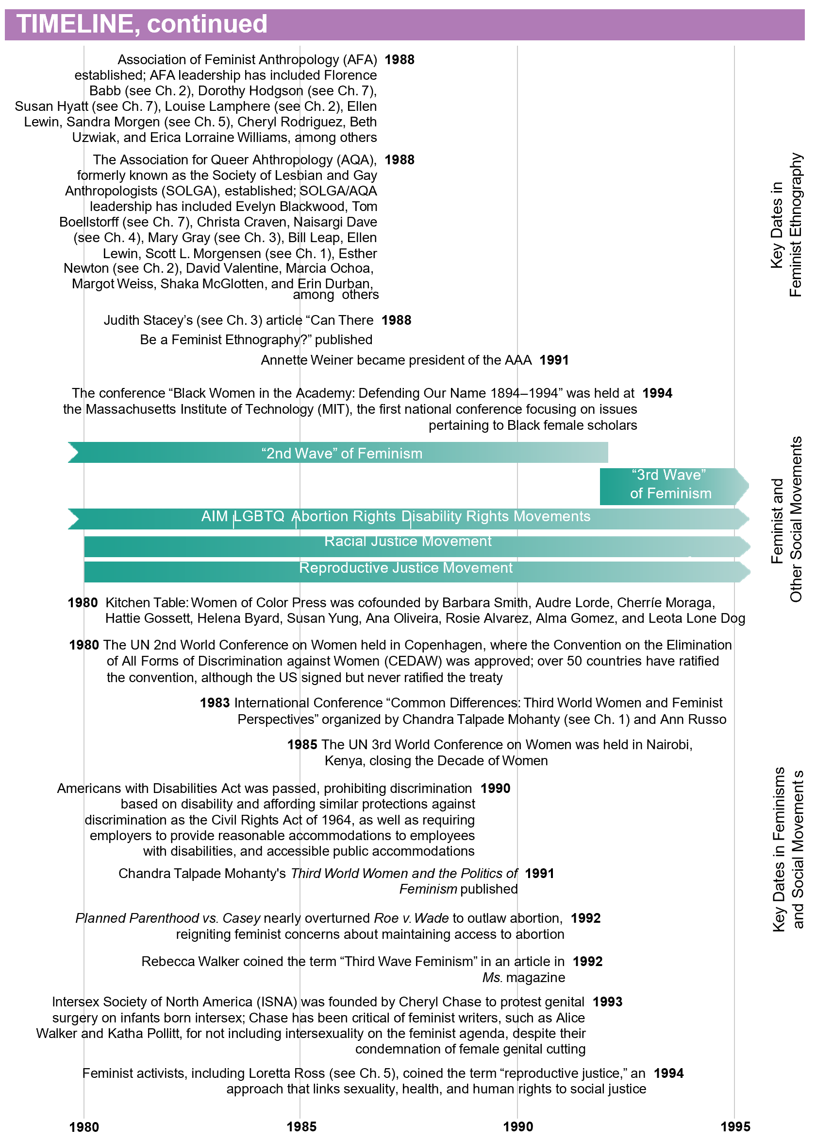
© Rowman & Littlefield

Slide 5
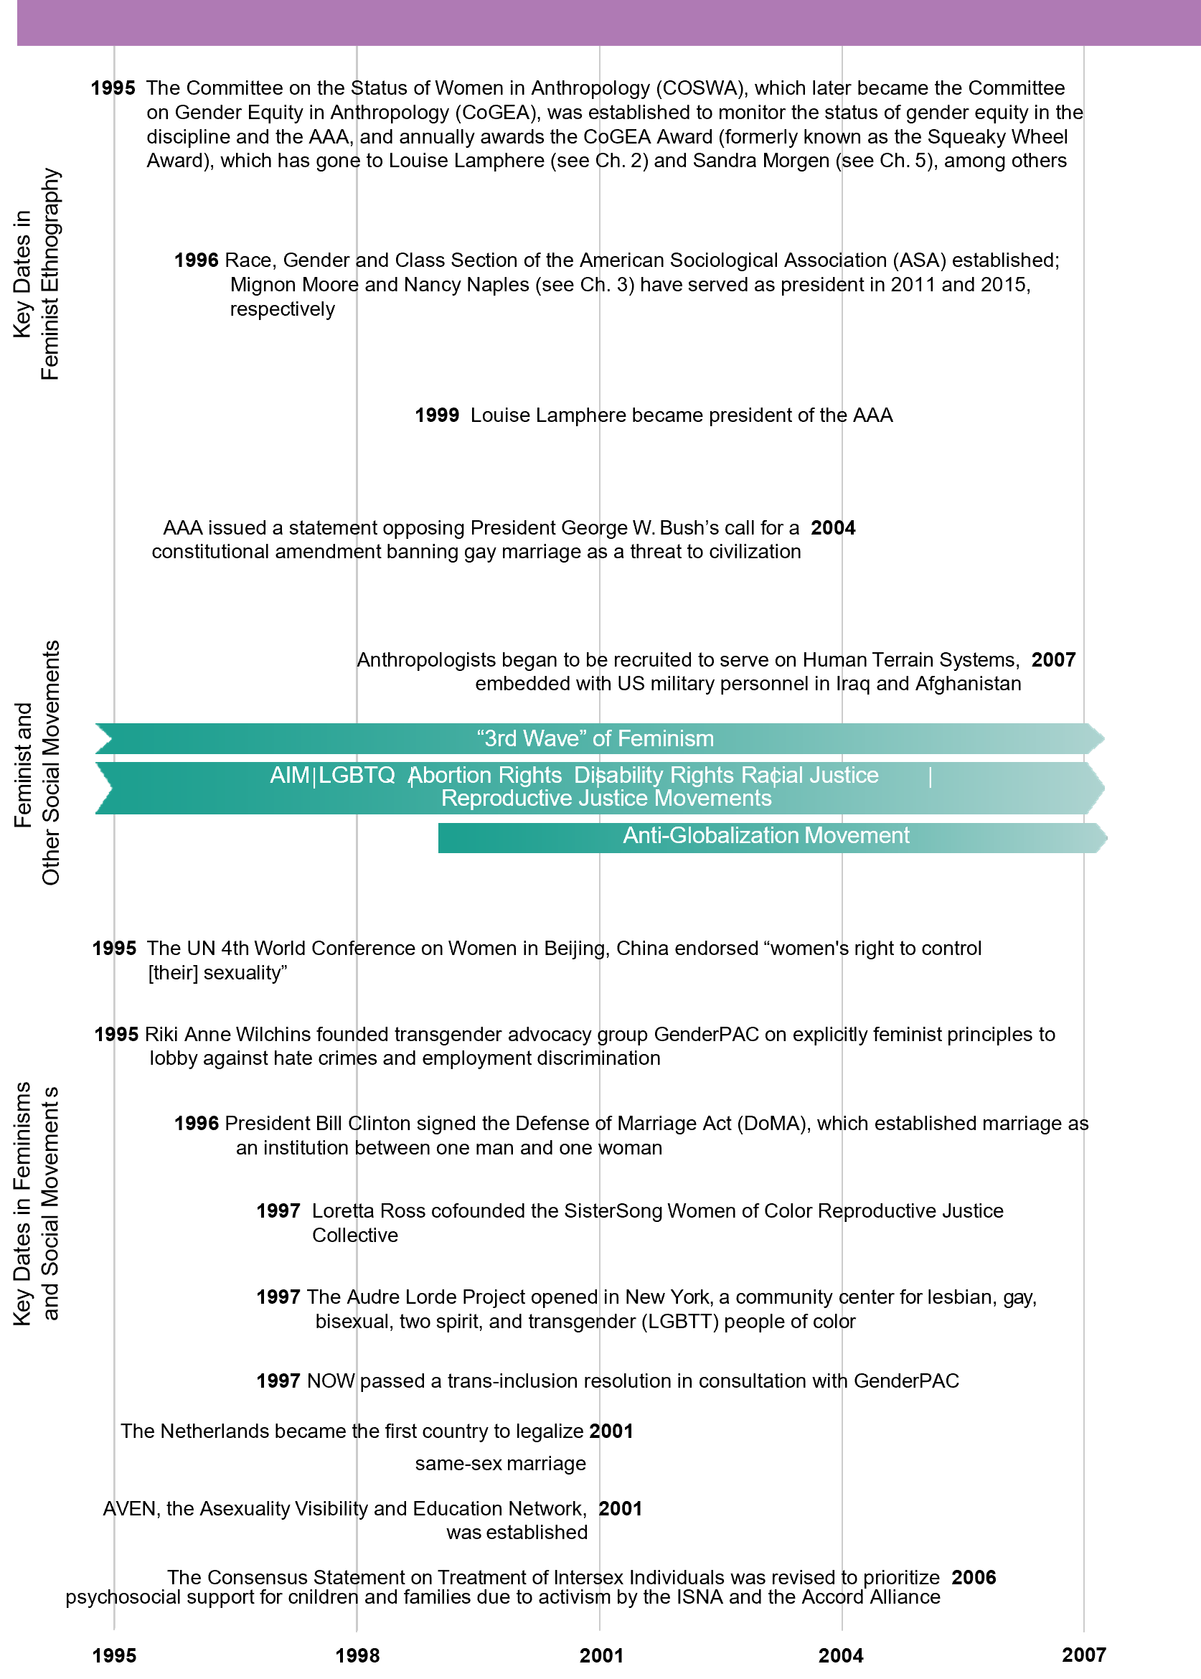
© Rowman & Littlefield

Slide 6
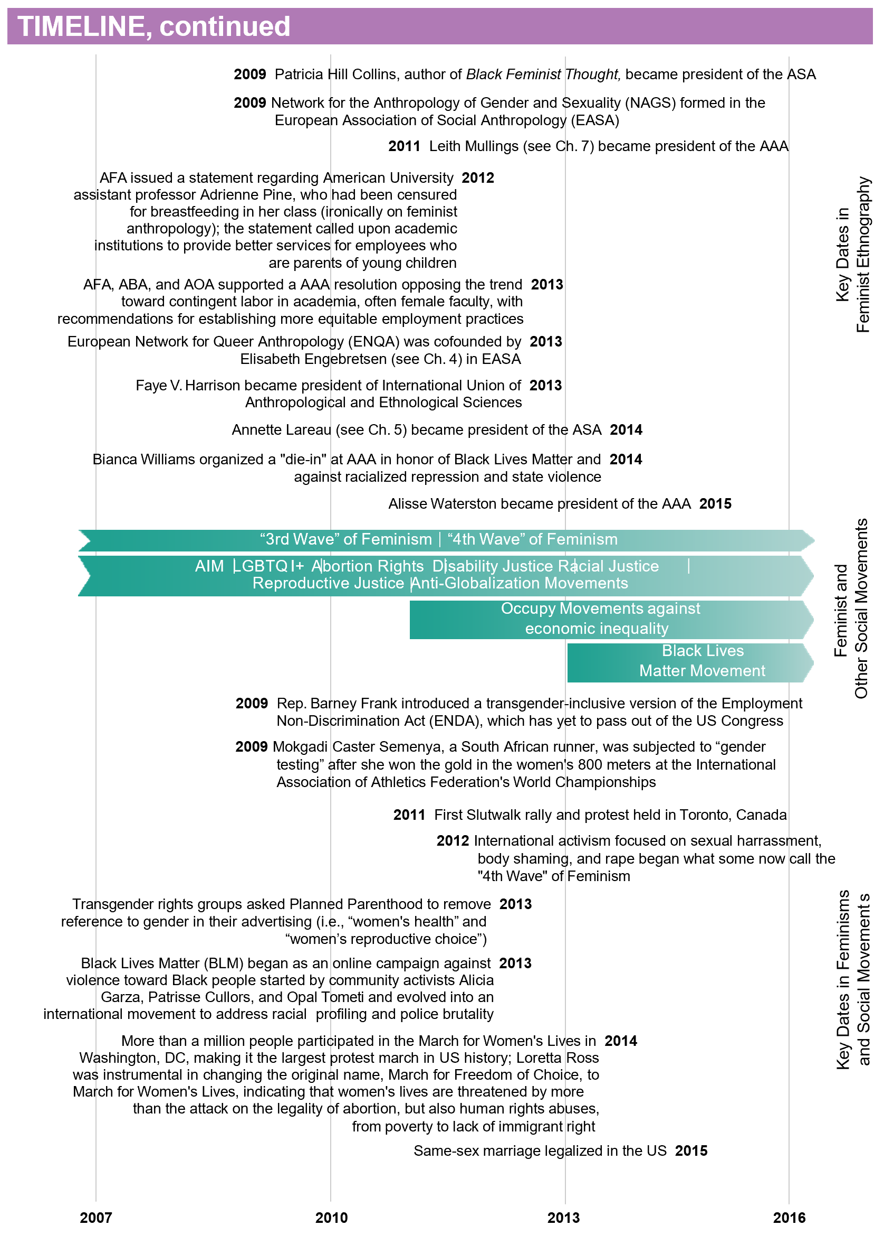
© Rowman & Littlefield

Slide 7
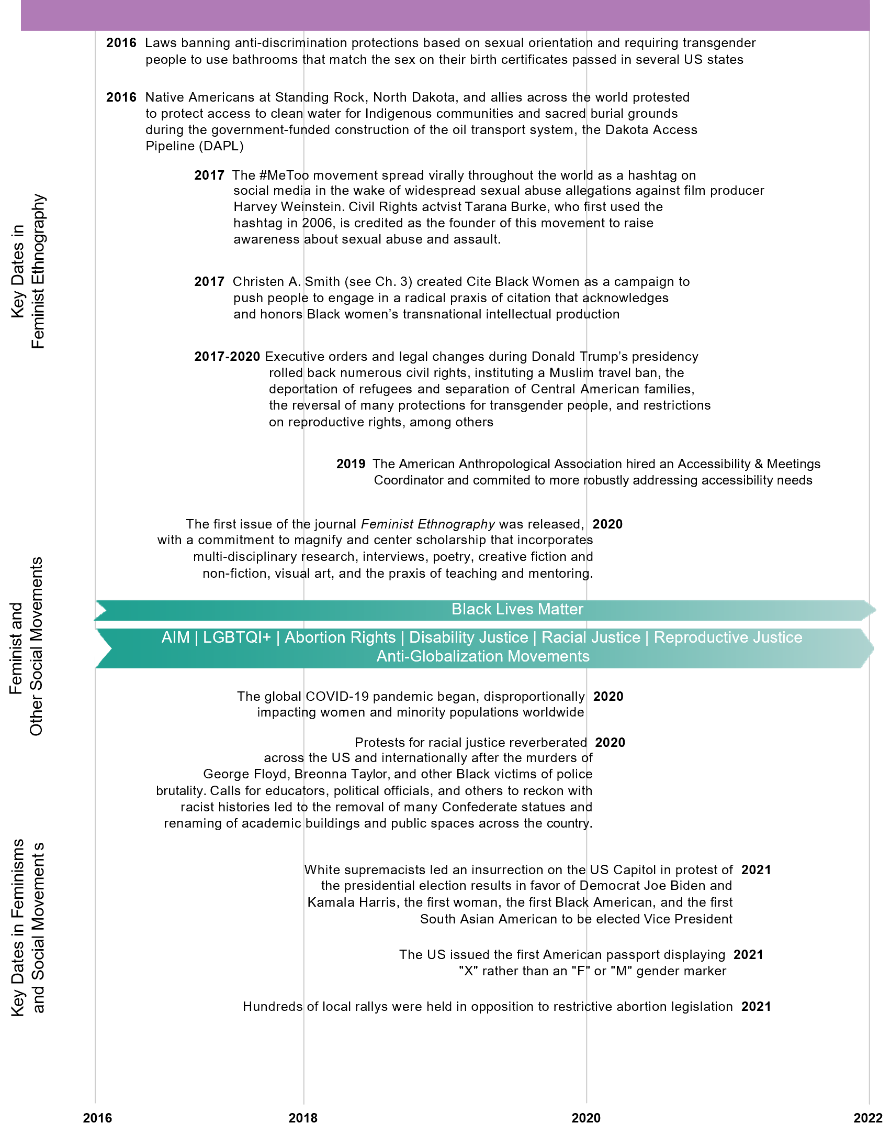
© Rowman & Littlefield

