Slide 1
Frankenstein
CHAPTER 5

Slide 2
NOTES TO TEACHERS
These were originally made for teaching AQA AS and A-Level Language and Literature courses.
Hopefully, with some editing, they can be adaptable to:
your exam board
your Year 12 or 13 cohorts
how you wish to teach your groups.

Slide 3
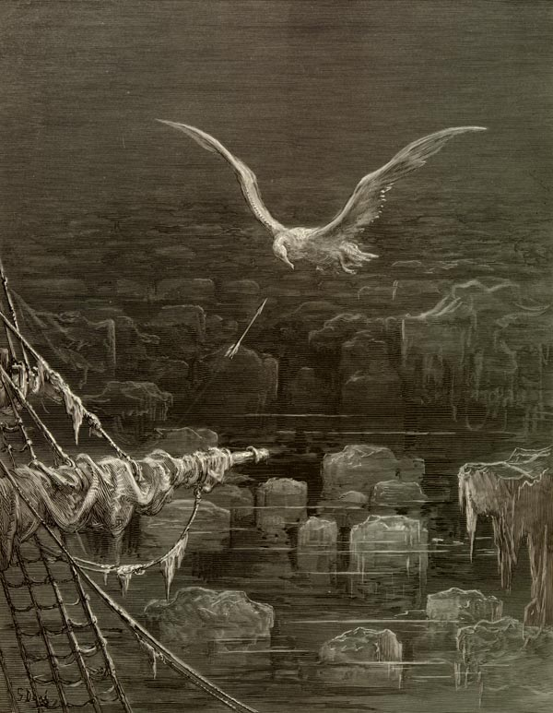
LITERARY CONTEXT: COLERIDGE’S THE RIME OF THE ANCIENT MARINER
Orson Wells’ full version
https://www.youtube.com/watch?v=oRGnoFf2cZQ
Ancient Mariner in 3 minutes
https://www.youtube.com/watch?v=87AmKo7yy6c
Short film version
https://www.youtube.com/watch?v=bFZ3jirmdpc
Source of image:
https://ebooks.adelaide.edu.au/c/coleridge/samuel_taylor/rime/
The original text
https://www.poetryfoundation.org/poems-and-poets/poems/detail/43997

Slide 4
HORROR AND TERROR
Gothic novelist Ann Radcliffe (On the Supernatural in Poetry, 1826) distinguished between terror and horror.
Terror relies on subtle suggestion to create tension and fear.
Horror is direct and explicit in the depiction of death, decay and violence.
Shelley draws alternately upon horror and terror, and this is fairly clear to see in Chapter 5.

Slide 5
HORROR AND TERROR AND CHAPTER 5
Examples of terror | Examples of horror | What do you notice about the language used to construct them?

Slide 6
GOTHIC SPACE
Claire Kahane in The Gothic Mirror (1985) notes that the heroine of an eighteenth-century Gothic novel:
“penetrates the obscure recesses of a vast labyrinthine space and discovers a secret room sealed off by its association with death. In this dark secret corner of the Gothic structure, the boundaries of life and death themselves seem confused.”
Look closely at Victor’s laboratory – to what extent is this an update of the convention described by Kahane? (You may need to look at both Chapter 4 and 5 for this.)

Slide 7
COMPREHENSION QUESTIONS
How does Victor react when his creation comes to life? Explain your feelings about his reaction to his creation. Were you surprised? Why or why not?
Does Victor’s dream exploit terror, or horror in its narration?
How might the passage from Coleridge’s Rime of the Ancient Mariner apply to Victor Frankenstein?
How does Victor react to Henry Clerval’s arrival in Ingolstadt, and what does this tell us about their relationship?
What does the Creature do after leaving Victor’s laboratory, and why?
What is the favour that Henry asks of Victor? Why is this necessary?

Slide 8
FRANKENSTEIN AND TEMPORAL SHIFTS CHAPTERS 1 - 5
Temporal shift | Victor | Purpose? Effect? Language used to achieve this?
Analepsis (flashback)
Prolepsis (flashforward)

Slide 9
Chapter 5 Extract analysis: tone, register, lexis, semantics, sentence structures, noun phrases, imagery e.g. simile, phonology e.g. alliteration, sibilance What can you find? Why is it there?
Exam Q: What do we learn about Victor Frankenstein from this extract?
The different accidents of life are not so changeable as the feelings of human nature. I had worked hard for nearly two years, for the sole purpose of infusing life into an inanimate body. For this I had deprived myself of rest and health. I had desired it with an ardour that far exceeded moderation; but now that I had finished, the beauty of the dream vanished, and breathless horror and disgust filled my heart. Unable to endure the aspect of the being I had created, I rushed out of the room, continued a long time traversing my bed chamber, unable to compose my mind to sleep. At length lassitude succeeded to the tumult I had before endured; and I threw myself on the bed in my clothes, endeavouring to seek a few moments of forgetfulness. But it was in vain: I slept, indeed, but I was disturbed by the wildest dreams. I thought I saw Elizabeth, in the bloom of health, walking in the streets of Ingolstadt. Delighted and surprised, I embraced her; but as I imprinted the first kiss on her lips, they became livid with the hue of death; her features appeared to change, and I thought that I held the corpse of my dead mother in my arms; a shroud enveloped her form, and I saw the grave-worms crawling in the folds of the flannel. I started from my sleep with horror; a cold dew covered my forehead, my teeth chattered, and every limb became convulsed: when, by the dim and yellow light of the moon, as it forced its way through the window shutters, I beheld the wretch -- the miserable monster whom I had created. He held up the curtain of the bed and his eyes, if eyes they may be called, were fixed on me. His jaws opened, and he muttered some inarticulate sounds, while a grin wrinkled his cheeks. He might have spoken, but I did not hear; one hand was stretched out, seemingly to detain me, but I escaped, and rushed down stairs. I took refuge in the courtyard belonging to the house which I inhabited; where I remained during the rest of the night, walking up and down in the greatest agitation, listening attentively, catching and fearing each sound as if it were to announce the approach of the demoniacal corpse to which I had so miserably given life.

