Slide 1
Frankenstein
CHAPTER 24

Slide 2
NOTES TO TEACHERS
These were originally made for teaching AQA AS and A-Level Language and Literature courses.
Hopefully, with some editing, they can be adaptable to:
your exam board
your Year 12 or 13 cohorts
how you wish to teach your groups.

Slide 3
CHAPTER 24/ VOLUME III, CHAPTER 7
Victor’s increasing madness
As Victor narrates his pursuit of the Creature all across Europe, Russia and eventually the Arctic, it becomes increasingly clear that his mind is becoming increasingly unhinged (Why might this make us question the validity of his narration?).
When Victor visits the cemetery he believes the departed spirits of his loved ones hover around him– which emphasises the extent of his delusion(s) and increasingly looser grasp of reality.
As Victor’s rage towards the Creature continues to increase, he only hears in response the ‘fiendish laugh’ of the Creature.
Ironically, Victor believes that good spirits of the departed have left parcels of food for him, whereas we know that it is of course, the Creature. This is also another example of the narrative mirroring that occurs in the text, which part of the text’s narrative is mirrored here and why? This is also an example of reader position of privilege, due to Shelley’s ‘Russian Doll’ narrative structure, we are party to more information than the characters who narrate and participate in the story.

Slide 4
CHAPTER 24/ VOLUME III, CHAPTER 7
The merging of Victor and the Creature
At this point in the text, all three narratives merge in this chapter as all three narrators converge in the same, desolate location.
Victor and the Creature are full of rage and fury, both believing themselves to be the most miserable, and the true victim of this sorry tale.
There is even a moment in Walton’s narration where the merging of Victor and the Creature is more explicit as Walton observes the Creature within Victor – locate the relevant quotation for this moment:
Explore the language Shelley uses
What is the purpose and effect of the language she chooses and why?
Victor’s tranquil voice and disposition disappear quickly and, ‘like a volcano bursting forth, his face would suddenly change to an expression of wildest rage.’ Akin to Jekyll’s transformation into Mr. Hyde. Consider the relevance of the gothic concept of metamorphosis at the moment in the narrative.

Slide 5
CHAPTER 24/ VOLUME III, CHAPTER 7
Victor or the Creature? Can we tell?
‘I wondered like an evil spirit, for I had committed deeds of mischief beyond description horrible.’
‘I had begun life with benevolent intentions…Now all was blasted.’
Who says which quotation above?
Who is it that hates and suffers the most?

Slide 6
CHAPTER 24/ VOLUME III, CHAPTER 7
Symbolism: Fire and Ice
In Fire and Ice in Frankenstein (1979), Andrew Griffin observes that while fire is associated with life, ‘vital fire or fiery life’, ice is what negates fire; it blights and kills; it is repression and death. (pp 49-50)
These two extremes are frequently brought together in Frankenstein – when and where is this most memorably done? Why?
In the final chapter, we witness the Creature’s plan to seek the furthest northern extremity and then light the funeral pyre and, ‘consume to ashes’ his ‘miserable frame’ we see the most dramatic combination and juxtaposition of fire and ice in the novel.
Fire will return the frame to life, fire will return the frame (of the body) to ashes, and his ‘burning miseries’ will be made visible and consumed by the torturing flames. Although this is implied, the Creature’s final moments are ambiguous, why might this be?
Task: Find ALL the examples of language relating to fire and ice in this chapter.

Slide 7
CHAPTER 24/ VOLUME III, CHAPTER 7
Gothic endings
In the earlier 18th century Gothic texts (of writers such as Ann Radcliffe) - the villains are defeated and the heroine, after her extensive adventures, is finally reinstated with respectability though her marriage.
This kind of text, and ending, is parodied by Jane Austen in Northanger Abbey (1818) which ends in ‘perfect felicity’.
There is no ‘perfect felicity’ in Frankenstein. All ends in failure, no one really receives a happy ending.
Furthermore, the ending is marked by ambiguity, and example of an ‘open ending’ (David Lodge, The Art of Fiction’ 1993, p. 234) leaving possibilities of different futures.
So, in the context of this the type of Gothic text, the reader is like the Creature, ‘lost in darkness and distance’.

Slide 8
CHAPTER 24/ VOLUME III, CHAPTER 7
Key quotation
Victor describes himself to Walton: ‘like an archangel who aspired to omnipotence, I am chained to eternal hell.’
Victor has linked himself to Satan, like the Creature, so the merging of the two characters is complete
He continues the motif of the Romantic, satanic hero and suggests that hell is something eternal.
Are there other interpretations that you can observe?

Slide 9
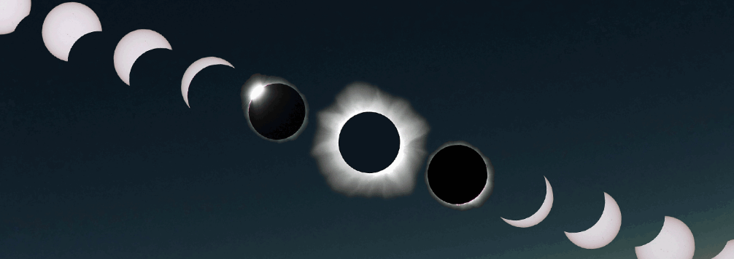
VICTOR AND THE CREATURE REACH ‘TOTALITY’:
Find examples in Chapter 24, where Victor’s language and characterisation seem indistinguishable from the Creature
Notes:
Image credit unknown. Would like to credit if possible.

Slide 10
CHAPTER 24
READ THE EXTRACT AND EXAMINE HOW SHELLEY PRESENTS WALTON’S NARRATIVE VOICE IN THIS EXTRACT (FOCUS: NARRATIVE TECHNIQUE)
Walton, in continuation.
August 26th, 17-
You have read this strange and terrific story, Margaret; and do you not feel your blood congeal with horror, like that which even now curdles mine? Sometimes, seized with sudden agony, he could not continue his tale; at others, his voice broken, yet piercing, uttered with difficulty the words so replete with anguish. His fine and lovely eyes were now lighted up with indignation, now subdued to downcast sorrow and quenched in infinite wretchedness. Sometimes he commanded his countenance and tones and related the most horrible incidents with a tranquil voice, suppressing every mark of agitation; then, like a volcano bursting forth, his face would suddenly change to an expression of the wildest rage as he shrieked out imprecations on his persecutor.
His tale is connected and told with an appearance of the simplest truth, yet I own to you that the letters of Felix and Safie, which he showed me, and the apparition of the monster seen from our ship, brought to me a greater conviction of the truth of his narrative than his asseverations, however earnest and connected. Such a monster has, then, really existence! I cannot doubt it, yet I am lost in surprise and admiration. Sometimes I endeavoured to gain from Frankenstein the particulars of his creature’s formation, but on this point he was impenetrable. “Are you mad, my friend?” said he. “Or whither does your senseless curiosity lead you? Would you also create for yourself and the world a demoniacal enemy? Peace, peace! Learn my miseries and do not seek to increase your own.” Frankenstein discovered that I made notes concerning his history; he asked to see them and then himself corrected and augmented them in many places, but principally in giving the life and spirit to the conversations he held with his enemy. “Since you have preserved my narration,” said he, “I would not that a mutilated one should go down to posterity.”

Slide 11
USEFUL KEY WORDS
Literary key words: narrator, narratee, narrative point of view, perspective, narrative voice, tone, register, implied/actual reader, implied/actual writer, central events, additional events, analepsis, prolepsis
Linguistic key words: mode, lexical choice (word classes and sub-word classes), morphology, euphemism, dysphemism, synonyms, antonyms, hyponymy, semantic field
Syntactical choices: simple, compound, complex minor sentences, declarative, interrogative, imperative, exclamatory sentences
Imagery: metaphor (simile, metaphor, anthropomorphism, zoomorphism), symbolism
Rhetorical structures: polyptoton, antithesis, anadiplosis, diacope, anaphora, cataphoric reference (→) , anaphoric reference (←)
Phonology: alliteration, assonance, consonance, sibilance
Pragmatics: embodied knowledge, schemas, co-text, Grice’s maxims, implicature, Goffman’s politeness principals, deixis
Discourse: Labov and Goodwin’s story structures, multi-speaker interactions, turn taking, adjacency pairs, preferred response, dispreferred response, and common spoken language features like repairs and elision.
DO NOT FORGET CONTEXTUAL INFLUENCES (NARRATIVE STRUCTURE, SOCIAL, HISTORICAL, AUTHORIAL, POLITICAL) WHEN ANALYSING AN EXTRACT

Slide 12
Cross reference to other parts of the text
Narrative purpose of language use
Language used (terms)
Quote:
Focus, either: point of view, presentation of time/space, narrative structure, characterisation
Notes:
Use to get students to develop a deep analysis of a quotation

Slide 13
Action
Reaction
Dialogue
Description
Walton
Chapter 24

