Slide 1

Copyright
Text copyright © Fe Brewer, Mary Hind-Portley and Gwen Nelson
Fe Brewer, Mary Hind-Portley and Gwen Nelson have asserted their rights under the Copyright,
Designs and Patents Act, 1988, to be identified as Authors of this work
© Fe Brewer, Mary Hind-Portley and Gwen Nelson, 2025

Slide 2
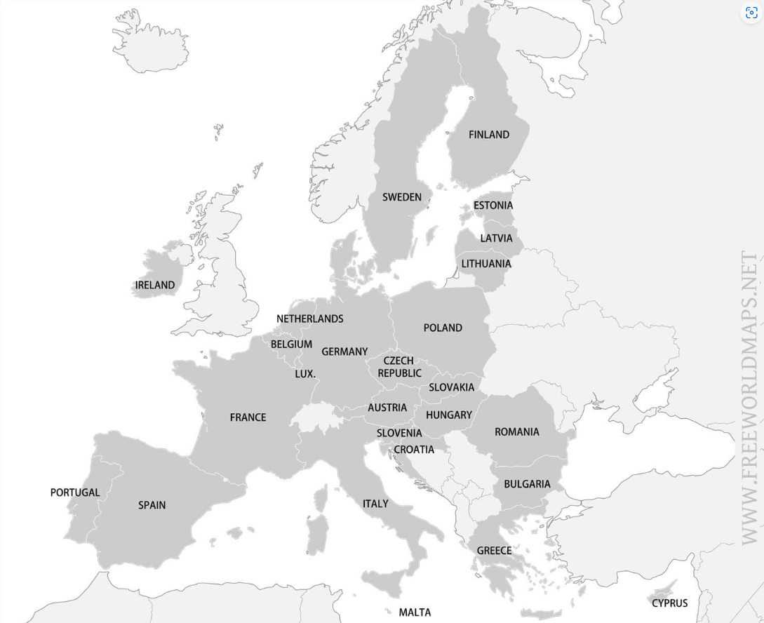
Key Locations:
Geneva
Ingolstadt
Montanvert
Locations explored with Clerval: Strasburg - Cologne - Rotterdam -London (Greenwich, Gravesend, Woolwich, Tilbury Fort) - Windsor - Oxford - Matlock - Derby - Cumbria - Edinburgh - Orkney Isles
Locations travelled to by Victor alone: Orkney - Ireland
Locations travelled to by Victor and Alphonse Ireland - Holyhead - Portsmouth - Havre - Paris - Geneva
Locations Victor travels to in
search of the creature: The Rhone -the Mediterranean - the Black Sea -Tartary - Russia - the Arctic
Walton’s locations: London - St Petersburg - Archangel

Slide 3
Section 1: Walton’s Letters
How does Shelley use Walton’s narrative voice at the beginning of Frankenstein?
Why must Walton and Victor meet on the deadly ice flow?

Slide 4
Summary of Key Points
Letter 1:
Walton writes to his sister, Margaret Saville, explaining his progress so far with his Arctic expedition.
He gives his current and next geographical location: St Petersburg and then Archangel.
Letter 2:
In Archangel, Walton writes again to his sister, telling her about his crew.
He tells her that he is certain of success, and writes of the wondrous Arctic landscape.
Letter 3:
The length of this letter shows that there seems to be little worth writing to his sister about.
His crew are as yet unfazed by any of the cold weather or icebergs that they encounter.
He reassures his sister that he will not ‘rashly encounter danger’, while also boasting of the anticipated triumph of his expedition.

Slide 5
Summary of Key Points
Letter 4:
Walton and his crew are surrounded by ice and thick fog.
Once the fog clears, Walton and his crew catch sight of a gigantic man-like creature being pulled on a sledge.
In the morning, there is another unexpected encounter with a stranger on a sledge, on the brink of death.
Walton takes charge of the stranger’s care and both men begin talking to each other.
The stranger insists on telling Walton the story that explains why he is in such a wretched state on the ice floes.

Slide 6
Key Vocabulary: Letter 1
Word | Quotation | Definition
ardent | ‘I am too ardent in execution and too impatient of difficulties.’ | having intense emotion or enthusiasm (Recurs in all letters and Chapters 2, 3, 4, 9, 12, 13, 14, 17, 18, 21, 23, 24)
forebodings | ‘You will rejoice to hear that no disaster has accompanied the commencement of an enterprise which you have regarded with such evil forebodings.’ | in anticipation of something happening, especially approaching or overhanging evil
inspirited | ‘Inspirited by this wind of promise, my daydreams become more fervent and vivid.’ | to put spirit, life or energy into; to quicken, enliven, animate; to cheer, encourage; to incite, stir
fervent |  | of persons, their passions, dispositions or actions; ardent, intensely earnest, often used in relation to love or hatred (from 17th century onwards)
diffusing | ‘There, Margaret, the sun is for ever visible, its broad disk just skirting the horizon and diffusing a perpetual splendour.’ | to send forth (an immaterial, or abstract thing) in many or all directions; to spread among a large number of people; to disseminate
splendour |  | magnificence; great show of riches or costly things; pomp, parade (transitive verb: to move with splendour)

Slide 7
Key Vocabulary: Letter 2
Word | Quotation | Definition
dauntless | ‘those whom I have already engaged… are certainly possessed of dauntless courage.’ | not to be daunted; fearless, intrepid, bold, undaunted
assailed | ‘If I am assailed by disappointment, no one will endeavour to sustain me in dejection.’ | to attack with physical violence, assault
endeavour |  | to try, to make an effort for a specified object (objective); to attempt
inclinations | ‘my early inclinations’ | a person’s natural tendencies or preferences

Slide 8
Key Vocabulary: Letter 3
Word | Quotation | Definition
enterprise | ‘my courageous, yet sometimes despairing, enterprise’ | a project or undertaking, especially one that is difficult
satiate | ‘satiate my curiosity’ | to fully satisfy a desire or appetite
zeal | ‘how much happier I am than during my earlier zeal’ | great energy or enthusiasm in pursuit of a cause

Slide 9
Key Vocabulary: Letter 4
Word | Quotation | Definition
impertinent | ‘Certainly; it would indeed be very impertinent and inhuman in me to trouble you with any inquisitiveness of mine.’ | not showing proper respect; rude
fastidious | ‘you are therefore somewhat fastidious’ | very attentive to and concerned about accuracy and detail
benevolence | ‘his whole countenance is lighted up, as it were, with a beam of benevolence and sweetness that I never saw equalled’ | the quality of being well-meaning; kindness (Recurs in Chapters 3, 11, 15, 16, 17, 21)
unintelligible | ‘but there is something so strange and unintelligible in his manner that I could not help remarking it to you’ | not able to be understood

Slide 10
Key Questions to Consider
‘Why’ is an important question, not only within the world of the text but when also considering authorial intent and meaning.
In Letters 1 and 2, Walton was certain that his expedition would be a magnificent success. Why is he less certain in Letters 3 and 4?
Why does Shelley provide the reader with the merest glimpse of the Creature in Letter 4?
Why does Victor Frankenstein enter the narrative in Letter 4 and not Letter 1?
Why begin the narrative in the setting of the Arctic?
Why is it important that readers are introduced to two ambitious men of science, rather than
just one?
Stretch questions
Why does Shelley use a frame narrative?
Why does Shelley choose to use letters for Walton’s narrative?

Slide 11
Plot and Character Development
1. Who is Robert Walton and what are his letters about?
2. Why is Walton travelling?
3. Where is Walton? Are the places real?
4. Why does nothing much seem to happen in Letter 3?
5. Who do Walton and his crew see before they find Victor?
6. What is Walton’s reaction to Victor’s arrival?
7. Why does Shelley withhold Victor Frankenstein’s name from the reader until the end of Letter 4?
8. How does Victor’s arrival develop Walton’s character and the plot?

Slide 12
Structure: Letters 1 and 2
Letter 1 | Letter 2
Opening: ‘You will rejoice to hear that no disaster has accompanied the commencement of an enterprise which you have regarded with such evil forebodings’ | Opening: ‘How slowly the time passes here, encompassed by frost and snow!’
Ending: ‘Heaven shower down blessings on you, and save me, that I may again and again testify my gratitude for all your love and kindness’ | Ending: ‘Remember me with affection should you never hear from me again’
Consider: If there is a shift in Walton’s confidence levels between the start and end of Letter 1? If so, why? What does this show us about his character? | Consider: The significance and purpose of alluding to Coleridge’s ‘The Rime of the Ancient Mariner’ in the opening sentence. The significance and purpose to Walton alluding to the fact that he may not come home alive. If there has been a further shift in Walton’s confidence about his expedition from Letter 1? If so why?

Slide 13
Structure: Letters 3 and 4
Letter 3 | Letter 4
Opening: ‘I write a few lines in haste to say that I am safe – and well advanced on my journey’ | Opening: ‘So strange an incident has happened that I cannot forbear recording it’
Ending: ‘Heaven bless my beloved sister!’ | Ending: ‘Strange and harrowing must his story be, frightful the storm which embraced the gallant vessel on its course and wrecked it – thus!’
Consider: The purpose of such a short letter, with few details in, to the narrative as a whole? How might this affect our perception of events in the following letter? | Consider: The purpose of the clear shift away from Walton’s thoughts about his own expedition and his sister towards now focusing on Victor and the storm (figurative and literal) that his appearance has ushered in. That this is the first letter that doesn’t contain a reference to Margaret in the opening or closing line. Instead, Shelley provides us with a deliberate hint of what is to come. The Creature has also arrived into the narrative, but remains very much in the background, why might this be?

Slide 14
Key Extract 1: Letter 3
How does Shelley use language to develop Walton’s character in this extract from Letter 3?
‘But success shall crown my endeavours. Wherefore not? Thus far I have gone, tracing a secure way over the pathless seas: the very stars themselves being witnesses and testimonies of my triumph. Why not still proceed over the untamed yet obedient element? What can stop the determined heart and resolved will of man?’

Slide 15
Key Extract 2: Letter 4
How does Shelley use language to introduce her key characters in this extract from Letter 4?
‘About two o’clock the mist cleared away, and we beheld, stretched out in every direction, vast and irregular plains of ice, which seemed to have no end. Some of my comrades groaned, and my own mind began to grow watchful with anxious thoughts, when a strange sight suddenly attracted our attention, and diverted our solicitude from our own situation. We perceived a low carriage, fixed on a sledge and drawn by dogs, pass on towards the north, at the distance of half a mile: a being which had the shape of a man, but apparently of gigantic stature, sat in the sledge, and guided the dogs. We watched the rapid progress of the traveller with our telescopes, until he was lost among the distant inequalities of the ice.’

Slide 16
Key Quotations: Walton
‘You cannot contest the inestimable benefit which I shall confer on all of mankind’, Letter 1
‘I prefer glory to every enticement that wealth placed in my path’, Letter 1
‘For my own part, I begin to love him as a brother’, Letter 4
‘He must have been a noble creature in his better days’, Letter 4

Slide 17
Key Quotations: Victor
‘His limbs were nearly frozen, and his body dreadful emaciated by fatigue and suffering’, Letter 4
‘I have lost everything and cannot begin life anew’, Letter 4
‘He must have been a noble creature in his better days’, Letter 4

Slide 18
Pit Stop: S-T-R-E-T-C-H - Absence and negative space
Here (Walton’s Letter 4) the absence of something – a negative space – also constructs meaning. Walton never asks about his sister, or about her children’s wellbeing. This lack of concern for his only living relatives carries meaning. The ‘negative space’ of this absence indicates narcissism, a characteristic that Walton shares with Victor, although their levels of narcissism differ.
Consider what is noticeable by its absence, such as:
a name for the Creature
any terms of endearment for the Creature from Victor
a possessive determiner (my, mine) when Victor narrates the creation of the Creature and his later encounters with him
paternal and maternal figures in the Creature’s life
hope for the Creature in the latter parts of the novel.

Slide 19
End of Walton’s letters:
What are Walton’s feelings towards Victor?
Why might this be important to the whole novel?
Write 2 or 3 sentences in response to the questions.
You may ‘steal’ words from the questions to begin or complete your sentences.
You should use SHORT 1 or 2 word quotations.
Explain your thinking (‘show your working’ as in Maths).

Slide 20
Language and motifs to keep track of as we read
Religious (Christian) language and symbolism: e.g. spirit, soul, saintly, bless, light
God/God-like qualities: e.g. omnipotence, to create life (things only a God should be concerned with)
The language of conception and pregnancy: e.g. conceive, pans, labour
Aesthetics: e.g. what is beautiful and what is repulsive/ugly
Promethean qualities: e.g. over-reaching, over-ambition, arrogance, the need for glory

Slide 21
Section 2: Chapters 1-3
What are the key influences in Victor’s early life?

Slide 22
Summary of Key Points
Chapter 1:
Victor’s parents meet and begin a family.
Victor receives a ‘pretty present’ – Elizabeth – who becomes his ‘more than sister’ and joins the Frankenstein family.
Chapter 2:
Victor introduces his friend Clerval, a young man from school who becomes a good friend of Victor and Elizabeth.
Victor discovers ‘natural philosophy’ and begins an obsessive journey of discovery.
Victor’s father dismisses his choice of scientific literature.
Chapter 3:
Victor’s mother, Caroline, dies.
Victor begins his time at Ingolstadt University.
Victor’s determination to explore science is solidified.

Slide 23
Key Vocabulary: Chapter 1 and Chapter 2
Word | Quotation | Definition
Chapter 1: distinguished | ‘One of the most distinguished families’ | a respected or admired person, or their work
Chapter 2: sublime virtue genius galvanism | ‘the sublime shapes of the mountains’ ‘the virtues of heroes, and the actions of men were his theme’ ‘Natural philosophy is the genius that has regulated my fate’ ‘the explanation of a theory which he had formed on the subject of electricity and galvanism’ | 1: of great or excellent beauty 2: extreme or unparalleled 1: having strong or high moral standards 2: good actions undertaken (these will often benefit others) 1: a very intelligent person 2: a person regarded as having influence over good or evil a branch of science named after Galanvi, an Italian scientist who experimented on animals with electricity

Slide 24
Key Vocabulary: Chapter 3
Word | Quotation | Definition
malignity | ‘Her watchful attentions triumphed over the malignity of the distemper’ | the quality of intending to cause harm
sacrilege | ‘It appeared to me sacrilege so soon to leave’ | the act of treating something holy without respect
pioneer | ‘I will pioneer a new way’ | a person who is one of the first people to do something

Slide 25
Key Questions to Consider
Why does Shelley have Victor tell us so much about Victor’s family?
Why is it important for us to know about Victor’s early life?
Why are Victor’s descriptions of family and science so separate?
Why does Victor fall in love with science?
Stretch questions
Why does Shelley change Elizabeth’s origin story so much in her 1831 edit?
Why does Shelley portray women in the way that she does?
Why is the relationship between Victor and his father so important to our understanding of Victor’s character?

Slide 26
Key Extract 1
How does Shelley use language to present Victor’s feelings about Elizabeth?
‘And when, on the morrow, she presented Elizabeth to me as her promised gift, I, with childish seriousness, interpreted her words literally and looked upon Elizabeth as mine – mine to protect, love, and cherish. All praises bestowed on her I received as made to a possession of my own. We called each other familiarly by the name of cousin. No word, no expression could body forth the kind of relation in which she stood to me – my more than sister, since till death she was to be mine only.’

Slide 27
Key Extract 2
How does Shelley use language to foreshadow Victor’s destructive passion for science? ​​
‘I feel exquisite pleasure in dwelling on the recollections of childhood, before misfortune had tainted my mind and changed its bright visions of extensive usefulness into gloomy and narrow reflections upon self.’

Slide 28
Key Extract 3
How does Shelley portray Elizabeth and her influence on Victor?
‘Her sympathy was ours; her smile, her soft voice, the sweet glance of her celestial eyes, were ever there to bless and animate us. She was the living spirit of love to soften and attract; I might have become sullen in my study, rough through the ardour of my nature, but that she was there to subdue me to a semblance of her own gentleness.’

Slide 29
Key Quotations: Victor
‘I was their plaything and their idol, and something better - their child, the innocent and helpless creature bestowed on them by heaven’, Chapter 1
‘I feel exquisite pleasure in dwelling on the recollections of childhood, before misfortune had tainted my mind’, Chapter 2
‘The raising of ghosts or devils was a promise liberally accorded by my favourite authors, the fulfilment of which I most eagerly sought’, Chapter 2
‘The time at length arrives when grief is rather an indulgence than a necessity’, Chapter 3
‘I will pioneer a new way, explore unknown powers, and unfold to the world the deepest mysteries of creation’, Chapter 3

Slide 30
Key Quotations: Alphonse
‘He was respected by all who knew him for his integrity and indefatigable attention to public business’, Chapter 1
‘There was a sense of justice in my father’s upright mind which rendered it necessary that he should approve highly to love strongly.’, Chapter 1
‘When I mingled with other families I distinctly discerned how peculiarly fortunate my lot was, and gratitude assisted the development of filial love’, Chapter 2
‘My father looked carelessly at the title page of my book and said, “Ah! Cornelius Agrippa! My dear Victor, do not waste your time upon this; it is sad trash.”, Chapter 2

Slide 31
Key Quotations: Caroline
‘Caroline Beaufort possessed a mind of an uncommon mould, and her courage rose to support her in her adversity’, Chapter 1
‘On her deathbed, the fortitude and benignity of this best of women did not desert her’, Chapter 3

Slide 32
Key Quotations: Elizabeth
‘The beautiful and adored companion of all my occupations and my pleasures’, Chapter 1
‘She busied herself with following the aerial creations of the poets; and in the majestic and wondrous scenes which surrounded our Swiss home’, Chapter 2
‘The saintly soul of Elizabeth shone like a shrine-dedicated lamp in our peaceful home’, Chapter 2
‘Never was she so enchanting as at this time, when she recalled the sunshine of her smiles and spent them upon us’,
Chapter 3

Slide 33
Key Quotations: Clerval
‘He was a boy of singular talent and fancy’, Chapter 2
‘And Clerval - could aught ill entrench on the noble spirit of Clerval?’, Chapter 2
‘But when I spoke, I read in his kindling eye and in his animated glance a restrained but firm resolve not to be chained’,
Chapter 3

Slide 34
Structure: Chapter 1
Opening: ‘I am by birth a Genevese, and my family is one of the most distinguished of that republic’
Ending: ‘No word, no expression could body forth the kind of relation in which she stood to me – my more than sister, since till death she was to be mine only’
Look out for: • What has Shelley already told us about Victor Frankenstein before his narrative begins? • How does Victor’s idealistic recounting of his childhood contrast this?
Notes:
Fe ‘ the ‘look out for’? Added bullet points from underneath ‘opening’ and ‘ending’ from MS

Slide 35
Structure: Chapter 2
Opening: ‘We were brought up together; there was not quite a year difference in our ages’
Ending: ‘Destiny was too potent, and her immutable laws had decreed my utter and terrible destruction’
Look out for: Increasing hints at the separation of Victor’s domestic home life and independent pursuits Foreshadowing and hints at thwart is later to come

Slide 36
Structure: Chapter 3
Opening: ‘When I had attained the age of seventeen my parents resolved that I should become a student at the university of Ingolstadt’
Ending: ‘Thus ended a day memorable to me; it decided my future destiny’
Look out for: The distinct shift between family life and Victor’s life as an individual young man Victor’s sudden shifts in emotional response to his grief

Slide 37
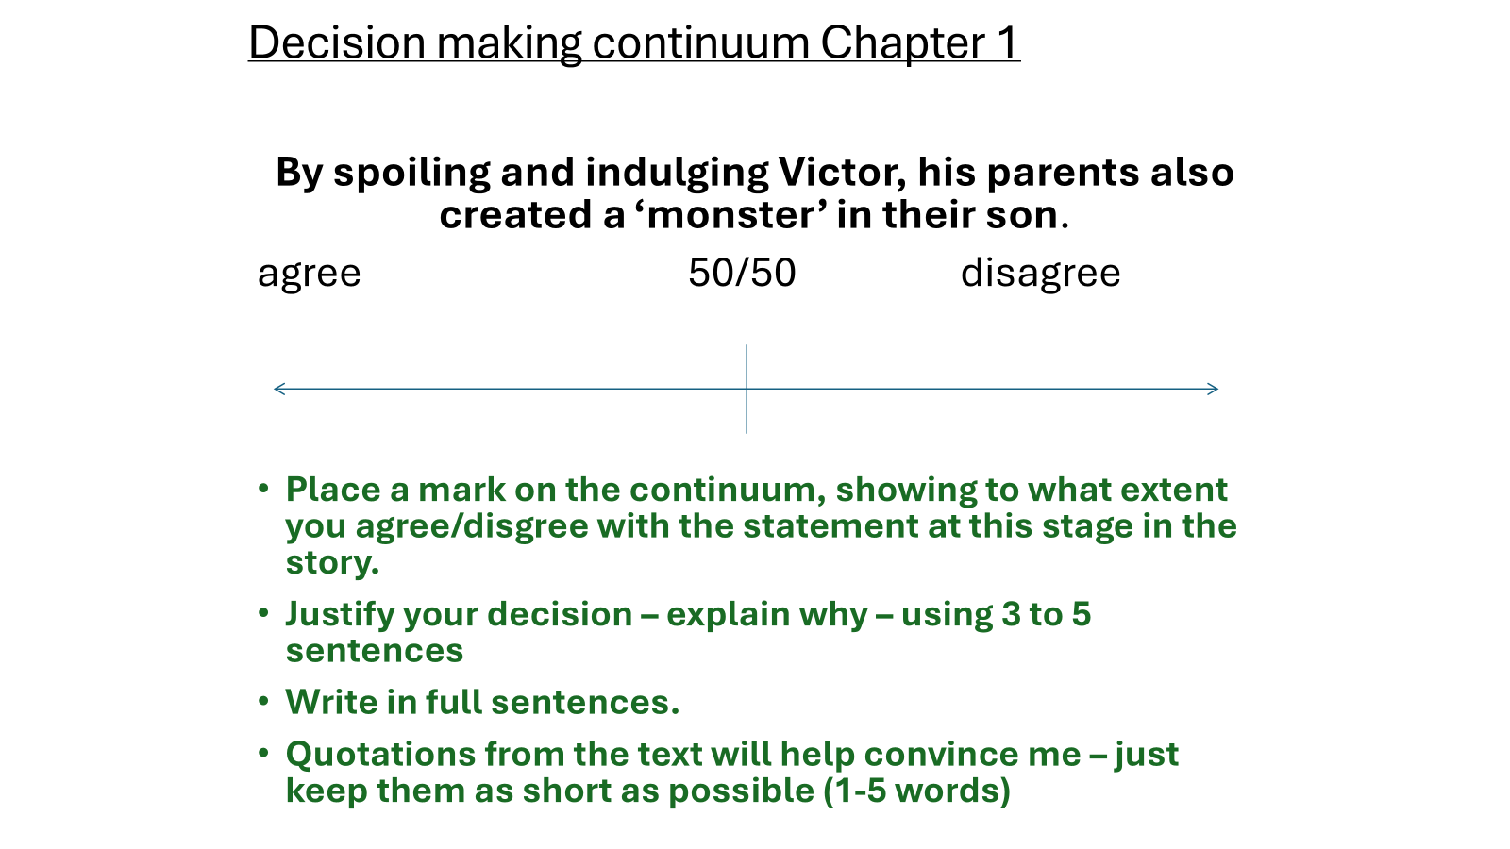
Plot and Character Development
1. Who are Victor’s family and friends? What do they do?
2. How does the Frankenstein family develop in Chapters 1 to 3?
3: How does Victor’s relationship with his father change in Chapters 1 to 3?
4. Why is Geneva important to the Frankenstein family?
5. How does Victor discover science?
6. What is Elizabeth’s influence on Victor and Clerval?
7. How does Shelley portray Victor as he comes of age?

Slide 38
Quick re-cap - Chapter 3 so far:
Write 3 - 4 sentences.
Use appropriate quotations.
1. What is Frankenstein’s opinion of Krempe, and why?
2. What is Frankenstein’s opinion of M. Waldam and why?
For both questions: consider the role that the concept of ‘aesthetics’ has in relation to Frankenstein’s opinions of his professors?

Slide 39
Section 3: Chapter 4
Why does Victor persist in his ambition to create new life?
Is everything scientifically possible ethically justifiable?

Slide 40
Summary of Key Points
Victor arrives at Ingolstadt University, meeting Professors Krempe and Waldman. He prefers Waldman over Krempe, partly because he finds Krempe ugly and partly because Waldman flatters his ego.
Victor’s admiration and friendship with Professor Waldman develops.
Victor becomes fascinated with life and death, and begins to consider the possibility of reanimation.
Victor has an (unrevealed) epiphany about the secret of the creation of life, and begins collecting the body parts of dead humans and animals, obsessively assembling them into a creature.
Victor’s obsessive work is detrimental to his health and his relationships with others.

Slide 41
Key Vocabulary: Chapter 4
Word | Quotation | Definition
natural philosophy | ‘From this day natural philosophy, and particularly chemistry, in the most comprehensive sense of the term, became nearly my sole occupation’ | the study of all natural phenomena in the physical world (in the 19th century)
physiognomy | ‘I found even in M. Krempe a great deal of sound sense and real information, combined, it is true, with a repulsive physiognomy and manners’ | the physical appearance of the face
infallibly | ‘A mind of moderate capacity which closely pursues one study must infallibly arrive at great proficiency in that study’ | in a way that is never wrong or never fails
minutiae | ‘I paused, examining and analysing all the minutiae of causation’ | small or unimportant details

Slide 42
Pit Stop: vocabulary and creative writing
Select up to 5 words from a previous vocabulary table.
Learners must use all 5 words appropriately in a short writing task. Present them with a writing stimulus, or scenario for some creative or transactional writing.
An example scenario stimulus: Write about a time when something important to you did not go to plan.
Prescribe the time limit for the writing. Some of the writing produced can then be live marked under a visualiser.

Slide 43
Example: vocabulary and creative writing
Word | definition
irksome | annoying
malignity | the quality of intending to cause harm
splendour | magnificence; great show of riches or costly things; pomp, parade (transitive verb: to move with splendour)
fervent | of persons, their passions, dispositions or actions; ardent, intensely earnest, often used in relation to love or hatred (from 17th century onwards)
minutiae | small or unimportant details
Task:
Use all 5 words accurately and appropriately to write about a time when someone did something that annoyed you.
You may alter word endings to make sure your sentences make sense e.g.
Irksome - irksomeness
Malignity - malign - malignant
Splendour - splendid -splendorous
Time limit: 15 minutes

Slide 44
Plot and Character Development
1. Why is Victor’s continued dislike for Krempe significant in this chapter and the next?
2. Why, after his scientific epiphany, does Victor never query the ethics of his experiment?
3. Why are the details of this scientific epiphany never revealed?
4. Why is Victor motivated to carry out such gruesome tasks in the name of ‘science’?
5. Why is he driven to obsession while making the Creature?
6. Why does he isolate himself so completely from friends and family?

Slide 45
Key Extract 1
How does Shelley use language to present the discovery and temptation of taboo knowledge in this extract from Chapter 4?
‘I paused, examining and analysing all the minutiae of causation, as exemplified in the change from life to death, and death to life, until from the midst of this darkness a sudden light broke in upon me – a light so brilliant and wondrous, yet so simple, that while I became dizzy with the immensity of the prospect which it illustrated, I was surprised, that among so many men of genius who had directed their enquiries towards the same science, that I alone should be reserved to discover so astonishing a secret.’

Slide 46
Key Extract 2
How does Shelley use language to demonstrate Victor’s obsessive, destructive character in this extract from Chapter 4? ​​
‘Who shall conceive the horrors of my secret toil, as I dabbled among the unhallowed damps of the grave, or tortured the living animal to animate the lifeless clay? My limbs now tremble, and my eyes swim with the remembrance; but then a resistless, and almost frantic, impulse, urged me forward; I seemed to have lost all soul or sensation but for this one pursuit.’

Slide 47
Structure: Chapter 4
Opening: ‘From this day natural philosophy, and particularly chemistry… became nearly my sole occupation’
Ending: ‘Sometimes I grew alarmed at the wreck I perceived that I had become;... I promised myself both of these [exercise and amusement] when my creation should be complete’
Consider this opening and ending in light of the concept of reader privilege. Reader privilege concerns who has access to what kind of information (as well as insight and foresight) and when. Ask learners to consider if: the reader knows more than the characters in the text? they can make judgement about characters and events that the characters in the text cannot (which ones and why?) and (if so) what conclusions can the reader draw because of our privileged knowledge?

Slide 48
Keeping track of Victor: Chapters 3 and 4
What are the MOST IMPORTANT things we learn about Victor Frankenstein in these chapters? | What do you think Victor should have paid more attention to at Ingolstadt University?

Slide 49
Keeping track of Victor: Chapters 3 and 4
Possible answers
What are the MOST IMPORTANT things we learn about Victor Frankenstein in these chapters? | What do you think Victor should have paid more attention to at Ingolstadt University?
Victor’s mother ‘sickened’ from scarlet fever while looking after Elizabeth. Her death informs what he studies at Ingolstadt, and his motivation for creating life (and cheating death). Victor is pained by his parting from Clerval, possibly more so than Elizabeth (his future wife). He blames ‘Chance’ and ‘The Angel of Destruction’ as forceful influences on his behaviour and choices at Ingolstdat (not taking responsibility for his actions). He judges Krempe, the first Professor he meets as ‘repulsive’ foreshadowing his reaction to his ugly child when it’s born. He meets Waldman and notices his ‘aspect’ (face) has the ‘greatest benevolence’ - his pleasing aesthetics making him worth paying attention to. | Krempe’s reasons for being so dismissive about ‘alchemists’ and older theories of science and natural philosophy. Victor did not even ask why he held such opinions. He ignores this advice from Waldman in Chapter 4, ‘If your wish is to become really a man of science, and not merely a petty experimentalist, I should advise you to apply to every branch of natural philosophy, including mathematics’ and sticks to only studying older ideas of natural philosophy that will enable him to cheat death. His lack of wider context for his studies means he lacks any form of ethical and moral education.

Slide 50
Key questions for the end of Chapter 4
What clues do we have in Chapter 4 that suggests Victor’s great experiment will go wrong?

Slide 51
Decision-making continuum: Chapters 1 to 4
Chapters 1 to 4: Victor is the hero in the novel Frankenstein.
agree 50/50 disagree
Place a mark on the continuum, showing to what extent you agree/disgree with the statement at this stage in the story.
Justify your decision – explain why.
Use full sentences.
S-T-R-E-T-C-H yourself: Quotations from the text will help convince me – just keep them as short as possible (2-5 words).

Slide 52
Section 4: Chapter 5
Why does Victor view his experiment as a complete failure?

Slide 53
Summary of Key Points
Victor’s experiment is brought to life, but rather than celebrate, Victor suddenly sees the Creature’s ugliness and considers him a terrible failure.
The Creature reaches out to his creator, which Victor interprets as a threat, and so runs away out of his apartment into a nearby church courtyard.
Clerval suddenly arrives in Ingolstadt, which delights Victor, who is relieved to see that his Creature has fled.
The relief of the empty apartment provokes maniacal laughter in Victor. Soon afterwards, Victor faints with a fever.
Clerval nurses him back to health, and the chapter ends with news of a letter received from Elizabeth.

Slide 54
Pit Stop:
Retrieval point: Victor’s childhood
Aesthetics and idolatry
Before reading this chapter, we need to recall the nature of Victor’s childhood, and how it made the man who made a monster (the Creature).
How did Victor learn that what is aesthetically pleasing (e.g. beautiful) is better than ugliness?
When he describes his mother and Elizabeth, what is the focus of his description?
Victor’s parents put him on a pedestal, and rarely if ever, denied him anything he wanted - what effect did this have on Victor as he moved into adulthood?
At the end of the chapter: To what extent are we surprised by Victor’s rejection of his creation?
Explain your thinking.

Slide 55
Key Vocabulary: Chapter 5
Word | Quotation | Definition
dreary | ‘It was on a dreary night of November, that I beheld the accomplishment of my toils’ | boring, making you feel unhappy
accomplishment |  | something that is successful or achieved with a lot of effort
dismally | ‘It was already one in the morning; the rain pattered dismally against the panes’ | in a way that makes you feel sad and without hope
convulsive | ‘it breathed hard, and a convulsive motion agitated its limbs’ | movements of muscles in your body that you cannot control
dun | ‘that seemed almost of the same colour as the dun white sockets in which they were set’ | of a greyish brown colour

Slide 56
Pit Stop: vocabulary builder
The combination of key vocabulary and key quotation revision is both fruitful and efficient. Learners could consider the question and quotation below:
1. To whom does Victor Frankenstein refer to in this quotation?
‘His gentleness was never tinged by dogmatism, and his instructions were given with an air of frankness and good nature that banished every idea of pedantry.’
2. Usually, the words ‘dogmatic’ (dogmatism) and ‘pedant’ (pedantry) are used pejoratively (to show contempt or disapproval). This is not the case here. How and why have these terms become a compliment to Waldman instead?
Purpose: This will enable you to recall the ‘facts of the text’, as well as allowing you to better develop your understanding of writers making choices – that words, and specific combinations of words, are not arrived at by chance or accident.
Notes:
Answer: Q 1 - Professor Waldman

Slide 57
Pit Stop: S-T-R-E-T-C-H
To explore the significance of the birth and rejection of the Creature:
‘Victor’s rejection of his creation is completely predictable.’ To what extent do you agree with this statement?
You must:
Use quotations in your response
Use terminology where and when it is appropriate
‘Show your working’ - which means explain your thinking and reasoning
You must not:
Sit on the fence - neither agree nor disagree - make a decision, write with that decision in mind.

Slide 58
Key Questions to Consider
Why?
Why can Victor’s behaviour be regarded as ‘Promethean’?
Why might the reader’s relationship with Victor change here?
Why does Victor misinterpret the Creature’s gesture of reaching towards him?
Why is it Clerval who nurses Victor back to health, and not Elizabeth?
Stretch questions
At the point of the Creature’s birth, with whom is the reader positioned and why?
At the point of the Creature’s rejection, does the reader’s positioning change? Why?

Slide 59
Plot and Character Development
1. What is the most significant moment of this chapter?
2. What is even more significant than the birth of the Creature?
3. What is the significance of the Creature’s successful creation?
4. How does Victor feel about this Creature before he brings it to life?
5. What does Victor think about his Creature after it comes to life?
6. What is Victor’s response to these feelings?
7. What is the significance of Clerval’s entrance?
8. What is Clerval and Victor’s relationship like?

Slide 60
Pit Stop: keeping a track of key ideas - playing God and rejection
What happens when….?
Key idea | Quotations and notes
Man takes on the role of God and succeeds?
The mortal God fails in his responsibilities to his creation?
The mortal God rejects his child, so rejects the role of the father?
A child’s (the Creature’s) education is left to chance?
A mortal God ‘improves’ upon God and nature’s work and creates a superhuman?
The woman’s role of bearer and carer of children is usurped by science?

Slide 61
Pit Stop: S-T-R-E-T-C-H
Frankenstein is a text in which we cannot fully trust the reliability, and objectivity of any narrator.
Victor says this to Clervan after he asks Victor to write a letter home:
'Is that all, my dear Henry? How could you suppose that my first thought would not fly towards those dear, dear friends
whom I love, and who are so deserving of my love.’
Keeping the idea of narrator (un)reliability in mind, consider this question:
Do we (the reader) believe what Victor says to Clerval at this point in the text?
Why? Why not?

Slide 62
Pit Stop: Developing language analysis: Depth/breadth
This is one of the most well-known quotations from this chapter and, indeed, the whole text. Contained within it are some contradictions, highlighted in bold:
‘It was on a dreary night of November, that I beheld the accomplishment of my toils.’
Focus on the specifics of language choices and placement which gives a more precise grasp of the choices that writers make and why they might make them.
Consider why:
• Shelley chose to use the adjective ‘dreary’ to describe the ‘night of November’ that Victor uses to bring his experiment to life?
• Shelley chose to use the noun ‘accomplishment’, which, according to most dictionaries, means the successful completion of a task?
• Shelley chose to use the adjective and noun above in the same sentence, which seem to have contradictory uses and meanings. What might this tell us about Victor as a character and how he feels at this specific moment?

Slide 63
Key Extract 1
How does Shelley use language to present Victor’s state of mind in this extract from Chapter 5?
'I thought I saw Elizabeth, in the bloom of health, walking in the streets of Ingolstadt. Delighted and surprised, I embraced her; but as I imprinted the first kiss on her lips, they became livid with the hue of death; her features appeared to change, and I thought that I held the corpse of my dead mother in my arms; a shroud enveloped her form, and I saw the grave-worms crawling in the folds of the flannel.’

Slide 64
Key Extract 2
How does Shelley use language to describe Frankenstein’s rejection of his creation in this extract from Chapter 5?
‘I started from my sleep with horror; a cold dew covered my forehead, my teeth chattered, and every limb became convulsed: when, by the dim and yellow light of the moon, as it forced its way through the window shutters, I beheld the wretch – the miserable creature whom I had created. He held up the curtain of the bed; and his eyes, if eyes they may be called, were fixed on me. His jaws opened, and he muttered some inarticulate sounds, while a grin wrinkled his cheeks. He might have spoken, but I did not hear; one hand was stretched out, seemingly to detain me, but I escaped, and rushed down stairs. I took refuge in the courtyard belonging to the house which I inhabited…’

Slide 65
Key Quotations: Victor
‘one hand was stretched out, seemingly to detain me, but I escaped, and rushed down stairs. I took refuge in the courtyard… where I remained during the rest of the night’ , Chapter 5
‘I struggled furiously, and fell down in a fit’, Chapter 5
‘I was lifeless, and did not recover my senses for a long, long time’, Chapter 5

Slide 66
Key Quotations: Clerval
’nothing but the unbounded and unremitting attentions of my friend could have restored me to life’, Chapter 5

Slide 67
Key Quotations: the Creature
’one hand was stretched out, seemingly to detain me’, Chapter 5

Slide 68
Structure: Chapter 5
Opening: ‘It was on a dreary night of November, that I beheld the accomplishment of my toils’
Ending: ‘Is that all, my dear Henry? How could you suppose that my first thought would not fly towards those dear, dear friends whom I love, and who are so deserving of my love’
Look out for: The setting of the opening - the ‘dreary night in November’ and what this might embody. The contrast between who Victor is focused on at the start of the chapter and the end of the chapter.

Slide 69
Key Questions for Chapters 4 and 5:
How does Shelley build up tension and horror in Chapters 4 and 5?
What is significant about Victor’s description of the Creature when it comes to life’?

Slide 70
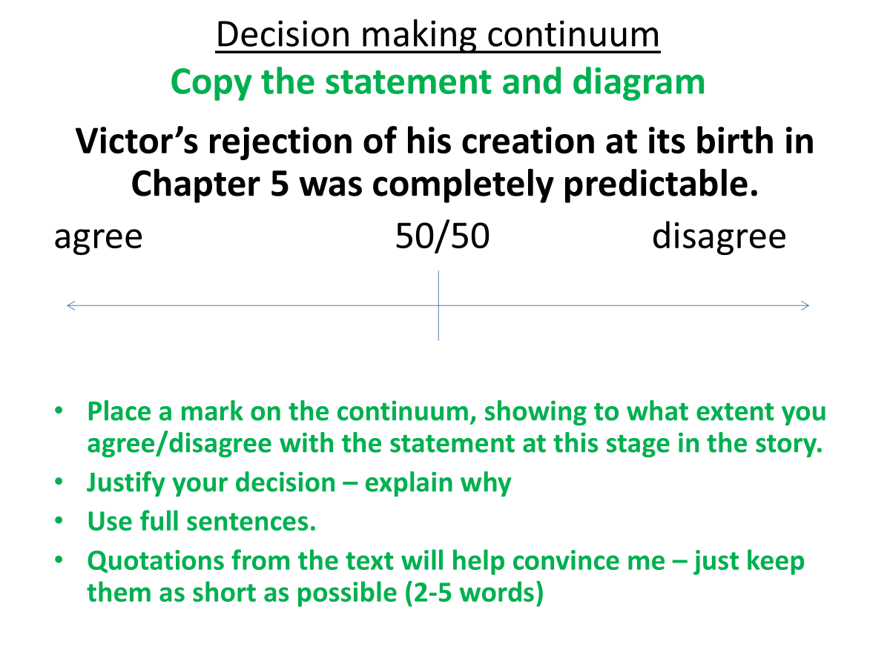

Slide 71
Section 5: Chapters 6-8
How does Shelley present the first consequences of Victor’s actions?

Slide 72
Summary of Key Points
Chapter 6:
Elizabeth writes to Victor concerned with how ill he has been.
Justine is introduced to the reader in the letter.
William is also mentioned in the letter.
Victor introduces Clerval to the university professors.
Victor and Clerval undertake a two-week tour around Ingolstadt.
Chapter 7:
Victor learns of William’s murder while reading a letter from his father.
By the end of the letter, he learns that Justine is accused of the murder.
Victor is certain that the Creature is the murderer and that Justine is innocent.
Chapter 8:
Justine’s trial begins; she is calm and dignified.
The prosecution advocate (lawyer) presents all the circumstantial evidence against Justine, which she cannot explain. (Justine has no ‘advocate for her defence’.)
Victor does not speak up in Justine’s defence, even though he knows that she is innocent.
Elizabeth speaks to the court, aiming to argue for Justine’s innocence. This backfires, and the court is even more convinced of Justine’s guilt.
A priest who visits Justine in her prison cell convinces her to confess to her guilt in order to absolve her soul.
Victor spends some time on the lake and in nature, while in the distance lightning plays on the tops of the mountains.

Slide 73
Key Vocabulary: Chapter 6 Part 1
Word | Quotation | Definition
convalescence | ‘It was a divine spring; and the season contributed greatly to my convalescence’ | the process of becoming well again after an illness or injury
dilatoriness | ‘The winter, however, was spent cheerfully; and although the spring was uncommonly late, when it came its beauty compensated for its dilatoriness’ | the quality of being slow and causing delay
perambulations | ‘We passed a fortnight in these perambulations: my health and spirits had long been restored, and they gained additional strength from the salubrious air I breathed, the natural incidents of our progress, and the conversation of my friend’ | the activity of walking around a place, especially for pleasure and in a leisurely way
salubrious |  | describing something that is pleasant, clean and healthy to live in

Slide 74
Key Vocabulary: Chapter 6 Part 2
Word | Quotation | Definition
convalescence | ‘It was a divine spring; and the season contributed greatly to my convalescence’ | the process of becoming well again after an illness or injury
encomiums | ‘his [Krempe’s] harsh blunt encomiums gave me even more pain than the benevolent approbation of M. Waldman’ | pieces of writing or speeches that praise someone or something highly
exculpate | ‘such a declaration would have been considered as the ravings of a madman and would not have exculpated her who suffered through me’ | to remove someone from blame
ignominy | ‘Could the dæmon who had (I did not for a minute doubt) murdered my brother also in his hellish sport have betrayed the innocent to death and ignominy?’ | public embarrassment or shame
obdurate | ‘He threatened excommunication and hell fire in my last moments if I continued obdurate’ | extremely determined to act in a particular way and not to change, despite what anyone else says

Slide 75
Key Vocabulary: Chapter 7
Word | Quotation | Definition
wretchedness | “What would be your surprise, my son, when you expected a happy and glad welcome, to behold, on the contrary, tears and wretchedness?” | the state of being unpleasant or of low quality; the feeling of being very ill, or unhappy
Plainpalais | “Last Thursday (May 7th), I, my niece, and your two brothers, went to walk in Plainpalais.” | a neighbourhood in Geneva, Switzerland
conjectured | “This account rather alarmed us, and we continued to search for him until night fell, when Elizabeth conjectured that he might have returned to the house.” | a guess about something based on how it seems, rather than proof
console | “Come, dearest Victor, you alone can console Elizabeth.” | to make someone who is sad or disappointed feel better, usually by giving them comfort or sympathy
prognosticated | “Is this to prognosticate peace, or to mock at my unhappiness.” | to give a judgement about what is likely it happen in the future, especially in connection with a particular situation

Slide 76
Key Vocabulary: Chapter 8
Word | Quotation | Definition
obliterated | ‘now all was to be obliterated in an ignominious grave; and I the cause!’ | an action that destroys something completely
ignominious |  | describes an action or experience as embarrassing because it was unsuccessful
solemnity | ‘her countenance, always engaging, was rendered, by the solemnity of her feelings, exquisitely beautiful’ | the state or quality of being solemn (very serious)
indignation | ‘a murmur of horror and indignation filled the court’ | the ​feeling​ of shock and anger when you feel that something is unfair
protestations | ‘But I do not pretend that my protestations should acquit me’ | a strong declaration that something is true or not true
bewildered | ‘That she had been bewildered when questioned by the market-woman was not surprising, since she had passed a sleepless night’ | confused and not understanding something or being able to decide what to do
timorous | ‘but fear, and hatred of the crime of which they supposed her guilty, rendered them timorous’ | frightened and nervous of other people and situations (relates to the verb ‘timid’)

Slide 77
Pit Stop: vocabulary builder
Below are examples of questions that will aid understanding of Shelley’s usage of some of her vocabulary.
Chapter 6:
• What does Victor’s dilatoriness as he travels home to Geneva tell us about his character at this moment in the text?
• Will the Frankenstein family be able to exculpate Justine from her fate?
Chapter 7:
• At this point in the text, who is the most diabolical character?
• Who wants to inflict retribution on whom in this chapter?
Chapter 8:
• Why does Victor believe that ‘all was to be obliterated’?
• What does Justine’s ‘solemnity’ in the face of a biased court tell us about her character?
• Why were witnesses ‘timorous’ when speaking in support of Justine’s character in court?

Slide 78
Pit Stop: etymology of the word ‘justice’
In this section of the novel, it is a good opportunity to explore the abstract noun ‘justice’. In this section of the novel (Chapters 6 to 8) what kinds of justice, and injustice, are experienced by: Victor, Justine, the Creature?
The table below is chronological, with the oldest root first:
Origin | Meaning
Latin iustus | upright, just
Latin iusticia | righteousness, equality
Old French (11th century) justice | legal rights, jurisdiction

Slide 79
Key Questions to Consider
Why?
Why is Justine framed for the murder of William?
Why is Justine introduced via Elizabeth’s letter?
Why are the public (within the world of the novel) so quick to believe her guilt?
Why do both Justine and Elizabeth’s words fail to make a difference to Justine’s fate?
Why is Justine’s death instrumental to the overall narrative?
Why does Justine’s death change our (the reader’s) relationship with Victor Frankenstein?

Slide 80
Pit Stop: S-T-R-E-T-C-H
Explore the following statement:
“In Frankenstein, innocent victims have suffered, and will continue to suffer,
at the hands of Victor’s arrogant and selfish actions.”
To what extent do you agree with this statement?
You should consider:
• the relevance of the Promethean myth and the concept of hubris
• Victor’s character development thus far
• Victor’s rejection of his creation in Chapter 4
• ideas about justice and consequences.

Slide 81
Plot and Character Development
1. How do Clerval and Victor respond to William’s death?
2. How are Victor’s feelings influenced by his environment?
3. How does Shelley use weather when reintroducing the Creature to the narrative?
4. How do the Frankenstein family respond to Victor’s return?
5. How does Shelley exploit the reader’s knowledge of Victor’s experiment in Chapter 7?

Slide 82
Key Extract 1: Chapter 7
How does Shelley use language to present the impact of Justine’s perceived guilt?
‘I do not know what you mean,’ replied my brother, in accents of wonder, ‘but to us the discovery we have made completes our misery. No one would believe it at first; and even now Elizabeth will not be convinced, notwithstanding all the evidence. Indeed, who would credit that Justine Moritz, who was so amiable, and fond of all the family, could suddenly become capable of so frightful, so appalling a crime?’
[Victor] ‘Justine Moritz! Poor, poor girl, is she the accused? But it is wrongfully; every one knows that; no one believes it, surely, Ernest?’

Slide 83
Key Extract 2: Chapter 8
How does Shelley use language to present Victor’s suffering?
‘We passed a few sad hours, until eleven o’clock, when the trial was to commence. My father and the rest of the family being obliged to attend as witnesses, I accompanied them to the court. During the whole of this wretched mockery of justice I suffered living torture. It was to be decided, whether the result of my curiosity and lawless devices would cause the death of two of my fellow-beings: one a smiling babe, full of innocence and joy; the other far more dreadfully murdered, with every aggravation of infamy that could make the murder memorable in horror.’

Slide 84
Key Quotations: Victor
‘The tortures of the accused did not equal mine; she was sustained by innocence, but the fangs of remorse tore my bosom and would not forgo their hold’,
Chapter 8

Slide 85
Key Quotations: Elizabeth
‘Elizabeth was sad and desponding; she no longer took delight in her ordinary occupations; all pleasure seemed to her sacrilege toward the dead; eternal’, Chapter 7
‘She had no doubt of her innocence; and she was so inflexible in her determination not to admit her guilt, she persisted in asserting her innocence’, Chapter 8

Slide 86
Key Quotations: Justine
‘Justine was calm; she was dressed in mourning, and her countenance, always engaging, was rendered, by the solemnity of her feelings, exquisitely beautiful’, Chapter 8
‘Justine, also, was very ill; but her countenance expressed affection even in death, and I burned with indignation and despair’, Chapter 8

Slide 87
Key Quotations: Alphonse
‘I wish to prepare you for the woeful news, but I know it is impossible; even now your eye skims over the page to seek the words which are to convey to you the horrible tidings’ (Chapter 7)

Slide 88
Structure: Chapter 6
Opening: ‘Clerval then put the following letter into my hands. It was from my own Elizabeth’
Ending: ‘My own spirits were high, and I bounded along with feelings of unbridled joy and hilarity’
Look out for: The positive perspective of Victor that runs through this chapter.

Slide 89
Structure: Chapter 7
​​Opening: ‘You have probably waited impatiently for a letter to fix the date of your return to us; and I was at first tempted to write only a few lines, merely mentioning the day on which I should expect you’
Ending: ‘If she is, as you believe, innocent, rely on the justice of our laws, and the activity with which I shall prevent the slightest shadow of partiality’
Look out for: The key moments that establish a change in the mood of the novel.

Slide 90
Structure: Chapter 8
Opening: ‘My father and the rest of the family being obliged to attend as witnesses’
Ending: ‘I beheld those I loved spend vain sorrow upon the graves of William and Justine, the first hapless victims to my unhallowed arts’
Look out for: Shifts in the tone of the novel now that innocent characters have died. Changes in Victor’s attitude towards his responsibilities. Consider: Why has Shelley chosen to begin with this focus on the Frankenstein family’s obligation to Justine, and to end with a focus on the innocent victims of his Creature? What predictions might there be based on Shelley’s focus on the death of innocent characters at this point in the novel?

Slide 91
Thinking Point
Consider Victor’s motivations in this chapter: what do you think is motivating his decision?
Guilt?
A sense of responsibility?
Care?
Fear?
Concern?
Ambition?
Something else?

Slide 92
Decision-making continuum
The Creature was ‘born’ evil which is why he may have murdered William Frankenstein.
agree 50/50 disagree
•Place a mark on the continuum, showing to what extent you agree/disgree with the statement at this stage in the story.
•Justify your decision – explain why.
•Use full sentences.
•Quotations from the text will help convince me – just keep them as short as possible (2-5 words).

Slide 93
Section 6: Chapters 9-10
How does Victor react to William’s death?

Slide 94
Summary of Key Points
Chapter 9:
Victor suffers from ill health as an emotional reaction to the death of William.
The family move from Geneva to their residence at Belrive and grieve for both William and Justine.
Victor decides to travel to Chamounix.
Chapter 10:
Victor explores the valley and then climbs to the summit of Montanvert.
Victor and the Creature meet.
The Creature begins his narration.

Slide 95
Key Vocabulary: Chapter 9
Word | Quotation | Definition
remorse | ‘The blood flowed freely in my veins, but a weight of despair and remorse pressed on my heart which nothing could remove.’ | a feeling of sadness and being sorry for what you have done
serenity | ’instead of that serenity of conscience which allowed me to look back upon the past with self-satisfaction, and from thence to gather promise of new hopes, I was seized by remorse and the sense of guilt’ | the quality of being peaceful and calm
immoderate | —“but is it not a duty to the survivors that we should refrain from augmenting their unhappiness by an appearance of immoderate grief? | too much or many, or more than is usual or reasonable
augmented | ‘But it was augmented and rendered sublime by the mighty Alps, whose white and shining pyramids and domes towered above all, as belonging to another earth, the habitations of another race of beings.’ | made greater or more intense

Slide 96
Key Vocabulary: Chapter 10
Word | Quotation | Definition
immutable | ‘the thunder sound of the avalanche or the cracking, reverberated along the mountains, of the accumulated ice, which, through the silent working of immutable laws, was ever and anon rent and torn, as if it had been but a plaything in their hands. | not changing, or unable to be changed
solemnising | ‘The sight of the awful and majestic in nature had indeed always the effect of solemnising my mind and causing me to forget the passing cares of life’ | observe or perform with dignity or gravity (seriousness)
despondence | ‘I walked about the isle like a restless spectre, separated from all the world, deserted and most wretched, in a state of despondence and solitude’ | a state of low spirits caused by loss of hope or courage
abyss | ‘I felt as if I were walking on the edge of an abyss, beyond which was the destruction I so fearfully dreaded’ | a deep or seemingly bottomless chasm; a profound difference or unfathomable situation

Slide 97
Pit Stop: vocabulary builder
Chapter 9:
1. Why does Victor feel ‘remorse’ in Chapter 9?
2. Should Victor feel ‘serenity’ after Justine and William’s deaths?
3. What is it that causes Victor’s suffering to be ‘augmented’ in Chapter 9?
Chapter 10:
1. What is ‘solemnising’ Victor’s mind in Chapter 10?
2. What is the cause of Victor’s ‘despondence’ in Chapter 10?
3. What might be symbolic about Victor’s ‘conflagration fading away’ at this point in the chapter?

Slide 98
Key Questions to Consider
Why?
Why does Victor choose to travel?
What does this reveal about his character?
Why does Shelley choose this point to introduce the Creature’s narrative?
Why is the landscape significant?

Slide 99
Plot and Character Development
1. How do the deaths of William and Justine impact upon the Frankenstein family?
2. How does Victor respond to William’s death?
3. What happens between Victor and the Creature – the creator and created?

Slide 100
Key Extract 1
How does Shelley use language to present Victor Frankenstein in this extract from Chapter 9?
‘The blood flowed freely in my veins, but a weight of despair and remorse pressed on my heart, which nothing could remove. Sleep fled from my eyes; I wandered like an evil spirit… I was seized by remorse and the sense of guilt, which hurried me away to a hell of intense tortures, such as no language can describe.’

Slide 101
Key Extract 2
How does Shelley use language to present Victor Frankenstein’s attitude towards his creation in this extract from Chapter 10?
‘“Why do you call to my remembrance,” I rejoined, “circumstances, of which I shudder to reflect, that I have been the miserable origin and author? Cursed be the day, abhorred devil, in which you first saw light! Cursed (although I curse myself) be the hands that formed you! You have made me wretched beyond expression. You have left me no power to consider whether I am just.”’

Slide 102
Key Quotations: Victor
‘I was seized by remorse and the sense of guilt, which hurried me away to a hell of intense tortures such as no language can describe’, Chapter 9
‘I shunned the face of man; all sound of joy or complacency was torture to me; solitude was my only consolation – deep, dark, deathlike solitude’, Chapter 9
‘I, not in deed, but in effect, was the true murderer’, Chapter 9

Slide 103
Key Quotations: Alphonse
‘”Do you think, Victor," said he, "that I do not suffer also? No one could love a child more than I loved your brother”’, Chapter 9

Slide 104
Key Quotations: Elizabeth
‘But I was restrained, when I thought of the heroic and suffering Elizabeth, whom I tenderly loved, and whose existence was bound up in mine’, Chapter 9
‘now misery has come home, and men appear to me as monsters thirsting for each other’s blood’, Chapter 9, Elizabeth to Victor

Slide 105
Structure: Chapter 9
Opening: ‘I stood beside the sources of the Arveiron, which take their rise in a glacier, that with slow pace is advancing down from the summit of the hills, to barricade the valley’
Ending: ‘The air was cold, and the rain again began to descend: we entered the hut, the fiend with an air of exultation, I with a heavy heart, and depressed spirits. But I consented to listen;... he thus began his tale’
Look out for: The mirroring of Victor’s position on the glacier and Walton’s position in the icy north. Examples of setting that embody the Gothic sublime.

Slide 106
Structure: Chapter 10
Opening: ‘Justine died; she rested; and I was alive’
Ending: ‘I remained at the window… listening to the rushing of the Arve... The same lulling sounds acted as a lullaby… sleep crept over me;... and blest the giver of oblivion’
Look out for: The moments of calm and what this is followed by. Similar feelings of longing for death that bookend the chapter.

Slide 107
Thinking Point
Consider Victor’s motivations in this chapter: what do you think is motivating his decision?
Guilt?
A sense of responsibility?
Care?
Fear?
Anger
Concern?
Ambition?
Something else?

Slide 108
Images of the sublime - credits
The following images were offered by kind permission of Mr Daniel Simcox, a Photography Lecturer in FE, whom I worked with at Warwickshire College, Rugby site.
The images were taken in the Alps, whilst on a walking holiday with his wife, and, as far as I know, he did not come back home with plans to make a new human from dead body parts.
He is still teaching photography to his willing and appreciative students.

Slide 109
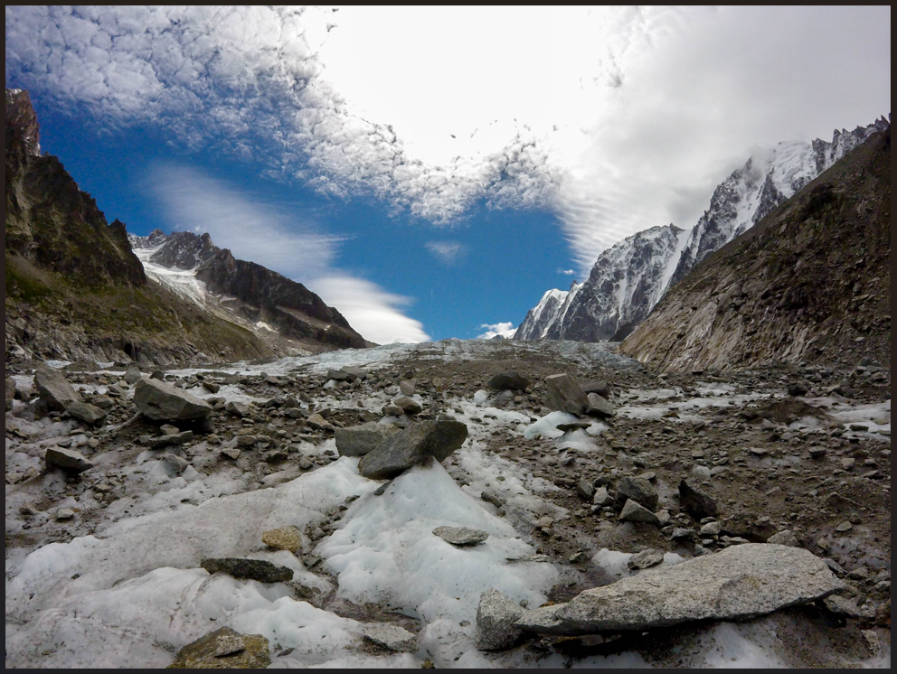
Romantic sublime - awe, beauty, wonder, whimsy

Slide 110
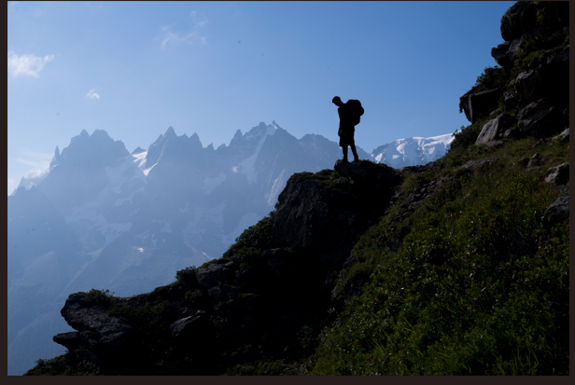
Romantic sublime - awe, beauty, wonder, whimsy

Slide 111
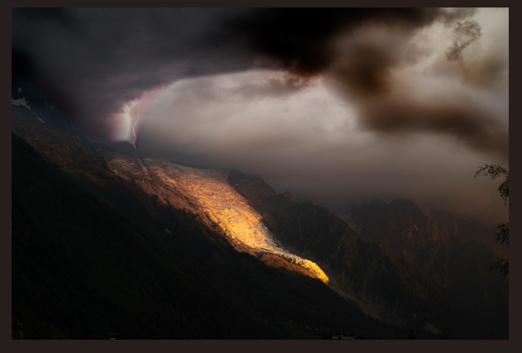
The Gothic sublime - awe, terror, fear, powerlessness (of man)

Slide 112
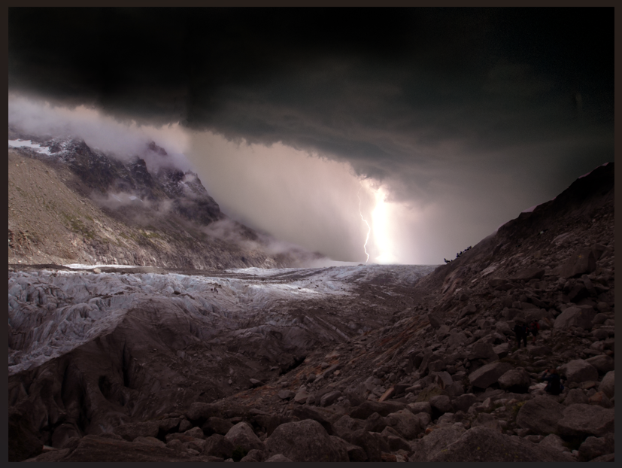
The Gothic sublime - awe, terror, fear, powerlessness (of man)

Slide 113
Section 7: Chapters 11-14
How does the Creature’s life begin?

Slide 114
Summary of Key Points
Chapter 11:
The creature realises he is alive.
Unsure of where he is or who he is, he feels scared and flees Victor’s rooms and finds himself in the woods.
In the woods, the creature meets a man who is terrified of him, he is confused, and finds a similar reaction when he comes across a village.
After some time, the creature finds a hovel near a family’s cottage and shelters there.
Chapter 12:
The creature watches the family in the cottage and develops affection for them.
After noticing they are poor, he begins to help them.
Chapter 13:
The creature is delighted that the family enjoy his secretive aid.
A young woman arrives to join the family. As she learns to speak their language, so too does the creature.
The creature learns to read too, and begins to discover more about the world, particularly about rich and poor, and about property.
Chapter 14:
The creature learns the history of the De Lacey family.
He also learns the history of Safie, the young woman, and how her father betrayed the De Laceys.
He learns about the imprisonment, release, and changing reputation of the De Lacey father.

Slide 115
Key Vocabulary: Chapter 11 and Chapter 12
Word | Quotation | Definition
Chapter 11: seized | ‘A strange multiplicity of sensations seized me’ | to take something quickly and keep or hold it
liberty | ‘I now found that I could wander at liberty’ | the freedom to live as you wish or go where you want
enchanted | ‘I was enchanted by the appearance of the hut’ | affected by magic, or seeming to be affected by magic
Chapter 12: affection | ‘Interchanging each day looks of affection’ | the feeling of liking for a person or place
sufficient | ‘I improved… but not sufficiently to follow up any kind of conversation’ | enough for a purpose

Slide 116
Key Vocabulary: Chapter 13 and Chapter 14
Word | Quotation | Definition
Chapter 13: endeavouring | ‘She was endeavouring to learn their language’ | to try to do something
rank | ‘Of rank, of descent, and noble blood’ | a particular position, higher or lower than others
noble |  | belonging to a high social rank in society, especially by birth
Chapter 14: Obnoxious | ‘He became obnoxious to the government’ | very unpleasant or rude
treacherous | ‘The treacherous Turk’ | a person who is treacherous deceives someone who trusts them, or has no loyalty

Slide 117
Key Questions to Consider
Chapters 11-14
Why is the Creature’s early ‘life’ important?
Why is the Creature’s repeated rejection significant?
Why does Shelley show a benevolent side to the creature?
Why does Shelley create the De Lacey family as she does?
Stretch questions
Why does Shelley include the De Lacey family?
Why does Shelley provide further examples of women in need of protection and rescue?

Slide 118
Plot and Character Development
1. What are the Creature’s first experiences of the world?
2. Who is the family that the creature meets?
3. Who is Safie? What is her story?
4. What does the Creature learn about humanity from books in this section?
5. How does the Creature respond to his new learning?
6. What does the Creature think and feel about the family?

Slide 119
Chapter 12 Key literary allusions - ‘Hamlet’
Hamlet explores these ideas, philosophising in his soliloquies:
'We know what we are, but know not what we may be.’
(Hamlet Act IV, Sc 5, line 43).
'What a piece of work is a man! How noble in
reason, how infinite in faculty! In form and moving
how express and admirable! In action how like an Angel!
in apprehension how like a god!’
(Hamlet Act II, Sc 2)
Shelley explores these same ideas via the Creature’s growth, his actions, and what he learns of humanity from his moment of birth, to the ‘present’ in the Arctic ice.

Slide 120
Key Extract 1
How does Shelley use language to show the innocence and vulnerability of the creature?
'I was still cold when under one of the trees I found a huge cloak, with which I covered myself, and sat down upon the ground. No distinct ideas occupied my mind; all was confused. I felt light, and hunger, and thirst, and darkness; innumerable sounds rang in my ears, and on all sides various scents saluted me; the only object that I could distinguish was the bright moon, and I fixed my eyes on that with pleasure.’

Slide 121
Key Extract 2
How does Shelley use language to show the Creature’s joy in Chapter 12?
'The pleasant showers and genial warmth of spring greatly altered the aspect of the earth […] Happy, happy earth! Fit habitation for gods, which, so short a time before, was bleak, damp, and unwholesome. My spirits were elevated by the enchanting appearance of nature; the past was blotted from my memory, the present was tranquil, and the future gilded by bright rays of hope and anticipations of joy.’

Slide 122
Key Extract 3
How does Shelley use language to convey the creature’s loneliness in Chapter 13?
'But where were my friends and relations? No father had watched my infant days, no mother had blessed me with smiles and caresses; or if they had, all my past life was now a blot, a blind vacancy in which I distinguished nothing. From my earliest remembrance I had been as I then was in height and proportion. I had never yet seen a being resembling me or who claimed any intercourse with me. What was I? The question again recurred, to be answered only with groans.’

Slide 123
Key Quotations: The Creature
‘I was a poor, helpless, miserable wretch’, Chapter 11
‘How I was terrified when I viewed myself in a transparent pool!’, Chapter 12
‘I became fully convinced that I was in reality the monster that I am’, Chapter 12
‘I wished sometimes to shake off all thought and feeling’, Chapter 13

Slide 124
What we know about the Creature at this point in the text:
Chapter | What we know (Is it implicit, or explicit? | Evidence from the text

Slide 125
Key Quotations: the De Lacey Family
‘Nothing could exceed the love and respect which the younger cottagers exhibited towards their venerable companion’, Chapter 12
‘It was poverty, and the suffered that evil in a very distressing degree’, Chapter 12
‘[De Lacey] was descended from a good family in France, where he had lived [...] in affluence, respected by his superiors and beloved by his equals’, Chapter 14

Slide 126
Key Quotations: Safie
‘I beheld a countenance of angelic beauty and expression’, Chapter 13
‘She was understood by, nor herself understood, by the cottagers’, Chapter 13
‘Lovely Arabian’, Chapter 14
‘She hesitated some time, but at length she formed her determination’, Chapter 14

Slide 127
Key themes and ideas:
The Creature and the DeLaceys
The Creature’s kindness shows that monstrosity and evil is not innate;
via the Creature, Shelley explores the how and why of learning (desire, need, curiosity);
he learns what the concept of a family is (in a very limited way);
he begins to worship the family as ‘false idols’.

Slide 128
Structure: Chapter 11
Opening: ‘It is with considerable difficulty that I remember the original era of my being; all the events of that period appear confused and indistinct’
Ending: ‘The family, after having been thus occupied for a short time, extinguished their lights and retired, as I conjectured, to rest’
Look out for: The parallels and contrasts between Victor and the Creature's description of the night the Creature was brought to life. The stages of the Creature’s development and how Shelley structures her chapter around this.

Slide 129
Structure: Chapter 12
Opening: ‘I lay on my straw, but I could not sleep. I thought of the occurrences of the day. What chiefly struck me was the gentle manners of these people, and I longed to join them, but dared not’
Ending: ‘the present was tranquil, and the future gilded by bright rays of hope and anticipations of joy’
Look out for: The changing pace of this chapter: there is little action, and little movement of place. The repetition of moments where the creature realises his difference from the family.

Slide 130
Structure: Chapter 13
Opening: ‘I now hasten to the more moving part of my story’
Ending: ‘allow me now to return to the cottagers, whose story excited in me such various feelings of indignation, delight, and wonder, but which all terminated in additional love and reverence for my protectors (for so I loved, in an innocent, half-painful self-deceit, to call them)’
Look out for: Hints at what is to come later for the Creature. The moment when Shelley shifts the focus from the DeLacey family to the Creature’s own self-reflection.

Slide 131
Structure: Chapter 14
Opening: ‘Some time elapsed before I learned the history of my friends’
Ending: ‘the woman of the house in which they had lived took care that Safie should arrive in safety at the cottage of her lover’
Look out for: The parallels in theme between this narrative and those of the other characters. The patterns of character and life chances for female characters that Shelley repeats throughout the novel.

Slide 132
Retrieval: relationships in early life
Copy the diagrams and use the words in the boxes and your own to help you make notes on how each character feels about the characters in their early lives.
admiration
mutual affection
longing
enjoying time together
confusion
caring
gratitude
Victor
Victor
Elizabeth
Victor (his ‘father’)
Victor
The Creature
Clerval
The DeLacey family
His parents
Safie

Slide 133
Discussion Points
Is the Creature how you expected him to be? Why/ why not?
How does your view of the Creature differ now that you have read his tale?
What do you think of how the Creature is treated by people? How does this change what you think of him?
How does your view of the DeLacey family change throughout the chapters in this section?

Slide 134
What is significant in Chapter 14?
The Creature is moved by the De Lacey story.
He learns that social status and class is dependent upon reputation.
He learns that the De Laceys welcomed Safie into their family.
The representation of Middle-Eastern characters as exotically beautiful and enigmatic (women, Safie), and devious, cunning and untrustworthy (Safie’s father) is problematic for today’s audience, but was not unusual in Victorian fiction at the time. The villains in Sherlock Holmes stories were often Middle-Eastern or from East Asia.

Slide 135
Section 8: Chapters 15-16
How does the Creature shift from benevolent to menacing?

Slide 136
Summary of Key Points
Chapter 15:
The Creature discovers a selection of books and reads them. He also reads Victor’s lab notes and diary.
The Creature decides that he will introduce himself to the De Laceys. He is anxious, but believes they will welcome him. Initially, the father does.
When the other De Laceys enter, they are horrified and beat the creature, forcing him to flee.
Chapter 16:
Dejected and furious, the Creature declares ‘war’ on mankind. He sets fire to the DeLacey cottage and sets out for Geneva to find Victor.
He makes one last attempt at benevolence, but is rejected again.
Near Geneva, the Creature meets young William Frankenstein and kills him. The Creature frames a young woman for the murder.
Finally, the Creature reveals to Victor that he desires a mate.

Slide 137
Key Vocabulary: Chapters 15 and 16
Word | Quotation | Definition
virtue | ‘I felt the greatest ardour for virtue rise within me, and abhorrence for vice’ (Ch15) | a good moral quality in a person or the general quality of being morally good
vice |  | a moral fault or weakness in someone’s character; illegal and immoral ​activities​
abhorrence |  | a feeling of hating something or someone
endured | ‘My travels were long and the sufferings I endured intense’ (Ch16) | to suffer something difficult, unpleasant or painful
desolation | ‘I too can create desolation’ (Ch16) | the state of a place that is empty or where everything has been destroyed

Slide 138
Key Questions to Consider
Why?
Why does the Creature hide and watch the De Laceys for so long?
Why does the Creature finally introduce himself to the family?
Why does Shelley have the Creature spend so long admiring the De Laceys?
Why does the Creature seek revenge?

Slide 139
Plot and Character Development
What are the books the Creature reads? What is their significance?
Who is the Creature’s narrative addressed to? Who writes it?
What impact does reading Victor’s notes have on the Creature?
What does the De Lacey’s rejection of the Creature reveal about them? How does the Creature respond?
What events change the Creature’s disposition?
What is the significance of the Creature framing Justine?
Stretch question: Why doesn’t Shelley give her Creature a name?

Slide 140
Key Extract 1
How does the Creature feel about himself (Chapter 15)?
And what was I? Of my creation and creator I was absolutely ignorant, but I knew that I possessed no money, no friends, no kind of property. I was, besides, endued with a figure hideously deformed and loathsome; I was not even of the same nature as man. I was more agile than they and could subsist upon coarser diet; I bore the extremes of heat and cold with less injury to my frame; my stature far exceeded theirs. When I looked around I saw and heard of none like me. Was I, then, a monster, a blot upon the earth, from which all men fled and whom all men disowned?’

Slide 141
Key Extract 2
How does Shelley convey the changing power dynamic between the Creature and Victor in this Chapter 16 extract?
‘We may not part until you have promised to comply with my requisition. I am alone and miserable; man will not associate with me; but one as deformed and horrible as myself would not deny herself to me. My companion must be of the same species and have the same defects. This being you must create.’

Slide 142
Key Quotations: The Creature
‘As yet, I looked upon crime as a distant evil’, Chapter 15
‘I felt the greatest ardour for virtue rise with me, and abhorrence for vice’, Chapter 15
‘inflamed by pain, I vowed eternal hatred and vengeance to all mankind.’ Chapter 16
‘I am alone and miserable; man will not associate with me, but one as deformed and horrible as myself would not deny herself to me’, Chapter 16

Slide 143
Key Quotations: the De Lacey Family
‘They did not appear rich, but they were contented and happy’, Chapter 15
‘The hearts of men, when unprejudiced by any obvious self-interest, are full of brotherly love and charity’, Chapter 15
‘Felix darted forward, and with supernatural force tore me from his father’, Chapter 15

Slide 144
Structure: Chapter 15
Opening: ‘Such was the history of my beloved cottagers’
Ending: ‘I saw him on the point of repeating his blow, when, overcome by pain and anguish, I quitted the cottage, and in the general tumult escaped unperceived to my hovel’
Look out for: The parallels between the stories of Victor and the Creature in their sharing of their early lives and education. The 3 discrete sections which track the Creature’s education and development into ‘monstrosity’. The De Lacey family and the book the Creature read. The Creature’s preparations for introducing himself to the family. The introduction itself.

Slide 145
Structure: Chapter 16
Opening: ‘Cursed, cursed creator! Why did I live?’
Ending: ‘My companion must be of the same species and have the same defects. This being you must create.’
Look out for: The moments where the Creature is alone and when he is around people. How the Creature’s solitude at the beginning and end of the chapter have parallels with the beginning and end of his life. The reparations of rejection that Shelley shares with us.

Slide 146
Pit Stop: vocabulary builder
Word | Definition
virtue vice abhorrance | a good moral quality in a person or the general quality of being morally good a moral fault or weakness in someone’s character. Alt. illegal and immoral activties a feeling of hating something or someone
endured desolation | to suffer something difficult, unpleasant or painful the state of a place that is empty or where everything has been destroyed
Use the key words from this chapter in sentences about other parts of the novel.
Eg.
Walton and his crew endure difficult weather on their travels.
Caroline Frankenstein is known for her benevolence.
Victor brings the Creature to life during a tumultuous storm.

Slide 147
Discussion Point: What’s in a name?
Shelley (through Victor’s voice) does not share the Creature’s name with her readers.
A name is an important part of a person’s identity. It is also a sign that someone is part of a wider community as, when we are alone, we don’t need names. Authors sometimes give their characters a name that reflects their personality.
What message could Shelley be giving her readers by not giving her Creature a name?
What does Shelley suggest about Victor when he doesn’t give his Creature a name?
What could Shelley be suggesting by giving her protagonist the name ‘Victor’?

Slide 148
Thinking Point: ‘mine’
‘looked upon Elizabeth as mine—mine to protect, love, and cherish’
Victor describes Elizabeth as ‘mine’ without considering her feelings about having a relationship with him. He decides that she will ‘be his’ and that they will be married. The Creature is different to Victor in many ways, but he has a similar perspective on a partner.
Explore the extract below and discuss your thoughts on how the Creature talks about his longed-for mate:
“I demand a creature of another sex…I will go to the vast wilds of South America…We shall make our bed of dried leaves; the sun will shine on us as on man and will ripen our food. The picture I present to you is peaceful and human, and you must feel that you could deny it only in the wantonness of power and cruelty.”

Slide 149
Section 9: Chapter 17
What is the significance of the mate?
How does this chapter change our views of Victor and the Creature?

Slide 150
Summary of Key Points
Chapter 17:
The Creature continues to explain that if he had a mate, he would be content and no longer angry.
Eventually, Victor agrees and the Creature leaves him, saying he will return when the mate is made.

Slide 151
Key Vocabulary: Chapter 17
Word | Quotation | Definition
malicious passion | ‘I am malicious because I am miserable’ ‘This passion is detrimental to me’ | intended to harm or upset someone a very powerful feeling

Slide 152
Key Questions to Consider
Why?
Why does the Creature want a mate?
Why is Victor so torn about whether to create one?
Why does Victor concede?
Why does Shelley hand the narrative back to Victor at this point?

Slide 153
Plot and Character Development
What is decided at the end of the chapter? Why? Do we trust this decision?
Who does the Creature blame for his unhappiness?
Why does the Creature want a mate?
What does the Creature promise Victor in return for the creation of a mate?
How does the request for a mate influence the readers’ feelings towards Victor?
What does the mate symbolise?
What does Victor’s response to the Creature’s request reveal about him?

Slide 154
Key Extract 1
How does Shelley use language to present Victor’s feelings towards the Creature?
“I do refuse it,” I replied; “and no torture shall ever extort a consent from me. You may render me the most miserable of men, but you shall never make me base in my own eyes. Shall I create another like yourself, whose joint wickedness might desolate the world. Begone! I have answered you; you may torture me, but I will never consent.” Chapter 17

Slide 155
Key Extract 2
How does Shelley’s Creature use language to appeal to Victor?
‘I will revenge my injuries; if I cannot inspire love, I will cause fear, and chiefly towards you my arch-enemy, because my creator, do I swear inextinguishable hatred. Have a care; I will work at your destruction, nor finish until I desolate your heart, so that you shall curse the hour of your birth.” Chapter 17

Slide 156
Key Quotations: The Creature
‘I am malicious because I am miserable.’ Chapter 17

Slide 157
Key Quotations: Victor
‘But I was bewildered, perplexed, and unable to arrange my ideas sufficiently to understand the full extent of his proposition.’ Chapter 17
‘Did I not as his maker owe him all the portion of happiness that it was in my power to bestow?’ Chapter 17

Slide 158
Structure: Chapter 17
Opening: ‘The being finished speaking and fixed his looks upon me in the expectation of a reply.’
Ending: ’The prospect of such an occupation made every other circumstance of existence pass before me like a dream, and that thought only had to me the reality of life.’
Look out for: The shift to Victor’s narrative voice. The dominance of the Creature’s dialogue over Victor’s. This chapter contains: Total word count: 1915 Total words of speech: 1067 Creature’s speech: 833 words Victor’s speech: 234 words

Slide 159
Thinking Point
Consider Victor’s motivations in this chapter: what do you think is motivating his decision?
Guilt?
A sense of responsibility?
Care?
Fear?
Concern?
Ambition?
Something else?

Slide 160
Monsters vs Humans?
Shelley plays with the idea of monsters in the novel, but she also encourages her readers to consider what it is to be human.
What do humans need to be happy?
What do humans need to feel safe?
What does it mean to have ‘humanity’?

Slide 161
Victor’s Emotions
Antagonistic | Affectionate | Confident | Ashamed | Awkward
Disgusted | Concerned | Calm | hopeless | Anxious
Dismayed | Merciful | Bold | Beaten | Appalled
Agitated | Compassionate | Elated | Dejected | Distressed
Affronted | Attentive | Self-assured | Disappointed | Fearful
Perturbed | Understanding | Collected | Dispirited | Fretful
Flustered | Loving | Composed | Shaken | Horrified

Slide 162
Thinking Point
In this chapter, Shelley transfers the narrative back to Victor.
Look through the chapter and identify which emotions Victor reveals through his speech to the Creature and which are revealed through his internal thoughts.
‘I was moved. I shuddered when I thought of the possible consequences of my consent, but I felt that there was some justice in his argument.’
What are the advantages of Shelley returning the narrative to Victor?
What could the impact of this chapter have been if the narrative had not be returned to Victor?

Slide 163
Section 10: Chapters 18-19
How does Shelley use journeys?

Slide 164
Summary of Key Points
Chapter 18:
Victor has returned to Geneva.
Victor’s health has improved but he his unable to consider the creation of a mate for the Creature.
He enjoys the solitude of sailing on the lake.
His father talks of the marriage to Elizabeth, but Victor needs to delay this because of his promise to the Creature.
Victor leaves for England with Henry Clerval, travelling across Europe.
Victor retrospectively reflects on the qualities of his beloved friend, Clerval.
Chapter 19:
Victor spends time in London with Clerval, and then they set off on a tour of England, heading for Scotland.
Victor is suffering from the ‘blight’ of depression and does not enjoy company, despite what he learns from it.
They continue to travel north to Scotland.
Victor leaves Clerval to set up a laboratory in the Orkneys.
He works on the ‘filthy process’ of creating a mate, understanding the horror of the process that he had previously ignored.
Victor feels a sense of foreboding.

Slide 165
Key Vocabulary: Chapter 18 and 19
Word | Quotation | Definition
sentiments | ‘The expression of your sentiments of this subject’ (Ch18) | a thought, opinion or feeling about a situation
dilatory | ‘The latter method of obtaining the desired intelligence was dilatory and unsatisfactory’ (Ch18) | slow and likely to cause a delay
machinations | ‘exempt my family from the danger of his machinations’ (Ch18) | complicated and secret plans
picturesque | ‘The course of the Rhine below Mayence becomes much more picturesque’ (Ch18) | attractive in appearance, especially in an old-fashioned way (in relation to a place)
irksome | ‘Company was irksome to me’ (Ch19) | annoying
abhorred | ‘although I abhorred society’ (Ch19) | to hate something or someone

Slide 166
Key Questions to Consider
Why?
Why do Victor and Clerval travel from Geneva to Scotland?
Why does Victor compare Clerval to his former self?
Stretch questions
Why does Victor choose a ‘barren’ place in which to work on creating a new life?
Why is the landscape important?
Why is Victor’s past significant?

Slide 167
Plot and Character Development
What type of journeys do the characters go on?
How does Shelley use the journey through England to Scotland to build up to the creation of the female Creature?
How is Clerval presented in this section?

Slide 168
Key Extract 1
How does Shelley use language to present the character of Clerval (Chapter 18)?
‘After some days spent in listless indolence, during which I traversed many leagues, I arrived at Strasburgh, where I waited two days for Clerval. He came. Alas, how great was the contrast between us!… In truth, I was occupied by gloomy thoughts, and neither saw the descent of the evening star, nor the golden sunrise reflected in the Rhine. – And you, my friend, would be far more amused with the journal of Clerval, who observed the scenery with an eye of feeling and delight, than in listening to my reflections. I, a miserable wretch, haunted by a curse that shut up every avenue to enjoyment.’
(The full extract can be found in the teaching resources.)

Slide 169
Key Extract 2
How is Victor Frankenstein’s retrospective grief conveyed in Chapter 18?
‘And where does he now exist? Is this gentle and lovely being lost forever? Has this mind, so replete with ideas, imaginations fanciful and magnificent, which formed a world, whose existence depended on the life of its creator; –... overflowing with the anguish which his remembrance creates. I will proceed with my tale.’
(The full extract can be found in the teaching resources.)

Slide 170
Key Extract 3
How is Victor Frankenstein’s view of the island and its inhabitants conveyed (Chapter 19)? ​​ ​​
‘On the whole island there were but three miserable huts, and one of these was vacant when I arrived. This I hired. It contained but two rooms, and these exhibited all the squalidness of the most miserable penury… As it was, I lived ungazed at and unmolested, hardly thanked for the pittance of food and clothes which I gave; so much does suffering blunt even the coarsest sensations of men.’

Slide 171
Key Quotations: Victor
‘I feared the vengeance of the disappointed fiend’, Chapter 18
‘I am happy to remark, my dear son... And yet you are still unhappy, and still avoid our society’, Chapter 18
‘my heart often sickened at the work of my hand’, Chapter 19

Slide 172
Key Quotations: Alphonse
‘I am happy to remark, my dear son, that you have resumed your former pleasures’, Chapter 18
‘I have always looked forward to your marriage with our dear Elizabeth as the tie of our domestic comfort’, Chapter 18
‘Do not suppose, however, that I wish to dictate happiness to you’, Chapter 18

Slide 173
Key Quotations: Clerval
‘“This is what it is to live,” he cried, “now I enjoy existence!”’, Chapter 18
‘his friendship was of that devoted and wondrous nature’, Chapter 18
‘Is this gentle and lovely being lost for ever?’, Chapter 18

Slide 174
Structure: Chapter 18
Opening: ‘Day after day, week after week,… I feared the vengeance of the disappointed fiend, yet I was unable to overcome my repugnance to the task which was enjoined me’
Ending: ‘At length we saw the numerous steeples of London, St. Paul’s towering above all, and the Tower famed in English history’
Look out for: The shift away from the domestic sphere again.

Slide 175
Structure: Chapter 19
Opening: ‘London was our present point of rest; we determined to remain several months in this wonderful and celebrated city’
Ending: ‘I looked towards its completion with a tremulous and eager hope, which I dared not trust myself to question, but which was intermixed with obscure forebodings of evil, that made my heart sicken in my bosom’
Look out for: The rapid progress through towns and cities that drives the changing settings. The cataphoric references to Clerval’s death.

Slide 176
Section 11: Chapters 20-21
What is the impact of the destruction of the female creature?

Slide 177
Summary of Key Points
Chapter 20:
Victor reflects on his creation of a mate for the Creature and destroys her while the Creature looks on.
The Creature visits Frankenstein to threaten that he will make Victor utterly miserable and will be with Victor on his wedding night.
Victor leaves and sets sail, dropping the remains of the female creature into the sea. The boat drifts and he arrives in Ireland.
He is then taken to a magistrate by the local people.
Chapter 21:
Victor meets the magistrate and is told his supposed crime: the murder of a gentleman (Clerval).
Victor succumbs to a fever and is ill for two months.
When recovered, the magistrate shows him great kindness and writes to Victor’s father.
Alphonse arrives in Ireland and Victor is soon acquitted of the murder.
Victor urges his father to take him home to Geneva, thinking that the Creature will go there next.
Frankenstein takes laudanum, but this does not stop him from having nightmares.
Frankenstein realises that the Creature is not on the boat and thinks that ‘truce was established between the present hour and the irresistible, disastrous future’.

Slide 178
Key Vocabulary: Chapters 20-21
Word | Quotation | Definition
malignant | ‘she might become ten thousand times more malignant than her mate’ (Ch20) | having a wish to do harm (evil)
countenance | ‘his countenance expressed the utmost extent of malice and treachery’ (Ch20) | the appearance or expression of someone’s face
malice |  | the wish to harm or upset people
treachery |  | behaviour that deceives or is not loyal to someone who trusts you
presentiment | ‘I felt a presentiment of who it was’ (Ch20) | a feeling that something, especially something unpleasant, is going to happen
spectre | ‘walked about the isle like a restless spectre’ (Ch20) | ghost
odious | ‘the scene of my odious work’ (Ch20) | extremely unpleasant and causing or deserving hate
deposed | ‘A woman deposed’ (Ch21) | gave a statement

Slide 179
Key Questions to Consider
Chapter 20
Why does Frankenstein reflect on his creation of a mate for the Creature?
Why does Frankenstein destroy the female creature? What reasons does he give?
Why does he do this with the Creature watching?
What are the consequences of the destruction of the female creature?
Chapter 21
Why does the opening focus on the ‘calm and mild manners’ of the magistrate?
Why do we hear so many witness statements about the discovery of the body?
Why does Frankenstein develop a fever?
Stretch questions
What is the importance of setting in Chapter 20?
What is further revealed about the relationship between Frankenstein and the Creature from each of their perspectives?
Why does Shelley focus on the interrogation and imprisonment of Frankenstein?

Slide 180
Plot and Character Development
1. How does Victor feel about creating the mate in this chapter?
2. How does Victor act in this section?
3. How does the Creature react to Victor’s destruction of his mate? Why?
4. How does Victor react to Clerval’s murder?
5. Who is Mr Kirwan?
6. What is Victor’s response to being freed from prison?

Slide 181
Key Extract 1
How does Shelley present Victor’s response to seeing the Creature (Chapter 20)?
‘As I looked on him, his countenance expressed the utmost extent of malice and treachery. I thought with a sensation of madness on my promise of creating another like to him, and trembling with passion, tore to pieces the thing on which I was engaged. The wretch saw me destroy the creature on whose future existence he depended for happiness, and, with a howl of devilish despair and revenge, withdrew.’

Slide 182
Key Extract 2
How does Shelley demonstrate Victor’s prejudice against social class and appearance (Chapter 21)?
‘This sound disturbed an old woman who was sleeping in a chair beside me. She was a hired nurse, the wife of one of the turnkeys, and her countenance expressed all those bad qualities which often characterise that class. The lines of her face were hard and rude, like that of persons accustomed to see without sympathising in sights of misery. Her tone expressed her entire indifference; she addressed me in English, and the voice struck me as one that I had heard during my sufferings.’

Slide 183
Key Extract 3
How does Shelley present Victor’s fear of the female (Chapter 20)?
‘she might become ten thousand times more malignant than her mate, and delight, for its own sake, in murder and wretchedness’

Slide 184
Key Extract 4
How does Shelley convey how strongly the Creature wants revenge (Chapter 20)?
‘Man! you may hate; but beware! your hours will pass in dread and misery, and soon the bolt will fall which must ravish from you your happiness for ever. Are you to be happy, while I grovel in the intensity of my wretchedness? You can blast my other passions; but revenge remains – revenge, henceforth dearer than light or food! I may die; but first you, my tyrant and tormentor, shall curse the sun that gazes on your misery. Beware; for I am fearless, and therefore powerful. I will watch with the wiliness of a snake, that I may sting with its venom. Man, you shall repent of the injuries you inflict.’’

Slide 185
Key Quotations: Victor
‘Three years before I was engaged in the same manner, and had created a fiend’, Chapter 20
‘Begone! I do break my promise; never will I create another like yourself, equal in deformity and wickedness’, Chapter 20
‘But sleep did not afford me respite from thought and misery; my dreams presented a thousand objects that scared me’, Chapter 21

Slide 186
Key Quotations: Mr Kirwan
‘I was soon introduced into the presence of the magistrate, an old benevolent man, with calm and mild manners. He looked upon me, however, with some degree of severity’, Chapter 21
‘I soon learned that Mr. Kirwin had shown me extreme kindness’, Chapter 21
‘I instantly wrote to Geneva’, Chapter 21

Slide 187
Key Quotations: Alphonse
‘Nothing, at this moment, could have given me greater pleasure than the arrival of my father’, Chapter 21
‘My father tried to awaken in me the feelings of affection’, Chapter 21
‘​​My father, who was watching over me’, Chapter 21

Slide 188
Structure: Chapter 20
Opening: ‘I sat one evening in my laboratory; the sun had set, and the moon was just rising from the sea; I had not sufficient light for my employment, and I remained idle’
Ending: ‘I must pause here; for it requires all my fortitude to recall the memory of the frightful events which I am about to relate, in proper detail, to my recollection’
Look out for: The recurring theme of procrastination. Foreshadowing of Victor’s family’s deaths.

Slide 189
Structure: Chapter 21
Opening: ‘I was soon introduced into the presence of the magistrate, an old benevolent man, with calm and mild manners’
Ending: ‘truce was established between the present hour and the irresistible, disastrous future, imparted to me a kind of calm forgetfulness, of which the human mind is by its structure peculiarly susceptible’
Look out for: Shelley’s delaying of the revelation of the murder victim’s identify. The motif of the ‘black mark’ which reveals the creature’s role in the murder. The use of letters to once again trigger movement in the Frankenstein household.

Slide 190
Thinking Point
In this section, Victor goes through a range of experiences and emotions including destroying the Creature’s mate, being threatened, nearly dying in a storm, being arrested, being ill, and being ill and looked after by his father.
Do we feel sympathy for Victor at any of these times? Why?
If not, why not? What is it that means we struggle to sympathise?

Slide 191
Section 12: Chapters 22-23
What is the impact of a loss of love?

Slide 192
Summary of Key Points
Chapter 22:
Victor and his father make their journey home from Ireland to Geneva.
Elizabeth worries that Victor loves another, but is reassured by him.
The two are married and set off for Villa Lavenza, their honeymoon destination.
Chapter 23:
Elizabeth is murdered.
The search for the Creature is unsuccessful.
In shock, Alphonse dies of a stroke.
Victor confesses his story to a magistrate.
Victor vows to seek out and destroy the Creature.

Slide 193
Key Vocabulary: Chapters 22 and 23
Word | Quotation | Definition
imperious | ‘I curbed the imperious voice of wretchedness’ (Chapter 22) | unpleasantly proud; expecting to be obeyed
invincible | ‘I should almost regard him as invincible’ (Chapter 22) | impossible to defeat or prevent from doing what is intended
incredulous | ‘Appeared at first incredulous’ (Chapter 23) | not wanting to believe something, and usually showing this
proportionate | ‘He shall suffer punishment proportionate to his crimes’ (Chapter 23) | an appropriate amount
transitory | ‘enjoying the transitory light’ (Chapter 23) | temporary; not permanent

Slide 194
Key Questions to Consider
Why?
Why does Shelley have Victor return to Geneva for his wedding?
Why does Victor wish to get married soon?
Why is Elizabeth murdered?
Why does Victor vow revenge on the Creature?
Stretch questions
Why do so many of Shelley’s female characters die?
Why does Shelley have Victor confess his story?

Slide 195
Plot and Character Development
What is decided at the end of the chapter? Why? Do we trust this decision?
Who does the Creature blame for his unhappiness?
Why does the Creature want a mate?
What does the Creature promise Victor in return for the creation of a mate?
How does the request for a mate influence the readers’ feelings towards Victor?
What does the mate symbolise?
What does Victor’s response to the Creature’s request reveal about him?

Slide 196
Key Extract 1
How does Shelley portray Victor’s guilt (Chapter 22)?
‘“I am not mad,” I cried energetically; “the sun and the heavens, who have viewed my operations, can bear witness of my truth. I am the assassin of those most innocent victims; they died by my machinations. A thousand times would I have shed my own blood, drop by drop, to have saved their lives; but I could not, my father, indeed I could not sacrifice the whole human race.”’

Slide 197
Key Extract 2
How does Shelley present Victor’s determination to destroy the Creature?
‘My revenge is of no moment to you; yet, while I allow it to be a vice, I confess that it is the devouring and only passion of my soul. My rage is unspeakable when I reflect that the murderer, whom I have turned loose upon society, still exists. You refuse my just demand; I have but one resource, and I devote myself, either in my life or death, to his destruction.’

Slide 198
Key Quotations: Alphonse
‘My father’s care and attentions were indefatigable’, Chapter 22
‘My father yielding at length my desire to avoid society and strove by various arguments to banish my despair’, Chapter 22
‘I intreat you never to make such an assertion again’, Chapter 22

Slide 199
Key Quotations: Victor
‘Could I behold this and live? Alas, life is obstinate and clings closest where it is most hated’, Chapter 23
‘I devote myself, either in life or death, to his destruction’, Chapter 23

Slide 200
Key Quotations: The Creature
‘A grin was on the face of the monster, he seemed to jeer, as with his fiendish finger he pointed to the corpse of my wife’, Chapter 23

Slide 201
Key Quotations: Elizabeth
‘I hope to see peace in your countenance and to find that our heart is not totally void of comfort and tranquillity’, Chapter 22
‘Happy and serene all nature appears!’, Chapter 22
‘Elizabeth observed my agitation for some time in timid and fearful silence’, Chapter 23

Slide 202
Structure: Chapter 22
Opening: ‘The voyage came to an end’
Ending: ‘The sun sank beneath the horizon as we landed, and as I touched the shore I felt those cares and fears revive which soon were to clasp me and cling to me for ever’
Look out for: The symbolic changing of weather and time. The shifts in mood throughout the chapter. The various beginnings and endings throughout the chapter.

Slide 203
Structure: Chapter 23
Opening: ‘It was eight o’clock when we landed; we walked for a short time on the shore, enjoying the transitory light, and then retired to the inn and contemplated the lovely scene of waters, woods, and mountains, obscured in darkness, yet still displaying their black outlines’
Ending: ‘I broke from the house angry and disturbed and retired to meditate on some other mode of action’
Look out for: The various endings that occur throughout this chapter. The mirroring of the lives of the Creature and Victor, particularly in the killing of Elizabeth following the destruction of the Creature’s mate.

Slide 204
Retrieval
Use the words from this chapter to write some sentences about other parts of the novel.
Eg. Early in the novel, Victor behaves as if he is invincible.
imperious
invincible
incredulous
proportionate
transitory

Slide 205
Thinking Point
Is Victor’s relationship with Elizabeth one that we would say is acceptable these days?
Consider:
Victor talks about Elizabeth as if she is a possession.
Elizabeth seems to feel connected to Victor, but he does not seem to show the same affection.
Victor does not tell Elizabeth the truth about his life until they are married.
Victor seems to feel better when Elizabeth is sad.

Slide 206
Thinking Point
These quotations capture how Victor feels about his storytelling abilities. Do you believe his judgement to be accurate? Why?
‘My manner as I thus addressed him was impressive but calm’
‘I now related my history briefly but with firmness and precision, marking the dates with accuracy and never deviating into invective or exclamation.’

Slide 207
Thinking Point
Alphonse’s name comes from alpha, meaning first, perhaps reflecting that he is the most senior of the Frankenstein men. It could also suggest that he is the origin of Victor (and the Creature’s) unhappiness.
How much do you think Alphonse’s parenting could be to blame for Victor’s unhappiness and neglect may facilitate valuable critical thinking. Consider:
Do you feel that Alphonse is a good father?
How much do you think that Alphonse really understands Victor?
Do you think that Victor feels safe and happy around his father?
Do you think that Alphonse has been a good parental role model for Victor?

Slide 208
Section 13: Chapter 24
What ideas of legacy does Shelley leave us with?

Slide 209
Summary of Key Points
Victor’s tale ends.
Walton turns away from his quest.
Walton hears a noise and finds the Creature in Victor’s cabin.
The Creature has killed Victor and argues with Walton before disappearing over the ice.

Slide 210
Key Vocabulary: Chapter 24
Word | Quotation | Definition
pilgrimage | ‘My tedious toil and torturous pilgrimage’ | a visit to a place that is considered special, or a journey undertaken by a pilgrim

Slide 211
Key Questions to Consider
Why?
Why does Victor wish Walton to continue?
Why does Walton turn home?
Why does Walton not sympathise with the Creature?
Why is the Creature so heartbroken by Victor’s death?
Stretch questions
Why does Shelley have Walton turn home?
Why does Shelley give the final part of the tale to the Creature?

Slide 212
Plot and Character Development
1. What motivates Victor to pursue the Creature?
2. What landscapes does Victor travel through?
3. What does Victor dream about?
4. How does Victor keep track of the Creature?
5. What happens to Walton’s ship?
6. What does Victor want Walton to do?
7. What is Walton’s response to Victor’s tale?

Slide 213
Key Extract 1
How does Shelley use language to present the Creature’s pain (Chapter 24)?
‘“Do you think that I was then dead to agony and remorse? He,” he continued, pointing to the corpse, “he suffered not in the consummation of the deed. Oh! Not the ten-thousandth portion of the anguish that was mine during the lingering detail of its execution. A frightful selfishness hurried me on, while my heart was poisoned with remorse. Think you that the groans of Clerval were music to my ears? My heart was fashioned to be susceptible of love and sympathy, and when wrenched by misery to vice and hatred, it did not endure the violence of the change without torture such as you cannot even imagine.”’

Slide 214
Key Extract 2
How does Shelley use language to reveal Walton’s feelings towards the Creature (Chapter 24)?
‘“Wretch!” I said. “It is well that you come here to whine over the desolation that you have made. You throw a torch into a pile of buildings, and when they are consumed, you sit among the ruins and lament the fall. Hypocritical fiend! If he whom you mourn still lived, still would he be the object, again would he become the prey, of your accursed vengeance. It is not pity that you feel; you lament only because the victim of your malignity is withdrawn from your power.”’

Slide 215
Key Quotations: The Creature
‘You live and I am satisfied’, Chapter 24
‘You will find near this place… a dead hare, eat and be refreshed’, Chapter 24
‘Now this crime has degraded me beneath the meanest animal’, Chapter 24
‘You hate me, but your abhorrence cannot equal that with which I regard myself’, Chapter 24

Slide 216
Key Quotations: Victor
‘Revenge kept me alive’, Chapter 24
‘Like the archangel who aspired to omnipotence, I am chained in an eternal hell’, Chapter 24
‘Do not return to your families with the stigma of disgrace marked on your brows’, Chapter 24

Slide 217
Key Quotations: Walton
‘Yet, could I, in justice, or even possibility, refuse the demand?’, Chapter 24
‘It is well that you come here to whine over the desolation that you have made’, Chapter 24

Slide 218
Structure: Chapter 24, Victor’s Narrative
Opening: ‘My present situation was one in which all voluntary thought was swallowed up and lost’
Ending: ‘Hear him not; call on the names of William, Justine, Clerval, Elizabeth, my father, and of the wretched Victor, and thrust your sword into his heart. I will hover near and direct the steel aright’
Look out for: The rapid, almost erratic change of emotions and settings. The short paragraphs about rage or movement which contrast the longer paragraph about the respite of sleep. The frequent use of exclamatives. The loss of exact timeframes as the chapter progresses.

Slide 219
Structure: Chapter 24, Walton’s Letters
Opening: ‘You have read this strange and terrific story, Margaret; and do you not feel your blood congeal with horror, like that which even now curdles mine?’
Ending: ‘He was soon borne away by the waves and lost in darkness and distance’
Look out for: The long sections of Victor’s speech which aid the transition between narrators. The changes in the way Walton addresses his sister and ends his letters as the chapter progresses. The changes in timeframe and tense. The ambiguous ending. The lack of final sign off (and almost disappearance of Walton’s voice).

Slide 220
Thinking Point
‘You may give up your purpose, but mine is assigned to me by Heaven, and I dare not.’
In this quotation, Victor tells Walton that he believes his purpose (finding and destroying the Creature) comes from Heaven.
Are there any other times when Victor suggests that his purpose comes from a source beyond him? What other motivations does Victor have at different times in the novel?

Slide 221
Thinking Point: mad, bad, bold
Victor, Walton and the Creature all have strong ambitions. Some of these are bold, some a mad, and some are risky and reckless.
Write down each character’s ambitions and explain whether you think they are bold, mad, or reckless.
E.g. Victor’s ambition is to … I believe this is … because…

Slide 222
Discussion Points
Did Victor deserve his fate? Why?
Was Walton right to turn back? Why might he have done this?
Are you satisfied with this ending? What ending would you prefer?
What do you think Shelley’s final message is?

Slide 223
Summary Tasks

Slide 224
Who is the real monster?
Throughout the novel, Shelley explores the themes of what it is to be human and what it is to be monstrous.
Use your knowledge of the novel to discuss who the real monster is.
You could:
Explore key examples of monstrosity in the novel.
Explore different ways in which Victor and the creature are ‘monsters’.

Slide 225
‘The creature had no option but to end his life. He would never have been accepted by mankind.’
Shelley’s Creature struggles to find his place in the world. Ultimately, he concludes that he cannot have a place in the world. Was he right to do so though?
Use your notes and knowledge of the novel to plan a response to the statement above.
I disagree/agree that the Creature had no choice but to end his life. I think this because…

Slide 226
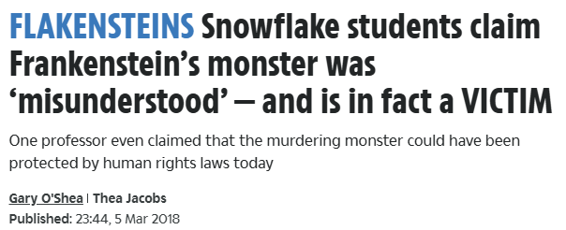
Villain or Victim?
In 2018, The Sun newspaper printed this headline. Create two mind maps: one should explore the reasons the Creature could be seen as a villain and the other should capture the ways in which the Creature could be seen as a victim.
One way in which the creature could be seen as a villain/victim is…
For example…
This suggests/ highlights/ reveals/ emphasises that…
This could be a way of Shelley trying to make her readers think… so that…

