Slide 1
Chapter 2
Preparation of the Budget Proposal

Slide 2
Budget Cycles
A budget cycle is a period of time in which the budget has to be prepared and executed.
The budget cycle has three phases:
Executive Preparation
Legislative approval
Budget Execution
Audit/Evaluation

Slide 3
Executive Preparation
The chief executive of a state or local government sets the tone for the policy issues that will be addressed during the preparation phase.
Guidelines are generally prepared by the chief budget/fiscal officer and given to agencies laying out key issues that will be addressed for the upcoming budget year, along with the timetable for submission. This would include items such as policy priorities and proposed new legislation affecting the budget. Agencies use this information to prepare their spending requests.

Slide 4
Executive Preparation
These requests are then forwarded to the chief executive’s budget office to be reviewed and analyzed. Often, hearings will be held with the agency to clarify the budget request.
The chief budget/fiscal office is responsible for the preparation of revenue estimates, particularly for the General Fund.
In analyzing the requests, the revenue that will be available is a key factor during the internal budget deliberation.
Once the requests have been received and analyzed, they are assembled into a single document. The budget is then submitted to the legislative body and also released to the public.

Slide 5
Legislative Approval
Similar to other legislation, a legislative body has to approve the budget.
The chief executive forwards the budget to the legislative body and when it approves the document, it has the force of the law.

Slide 6
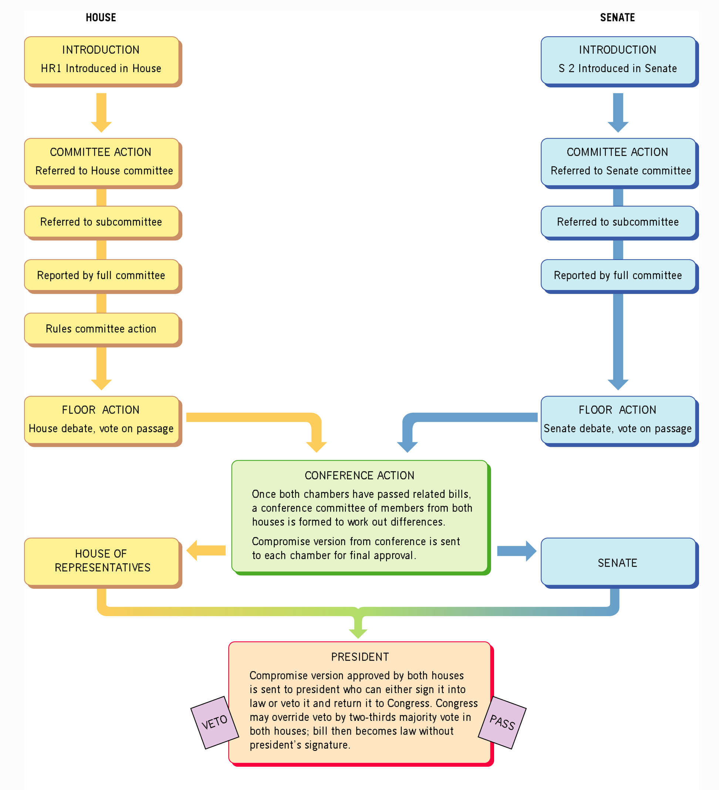

Slide 7
Budget Execution
At the beginning of the fiscal year, agencies carry out or execute their approved budget. Spending is monitored by the agencies and the executive budget office ensures that appropriations are not overspent.
Monthly, quarterly, and midyear budget reports are issued that provide comparison between actual revenue received to date and revenue projections and actual expenditures compared to appropriations.

Slide 8
If revenue projections are off the target, modifications should be made to ensure that the budget is balanced.
Budget shortfalls can cause serious operating and personnel problems for agency heads.

Slide 9
Audit/Evaluation Phase
The purpose of this phase is to determine if the budget was executed in the manner that was set forth in the legislation.
Does the approved budget and actual budget match?
An audit occurs after the fiscal year has ended and can be done internally and externally.
There are types of audits: financial and performance.

Slide 10
A financial audit checks to ensure that an agency’s financial statements fall within the principles of GAAP and gauge whether an agency has followed the laws and statutes regulating its spending.
A performance audit concentrates its efforts on efficiency and effectiveness by examining procurement, duplication, utilization of staff, legal compliance and measuring and reporting performance.

Slide 11
There are two types of performance audits:
Economy and efficiency audits determine whether the governmental unit is acquiring, protecting, and using its resources economically and efficiently and whether it has complied with laws and regulations on matters of economy and efficiently.
Program audits determine the extent to which desired results are being achieved and analyzed related compliance issues.

Slide 12
The Budget Calendar
Since state and local governments work around a fiscal year, budget approval has to occur prior to the beginning of the fiscal year. The beginning of the budget cycle differs for most states and cities.
A lot of local governments begin the fiscal year in January, July, September and October. The federal fiscal year begins October 1 and ends on September 30.

Slide 13
The Budget Game
Making budgeting decisions can be a very complicated process given the number of individuals involved and their ideas and goals.
Actors:
Chief Executive (administers the budget)
Budget Director (revenue forecast, compile budget request, run the budget office)
Legislator/Council Member (approve the budget)
Agency Director (head the bureaucracies, provide service, and constantly defending their budget request but not clear on whether they engage budget maximizing strategies.
Interest Groups
Individuals

Slide 14
In cases of revenue shortfalls, decision-makers have to decide where cuts should be made to compensate for the shortfall.
In most cases, budget requests are denied rather than raise taxes.
As a result, each agency has to essentially defend its budget in a formal hearing.

Slide 15
Budget Request
In preparing for a hearing, each agency should submit to the budget office a narrative explaining the purpose, goals, and objectives of the agency, a budget request, and a detailed explanation justifying new requests.

Slide 16
It is much easier for an agency to defend spending new monies when they can show that it fits the goals of the agency, the mission of the chief executive, and the priorities set by new legislation.
It is rare that the budget gets completely funded without changes. So, agencies have to be prepared to defend their request.

Slide 17
There are 2 basic ways to sell your budget.
Political budget-The agency director plays a political game rather than focus on the numbers.
Agencies use different strategies (tricks) out-maneuver politicians.
Technical budget-Focuses on numbers and facts.
Mandatory expenditures-The agency is legally required to conduct the service (e.g., salaries, FICA, pensions/retirement, unemployment compensation, and any other legal obligations)
Discretionary expenditures-Smallest part of the budget that often represent increases and are sought by everyone.
These funds will allow the agency to expand services and operate more efficiently and effectively.

Slide 18
Budget Proposal
Project Title: The title should represent the essence of the project. Be thoughtful.
Description and Rationale: Legislators often want a quick synopsis of the project. So, the description should be short with some thought put into the rationale.
Objectives Justifying the Need: These items should flow directly from the description and rationale.

Slide 19
Budget Proposal Con’t
Budget and Budget Description: What is it going to cost and what are you spending the money on? Line item or program budgets work well.
Measures of Success: Describe the key measurements (ie. performance) that allow the legislator to assess your performance.

