Slide 1
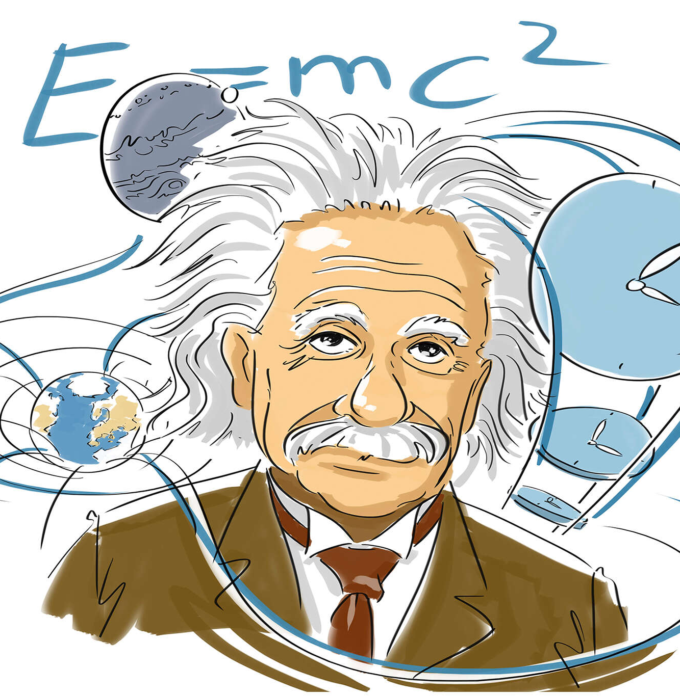

Chapter 2
The Nature of Citizen Beliefs

Slide 2
The Questions:
How sophisticated should citizens be for democracy to function?
What did early research find? And what did it imply about the nature of democracy?
How has recent research changed our image of citizens’ political abilities?
Do these opinion vary across nations, across social groups?
What are the possible consequences of these opinions?

Slide 3
Early Research: The Supercitizen Model
The Supercitizen Model:
for democracy to survive, the public must be a paragon of civic virtue (John Stuart Mill, John Locke, Alexis de Tocqueville, etc.)
Citizens should follow politics
Citizens should be knowledgeable
Citizens should be active
Citizens’ political decisions should be rational

Slide 4
Reality Versus a Theoretical Ideal
The first empirical studies of the American public found a much different reality:
“Our data reveal that certain requirements commonly assumed for the successful operation of democracy are not met by the behavior of the “average” citizen. . . Many vote without real involvement in the election... The citizen is not highly informed on the details of the campaign... In any rigorous or narrow sense, the voters are not highly rational. (Berelson, Lazarsfeld, and McPhee 1954, 307–10).

Slide 5
Converse’s Model of a Structured Belief System
Converse claimed that issue positions should be interconnected and linked to core values for citizens to make consistent and reasonable choices.
However, he said that most people lacks an ideological structuring principle and issue opinions were not clearly formed and not interlinked.

Slide 6
The Authors of The American Voter Concluded
“(the voter) is almost completely unable to judge the rationality of government actions; knowing little of the particular policies and what has led to them, the mass electorate isn’t able either to appraise its goals or the appropriateness of the means chosen to secure these goals” (1960, 543).
British Prime Minister, Winston Churchill
“The best argument against democracy is a five-minute conversation with the average voter.”

Slide 7
Elitist Theory of Democracy
These findings gave rise to an Elitist Theory of Democracy:
the model citizen “is not the active citizen; he is the potentially active citizen”
“Some people are and should be highly interested in politics, but not everyone is or needs to be”
“the democratic citizen... must be active, yet passive; involved, yet not too involved; influential, yet deferential”
“America suffers from too much democracy” (Fareed Zakaria, 2003)

Slide 8
Political Sophistication Reconsidered
More recently, researchers have offered a contrasting view of how citizens use various factors to make reasonable decisions:
Reasonable Choice versus full-information Rational Choice:
A New Model of Political Cognition
The Use of Issue Publics
The Use of Heuristics
Cognitive Mobilization
The Wisdom of Democratic Crowds

Slide 9
A Network Model of Political Feelings
Feelings About Obamacare and Connections to Other Factors.

Slide 10
Increasing Interest in Politics
Political interest has generally increased over time.
Source: Various national election surveys.

Slide 11
Political Conceptualization
Most citizens use several different criteria for judging political parties

Slide 12
A Diversity of Information Sources.
Citizens now use diverse information sources

Slide 13
How Voters Decide
One Size Doesn’t Fit All. There is no single model that fits everyone.
Diversity. People bring different skills and interests to their choices.
Shortcuts. Many people use heuristics (shortcuts) to make choices, and different heuristics.
Issue Publics. Different people focus on different issues that are important to them.
Improvement. Citizens political skills have been improving over time.
Reasonable Choices. In the end, elections are about making reasonable choices because no choice is perfect.

Slide 14
Democracy’s Strength
No one makes perfect decisions, but elections make reasonable decisions.
The strength of democracy is that choices are repeatedly made.
If the public makes poor decisions, candidates do not follow their promises, or events change—a new election allows voters to elect new leaders.
Winston Churchill: “Democracy is the worse form of government, except for all the rest”. (November 11, 1947)

Slide 15
A Thought Experiment
Would a group of 500 randomly selected Americans make better policy decisions than the current U.S. House of Representatives?

Slide 16
The End

