Slide 1
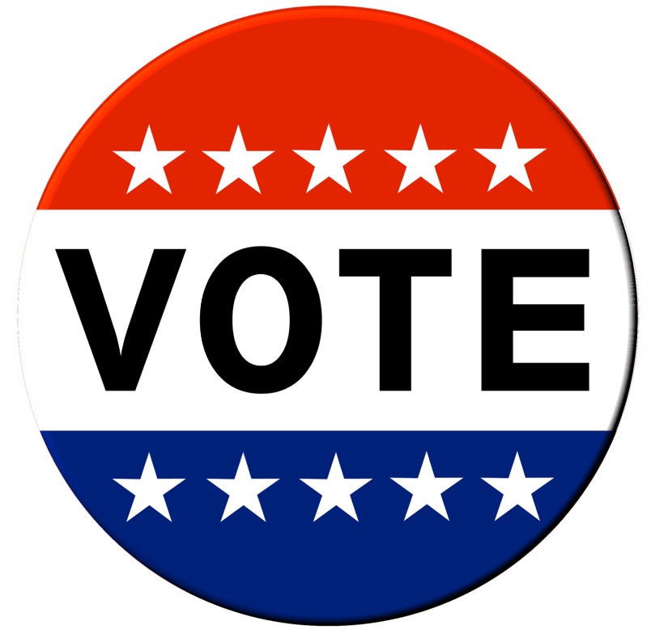
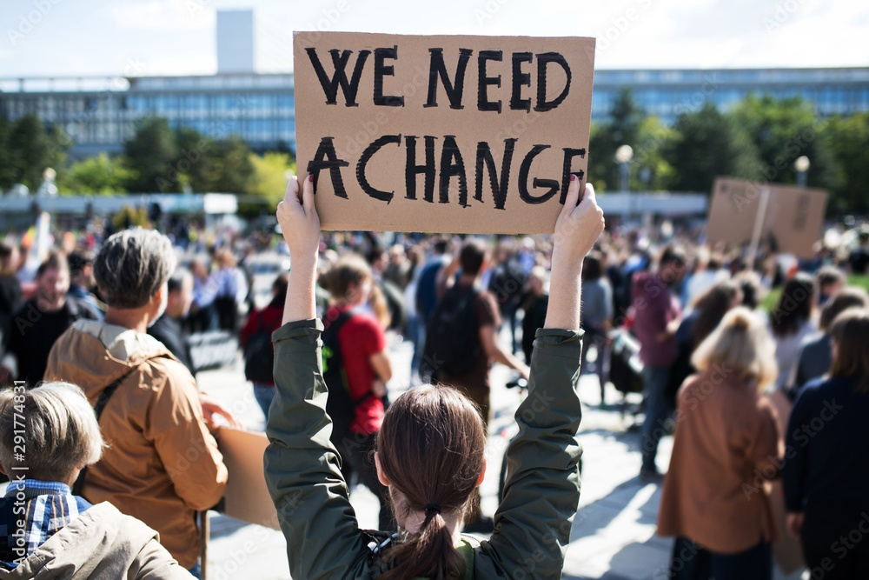
Chapter 3
How We Participate

Slide 2
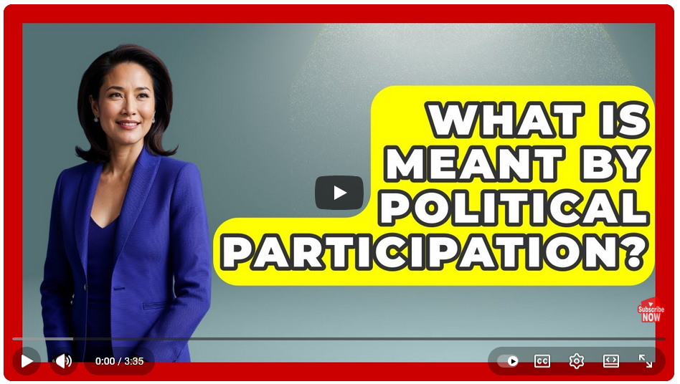
An Overview:
The Importance and Meaning
of Political Participation
View video here
https://www.youtube.com/watch?v=cQvD0ASw_zo

Slide 3
The Questions
Why would you choose this method of influence?
What are the forms of political participation and their characteristics?
Do Americans (or citizens in your nation) participate more/less than citizens in other democracies?
Is political participation increasing or decreasing over time?
What would you do to influence a political decision in your community?

Slide 4
Participation Pessimists: An Example
“The last thing people want is to be more involved in political decision-making: They do not want to make political decisions themselves; they do not want to provide much input to those who are assigned to make these decisions; and they would rather not know all the details of the decision-making process.”
John Hibbing and Elizabeth Theiss-Morse, Stealth Democracy, 2002, pg. 1-2.

Slide 5
Participation Optimists:
One frequently hears references to growing apathy on the part of the public. . . These allegations of apathy are misleading: mass publics are deserting the old-line oligarchical political organizations that mobilized them in the modernization era—but they are becoming more active in a wide range of elite-challenging forms of political action.
Ronald Inglehart, Modernization and Post-modernization, 1997, p. 307.

Slide 6
How Would You Participate?
ACTION
Suppose an unjust or unfair law was being passed by your local government. Could you change it? What would you do?
The choice of activity often depends on the skills and interests of the individual, and the desired goal.

Slide 7
Types of Political Activity
Political activities differ in their characteristics and influence on government.

Slide 8
Election Turnout for Voting Age Population
Turnout has generally decreased in established democracies.
BRITAIN
Source: IDEA

Slide 9
Voting Turnout
over
Time
 | Turnout is decreasing in most democracies

Slide 10
The Amount of Electing
Instead of counting the number of people who vote in national elections, we can measure the overall amount of electing. When this is considered, the US is quite high in the total amount of electing.
No country approaches the US in the frequency and variety of elections. No other country elects its lower house as often as every two years, or its president as frequently as every four years. No country popularly elects its state governors and town mayors, or such a wide variety of other elected offices (judges, sheriffs, attorneys general, and so on). Only the Swiss compete in the number of local referendums, and only Belgium and Turkey hold party “primaries”. Even taking turnout rates into account, Americans do not necessarily vote less often than other nationalities; most probably they do more voting.
A simple comparison highlights this difference: between 2016-2020, a resident of Oxford, England, had six votes to cast. In contrast, a resident of Buffalo, New York, could have cast over a dozen votes in 2024 alone. Turnout rates in national elections are thus a poor measure of the public’s overall political involvement because the structure of institutions and the electoral rules strongly influence turnout.

Slide 11
American Campaign Activity
Traditional forms of campaign activity dipped in the 1980s and 1990s but have since grown.
Source: American National Election Studies.

Slide 12
British Campaign Activity

Slide 13
Participation Across Nations
Americans are often more politically active than Europeans—except for voting.

Slide 14
Protest Activity
Australia
Austria
BRITAIN
Canada
Denmark
Finland
FRANCE
GERMANY
Iceland
Japan
Netherlands
Norway
Spain
Sweden
Switzerland
UNITED STATES
Average
Levels of protest now rival conventional forms of political action.
Source: European Values Survey/World Values Survey 2017-2022.
Note: The figure presents the percentage in each nation who have ever participated in each activity.

Slide 15
Protesting Has Generally Increased Over Time
Source: World Values Survey

Slide 16
What Does This Evidence Show
This has the potential to change how democracy works . . .
Instead, people are participating in other forms of action
Americans and Europeans are politically engaged, and more so today
Participation in elections has been flat or even declined

Slide 17
A Reconsideration
If you were concerned about a problem in your community, how would you try to influence the local government to address this problem?
Why did you select this way?

Slide 18
Ways the British Would Influence Local Politics
Contact Council
Source: 2020/21 British Social Life Survey

Slide 19
The End

