Slide 1
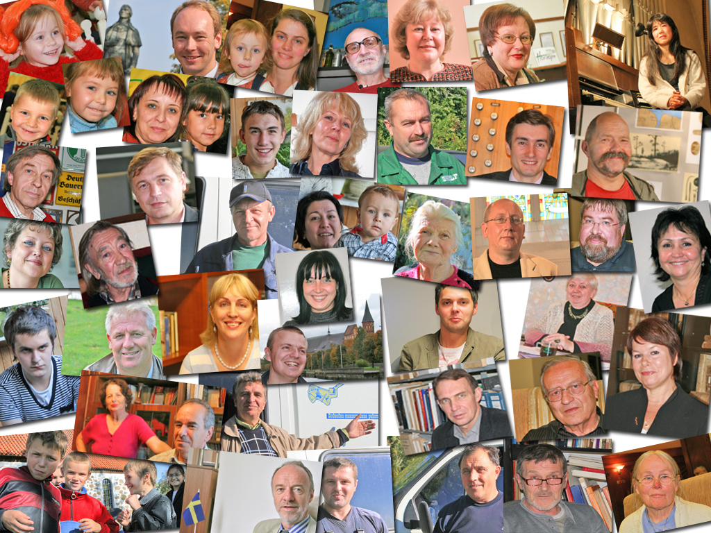
Chapter 5
Values in Change

Slide 2
The Questions
What are the possible consequences of value change?
How do personal values affect human behavior?
How can we measure such values?
Have value priorities changed over time?
What are the possible consequences of value change?
Do these values vary across nations? Do they systematically vary across social groups?

Slide 3
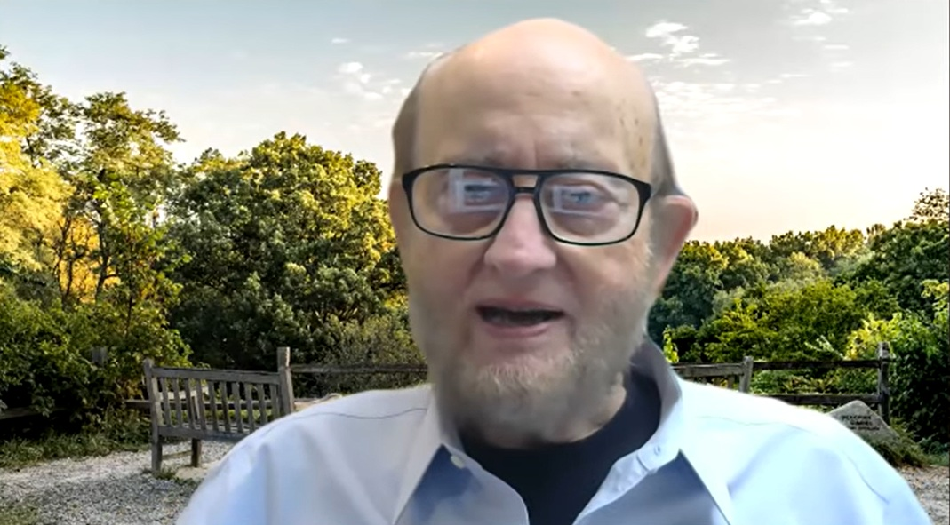
Interview with Ronald Inglehart
View video here
https://www.youtube.com/watch?v=ibQk4wjopOA

Slide 4
Social Modernization Thesis
Economics
Citizens experienced large increases in socio-economic well-being
Health
Healthcare improves and extends life spans
Education
Education levels and citizen skills have markedly increased.
Life Style
Personal Values
People became more cosmopolitan in their experiences and interests
People change their values about what is important for society and politics.
Societies and citizens are changing in many ways

Slide 5
Social Modernization Changes Citizens
New Resources/Skills
(Cognitive Mobilization)
Social
Modernization
New Postmaterial
(New Politics Values)

Slide 6
Cognitive Mobilization
Education levels: 2/3 of Americans in 1950s had less than HS degree, now 2/3 have some college.
Information: Only the Star Trek crew has more access to information than citizens today.
IQ: Average IQ has increased by 18 points over past 6 decades
Generation: Young citizens are the best educated, most informed, most cosmopolitan generation in human history.
Consequence: Political sophistication and engagement should increase

Slide 7
Inglehart Model of Value Change
Scarcity Hypothesis (People value most what they don’t have, and take what they do have for granted)
Socialization Hypothesis (Values learned early in life tend to persist during the life cycle)
Thus, as societal conditions change, citizens’ value priorities should also change.

Slide 8
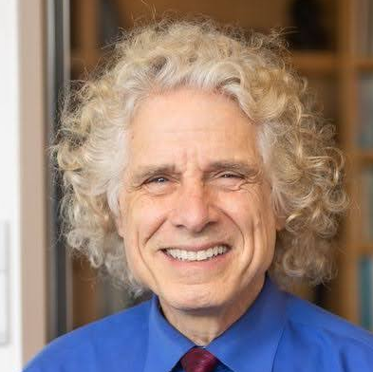
Pinker on the Modernization Process
“As societies shift from agrarian to industrial to informational, their citizens become less anxious about fending off enemies and other existential threats and more eager to pursue opportunities in life and to express their ideals. This, in turn, tilts their values toward greater freedom for themselves and others. . . . People begin to prioritize freedom over security, diversity over uniformity, autonomy over authority, creativity over discipline, and individuality over conformity.”
Steven Pinker, Enlightenment Now: The Case for Reason, Science, Humanism, and Progress. 2018

Slide 9
Material and Postmaterial Values
Materialist Values
Economic Security
National Security
Law and Order
Traditional Lifestyles
Status Quo
Quantity of Life
Postmaterial Values
Social Justice
International Cooperation
Participation/discuss
Lifestyle Choice
Open to Change
Quality of Life

Slide 10
Concepts and Survey Questions

Slide 11
Value Priorities In Affluent Democracies
Survey respondents can make six choices;
two items from each group of four.
The Materialist choices are in red.
Red are Materialist Items
Issue
High level of economic growth
A strong defense
More say in work/ community
Make cities/country beautiful
Maintain order in nation
More say in government
Fight rising prices
Protect free speech A stable economy
More humane society
Ideas count more than money
Fight against crime
Pick 2
What the Future Would Be Like
Pick 2
Pick 2

Slide 12
The Distribution of Values Among the American Public
The American public gives a higher priority to materialist goals.
Source: US Public, 2017 World Values Survey

Slide 13
Value Priorities In Affluent Democracies
People cite a mix of materialist and postmaterialist issues as the most important.
Source: World Values Survey

Slide 14
How the Balance of Values Has Changed Over Time
Most affluent democracies are becoming more postmaterialist
Source: four item value measure; 1970s European Community Survey and 2017-2018 EVS/WVS.

Slide 15
Question:
How can we tell if
1) societal conditions and/or
2) early life socialization
form citizen values?

Slide 16
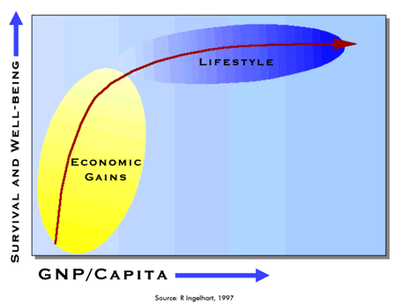
Economic and Value Change
As a nation’s GNP/capita increases, values shift to lifestyle goals

Slide 17
Affluence and Postmaterialism
Citizens in more affluent nations are more postmaterialist.
Source: World Values Survey

Slide 18
Thought Experiment
Think about your own values and those of your friends. Economic competition has seemingly increased in contemporary societies, as crises such as the 2008 Great Recession and the COVID Pandemic have eroded economic security. At the same time, discussions of cultural liberalism have increased in salience.
Are there differences between your generation and one 30 years older (e.g., your parents)?

Slide 19
Generations and Postmaterialism
Successive generations are becoming more postmaterialist
Source: Eurobarometers and World Values Survey

Slide 20
Expected Consequences of Value Change
In the Workplace. Greater discretion and autonomy at work.
Social Relations. An individual earns authority, rather than having it bestowed by a position.
Societal Standards. More tolerant of individual choice and alternative lifestyles.
Issue Agenda. Environmental quality, sustainable energy, gender equality, and multiculturalism.
Participation. Postmaterialists are more likely to favor protest and direct action.
Parties and Elections. Support green and progressive parties.
In short, many of the factors examined in this book.

Slide 21
Two Possible Models of Social Change
Postmaterial optimism: Social change improves the quality of citizenship and thus improves the quality of democracy.
Rival theory: Social change is harming the quality of citizenship by focusing on individual desires instead of our collective and basic needs.
Stay tuned to further chapters . . .

Slide 22
The End

