Slide 1
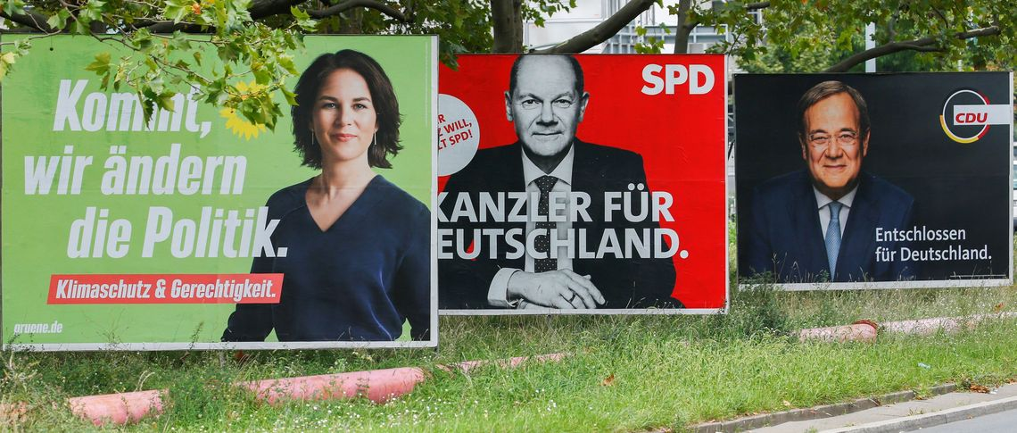
Chapter 7
Elections and Political Parties
Citizen Politics & Democracy, 8th ed © Russell J. Dalton & Timothy Hellwig

Slide 2
The Questions
Where do party systems come from?
What are social cleavages and how do they structure competition among political parties?
How is the supply of political parties different in the United States, Britain, France, and Germany?
What is the party space and how does it matter for representing citizens?

Slide 3

Political Parties & Democracy
“Parties are inevitable. No one has shown how representative government could be worked without them.” - James Bryce, 1921
“Modern democracy is unthinkable save in terms of political parties” - E. E. Schattschneider, 1942
Parties and electoral processes serve as the supply side of citizen politics
Chain of representation: Political parties link voters and candidates to governments and policy outcomes.
voters & candidates
political parties
government
policy

Slide 4
The History of Party Systems
Modern party systems reflect the historical patterns of national and socioeconomic development.
“The party systems of the 1960s reflect…the cleavage structures of the 1920s.” - Lipset & Rokkan (1967, 50)
Historic Era | Cleavage | Voting Groups
National Revolution | Center/periphery | Region
 | Church/state | Religious denomination
 |  | Religious/secular
Industrial Revolution | Land/industry | Urban/rural
 | Owners/workers | Middle/working class
Postindustrial Revolution | Cultural values | Cultural liberals/cultural conservatives

Slide 5
The American Party System
Two dominant parties; power shifts back and forth between them
Members of Congress selected from single-member electoral districts
Democrats and Republicans largest vote getter in nearly all districts
American parties are weak with decentralized organization

Slide 6
The British Party System
Most of 20th Century: A “two-and-a-half” party system with Conservative, Labour, Liberals
Today: party choices have expanded: regional parties, extreme parties
Members of Parliament selected from single-member electoral districts
British parties are strong and disciplined with centralized organization

Slide 7
The French Party System
A multiparty system with large menu of choice for citizens
Most of 20th Century: party competition in two blocs: on center-right and center-left
Today: fragmented system with old parties on center-right (Gaullists) and center-left (Socialists) in decline.
Two-tour electoral system. Candidates compete in single-member districts in first round; if none wins majority, second round picks winner by plurality.
Party system more personalized, less institutionalized compared to European neighbors.

Slide 8
The German Party System
A multiparty system; larger menu of choice for citizens
Electoral system is a mix of single member districts for candidates (first vote, or Erststimme) and multi-member districts from party lists (second vote, or Zweitstimme).
Public financing of campaigns, free access to media creates more level playing field
“Party government”: parties organize Bundestag activities and majority selects federal chancellor

Slide 9
Party Systems: The US and Great Britain
Party systems vary in the number of parties and their characteristics
Party | Year start | Pct votes | No. Seats | Party Structure | Party Structure | Years in Government, 1977-2024
United States (2024)
Democrats (Dem) | 1832 | 47.2 | 215 | Decentralized |  | 19
Republicans (Rep) | 1856 | 49.8 | 220 | Decentralized |  | 21
Great Britain (2024)
Labour (Lab) | 1900 | 33.7 | 412 | Centralized |  | 15
Green Party | 1990 | 6.7 | 4 | Mixed |  | 0
Liberal Democrats (LibDem) | 1987 | 12.2 | 72 | Decentralized |  | 2
Conservatives (Con) | 1830 | 23.7 | 121 | Mixed |  | 32
Reform | 2018 | 14.3 | 5 | Personalistic |  | 0
Scottish National Party (SNP) | 1934 | 2.5 | 9 | Mixed |  | 0
Other parties |  | 6.9 | 27 |  |  | 0

Slide 10
Party Systems: Germany and France
Party systems vary in the number of parties and their characteristics
Party | Year start | Pct votes | No. Seats | Party Structure | Party Structure | Yrs Gov’t, 1977-2024
Germany (2025)
Die Linke | 1990 | 8.8 | 64 | Centralized |  | 0
Social Democrats (SPD) | 1863 | 16.4 | 120 | Centralized |  | 28
Greens (Grüne) | 1980 | 11.6 | 85 | Decentralized |  | 11
Free Democrats (FDP) | 1948 | 4.3 | 0 | Decentralized |  | 29
Christian Democrats (CDU/CSU) | 1950 | 28.5 | 208 | Mixed |  | 32
Alternative for Germany (AfD) | 2013 | 20.8 | 151 | Mixed |  | 0
France (2024)
New Popular Front (NFP) | 2017 | 28.0 | 178 | Decentralized |  | 20
Ensemble bloc | 2016 | 20.0 | 150 | Decentralized |  | 2
The Republicans (LR) | 1976 | 10.5 | 56 | Mixed |  | 21
National Rally (RN) | 1972 | 29.3 | 125 | Personalistic |  | 0
Other parties |  | 12.2 | 68 |  |  | 0

Slide 11
The Structure of Political Space
In most Western democracies, the historic economic cleavage which once strongly shaped party competition has been joined by a new cultural cleavage.
Cultural liberal
Economic cleavage
Economic left
Economic right
Cultural cleavage
Cultural conservative

Slide 12
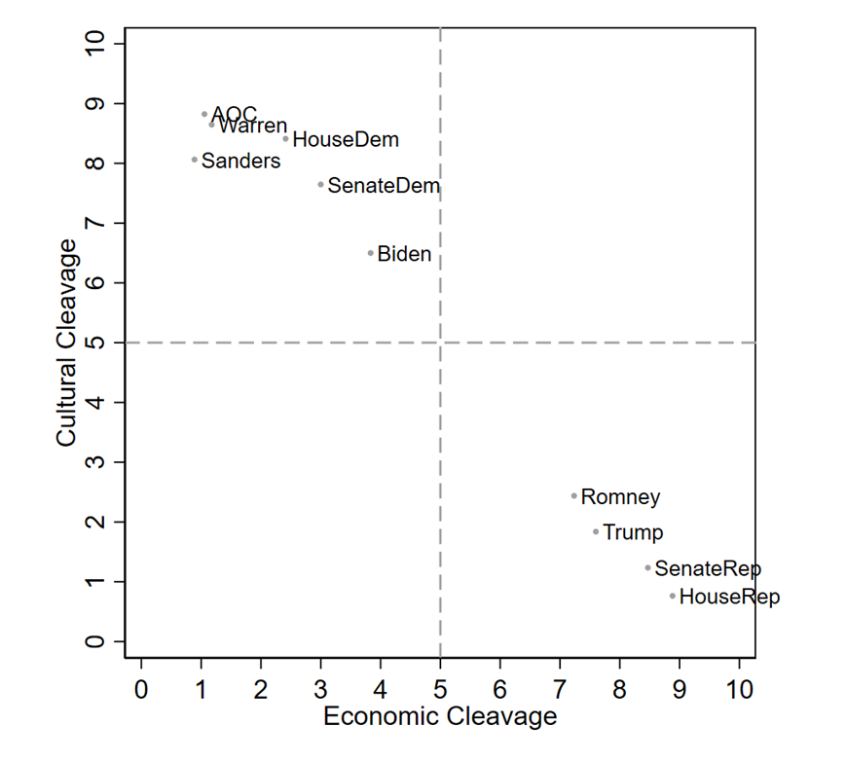
The American Political Space
American political actors now reflect a mix of economic and cultural positions
Conservative Liberal
Liberal Conservative
Source: Chapel Hill Expert Survey, 2019

Slide 13
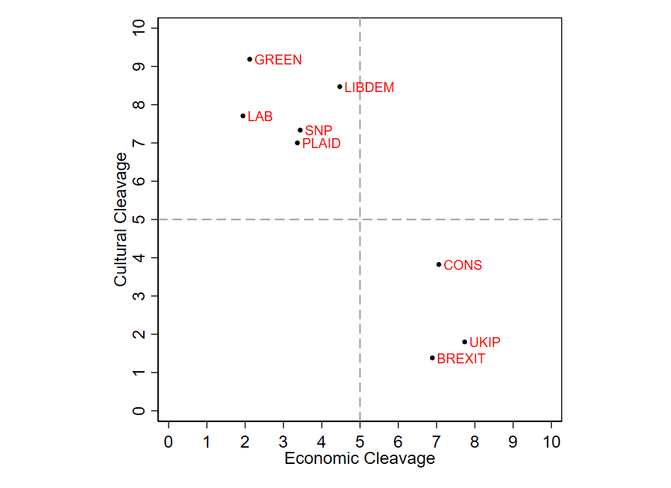
The British Political Space
Conservative Liberal
Liberal Conservative
Source: Chapel Hill Expert Survey, 2019

Slide 14
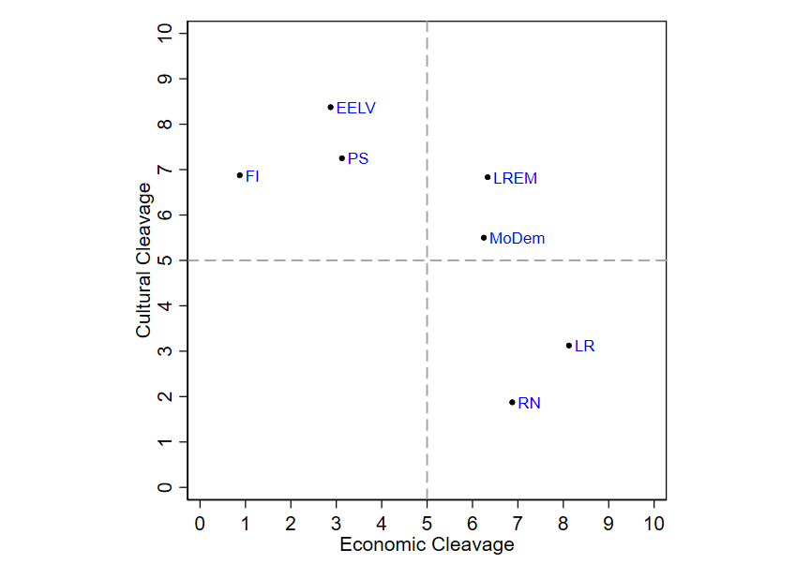
The French Political Space
Conservative Liberal
Liberal Conservative
Source: Chapel Hill Expert Survey, 2019

Slide 15
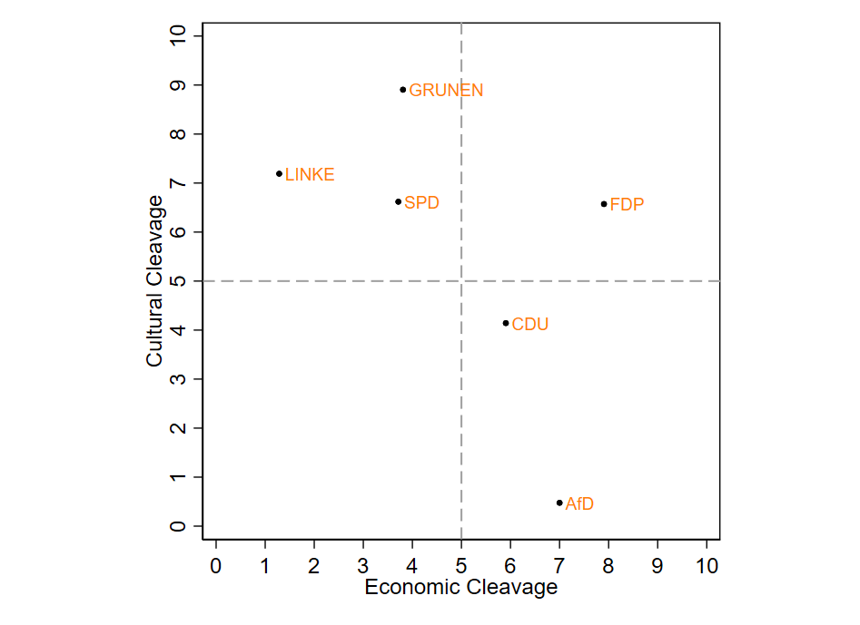
The German Political Space
Conservative Liberal
Liberal Conservative
Source: Chapel Hill Expert Survey, 2019

Slide 16
Party Systems Today
Is there a “best” party system?
United States: citizens’ choices limited to parties and candidates with economically leftist and culturally liberal or economically laissez-faire and cultural traditional positions.
Europe: multiparty systems offer wider range of choices.
Multi-dimensional space provides possibility of better representation.
But party supply is still limited.
Few parties combine market-friendly economic positions with liberal cultural views.
Traditional center-left parties have deserted working class voters on the economic left and cultural right.

Slide 17
Thought Experiment
How do party systems matter for political representation?
If the United States had multiparty systems like Europe, would this change the relationship between voters, governments?
Would it improve the democratic process?

Slide 18
The End

