Slide 1
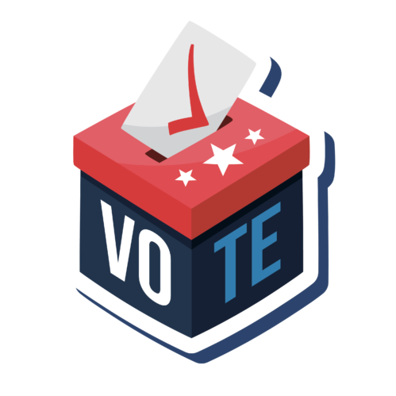
Chapter 10
Attitudes and Vote Choice
HEALTH CARE
THE ECONOMY
PENSIONS
ENVIRONMENT
IMMIGRATION
FOREIGN POLICY
Citizen Politics & Democracy, 8th ed © Russell J. Dalton & Timothy Hellwig

Slide 2

The Funnel of Causality Redux
Electoral politics may begin as competition between rival groups or party camps, but elections ultimately revolve around issues, what voters demand, and what political parties pledge to supply

Slide 3
The Questions
What is required for issue voting?
Which issues are most important for understanding voter choices?
Does performance in office matter for government support?
What are the types of issues and how do they matter for how voters decide?
Are candidate images beneficial or harmful as predictors of the vote?

Slide 4
Requirements for Issue Voting
Issue voting often presumes a sophisticated electorate
Requirements for issue voting from The American Voter (Campbell et al. 1960). Issue voters should:
be interested in the issue.
hold an opinion on the issue.
know the party/candidate positions on the issue.
This is a high bar which many voters cannot clear.
A more optimistic view: People are “moved by concern about the central and relevant questions of public policy…” “Voters are not fools” V. O. Key (1966)
Optimistic view in practice: voters are issue specialists--they focus on a few major issues use them to inform their vote.

Slide 5
Types of Issues
Different types of issues may affect voting choices.
Time Frame | Position | Performance | Attribute
Retrospective | Policy appraisal | Performance evaluation | Attribute voting
Prospective | Policy mandate | Anticipatory judgment
Position issues: conflicts over different policy goals
Performance issues: judgments about effectiveness an officeholder or party pursues political goals
Attributes: traits or characteristics of the parties or candidates
Type of issue and time frame → typology of the different types of issue calculations that voters employ

Slide 6
Position Issues and the Vote
Which issues matter most for how voters decide?
Difficult to compare issue influence across time or nations. Indeed, the impact of specific issues should shift over time.
A snapshot of issue voting: Left/Right & Role of Government
Sources: Left/Right attitudes: ANES 2024; BES 2024; FES 2024; GLES 2025; Role of government in economy: 2020 ISSP. Note: Figures are Cramer’s V coefficients between issue positions and party vote preference.

Slide 7
Position Issues and the Vote
A snapshot of issue voting: Immigration, Environment, & Gender
Sources: 2020 ISSP & 2017–21 WVS.
Note: Table reports Cramer’s V coefficients between issue positions and party vote preference.

Slide 8
Position Issues and the Vote
A snapshot of issue voting: Moral issues & Foreign Policy
Sources: 2016 ISSP & 2017–21 WVS.
Note: Table reports Cramer’s V coefficients between issue positions and party vote preference.

Slide 9
Left/Right Attitudes and the Vote: US & UK
Most people vote based on broad political orientations rather than issue-by-issue analyses
Positions on the Left/Right scale capture the general impact of policy preferences on voting choice
People perceive parties to be located along left/right dimension; the average citizen is near the middle
Sources: ANES 2024 & BES 2024

Slide 10
Left/Right Attitudes and the Vote: France & Germany
Most people vote based on broad political orientations rather than issue-by-issue analyses
Positions on the Left/Right scale capture the general impact of policy preferences on voting choice
People perceive parties to be located along left/right dimension; the average citizen is near the middle
Sources: FES 2024 & GLES 2025

Slide 11
The Power of Left/Right Attitudes
How much do citizens’ left/right positions influence their vote?
Percentage of people voting for a Right party based on the voter’s self-placement on the Left/Right scale.
Sources: American National Election Study 2024; British Election Study 2024;
French Election Study 2024; German Longitudinal Election Study 2025.

Slide 12
Performance Issues and the Vote
Can the government deliver? It makes little sense to care about policy positions if the government is unable to make good on its promises.
Voters “typically have one comparatively hard bit of data: they know what life has been like during the incumbent’s administration.” Fiorina (1981, 5)
Percentage voting for the incumbent based on perception of the economy over the last twelve months.
Sources: American National Election Study 2024; British Election Study 2024; French Election Study 2024; German Longitudinal Election Study 2025.

Slide 13
Performance Issues and the Vote: Debates
Though performance matters, questions remain open for debate
Do voters base evaluations on their personal economic situation or on the broader national economy?
Are voters retrospective or prospective in their economic evaluations?
How does the economy compare to other performance areas (foreign policy, health care, environment)?
Causality: do voters support parties based on the economy or do voters evaluate the economy based on who’s in charge?
Are voters able to attribute responsibility? Depends on electoral and party systems.

Slide 14
Candidate Images and the Vote
Candidate images also may matter.
One view: impact of candidate image on vote is a concern
People’s vote may turn on superficial criteria such as candidate’s looks, style, or social media persona.
Candidate images are not independent of party preferences. Example from 2024 US election:
Party vote for Congress | Like Kamala Harris | Like Donald Trump
Democrat | 88% | 5%
Republican | 9% | 88%
Another view: impact of candidate images on vote is informative.
Character, competence, and other personal qualities of a candidate provide important information about her/his likely performance in office.

Slide 15
The End of the Causal Funnel
Correlates of the vote in elections in the U.S., Britain, France, & Germany
Note: Figure entries are standardized coefficients from multiple regression models with parties (legislative elections) and candidates (presidential elections) coded using public perceptions of their Left/Right positions. Sources: ANES Study 2024, FES 2024, BES 2024; GLES 2025.

Slide 16
Subpublics: Issue Salience & Issue Voting
The concept of issue publics suggests that interests are not evenly distributed.
The power of issue voting depends both on the voter’s position on the issue and the salience of the issue
Issues and the Vote, France 2017
If respondent views issue as important, they are more likely to base their vote on party competency on the issue
Source: FES 2017.
Note: Figure entries are Cramér’s V correlations.

Slide 17
Thought Provoking
Chapters 8, 9, and 10 have documented changes in citizen politics in recent decades:
The long-term determinants of voting have weakened
The importance of short-term factors has increased
Voters are more fragmented into separate subpublics
What are the consequences of these changes for democracy? If mass publics have changed, does that mean a more just, free, and equal political system? Or does it suggest a decline in the quality of democracy?

Slide 18
The End

