Slide 1
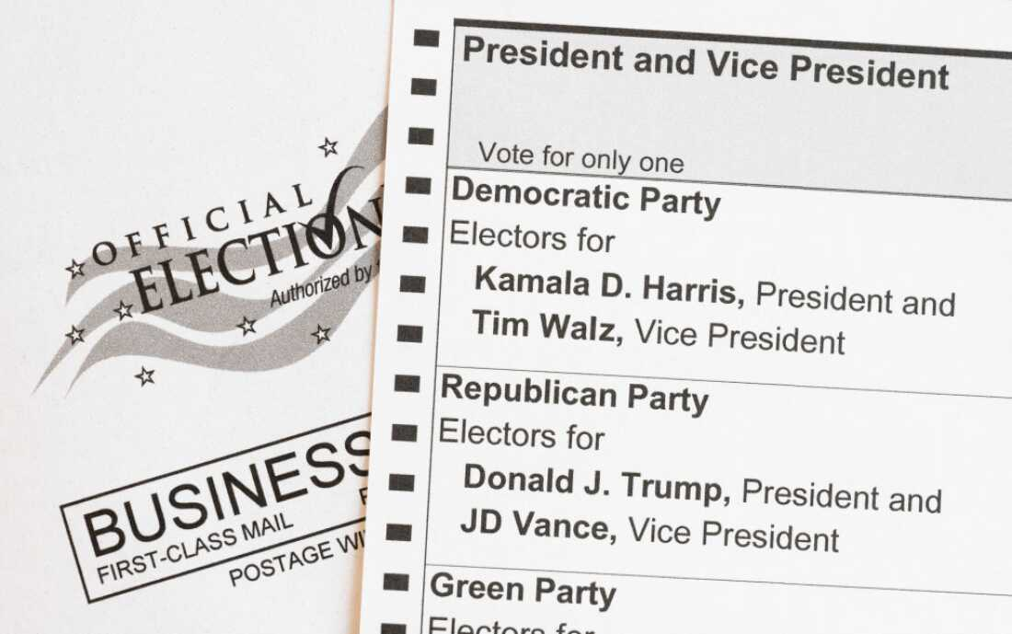
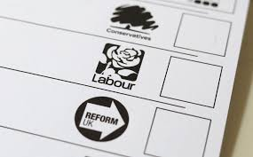
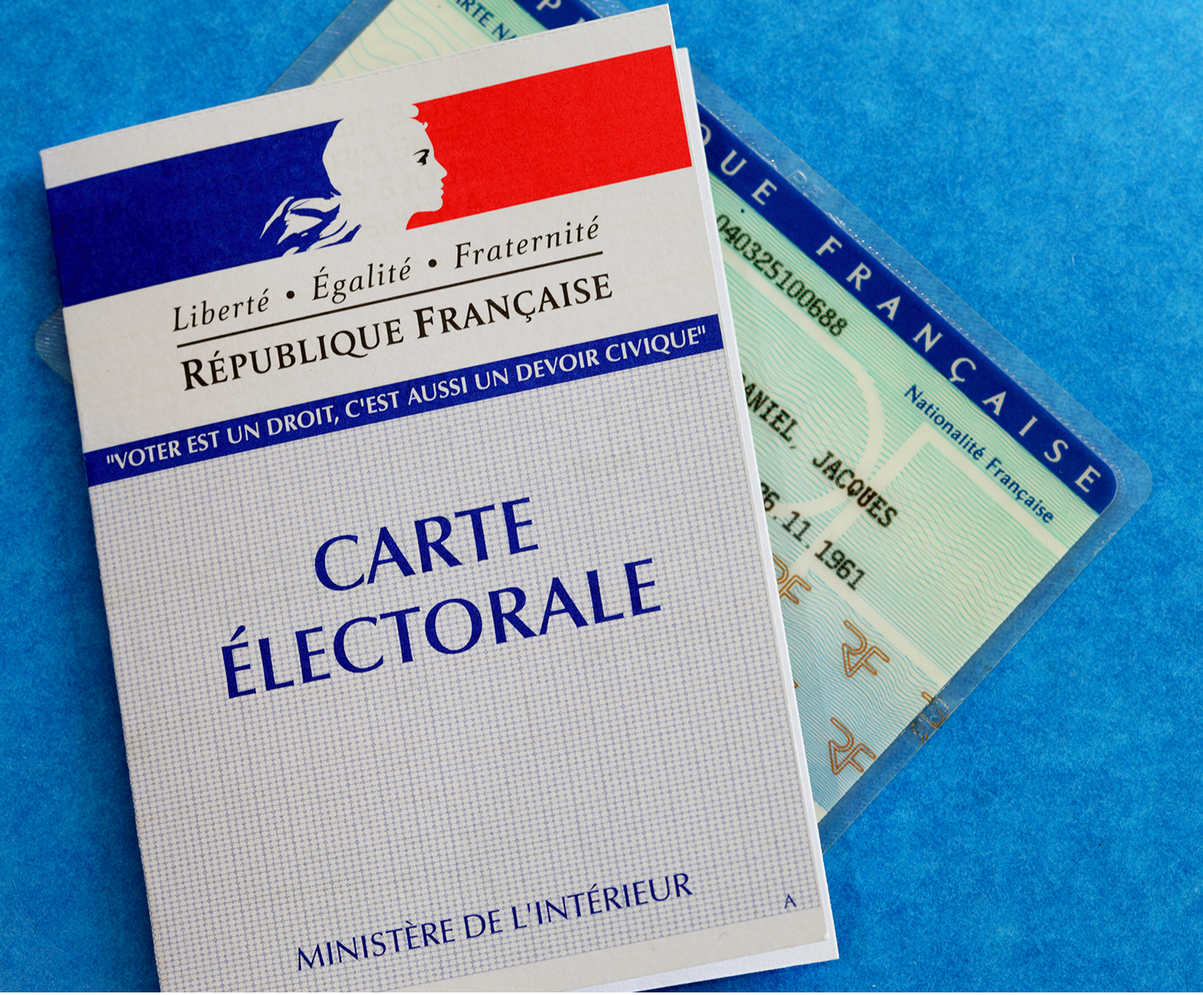
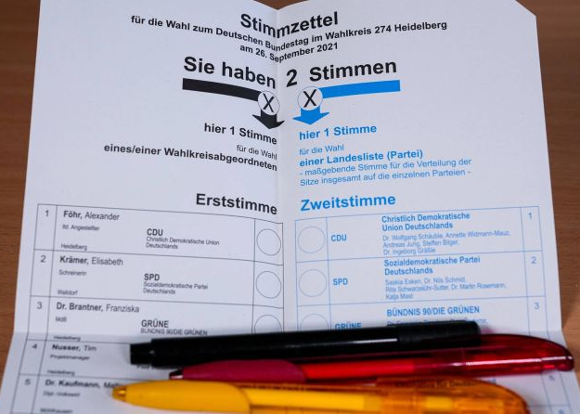
Chapter 9
Partisanship and Voting
Citizen Politics & Democracy, 8th ed © Russell J. Dalton & Timothy Hellwig

Slide 2
The Social-Psychological Model of Voting
This figure shows how broad social and psychological elements gradually become focused and specific, leading to voting choice.

Slide 3
The Funnel of Causality
The funnel of causality connects the various elements—either distant or proximate, or societal versus individual—that influence voting choice
The wide end of the funnel represents social conditions that structure political conflict; attention shifts to explicitly more political factors as we move through the funnel.
The factors on the left of the figure are temporally distant from the voting decision; the factors on the right are more proximate to voting choice.
The factors on the left are conditions of society, and then groups; the factors on the right are considerations made by the individual voter.

Slide 4
Party Identification
A long-term attachment to a political party is the cornerstone of the social- psychological model.
The first American National Election Studies found many voters begin each election having already decided on their party preference. These loyalties are a central part of an individual’s belief system and provide a source of political cues for other attitudes and behaviors.
University of Michigan researchers described these partisan loyalties as a sense of party identification (PID). They maintained that PID is a long-term, affective, psychological identification with one’s preferred political party
“Few factors are of greater importance for our national elections than the lasting attachment of tens of millions of Americans to one of the parties. These loyalties establish a basic division of electoral strength within which the competition of particular campaigns takes place. And they are an important factor in ensuring the stability of the party system itself. ... The strength and direction of party identification are of central importance in accounting for attitude and behavior” Campbell et al. 1960, 121.

Slide 5
The Learning of Party Identification
Party attachments are often “inherited” from one’s parents and generally increase with age and repeated support of the same party.
Sources: ANES 2024; BES 2024; FES 2024; GLES 2025.
Note: The surveys use different partisanship questions, so the level of partisanship is not directly comparable across countries.

Slide 6
United States, 2020-2024
 |  | Vote choice
 |  | Stable | Variable
Party ID | Stable | 43 | 34
 | Variable | 9 | 14
Great Britain, 2019-2024
 |  | Vote Choice
 |  | Stable | Variable
Party ID | Stable | 39 | 29
 | Variable | 10 | 22
France, 2022-2024
 |  | Vote Choice
 |  | Stable | Variable
Party ID | Stable | 45 | 24
 | Variable | 13 | 18
The Stability of Party Identification
Even when people shift their votes, they often keep the same party identification.
Sources: American National Election Study 2020-2024; British Election Study 2019-2024; French Election Study 2022-2024.

Slide 7
Party Identification: The Ultimate Heuristic
Party ID creates a basis of political identity.
It provides cues for evaluating political events, candidates, and issues
It mobilizes participation in campaigns and election turnout
It provides cues on voting preferences
It stabilizes voting patterns for the individual and the party system

Slide 8
Dealignment: The Weakening of Party Ties
The percentage of party identifiers has been trending downward in these four core countries (and in most established democracies).
Source: Various national election studies.
Note: The surveys use different partisanship questions, so the level of partisanship is not directly comparable across countries.

Slide 9
What Eroded Partisanship?
There are many potential explanations for the downward trend in party identifiers
Political parties have difficulty addressing the long-standing economic and social policy challenges.
Some citizens expect parties to address a new set of cultural issues that often conflict with traditional policy goals.
These competing policy demands may exceed the ability of parties to represent a majority and govern effectively.
The growing role of the mass media weakens party control over information and casts a critical eye on party actions.
The diminished role of parties lowers trust in parties as political institutions.
And the public is also changing . . .

Slide 10
Cognitive Mobilization and Apartisans
Another cause of dealignment may be the ability of citizens to make political choices without relying on party cues.
Cognitive mobilization theory implies that the growth in
independents should be concentrated among a distinct group of citizens: the young, the better educated, and those with postmaterial values.
These individuals have less need for habitual party loyalties and are more likely to make vote choices based on the content of elections.
More sophisticated voters should be a boon for the democratic process.

Slide 11
Mobilization Patterns
Apartisans are the “new independents.” They possess high levels of political involvement and sophistication, but they don’t identify with any political party.
 | Strength of partisanship
Cognitive mobilization |  | Independent | Party identifier
 | High | Apartisan | Cognitive partisan
 | Low | Apolitical independent | Ritual partisan

Slide 12
Four Mobilization Types
The four mobilization types differ in their level of voting and political activity, and in their reliance on party cues.
Apolitical
Independent
Ritual Partisan
Cognitive
Partisan
Apartisan
Older, less educated, politically uninvolved, often non-voters.
Better educated, issue oriented. Identifies with and votes for the same party.
Young, better educated, politically engaged, non-partisan, and votes based on parties’ policies.
Strong party identity, less sophisticated, identifies with and relies on party cues on issues and voting.

Slide 13
Volatility in Party Vote Shares
One example of dealignment effects is the volatility in party vote shares between elections that have increased over time.
The results are based on all legislative elections for 21 established democracies from 1946 until 2023. The dots represent national averages by year; the line reports the five year-running average

Slide 14
Other Potential Consequences of Dealignment
Partisan dealignment is paralleled by declining voter turnout and participate in election campaigns (see Chapter 3)
Issues may become more central to voter decisions.
Campaigns are more likely to matter more because fewer voters base their choices on standing partisan predispositions, and voters are beginning to choose.
However, parties may come and go with the political tides, making it hard to hold parties responsible for past actions.
Candidate-centered politics may increase, diminishing the benefits of responsible party government.

Slide 15
A Thought Experiment
Which pattern of mobilization depicted in this chapter fits you best?
Are you an apartisan, an apolitical independent, a cognitive partisan, or a ritual partisan?
What are the benefits and drawbacks of this pattern of mobilization?

Slide 16
The End

