Slide 1
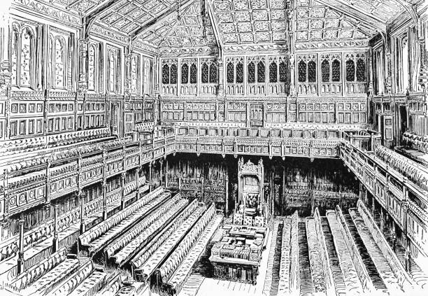
Chapter 11
Political Representation
Citizen Politics & Democracy, 8th ed © Russell J. Dalton & Timothy Hellwig

Slide 2
The Questions
Is representative democracy good or bad?
How does political representation differ across the United States and Europe, and why?
What are the different ways to conceive and assess “representation”?
If representation works, then why do some people feel unrepresented by any party or candidate?
How well does representation work in Western democracies today?

Slide 3
Representative Democracy: Good or Bad?
Virtues
Vices
Direct democracy is not feasible in modern societies
Citizens need not possess high levels of political sophistication
Popular control of government possible with periodic & competitive elections
undermines democracy by transferring power from the people to a small group of elected officials
Direct forms of participation better than mediated influence
More direct forms possible with referendums and citizen action groups.
We cannot resolve this debate,
but we can assess how well the representation process works →

Slide 4
Representation as Supply and Demand
Citizens make demands, expressed in terms of preferences for certain policies and against others.
Elected representatives supply policies such as lower taxes, more affordable health care, cleaner air, etc.
If representatives fail to supply the policies citizens demand, they risk losing power at the next election.
Sounds good, right?
But how do we know if its working?

Slide 5
Representation as Collective Correspondence
Representation as the similarity between the attitudes of the political elite and attitudes of the overall public
Representation is strong when the correspondence between elite attitudes and public attitudes is high.
Analytical problem: matching collectives to assess correspondence between “elite opinion” and “public opinion”
Three possible approaches:
Match elites and publics by nation
Match elites and publics by district
Match elites and publics by party

Slide 6
Matching Elites and Publics by Nation
Comparing opinions of citizens and party leaders in 14 democracies
The positions of political parties correspond broadly to those of the national publics
Sources: 2024 European Election Study and 2024 Chapel Hill Election Study.

Slide 7
Matching Elites and Publics by District
Comparing opinions of citizens and elites at national level glosses over the quality of representation within the political system
Dyadic correspondence: comparing an individual legislator to his/her constituency
Two perspectives on dyadic correspondence
Legislator as trustee: legislators should be allowed to follow their own beliefs about what they thought was best for their constituency and the nation. (Burke, 1774)
Legislator as delegate: Voters instruct delegate on district preferences before they went to Parliament, and the legislator was obliged to follow the district’s mandate

Slide 8
Matching Elites and Publics by District
Miller & Stokes, Constituency Influence in Congress (1963)
Citizens can influence legislator’s actions either by trustee linkages (paths a & b) or delegate linkages (paths c & d).
Miller & Stokes’ research shows that representation works. Some issue areas fit the trustee model (social welfare); others approximated the delegate model (civil rights)

Slide 9
Matching Elites and Publics by District
Congruence between district opinion and representatives’ positions,
US Congress 2020
District opinion is related to the representative’s overall position
Sources: 2020 Cooperative Election Study and Lewis et al. (2025).

Slide 10
Matching Elites and Publics by Party
The Responsible Party Government Model
People have informed preferences and policy choices.
Parties offer distinct policy options Perceptions of parties’ positions guide voting choices.
“citizens in Western democracies are represented through and by parties. This is inevitable” Giovanni Sartori (1968, 471)
District-Legislator & Voter-Party demand-supply linkages compared
Dyadic correspondence within districts pertains → representation by individual legislators in weak party systems.
Party government model → representation by political parties in strong party systems.
In most European parliamentary systems, candidates are chosen by party elites and voters select from party lists.

Slide 11
Matching Elites and Publics by Party
European Parties and their Voters on the Left/Right Dimension
Party voters’ Left/Right positions very close to their party’s position
Elites more extreme than publics
Sources: 2024 European Election Study and 2024 Chapel Hill Election
Study.

Slide 12
Matching Elites and Publics by Party
European Parties and their Voters on Redistribution
Voters’ positions on redistribution from rich to poor are related to but less dispersed than parties’ positions
Sources: 2024 European Election Study and 2024 Chapel Hill Election
Study.

Slide 13
Matching Elites and Publics by Party
European Parties and their Voters on Immigration
Voters’ positions on immigration are related their party’s position but many parties favor restrictive policies
Sources: 2024 European Election Study and 2024 Chapel Hill Election
Study.

Slide 14
The Impact of Representation
Does representation work?
Both district- and party-based models provide citizen–elite linkages. But they do so in different ways.
The district system is more flexible for candidates and issues and allows for greater responsiveness to the interests of each district.
The party system is more stable and excels on issues for which party positions are coherent and salient.
However, many people appear dissatisfied with current politics.
Institutional complexity limits opportunities for ideological congruence between voters and governments.
New issue demands and new parties add to this complexity.

Slide 15
The Paradox of Representation
If democracy works, why do so many people feel unrepresented?
Do You Feel Represented?
Percent who feel represented by a party
Source: CSES module V, 2016-2021
A matter of supply and demand?
Demand side: citizen expectations for the government have fragmented into many issue publics; parties unable to represent conflicting issue demands.
Supply side: representation limited by the number of choices. Countries with more parties may do a better job of representing voters overall.

Slide 16
Thought Provoking
As discussed in Chapter 1, different nations have different institutions, and these systems affect how politics works.
To what extent are the institutional features of these different
systems help us understand differences in political representation across these countries?

Slide 17
The End

