Slide 1
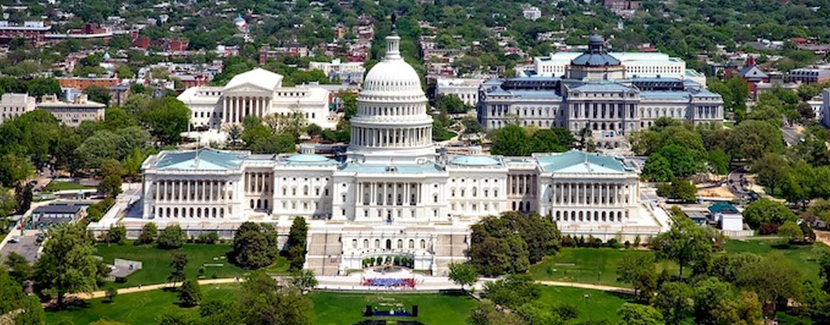
Chapter 12
Citizens and the Democratic Process

Slide 2
Question for the Day
Did politics in the United States—or in Britain, France, or Germany—work better in the 1950-60s than it does today?
Would we prefer the political process of that time to today?

Slide 3
The Research Questions:
How do citizens evaluate the government and the political process?
Have opinions changed over time?
What caused any changes that occurred?
What are the implications for contemporary democracies?

Slide 4
Types of Political Support

Slide 5
Distrust in Government
Americans’ Trust in Government Has Decreased Over Time.
Source: American National Election Studies

Slide 6
Do Politicians Care?
The belief that politicians care what people think has declined over time
Source: Various National Timeseries

Slide 7
Negativity Toward Political Elites
In many democracies a plurality or even a majority are highly critical of political elites.
Australia Austria
BRITAIN
Canada
Denmark
Finland
FRANCE
GERMANY
Ireland
Italy
Japan
Netherlands
New Zealand
UNITED STATES

Slide 8
Moving Up a Level:
Has trust in social and political institutions also changed over time?

Slide 9
Institutional Confidence in the United States
Confidence in the leadership of institutions has decreased since the 1960s
Sources: 1966 from Harris Poll; 1973–2024, General Social Surveys.

Slide 10
Average Confidence in All Institutions, US
Average confidence in institutions has decreased since the 1960s
Sources: 1966 from Harris Poll; 1973–2022, General Social Surveys.

Slide 11
Confidence in Institutions Across Nations
Confidence in political institutions is low in all four nations, especially toward political parties.
Source: 2017–20 World Values Survey.

Slide 12
Consequences of Dissatisfied Citizens
Lower Compliance (tax evasion, rule-breaking)
Less Volunteering (e.g, census, civic groups, juries)
Decreased Electoral Participation
Increased Protest/Direct Action
Information Heuristic (protest votes)
Pressures for Institutional Change

Slide 13
Faith in Democracy – Is the Sky Falling?
“Democracy is worth dying for, because it's the most deeply honorable form of government ever devised by man.”
President Ronald Reagan, 1984
“Many forms of Government have been tried, and will be tried in this world of sin and woe. What is amazing, is that despite all the conflict, our experiment in democracy has worked better than any form of government on earth.”
President Barack Obama, 2009
However
“While the overwhelming majority of Americans support democracy, there is a reason to be concerned, as support for democracy in the U.S. and rejection of authoritarian options is weaker than in many of our peer democracies around the world.”
Larry Diamond, Hoover Institution, 2018

Slide 14
Regime Preferences
How would you answer the following question:
I'm going to describe various types of political systems and ask what you think about each as a way of governing this country. For each one, would you say it is a
very good,
fairly good,
fairly bad, or
very bad way
of governing this country?
A. Having a democratic political system
B. Having a strong leader who does not have to bother with parliament and elections

Slide 15
Democracy vs Autocracy
Citizens in all four nations clearly prefer democracy over autocratic government
Democracy Autocracy Democracy Autocracy
Source: World Values Survey

Slide 16
Good Ways to Govern
Most citizens are positive about representative and direct democracy, while an autocratic government is a distant last place.
Australia
BRITAIN
Canada
FRANCE
GERMANY
Greece
Italy
Japan
Netherlands
Spain
Sweden
UNITED STATES
Average
Source: 2023 Pew Global Attitudes Survey

Slide 17
Predicting Who Prefers Democracy vs a Strong Leader
Approval of democracy is more common among older people, the better educate, those interested in politics and postmaterialists.
Source: World Values Survey, 2017-2020

Slide 18
National Pride
Has dissatisfaction with government generalized to decreasing pride in one’s nation?
“Patriotism is supporting your country all the time, and your government when it deserves it.”
Mark Twain, 1901
“The highest patriotism is not a blind acceptance of official policy, but a love of one's country deep enough to call her to a higher plain.”
Senator George McGovern, 1971

Slide 19
National Pride
Feelings of national pride vary widely across democracies.
Sources: 1981-1983 World Values Survey; 2017-2020 World Values Survey/European Values Survey.
Note: Figure entries are the percentages feeling “very proud” of their nation.

Slide 20
Reactions to Dissatisfied Democrats
The Democratic Elitist Perspective
Widespread political dissatisfaction occurs because excessive public demands overtax governments’ ability to satisfy them. Fareed Zakaria (2003): “What we need in politics today is not more democracy, but less.”
A Democratic Citizen Perspective
Political dissatisfaction arises because social modernization and cognitive mobilization raise citizens’ expectations of government. People are more demanding of politicians, more critical of how the process functions, and want more democratic reform.

Slide 21
Diverging Views about Democracy
Postmaterialists see democracy as more important but are less positive about the extent of democracy in their nation
Source: World Values Survey, Germany and United States samples combined

Slide 22
What Reforms Do Citizens Want?
Improving Political Leadership:
People want politicians who are more responsive to the public’s needs, more attentive to the public’s voice, less corrupt, and more competent. Many would also like political leaders to be more representative of the population in terms of gender, age, race, and other factors.
Government Reform:
Many believe improving democracy requires significant political reform. Such reforms include changing electoral systems, shifting the balance of power between institutions, and placing limits on how long politicians and judges can serve. In several countries, people express a desire for more direct democracy.
Based on Pew Center surveys of the American public.

Slide 23
A Thought Experiment Redux:
Would a group of 500 Americans randomly selected from the overall population make better policy decisions than the current U.S. House of Representatives?

Slide 24
The End . . .

