Slide 1


Your default setting
#TMShef
@ianmcdaid
©100 Ideas for Secondary Teachers: Outstanding Science Lessons (Bloomsbury Education, 2015)

Slide 2
On a typical day,
with a typical class,
with typical planning
and typical progress…

Slide 3
What does a pupil experience in your lesson?

Slide 4
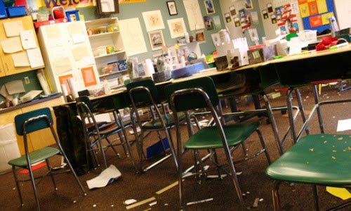
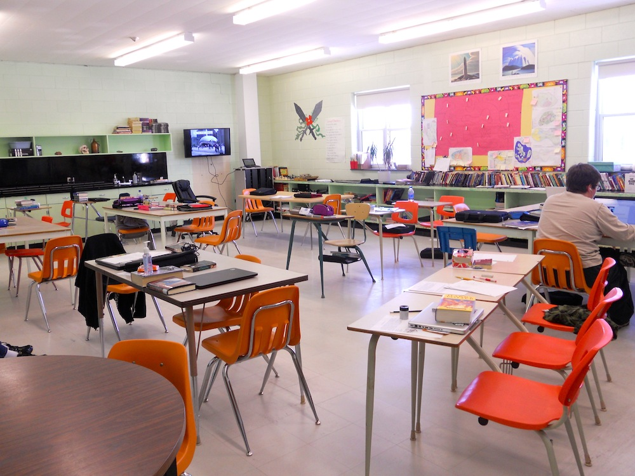
This defines you !

Slide 5
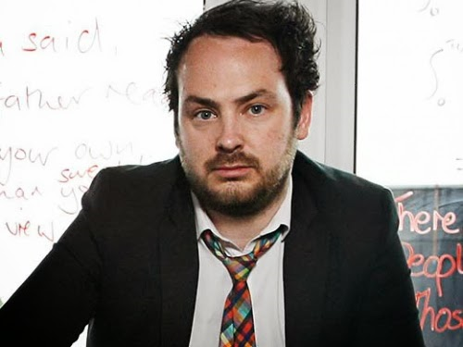

This also defines
you!

Slide 6
What else defines you?

Slide 7
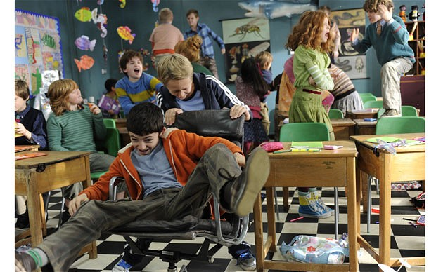

Slide 8
What do people think when they see…

Slide 9
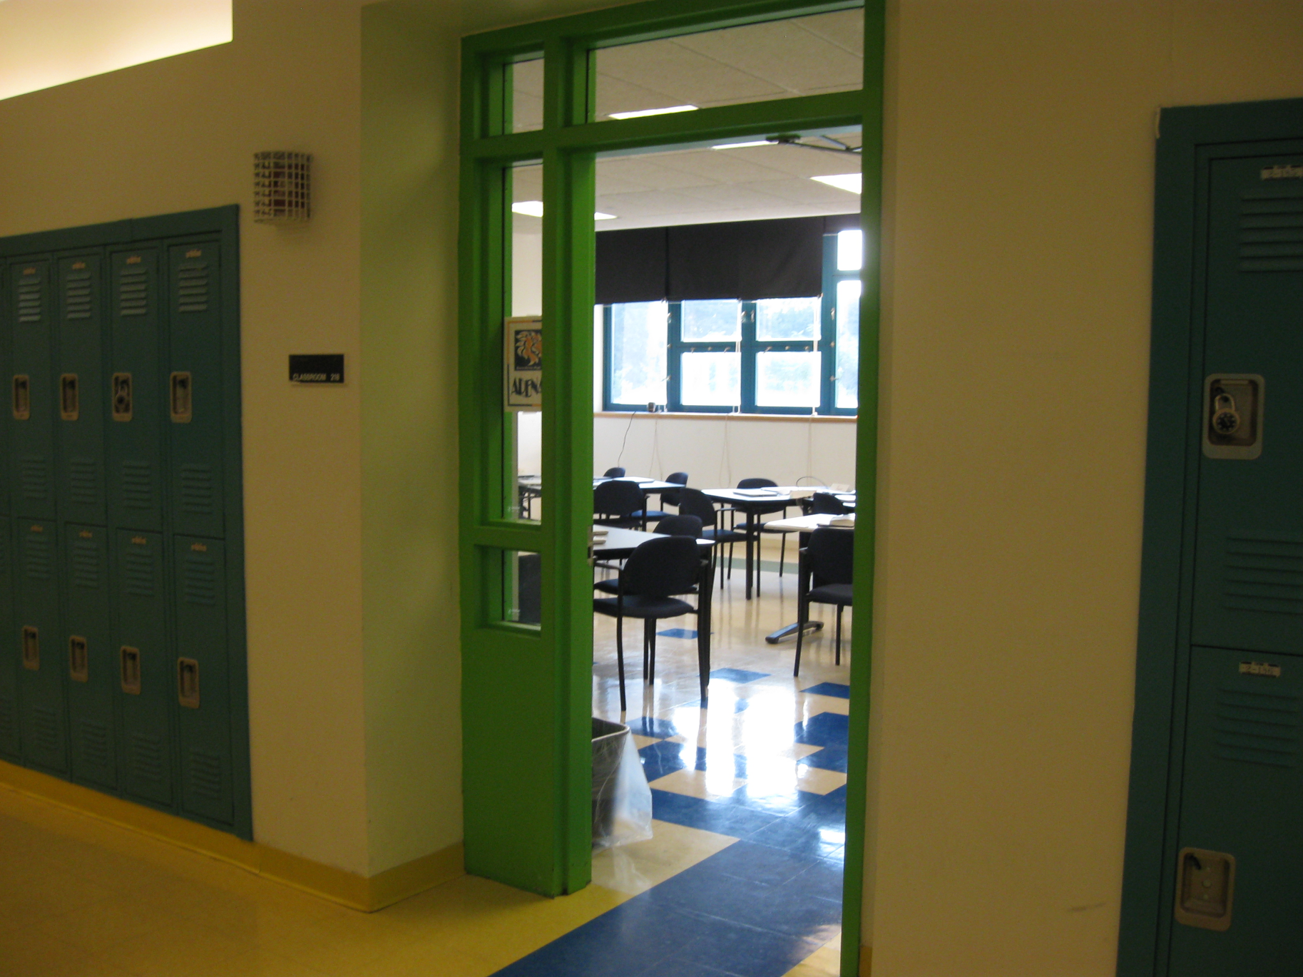

Slide 10
Or….

Slide 11
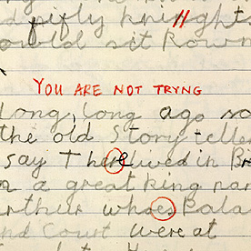

Slide 12
Or….

Slide 13


Slide 14
So when you next step in to a classroom, where have you set that default setting?

Slide 15
And finally…

Slide 16
How do your colleagues perceive you?

