Slide 1
Interactive teaching
#TMShef
@ianmcdaid
©100 Ideas for Secondary Teachers: Outstanding Science Lessons (Bloomsbury Education, 2015)

Slide 2
Getting to know each other!
Around the room you will find a collection of objects related to an introduction to crude oil.
Use the world café method to get participants to share ideas.

Slide 3
Pupils working interactively
You walk in to a classroom and pupils are working interactively.
What learning behaviours would you observe taking place in that classroom?
Spend 2-3 minutes in groups and record your ideas.

Slide 4
Making it happen in the classroom!
Now lets look at simple, practical and easy ideas to help you get pupils working more interactively from TOMORROW. I have used everything in this online resource either in my own school or whilst working with other schools in the past few months.

Slide 5
The hook!
Starter activities: how do we get pupils focused and engaged as soon as they walk in the room?

Slide 6
Images with question starters
Use the question starters you have been given to write three questions you have for me after looking at this image.

Slide 7
Question starters
Now discuss how these could be used to get pupils working together.

Slide 8
Collection of images to stimulate discussion
You now have 2 minutes to write your own lesson objectives and outcomes for the lesson that follows this image.
How would you use this to actively engage pupils?

Slide 9
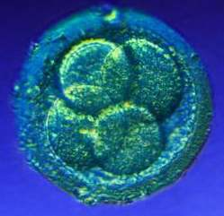
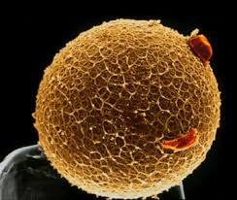
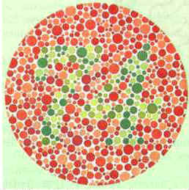

Slide 10
Wordles
Take minutes to produce
Good for literacy
Good for revision
www.wordle.net

Slide 11
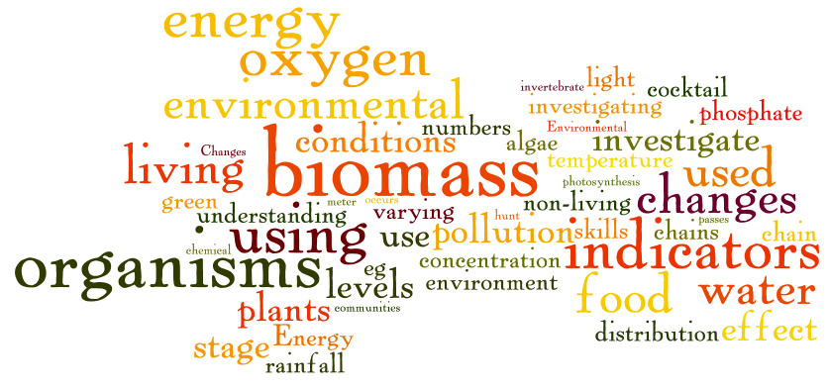
Wordles linked to hexagons
Write the ten biggest words on your hexagons.

