Slide 1
A New Start

Slide 2
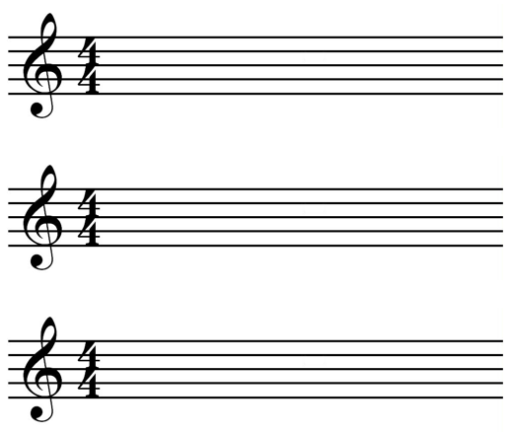
A New Start

Slide 3
Things to Think About
What are you looking forward to this year?
What are you nervous about?
What new chance or experience would you like to have?
What would you like to do better than last year?
How would you like to be different?

