Slide 1
Justice and Fairness

Slide 2
Justice and Fairness
Justice: people being treated fairly and reasonably. Justice is an action that is morally right and fair.
Fairness: treating people in an impartial, unbiased way – without showing favouritism or discriminating against anyone.

Slide 3
‘It’s not fair!’
Just because you don’t like something, don’t agree with something, or don’t get what you want, doesn’t mean something is unfair.

Slide 4
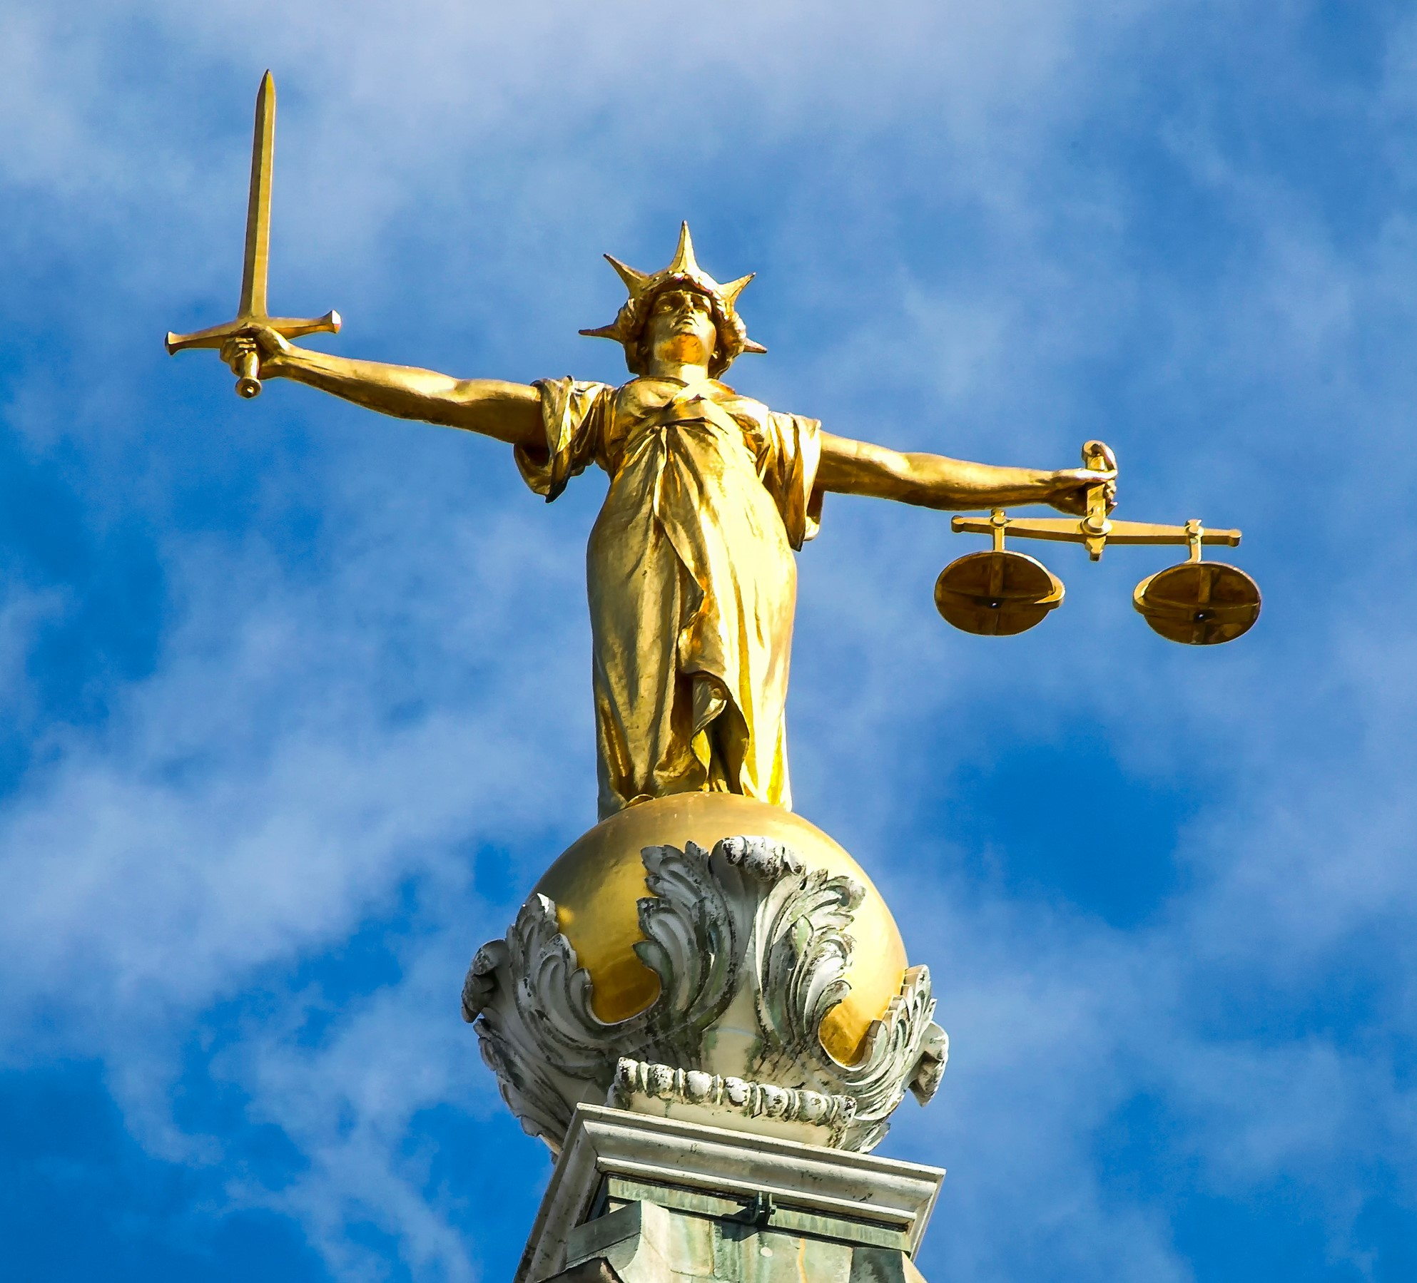
Lady Justice
What might the weighing scales represent?
What might the sword represent?
Lady Justice is often shown with a blindfold. What might that represent?

Slide 5
Things to Think About
Was what Queen Verity decided ‘unbiased and reasonable’?
Was what Queen Verity did fair?
Did she do the right thing?
Is justice the same as being fair?
Is life always just and fair?

