Slide 1
Thomas Edison

Slide 2
Thomas Edison
He was born in 1847 in Ohio, USA.
He had very little formal education as a child, attending school only for a few months.
He was taught reading, writing and arithmetic by his mother.
He was a very curious child and taught himself a lot by reading on his own.
This belief in self-improvement remained throughout his life.

Slide 3
Inventions
Thomas Edison invented the phonograph (also known as the gramophone). This was the most common way of playing recorded music from the 1870s to the 1980s.
His other famous inventions were the lightbulb and the projector.
Thomas Edison was partially deaf. Some of his first inventions were devices to help him with tasks which involved being able to hear well.

Slide 4
Quotes
‘Genius is one per cent inspiration and ninety-nine per cent perspiration. Accordingly, a genius is often merely a talented person who has done all of his or her homework.’
‘The three great essentials to achieving anything worthwhile are: first, hard work, second, stick-to-it-iveness, and third, common sense.’
‘I readily absorb ideas from every source, frequently starting where the last person left off.’

Slide 5
Quotes
‘To have a great idea, have a lot of them.’
‘Someday, man will harness the rise and fall of the tides, imprison the power of the sun, and release atomic power.’
‘Opportunity is missed by most people because it comes dressed in overalls and looks like work.’
‘Just because something doesn’t do what you planned it to do in the first place doesn’t mean it’s useless.’

Slide 6
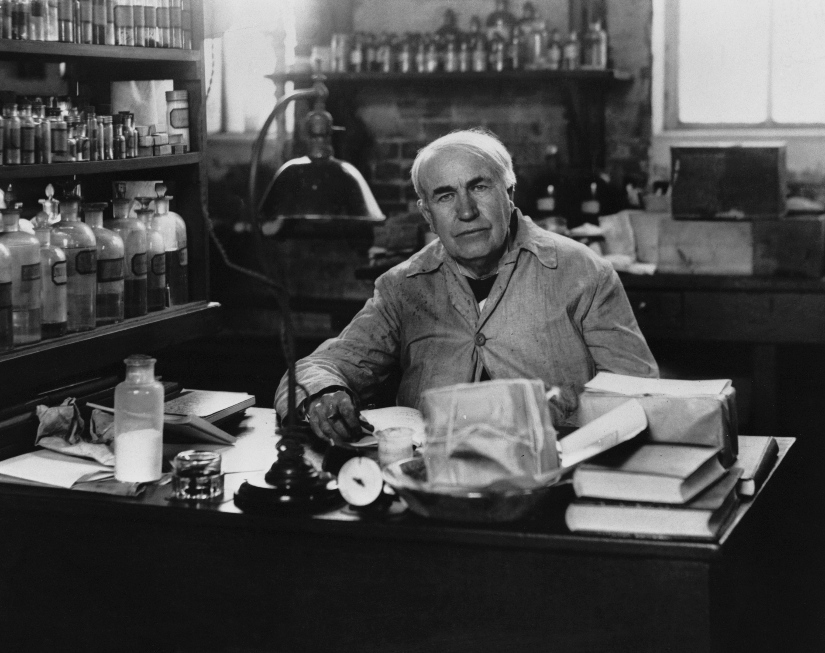
Quotes
‘I am not discouraged, because every wrong attempt discarded is another step forward.’
‘I never failed once. It just happened to be a 2000-step process.’
‘I’m proud of the fact that I never invented weapons to kill.’
© Getty

Slide 7
Things to Think About
Don’t give up
Do your best
Always have a go at something
Learn from your mistakes
You never know what you could achieve!

