Slide 1
Scientists

Slide 2
Can you name a famous scientist?

Slide 3
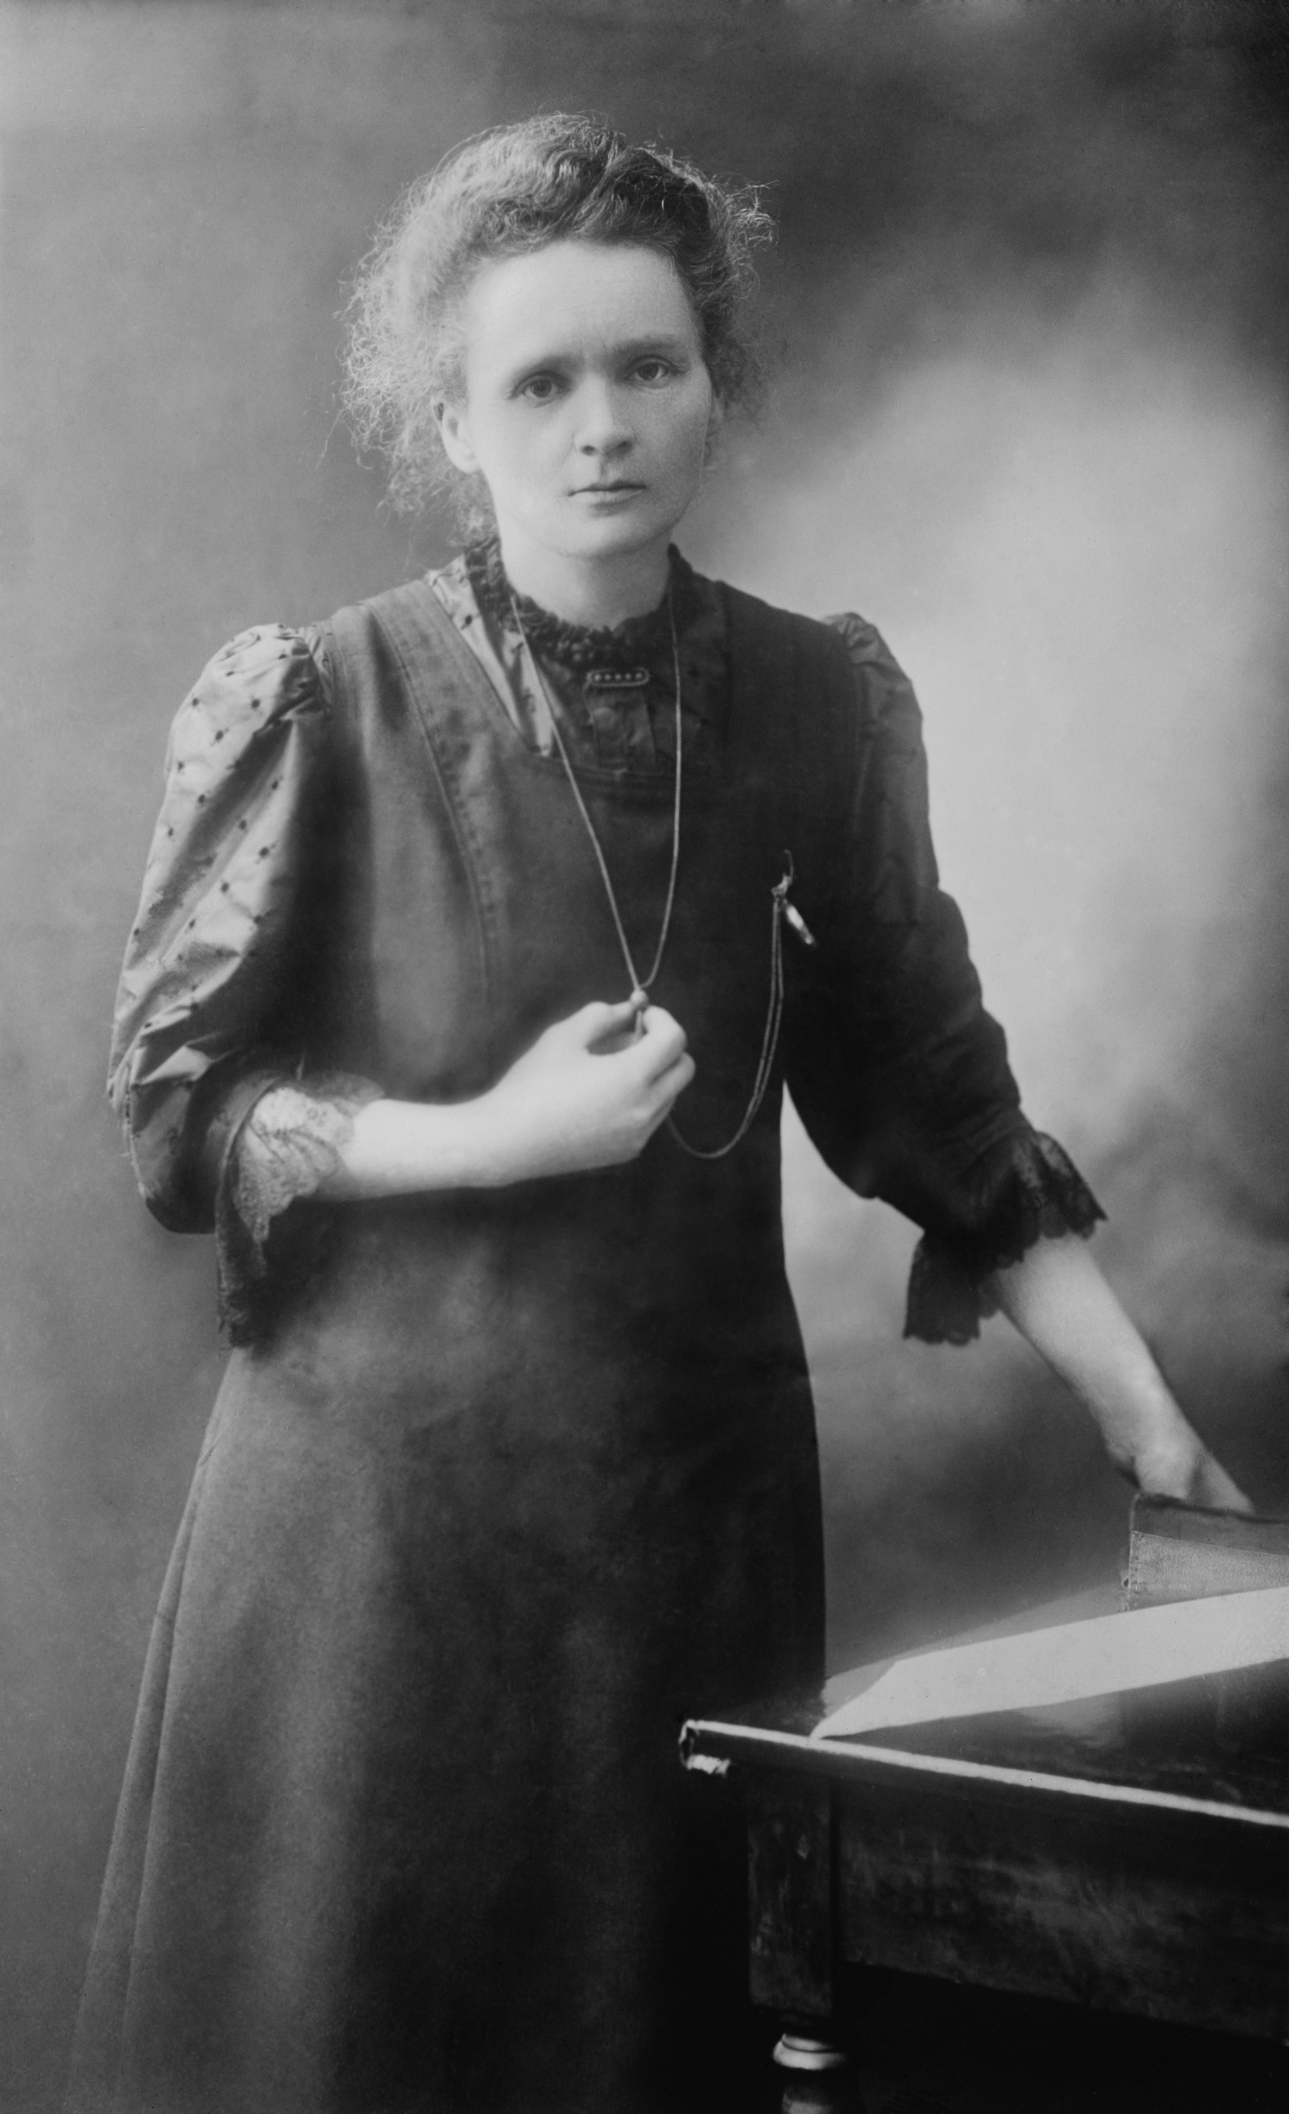
Marie Curie
Born in Poland, lived 1867–1934. Moved to France to study Maths and Physics
Investigated radioactive rays given off by the chemical element uranium
Discovered two new elements: polonium and radium
Won Nobel Prize for Physics in 1903 and for Chemistry in 1911

Slide 4
Hypatia of Alexandria
Egyptian philosopher, lived about 1,600 years ago, c. 350/370–415 AD/CE.
Taught by her father – became an expert in Mathematics and Astronomy (better than her dad!)
Was one of Alexandria’s first female teachers
Invented a new version of the hydrometer
Killed by an extremist Christian mob in 415 AD/CE

Slide 5
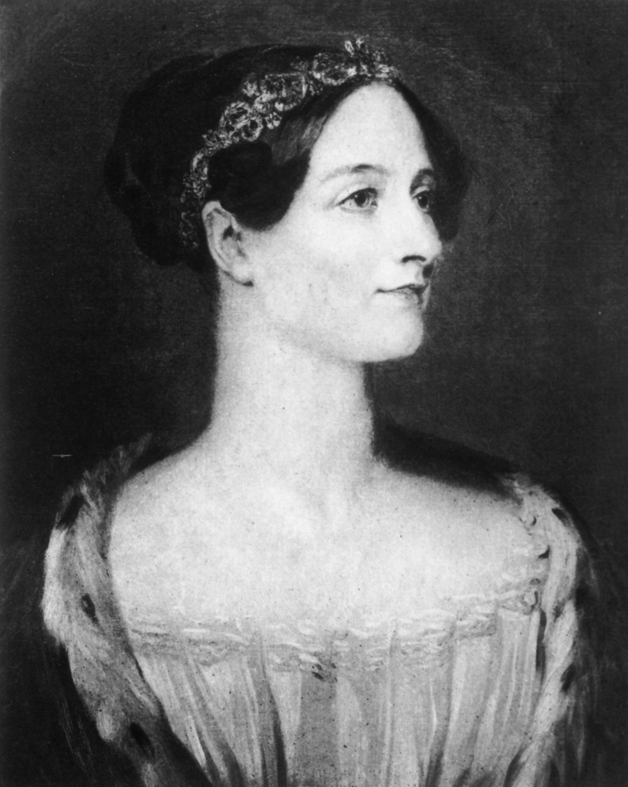
Ada Lovelace
Lived 1815–52
Studied maths, like her mother, and had an amazing imagination
Designed a flying machine, aged 12
Met Charles Babbage when she was 17
Developed his ideas further and is considered to be the world’s first computer programmer
© Getty

Slide 6
Other scientists
Maggie Aderin-Pocock (b. 1968)
Rosalind Franklin (1920–58)
Wang Zhenyi (1778–97)
Yoky Matsuoka (b. 1972)
Caroline Herschel (1750–1848)
Jane Goodall (b. 1934)
Lise Meitner (1878–1968)

Slide 7
Things to Think About
Women are still underrepresented in the fields of science and technology in the UK.
Historically, women were not encouraged to study in these fields and we still see the results of this today.
We need brilliant scientists to solve the world’s problems, regardless of gender.

