Slide 1
Training for Leaders: Start spreading the news
Session 3
© Jennifer Ludgate, 2019

Slide 2
Aims of these sessions:
To encourage you to lead your areas/faculties/departments in becoming further research-informed
To provide you with the basic tools in order to share your knowledge
To save time in considering the best ways to share your knowledge
To give an opportunity to discuss your thoughts and approaches to leading research-informed practice with those in a similar position
To encourage us to think creatively and further encourage change

Slide 3
Your vision:
Share your vision for research-informed practice in your area.

Slide 4
What does a successful vision require?
Clarity – are you clear what you want?
Purpose – what is the purpose in your vision? To support, to challenge, to encourage?
Be achievable – it’s not a dream!
Be understandable.
Brevity matters.

Slide 5
How can you encourage a research-informed practice mentality?
Research posters
A weekly newsletter with a blog
A half-termly reading or journal club
Reading briefings per half term
Research postcards
A research focus for each term
Observation triads

Slide 6
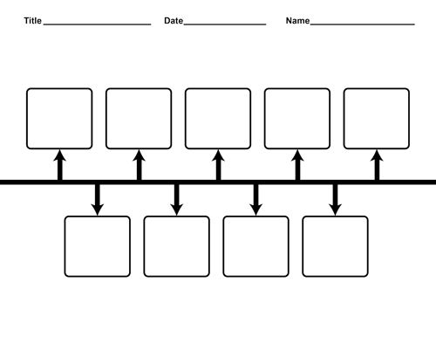
Next steps:
Create a timeline of strategies that might work in your area

Slide 7
Any final thoughts or questions?

