Slide 1
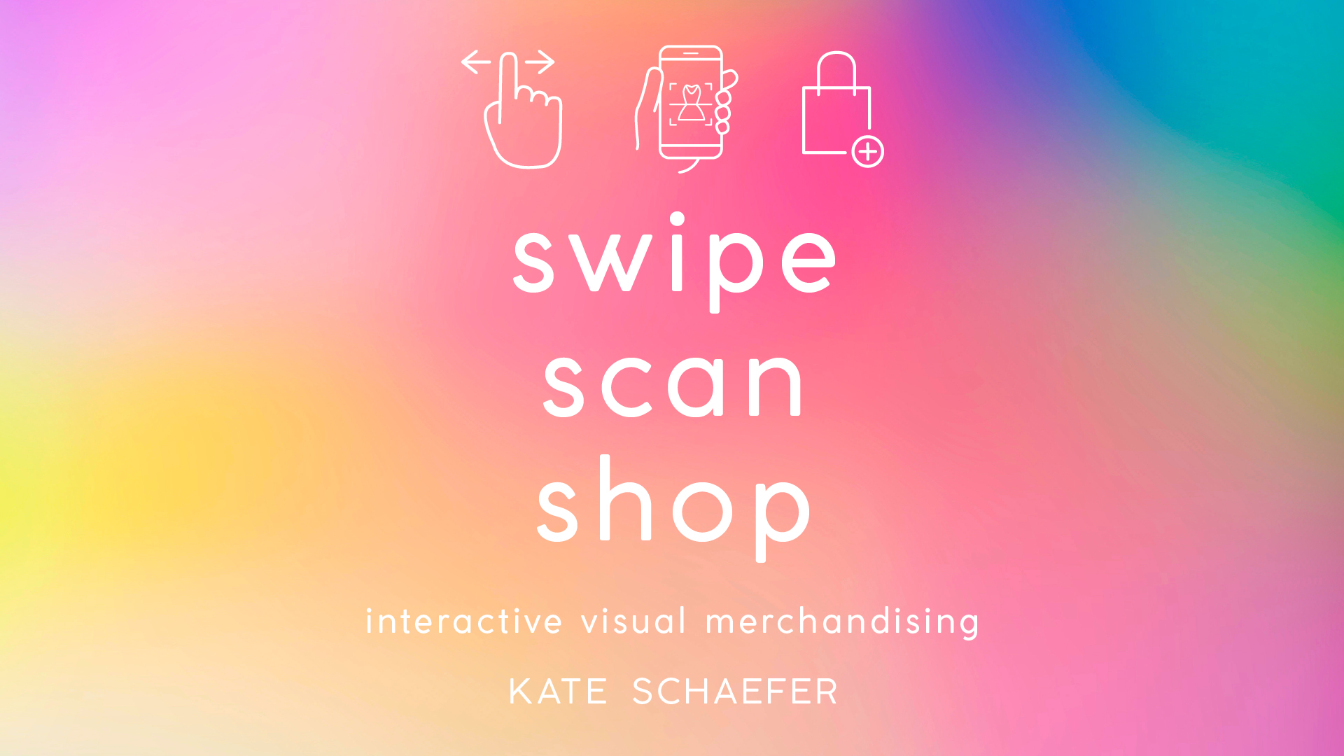
swipe, scan, shop: interactive visual merchandising
KATE SCHAEFER

Slide 2
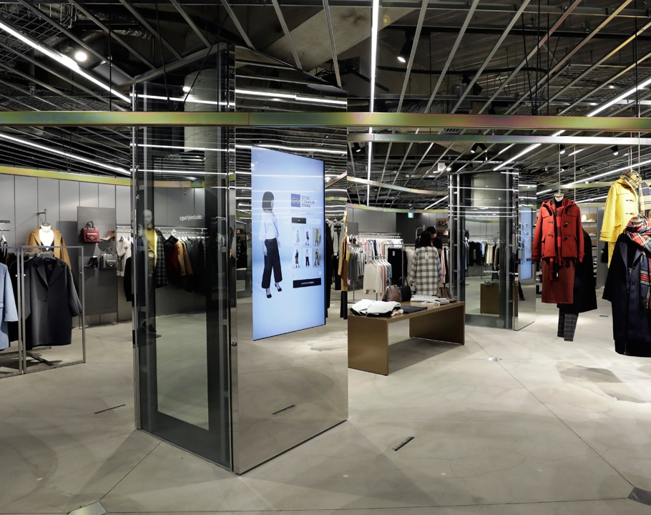
Introduction
The retail environment is highly competitive as retailers are competing with pure play e-commerce sites, omnichannel retailers and brick and mortar retailers
The brick-and-mortar retail environment is rapidly changing to meet the needs of consumers: Quick, convenient, and efficient yet customized based on consumer preferences
Retailers are incorporating new technologies in the brick-and-mortar retail environment in order to remain relevant in the marketplace.
Change doesn’t happen unless we push ourselves to do things differently!

Slide 3
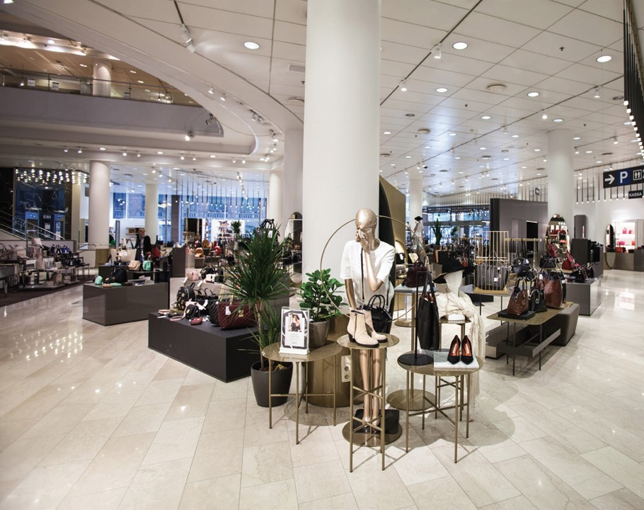
What is visual merchandising?
CHAPTER ONE

Slide 4
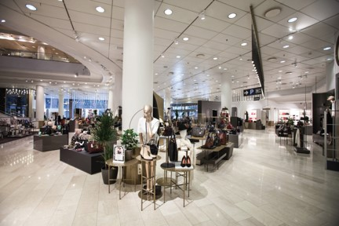
What is visual merchandising?
Anything that is visible to a customer within a retail environment is part of visual merchandising
It is a form of communication that educates, informs, and entertains

Slide 5
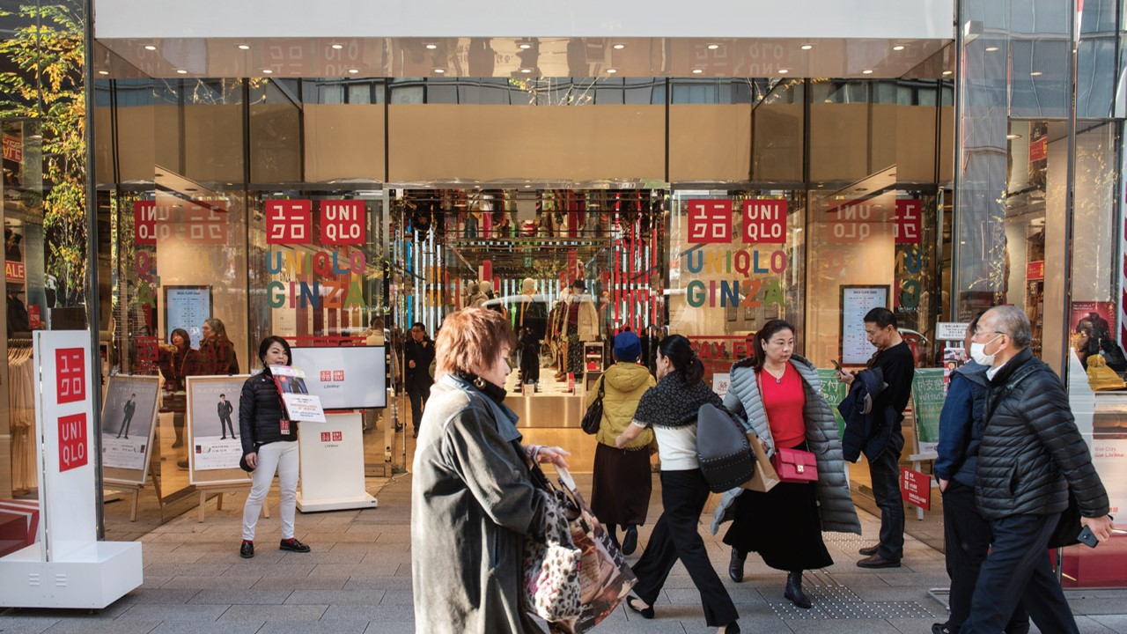
Visual merchandising includes:
Signage
Lighting
Fixtures
Mannequins and forms
Décor
Props
Seating
Cash wrap
Interior displays
Exterior displays

Slide 6
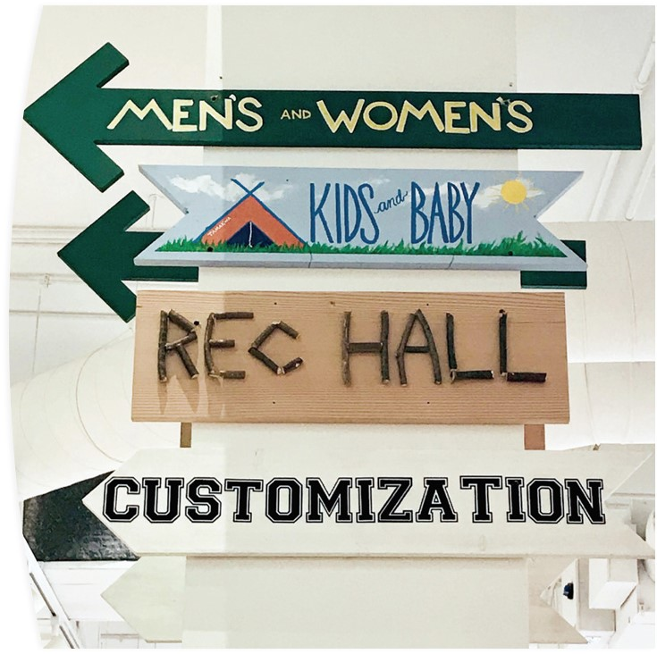
Signage
Retail and branded signage allows retailers to communicate with customers without having to rely on sales associates
Price
Store location
Promotions
Consistent font size, color, and type reinforce brand messages and recognition

Slide 7
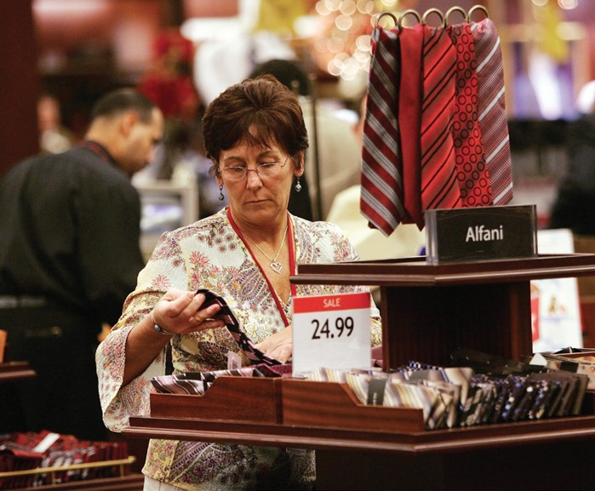
The five most crucial types of retail signage:
Outdoor signage
Informational signage
Persuasive signage
Americans with Disabilities Compliant signage
Mats
And an important extra:
Digital signage

Slide 8
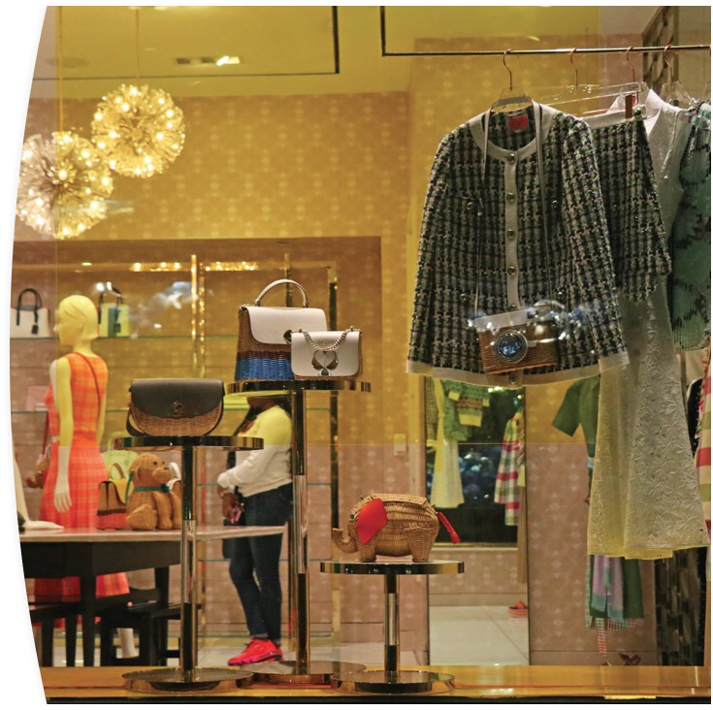
Lighting
Effective lighting is used both for function and aesthetic
All in-store lighting should be complementary to one another

Slide 9
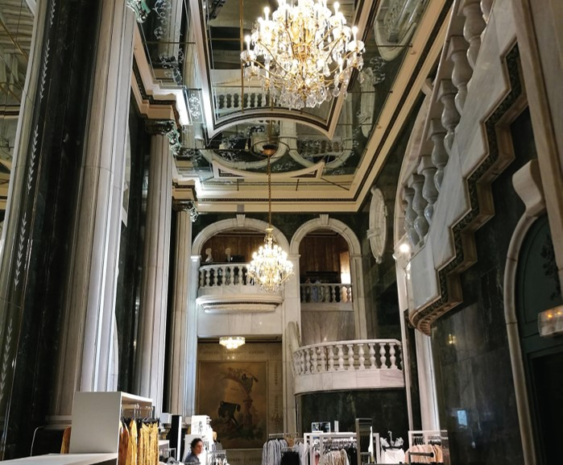
Types of lighting:
Ambient lighting
Task lighting
Accent lighting
Decorative lighting

Slide 10
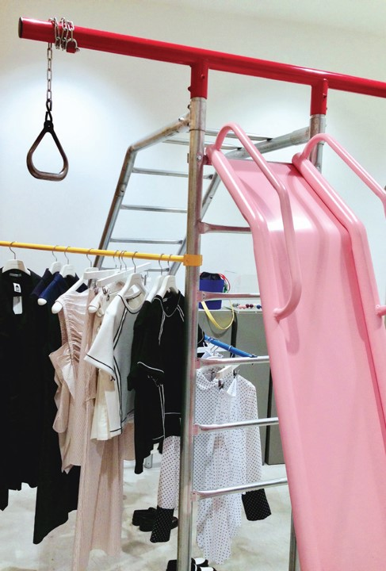
Fixtures
Fixtures allow retailers to place product on the sales floor
Fixtures enable customers to shop in a systematic way
Fixtures reinforce brand image

Slide 11
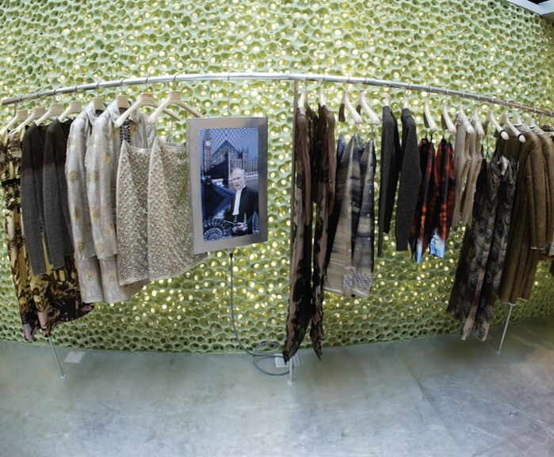
Types of fixtures:
Permanent fixtures
Temporary fixtures
Standard fixtures
Custom fixtures
Freestanding fixtures
Wall-mounted fixtures

Slide 12
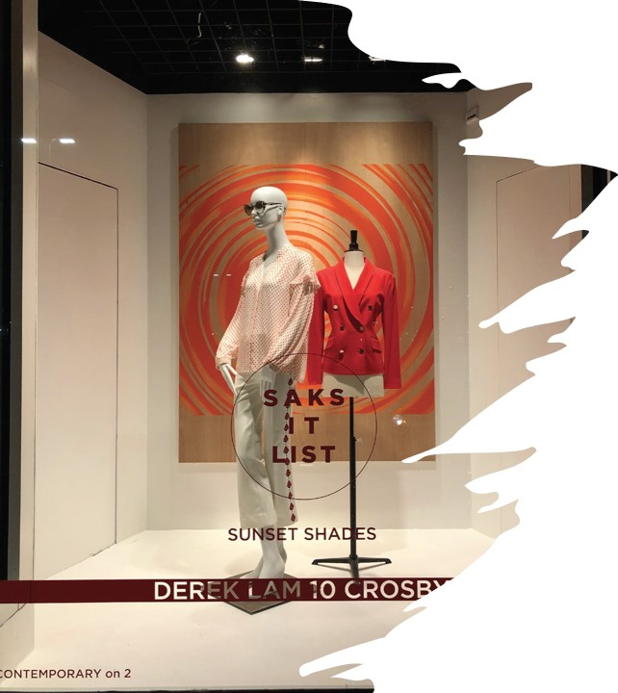
Mannequins and forms
Mannequins and forms bring apparel and accessories to life, allowing customers to see merchandise on a body
Shows product fit and sizing
Demonstrates hemlines, necklines, sleeve length
Shows details and embellishments
Mannequins and forms are chosen based on retailer’s product offerings as well as store aesthetic
Poses, materials, personality variables
Digitally connected mannequins and forms provide new opportunities for brands and customers

Slide 13
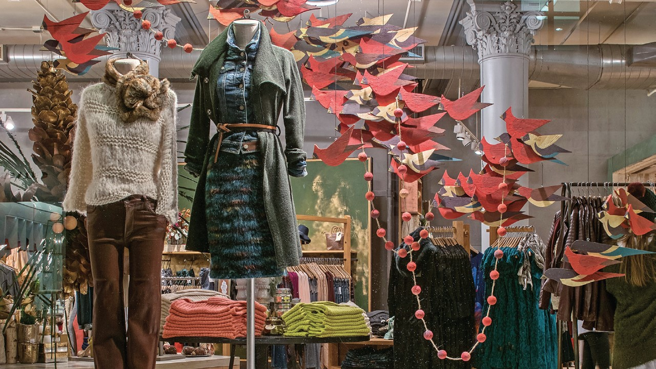
Décor and props
Decorative elements are incorporated throughout retail environments in order to enhance the story being told
Is it the story of the retailer, season, or specific promotion?
Create compelling displays that result in increased visibility and awareness of products
Live merchandise versus display items
Increasingly seen in social media posts, both brand-generated and consumer-generated

Slide 14
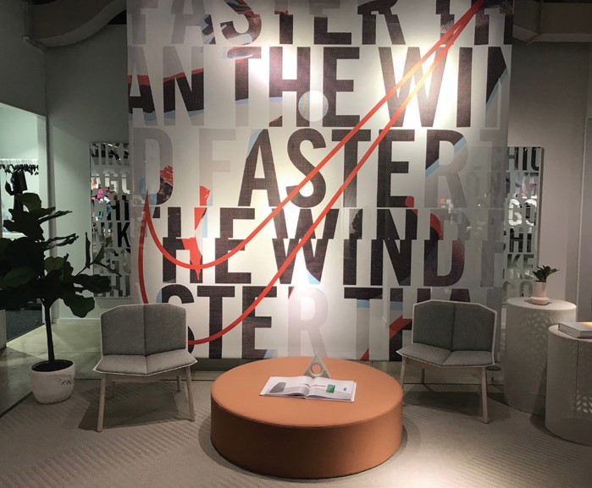
Seating areas
Dedicated space on the sales floor for customer seating
Provides both a physical and visual break
Integrates entertainment, information sharing, food and beverage

Slide 15
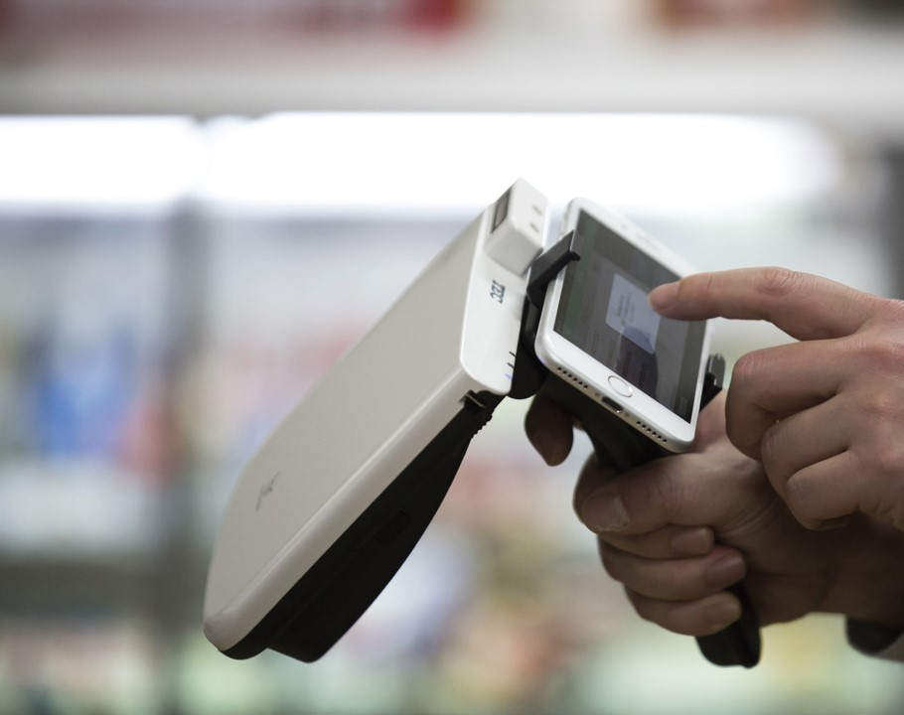
Cash wraps
Last point of contact between retailer and customer
Complete the sale, open a credit card, ask a question, return a product
Must be well-designed and strategically placed on the sales floor
Decreased in size (or even disappeared completely!)

Slide 16
interior and exterior displays
Used to attract, inform, and engage shoppers
Reinforce brand messaging
Branded signage
Mannequins and forms
Fixture design(s)
Product adjacencies

Slide 17
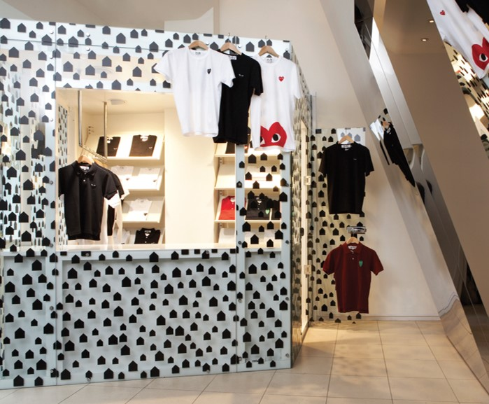
Interior and exterior displays
How do retailers ensure their displays don’t go unnoticed?
Create dimension through height, depth, color, and scale
Create a focal point
Product information should be easily accessible
Make them interactive!
Consider price expectations
Invigorate merchandise

Slide 18
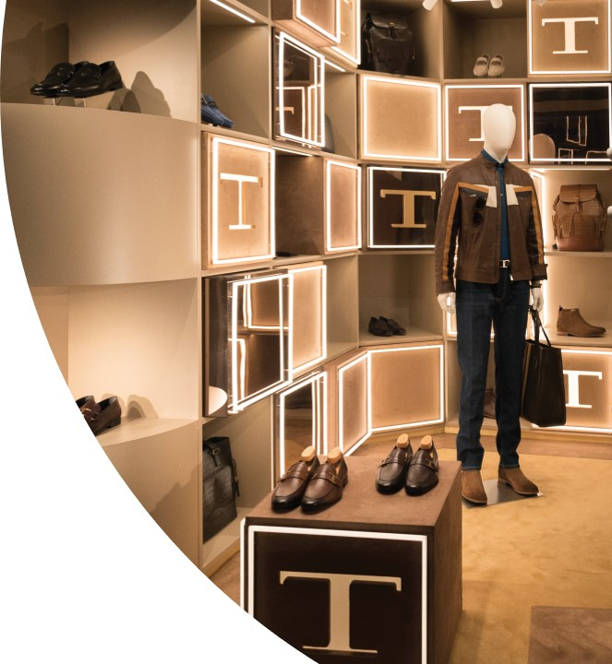
Why is visual merchandising used?
Create compelling retail environment that connects with customers
Engage and inspire customers
Generate awareness and provide product accessibility

Slide 19
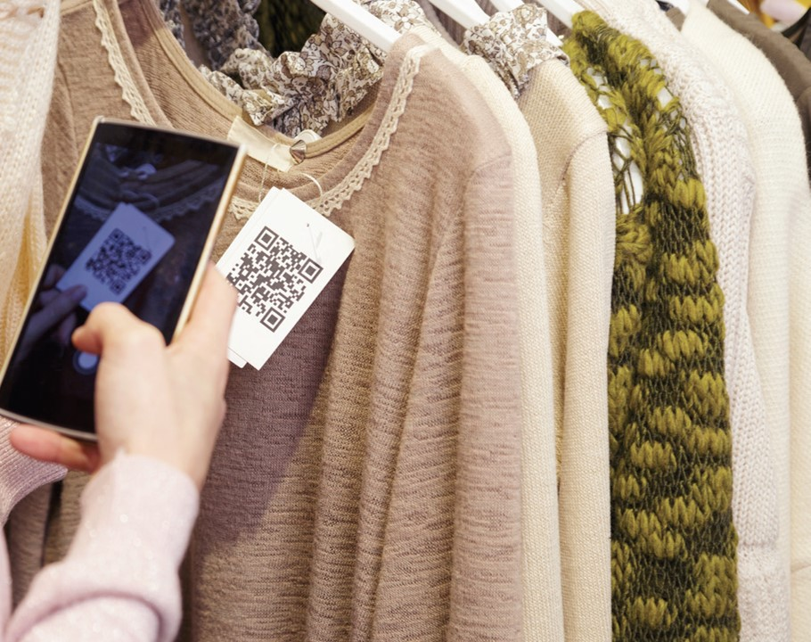
How has visual merchandising progressed over the last decade?
Phygital retail: Bringing together the online and offline experience; the integration of digital and physical retail
Brand messaging is shared digitally through both consumer-generated and brand-generated content
In-store experiences are interactive
Beacon technology, QR codes, touchscreens

Slide 20
How has visual merchandising progressed over the last decade?
Internet of Things (IoT): use of objects or devices to send data to other devices, then processed and used to send relevant alerts or notifications to customers
Results in more personalized messages
Creates more meaningful connections between retailers and customers
Experiential retail: Provides an active retail experience, allowing shoppers to test out products before purchasing
Reduces inventory on the sales floor
Increases touch-points between products, customers, and sales teams

Slide 21
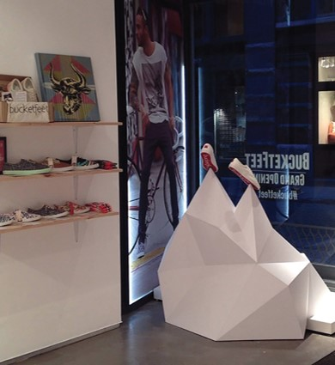
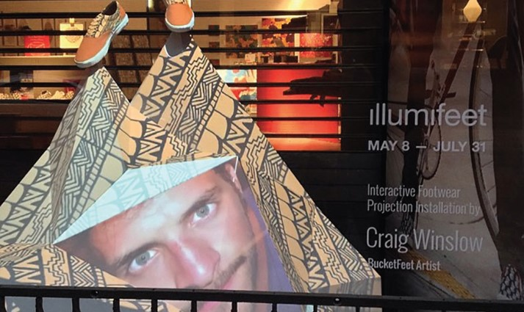
Craig Winslow Designs
Illumifeet: Used interactive projection mapping and sensory technology to inform, educate, inspire, and entertain passersby for sneaker company Bucketfeet

Slide 22
Key terms
Accent lighting
ADA Compliant signage
Ambient lighting
Customizable lighting
Decorative lighting
Endless aisles
Experiential retail
Informational signage
Internet of Things
Outdoor signage
Persuasive signage
Phygital experience
Task lighting
Visual merchandising

Slide 23
Critical thinking: The application process
After completing the chapter readings, reflect on the information and experiences shared. Apply what you learned to future retail experiences:
Finding inspiration from Dover Street Market’s retro swing set as a fixture, what are two unexpected fixtures that could be incorporated into a store? What store(s) do you recommend for these fixtures?
As retailers choose to add seating areas to their sales floors, what might be included in the seating area in order to further connect with shoppers?
Imagine you work for a large retailer. The departmental budget allows for you to make one purchase of a decorative prop that has the potential to be repurposed throughout various departments. What will you purchase? Explain at least 3 different ways you plan on repurposing it for different departments.
As buyer behavior changes, what other retail components might fall under the purview of visual merchandisers?
Why is the Internet of Things important for visual merchandising teams?

