Slide 1
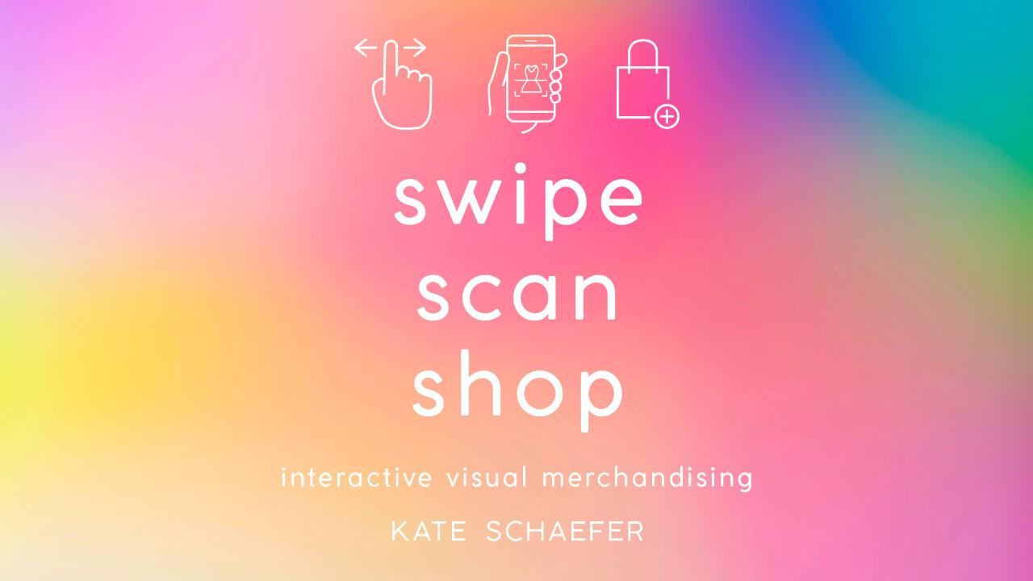

Slide 2
The history and evolution of visual merchandising
CHAPTER 2

Slide 3
The history and evolution of visual merchandising
In order to understand the ‘why’ of visual merchandising, it is important to know how and when it all began.
Learn how visual merchandising has evolved over the last century to include the immersion of digital technologies and sensory merchandising.

Slide 4
The history and evolution of visual merchandising
Historically, customers visited stores to make intentional purchases; customers told store owners what they were shopping for and store owners would bring relevant product out from a backroom.
In the 1800s, retailers began displaying merchandise in store windows and on exterior tables to create awareness of available products. Purchases were based on desire rather than need.

Slide 5
The history and evolution of visual merchandising
1840s
In the 1840s, the Industrial Revolution brought about new technologies: lighting and large glass windows
Store owners created oversized displays to inform shoppers as to offerings
1852
In 1852, Le Bon Marche opened in Paris and is recognized as the first department store in the world.
Windows featured an array of product to call attention to depth and breadth of merchandise offerings.
1870
In 1870, mannequins were introduced

Slide 6
The history and evolution of visual merchandising
In the early 1900s, department store Selfridges began leaving store windows on overnight, allowing customers to browse merchandise 24 hours a day, 7 days a week.
Macy’s introduced animatronic windows, acting strictly as entertainment as no live product is displayed.
During the Great Depression of the 1930s, retail windows were used as a form of escapism; window shopping became popular.
In the 1960s, mannequins and window displays were used to address social trends to connect like-minded customers through dress.

Slide 7
The history and evolution of visual merchandising
In the 1970s and 1980s, store windows reflected the daily lives of customers, including realistic mannequins. Mannequins had become more realistic: different ethnicities, body shapes and facial expressions.
During the 1990s, window and in-store displays were tied to elaborate marketing budgets to create aspirational displays, oftentimes featuring supermodels and celebrities.

Slide 8
The history and evolution of visual merchandising
At the end of the 1990s, aspirational displays were quickly abandoned and visual merchandising displays shifted to present products in a more realistic, attainable way.
Mannequins represented mainstream customers in looks and lifestyle.
Realistic mannequins reflected the varying sizes, shapes and ages of customers, including maternity, petite, and plus size.

Slide 9
The history and evolution of visual merchandising
When the use of mannequins became stale and redundant, mannequins were replaced with oversized graphics from marketing campaigns.
Models and celebrities were featured in displays as brand spokespeople.
Displays were designed to represent customer lifestyles and oftentimes included complementary products.
In the early 2000s, with growing access to the internet, brick and mortar retailers began competing with e-commerce sites.

Slide 10
The history and evolution of visual merchandising
In order to compete with e-commerce sites, brick and mortar retailers began integrating more extensive decorative elements and special events into store displays to provide customers specialized experiences.
This changed in 2008 with the economic downturn. As consumer spending was down, visual merchandising budgets were slashed. As a result, visual merchandising teams repurposed décor elements and props.

Slide 11
The history and evolution of visual merchandising
In 2018, visual merchandising teams played a role in brand storytelling
Brand storytelling: using various platforms to share the brand’s story with customer, ranging from brand’s history to behind the scenes activities and social interactions.
Experiential retail was introduced and quickly became an expectation
Shoppers were able to try products before making a purchase, customize products, or share experiences via social media
The retail sales floor shifted from maximizing selling space, inventory and merchandising fixtures to incorporating brand storytelling.
Imagery, fonts, colors, textures and historic elements, coupled with events and activities, allowed retailers to tell their branded stories.

Slide 12
Incorporating digital technologies
Rather than compete with online shopping, brick and mortar retailers began integrating processes, procedures, and product offerings digitally.
Omnichannel retail offers the ability for retailers to create a seamless shopping experience across various shopping channels.
Brings the online shopper into the store
Directs the brick-and-mortar shopper to digital platforms (e-commerce and s-commerce)
Social commerce (s-commerce): provides customers the ability to make a purchase through social media sites
Multichannel retail: Offers the ability to shop through different channels (these channels are not integrated with one another)
The integration of digital technologies in physical stores allows shoppers to be more informed consumers AND it gives them a reason to visit a store a rather than shop online.

Slide 13
Digital screens
Digital screens are used throughout brick-and-mortar stores to educate, entertain, and engage shoppers
Act as a reminder for customers to shop in-store rather than (or in addition to) shopping online
Digital screens include:
iPads: Used as a point of connection to entertain and inform shoppers
iPads: Provide a way for shoppers to customize product
Oversized screens: Offer a way for retailers to greet shoppers
Fixture integration: Features rotating messaging to call attention to product attributes as a point of differentiation.

Slide 14
The connected fitting room
Connected fitting rooms (smart fitting rooms) allow shoppers to use digital screens to communicate with sales associates and customize their shopping experience.
Smart mirrors: Often used in connected fitting rooms. Provide a touchscreen as a form of communication as well as a functional mirror.
Radio frequency identification (RFID): tracks stock, provides real-time updates on inventory levels, and is knowledgeable about customer order history

Slide 15
Other in-store technologies
QR codes: Provide product knowledge
Robots: Provide customer service
Smart shopping carts: Allow customers to be hands-free while shopping, creating a more convenient shopping experience
Magic mirrors: Display product information when products have been touched or picked up
Smart lockers: Utilized as part of the buy-online, pick-up instore model; lockers can be opened via the customer’s smartphone.
Digital price tags: Replace paper tags and signage with digital ones
Self-checkout: Shoppers complete the check-out process independently
Mobile wallet: Expedites the payment process

Slide 16
Successes and challenges: See now, buy now
Today’s consumers are accustomed to instant gratification throughout their lives; retail wants and needs are no different.
See now, buy now model is one way retailers and brands are working to respond to this shift in consumerism.
See now, buy now trend allows customers to purchase pieces straight from the runway instead of having to wait up to six months
This impacts both online and brick and mortar sales:
Brands are using augmented reality for online sales
Brands are livestreaming fashion shows with the ability to make a purchase
Runway shows provide digital screens for purchasing

Slide 17
Successes and challenges: See now, buy now
What does this mean for the sales floor?
Retailers are hosting pop-up shops for the new product
Retailers are creating shop-in-shop concepts to separate new product and existing merchandise
Retailers are integrating new and existing product for a cohesive shopping environment
How can visual merchandising teams differentiate between the see now, buy now collections and the other product on the sales floor?
Mannequin statements: Mannequin groupings can act as dividers to differentiate between groups and collections
Fixtures: Different fixtures and fixture finishes offer a subtle way to subconsciously tell a shopper the products are different
Signage: Informative signage allows shoppers to understand the different products they are looking at.
Imagery: Oversized images can act as a backdrop, focal point and directive for shoppers

Slide 18
Company spotlight: 1871
1871: Chicago’s Center for Technology and Entrepreneurship
1871 is a non-profit that inspires, equips and supports founders in the digital start-up community
Digital start-ups are part of an array of industries, from hospitality to finance to retail, all working to disrupt outdated business models, processes and procedures
EX3 Labs and Return Runners are some of the start-ups in the retail industry that are part of 1871

Slide 19
EX3 labs in 1871
EX3 Labs is an experience design and production innovation studio
They create digital solutions for companies to engage customers
For their retail clients: Augmented and mixed reality connects the customer and retailer in a more holistic way
Space visualization: Space planning teams use 360-degree space visualization and virtual reality to ‘see’ a store ahead of time, better understanding store layout, merchandise and merchandising strategies
Projection technology: Used alongside augmented reality and depth sensor cameras, projection technology allows shoppers to try on clothing without stepping foot in a fitting room
Mobile augmented reality: Develop location-based apps for gamified experiences, allowing consumers to interact with branded content in a fun, engaging way

Slide 20
ReturnRunners in 1871
ReturnRunners works to streamline the return process for retailers
Eliminates the hassles of returning unwanted merchandise
Creates a frictionless return experience so users connect with ”runners” via an app; the runner completes the return

Slide 21
Key terms
Connected fitting room
Conversational commerce
E-commerce
Multi-channel retail
Omnichannel retail
Radio frequency identification (RFID)
S-commerce
See now, buy now
Smart mirror

Slide 22
Critical thinking: The application process
After completing the chapter readings, reflect on the information and experiences shared. Apply what you learned to future retail experiences:
What are some advantages and disadvantages for customers to use in-store technologies to complete their purchases?
Window installations and in-store experiences often feel like tourist attractions, drawing in an audience. How do retailers turn these free “attractions” into sales?
What is the role of the visual merchandiser in the “see now, buy now” trend?
What components would you find beneficial within a smart mirror?

