Slide 1
ESAFETY
The wellbeing curriculum
CHAPTER 7: ESAFetY
Notes:
https://sdgs.un.org/goals for UN Sustainable Development Goals
Bring in a number of food items and attach a tag to each one to show
its price. Prepare a presentation with pictures of children who are clearly
hungry and statistics relating to hunger around the world.
Please
be
sensitive
to
your
audience
here. There
may
be
families
who struggle to put food on the table. If so, adapting one of the other
Sustainable
Development
Goals
might
be
more
appropriate
for
the
context of your school.

Slide 2
Watch and listen to this video from cbbc
https://www.youtube.com/watch?v=GHW6O3Mf0qE
Notes:
‘Who Do You Share Your Details With?’ by the News Kids on the Block, a
parody of a One Direction song performed by CBBC presenters, is a catchy
but powerful reminder of keeping safe online.

Slide 3
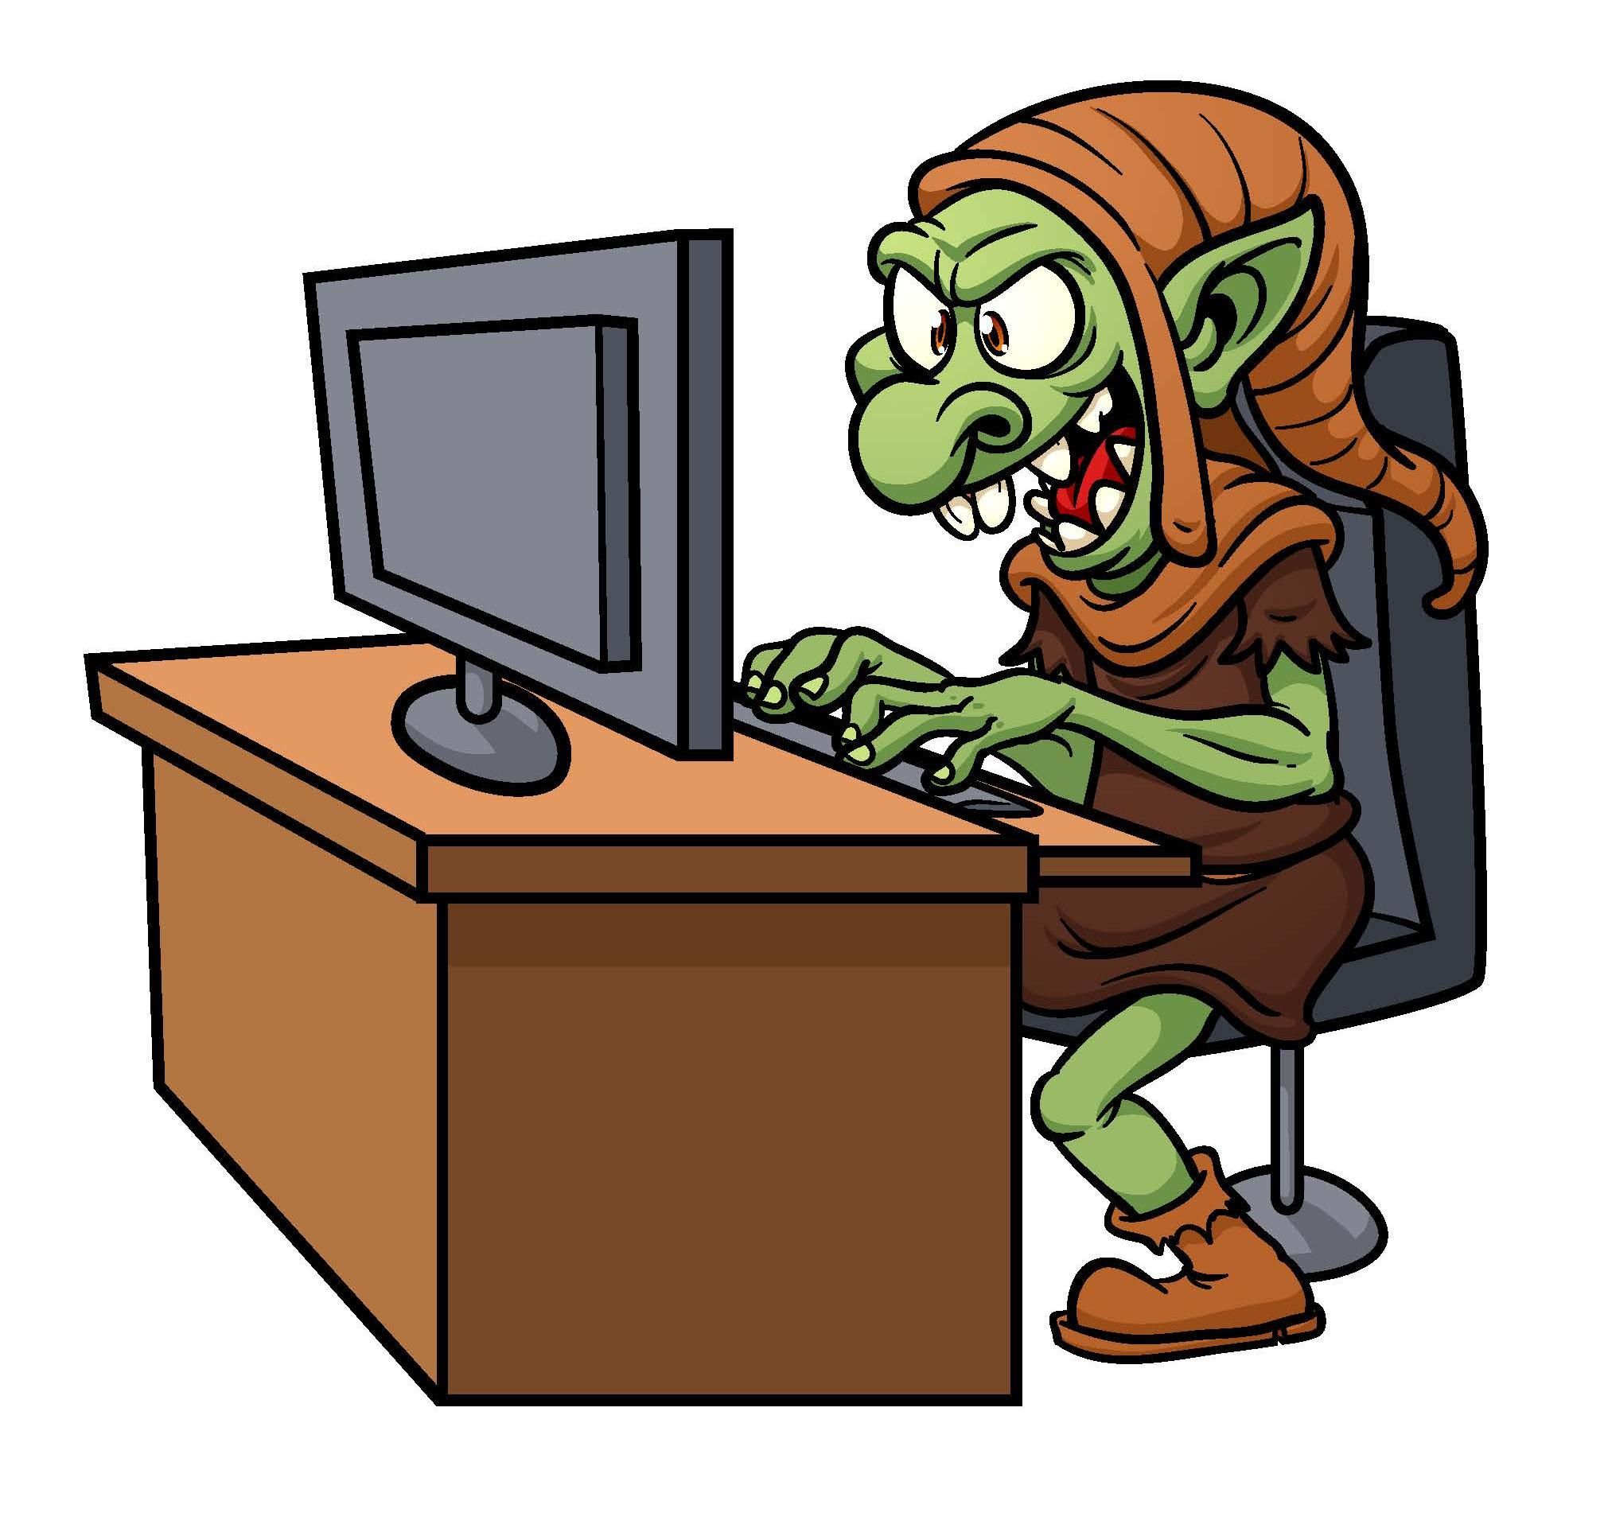
Have you heard of these words that describe online behaviour?
Trolling: Someone writing unkind or untrue things about someone on the internet.
Notes:
Ask the children whether they have heard of the following behaviours
online or know what they mean: https://www.shutterstock.com/image-vector/internet-troll-using-computer-vector-illustration-103792607

Slide 4
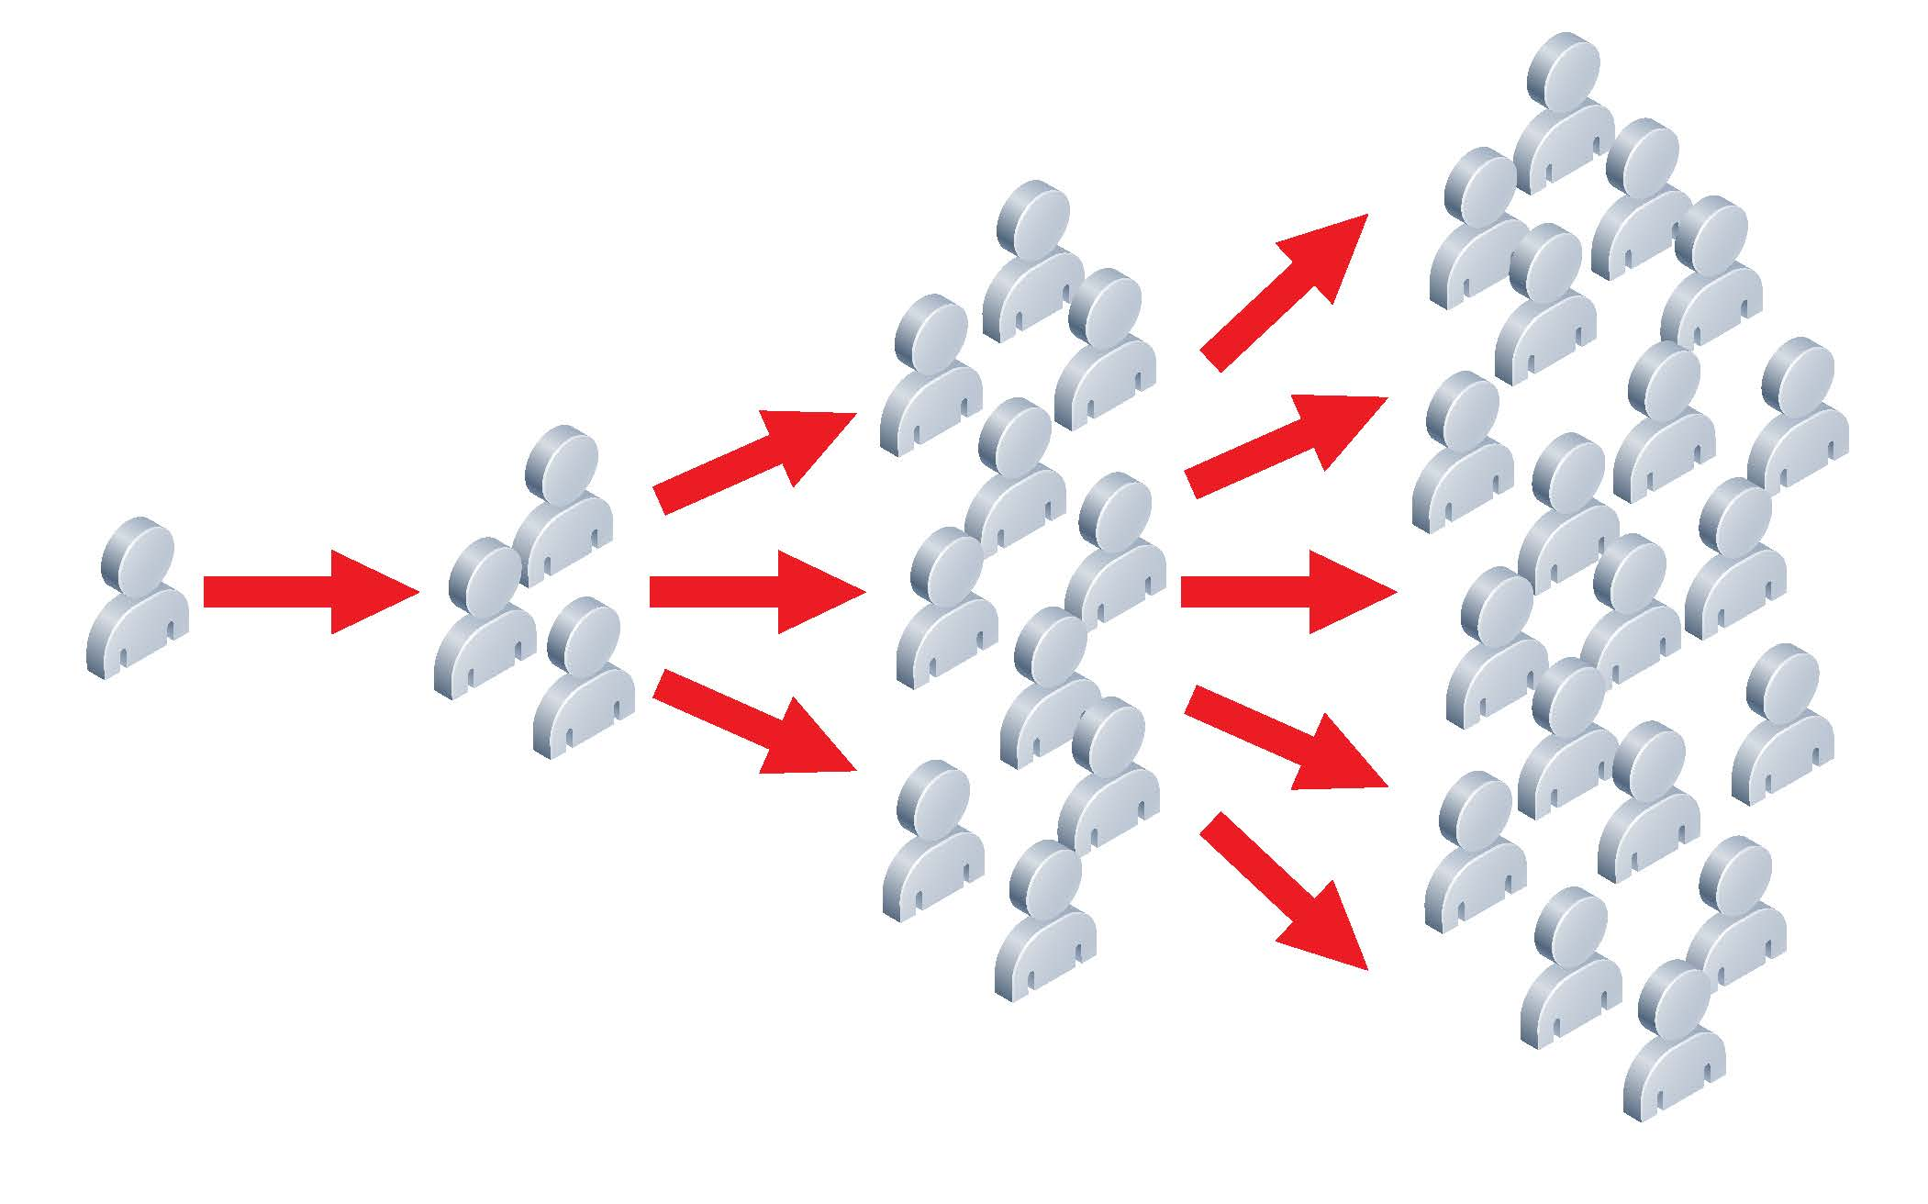
Have you heard of these words that describe online behaviour?
Going viral: when a picture or post gets thousands or millions of views we call it ‘going viral’.
Notes:
Ask the children whether they have heard of the following behaviours
online or know what they mean:
https://www.shutterstock.com/image-vector/illustration-something-spreading-lots-people-like-109620842

Slide 5
Have you heard of these words that describe online behaviour?
Meme: when text is add to an online picture for a joke or to make fun of someone or something.
Notes:
Ask the children whether they have heard of the following behaviours
online or know what they mean:

Slide 6
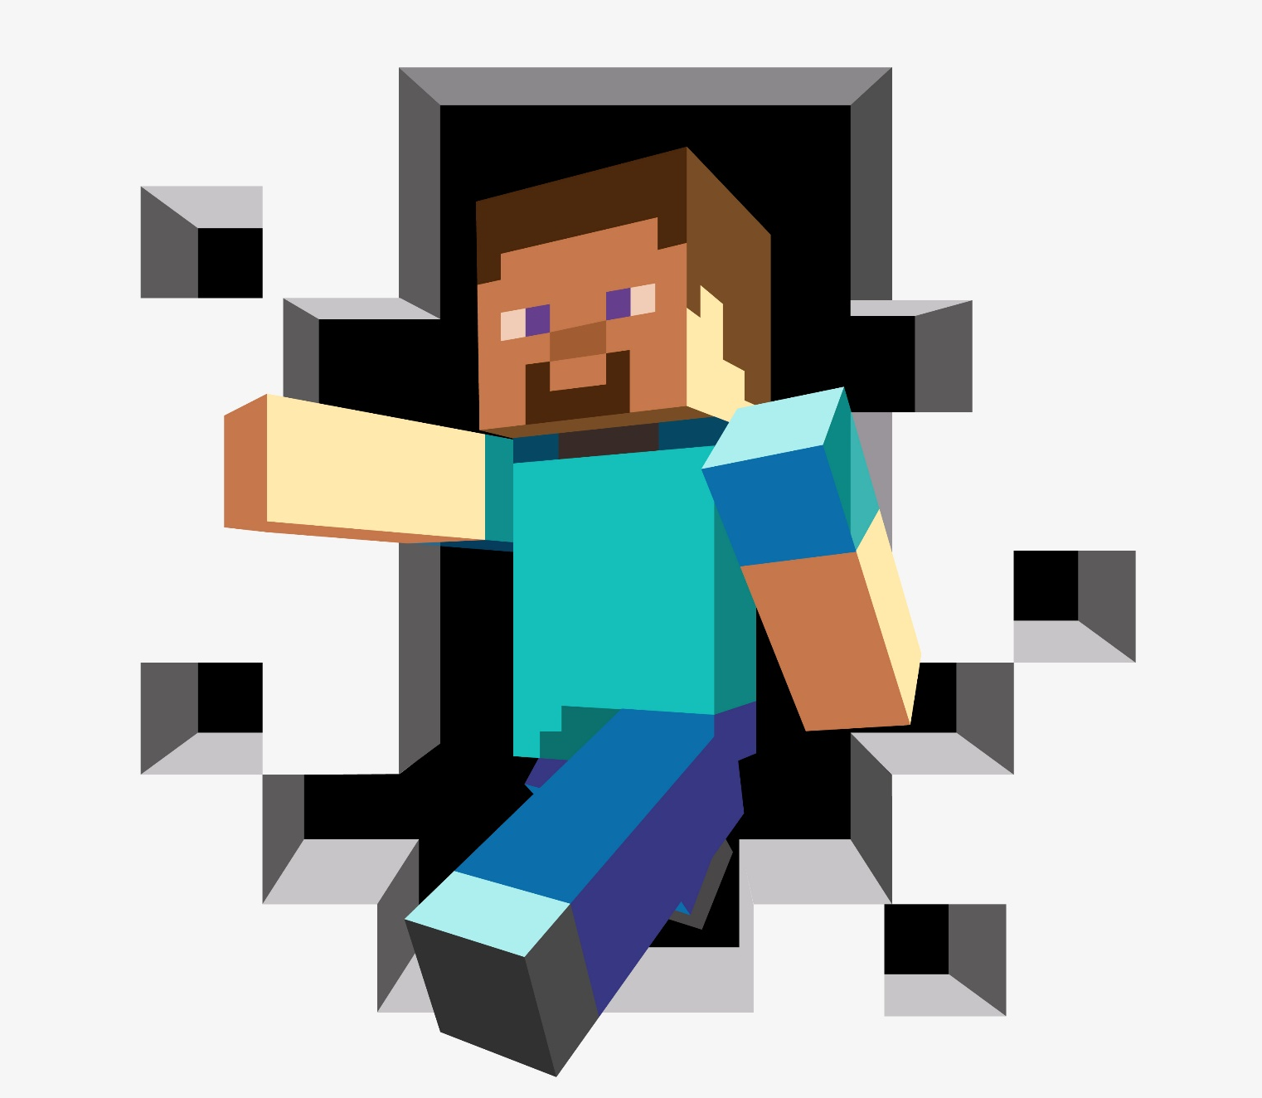
Have you heard of these words that describe online behaviour?
Griefing: when someone deliberately spoils your creation or steals your equipment in a game..
Notes:
Ask the children whether they have heard of the following behaviours
online or know what they mean: https://www.shutterstock.com/image-illustration/illustration-3d-man-o-monster-pixel-1964244898

Slide 7
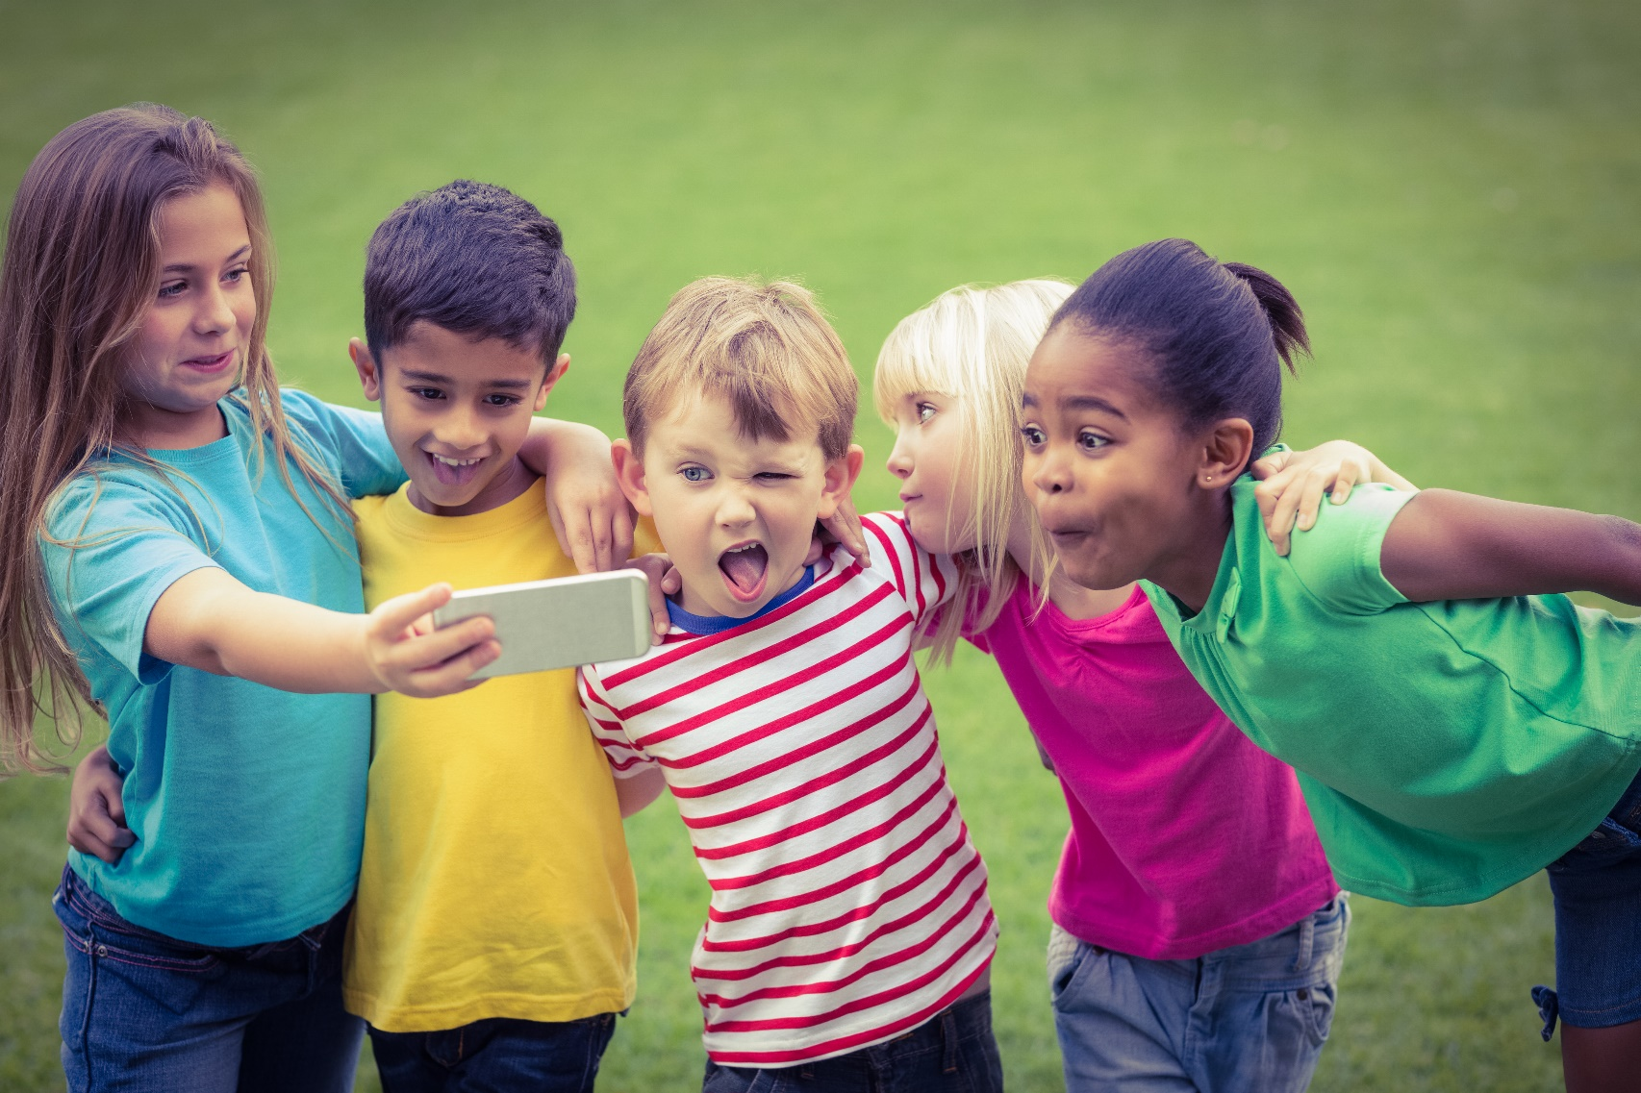
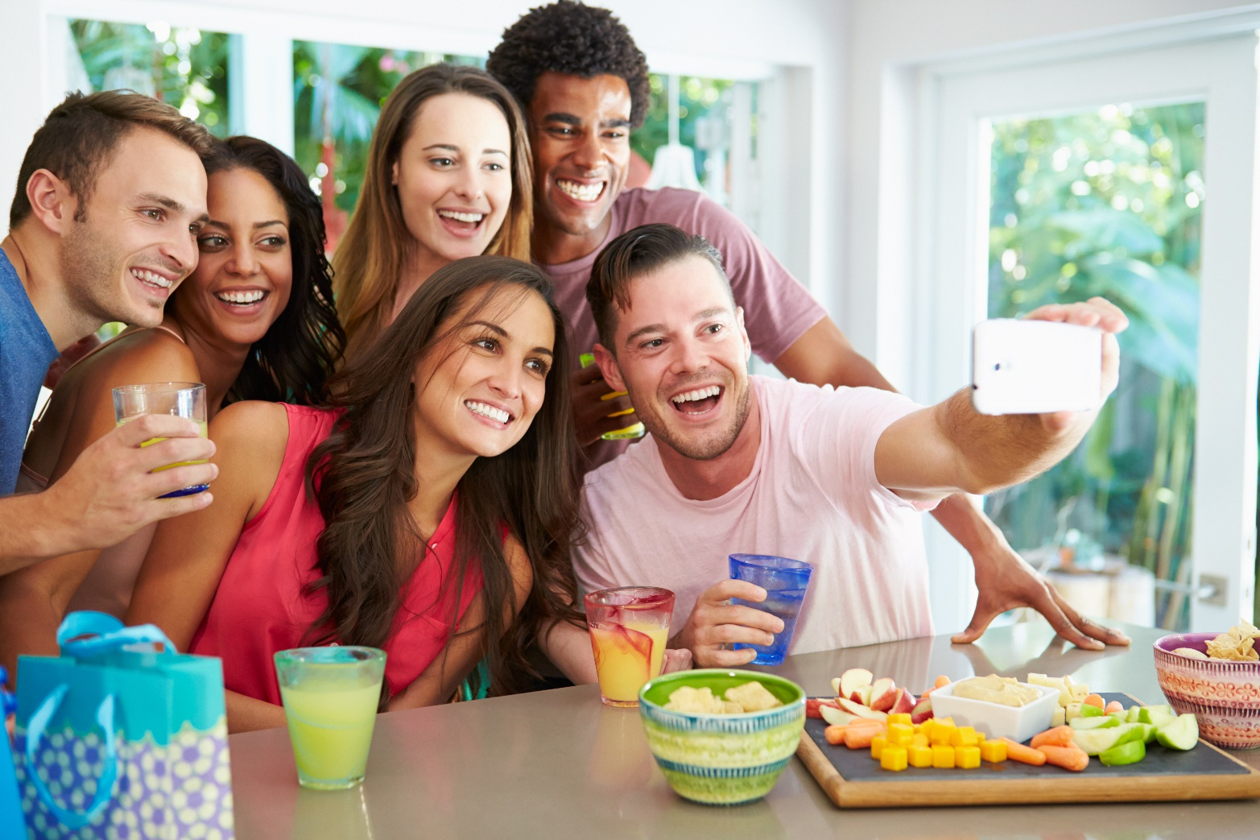
These photos were shared online
Notes:
You may wish to make your own choices- but do not include actual pictures of children or staff- this is the point of this assembly.
https://www.shutterstock.com/image-photo/smiling-classmates-posing-funny-taking-selfies-309237005 https://www.shutterstock.com/image-photo/brunette-african-american-woman-taking-selfie-553485874 https://www.shutterstock.com/image-photo/group-friends-taking-selfie-whilst-celebrating-207644986

Slide 8
Think about these questions
If I post a photograph on the internet, who could see it?
Notes:
Hopefully the children will recognise that anyone can see anything on the
internet. They may not know that they can report something untrue or
unkind to the NSPCC or Child Exploitation and Online Protection Centre
(CEOP), but ideally they will answer that they can tell a teacher or parent.
The third question is trickier; some children will know that people can
pretend to be someone else online. However, many will not, because it
is something that does come from experience and perhaps they may
have been shielded from this by cautious parents. Equally, their naivety
or curiosity might potentially have led them into a conversation with
a stranger

Slide 9
Think about these questions
If I post a photograph of myself on the internet and someone says something untrue or unkind about it, what can I do?
Notes:
Hopefully the children will recognise that anyone can see anything on the
internet. They may not know that they can report something untrue or
unkind to the NSPCC or Child Exploitation and Online Protection Centre
(CEOP), but ideally they will answer that they can tell a teacher or parent.
The third question is trickier; some children will know that people can
pretend to be someone else online. However, many will not, because it
is something that does come from experience and perhaps they may
have been shielded from this by cautious parents. Equally, their naivety
or curiosity might potentially have led them into a conversation with
a stranger

Slide 10
Think about these questions
If I am speaking to someone online, how I know they are they actually the person I think they are?
Notes:
Hopefully the children will recognise that anyone can see anything on the
internet. They may not know that they can report something untrue or
unkind to the NSPCC or Child Exploitation and Online Protection Centre
(CEOP), but ideally they will answer that they can tell a teacher or parent.
The third question is trickier; some children will know that people can
pretend to be someone else online. However, many will not, because it
is something that does come from experience and perhaps they may
have been shielded from this by cautious parents. Equally, their naivety
or curiosity might potentially have led them into a conversation with
a stranger

Slide 11
Think about these questions
Should I share any personal information online?
Notes:
Hopefully the children will recognise that anyone can see anything on the
internet. They may not know that they can report something untrue or
unkind to the NSPCC or Child Exploitation and Online Protection Centre
(CEOP), but ideally they will answer that they can tell a teacher or parent.
The third question is trickier; some children will know that people can
pretend to be someone else online. However, many will not, because it
is something that does come from experience and perhaps they may
have been shielded from this by cautious parents. Equally, their naivety
or curiosity might potentially have led them into a conversation with
a stranger

Slide 12
WHAT IS PERSONAL INFORMATION?
Anything that identifies you:
Name
Gender
School
Address
Age
Notes:
Ask the children what they understand by personal information. Should
this information ever be shared?
The
answer
to
the
fi rst
question
should
relate
to
something
that
identifi es a person: name, gender, school, address, age. The answer to the
second should be a very fi rm ‘no’ if the children have had a regular dose of
internet safety advice in previous years.

Slide 13
Should you share PERSONAL INFORMATION?
Notes:
Ask the children what they understand by personal information. Should
this information ever be shared?
The
answer
to
the
fi rst
question
should
relate
to
something
that
identifi es a person: name, gender, school, address, age. The answer to the
second should be a very fi rm ‘no’ if the children have had a regular dose of
internet safety advice in previous years.
https://www.shutterstock.com/image-vector/no-grunge-vintage-square-stamp-507791674

Slide 14
BE SHARE AWARE
Do not post pictures which include:
School uniform
Pictures of houses, especially if door numbers can be seen
Pictures of your friends taken on the way home
Pictures of your cats and dogs
Notes:
In this part of the assembly, talk about why the children should never have
their school uniform in a photo other than a school photo. Talk about other
things that shouldn’t be shared, such as pictures of houses, which might
give away door numbers, pictures of friends taken on the way home and
even photos of cats and dogs.

Slide 15
Should you share a password?
NO!
They can also be easily guessed if you use dates of birth or family and pet names.
Notes:
Should you share a password?
Again, the children should know not to share a password, but explain to
them that many passwords can be easily guessed because birthdays, pet
names and house numbers often feature in vulnerable passwords.

Slide 16
Should you be respectful online?
ALWAYS!
Rude and hurtful words humiliate and upset others.
Notes:
Online respect
Discuss with the children why we need to be respectful online and how
saying something hurtful or rude can humiliate other people. Go on to
talk about respecting ourselves online; if the children were asked to do
something they didn’t like, would they do it?

Slide 17
Two rules to be respectful online
Never say something that you would never say to that person in real life.
Never post a picture or a video of something if you wouldn’t want to see it on a t-shirt.
Notes:
Two good rules to remember to show respect online
Firstly, never say anything that wouldn’t be said to an actual person in
real life, and secondly, never post a picture or a video of something we
wouldn’t like to see printed on a poster or a t-shirt.

Slide 18
Know who you are talking to
Not everyone tells the truth online.
Someone who says they are eight years old might not be.
Someone might not give their real name.
If you don’t know that person, share no details and no pictures.
Notes:
Not everyone tells the truth online. Someone who says they’re eight years
old and called Alex may not be who they say they are. There is only one
rule here; do not talk to, share photos with or agree to meet someone you
don’t know in real life

Slide 19
What did we learn from today?
What are the good things about the internet?
What are some of the things you should be careful of online?
Should you be scared of the internet?
Can you think of one thing you would change about the internet?

Slide 20
Follow up
Talk about this in class.
Tell your teacher or teaching assistant of anything that worries you. They are there to listen.
Tell your parents they can come in for advice if they would like some.
Notes:
Make sure that these discussions are followed up in class and that teachers
and teaching assistants are open to listening to the worries that children
have about online use. Share concerns with parents in general terms as
part of ongoing good practice around computer safety.

Slide 21
Thank you for listening and taking part
Enjoy the rest of your day.

